Slide 1
Operator
Overloading

Slide 2
OBJECTIVES
1
What operator overloading is and how it makes programs more readable and programming more convenient.
To redefine (overload) operators to work with objects of user-defined classes.
3. The differences between overloading unary and binary operators.
4. To convert objects from one class to another class.
5. When to, and when not to, overload operators.
6. To use keyword explicit to prevent the compiler from using single-argument constructors to perform implicit conversions.

Slide 3
Overloading Binary Operators
  Non-static member function, one argument
  As a rule, in overloading of binary operators, the left hand operator is used to invoke the operator function and right-hand operand is passed as an argument.
  2. Global function, two arguments
    One argument must be class object or reference

Slide 4
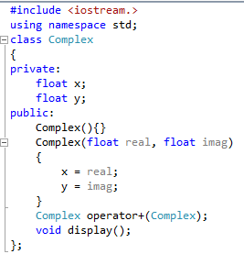
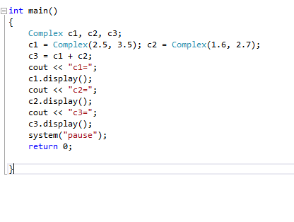
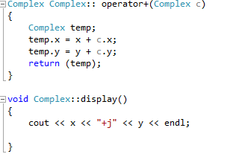
Overloading Binary + Operator

Slide 5
Overloading Binary Operators using Friend
The complex number program to overload + operator may be modified using a friend operator function as follows:
Replace the member function declaration by the friend function declaration.
friend complex operator+(Complex, Complex);
2. Redefine the operator function as follows:
Complex operator+(Complex a, Complex b)
{
return Complex((a.x+b.x),(a.y+b.y));
}

Slide 6
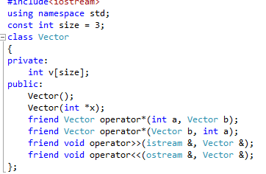
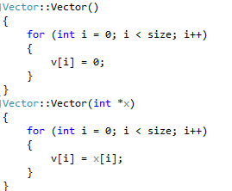
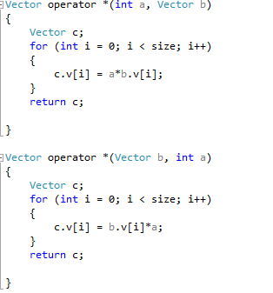
Overloading * Operator

Slide 7
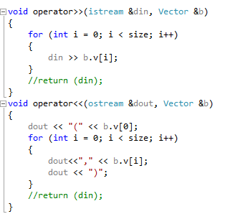
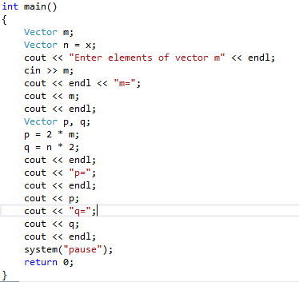

Slide 8
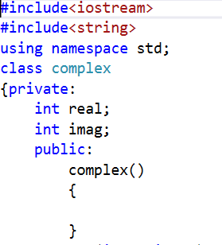
Overloading Assignment Operator

Slide 9
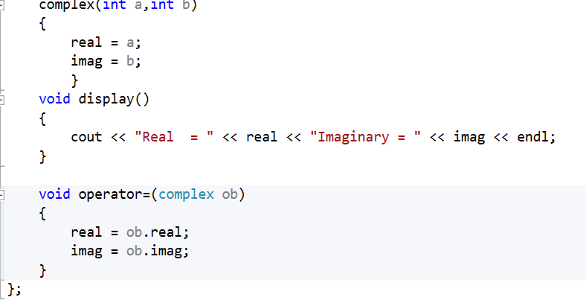

Slide 10
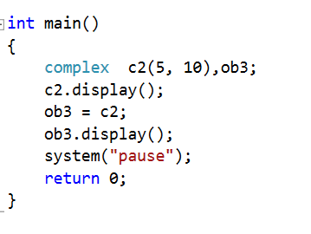

Slide 11
Case Study: Array Class
Pointer-based arrays in C++
  No range checking
  Cannot be compared meaningfully with ==
  No array assignment (array names are const pointers)
  If array passed to a function, size must be passed as a separate argument
Example: Implement an Array class with
  Range checking
  Array assignment
  Arrays that know their own size
  Outputting/inputting entire arrays with << and >>
  Array comparisons with == and !=

Slide 12
Case Study: Array Class (Cont.)
Copy constructor
  Used whenever copy of object is needed:
    Initializing an object with a copy of another of same type
      Array newArray( oldArray ); or
      Array newArray = oldArray (both are identical)
        newArray is a copy of oldArray
  Prototype for class Array
    Array( Array & );
    Must take reference
      Otherwise, the argument will be passed by value…

Slide 13
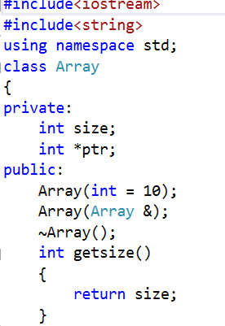

Slide 14
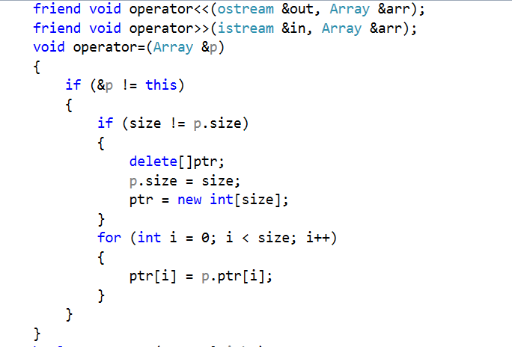

Slide 15
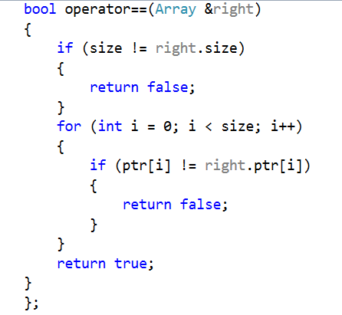

Slide 16
Array Default Constructor
Default constructor for the class specifies a default size of 10 elements.
Default constructor in this example actually receives a single int argument that has a default value 10.
The default constructor validate and assigns the argument to data member size, uses new to obtain the memory for the internal pointer based representation of this array and assigns the pointer returned by new to data member ptr.
Constructor uses a for statement to set all the elements of array to zero.

Slide 17
Array Copy Constructor
This constructor initializes an Array by making a copy of an existing Array object.
Copy constructors are invoked whenever a copy of an object is needed, such as in passing an object by value to a function, returning an object by value from a function or initializing an object with a copy of another object of the same class.
The copy constructor is called in a declaration when an object of class Array is instantiated and initialized with another object of class Array.

Slide 18
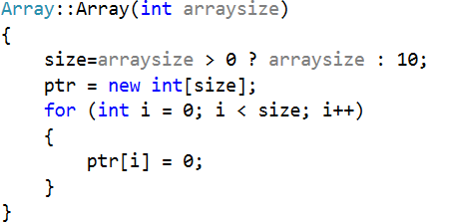
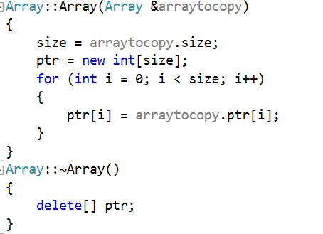

Slide 19
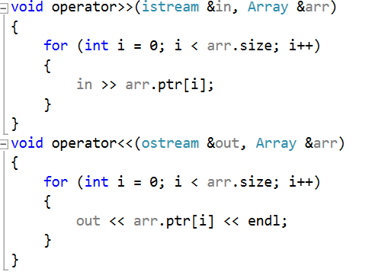

Slide 20
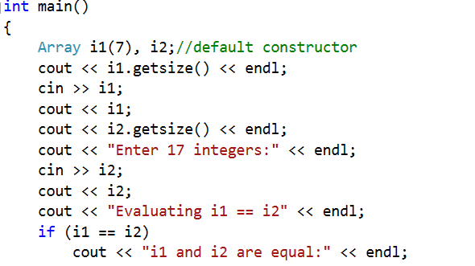

Slide 21
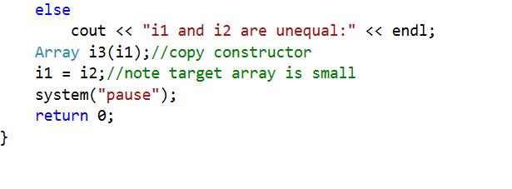

Slide 22
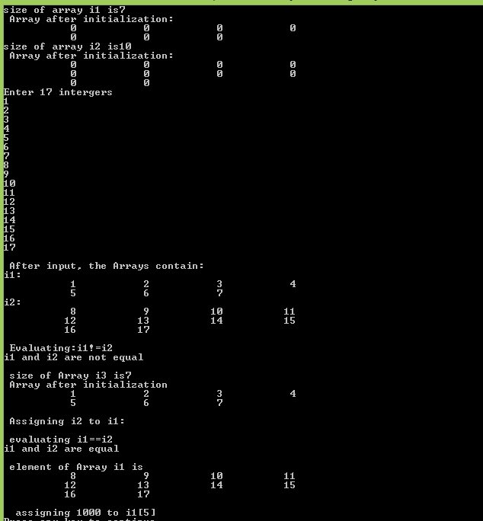

Slide 23
Copy Constructor
Generally in a constructor the object of its own class can’t be passed as a value parameter. But the classes own object can be passed as a reference parameter. Such constructor having reference to the object of its own class is known as copy constructor.
Moreover, it creates a new object as a copy of an existing object. For the classes which do not have a copy constructor defined by the user, compiler itself creates a copy constructor for each class known as default copy constructor.

Slide 24
Why argument to a copy constructor must be passed as a reference?
A copy constructor is called when an object is passed by value. Copy constructor itself is a function. So if we pass an argument by value in a copy constructor, a call to copy constructor would be made to call copy constructor which becomes a non-terminating chain of calls. Therefore compiler doesn’t allow parameters to be passed by value.

Slide 25
When is Copy Constructor Called?
In C++, a Copy Constructor may be called in following cases:
1. When an object of the class is returned by value.
2. When an object of the class is passed (to a function) by value as an argument.
3. When an object is constructed based on another object of the same class.
4. When the compiler generates a temporary object.

Slide 26
When is User-Defined Copy Constructor Needed?
If we don’t define our own copy constructor, the C++ compiler creates a default copy constructor for each class which does a member-wise copy between objects. The compiler created copy constructor works fine in general. We need to define our own copy constructor only if an object has pointers or any runtime allocation of the resource like file handle, a network connection..etc.

Slide 27
Copy constructor vs Assignment Operator
Which of the following two statements call copy constructor and which one calls assignment operator?
Newclass n1,n2;
Newclass n3=n1; ………………………(1)
n1=n2; ………………………………..(2)
Copy constructor is called when a new object is created from an existing object, as a copy of the existing object. Assignment operator is called when an already initialized object is assigned a new value from another existing object. In the above example (1) calls copy constructor and (2) calls assignment operator.

Slide 28
When should we write our own copy constructor?
C++ compiler provide default copy constructor (and assignment operator) with class. When we don’t provide implementation of copy constructor (and assignment operator) and tries to initialize object with already initialized object of same class then copy constructor gets called and copies members of class one by one in target object.
The problem with default copy constructor (and assignment operator) is – When we have members which dynamically gets initialized at run time, default copy constructor copies this members with address of dynamically allocated memory and not real copy of this memory. Now both the objects points to the same memory and changes in one reflects in another object, Further the main disastrous effect is, when we delete one of this object other object still points to same memory, which will be dangling pointer, and memory leak is also possible problem with this approach.
Hence, in such cases, we should always write our own copy constructor (and assignment operator).

Slide 29
Guidelines
Design an application using C++ which can perform a defined task.
Your application should exhibit proper user interface and should shows appropriate menus wherever required.
Application should also handle basic validation checks applicable to your application.
Your application should incorporate the basic features of object oriented programming (eg. constructor, overloading, polymorphism, inheritance, static, final, file handling, exceptional handling etc.).
Each project can be in a team of four members of the same section.

Slide 30
Important Note
You have to upload the source code along with 3 screen shots of your application on eclass
You have to give short presentation of approx. 7-10 min to explain and demonstrate your work.

Slide 31
Project Evaluation
Your work will be evaluated on following parameters
Problem Understanding (Clarity of your problem undertaken)
Usability ( design of user interfaces)
Scope (features/functions covered in your application)
Course Usage ( number of C++ features used in an application)
Validations handled.

