Slide 1
Inheritance

Slide 2
OBJECTIVES
1
To create classes by inheriting from existing classes.
How inheritance promotes software reuse.
The notions of base classes and derived classes and the relationships between them.
The protected member access specifier.
The use of constructors and destructors in inheritance hierarchies.
The differences between public, protected and private inheritance.
The use of inheritance to customize existing software.

Slide 3
Introduction
“Inheritance is the capability of one class to acquire properties and characteristics from another class.
The class whose properties are inherited by other class is called the Parent or Base or Super class.
And, the class which inherits properties of other class is called Child or Derived or Sub class.”

Slide 4
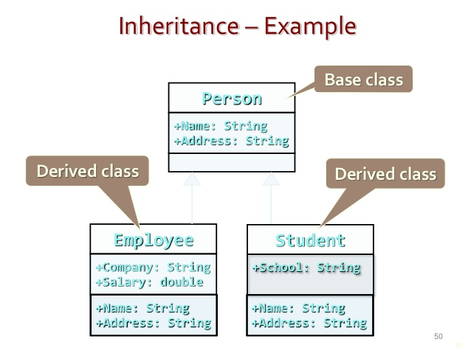

Slide 5
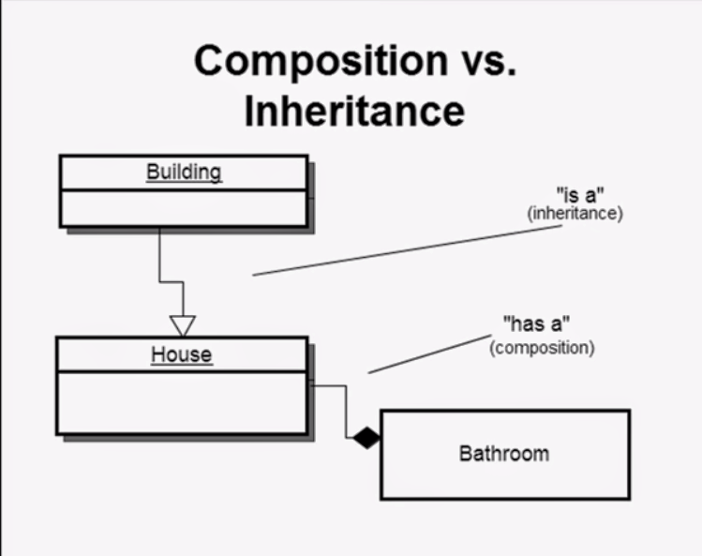

Slide 6
Purpose of Inheritance:
  Software reusability
  Create new class from existing class
    Absorb data and behaviors of existing class.
    Enhance with new capabilities
  Derived class inherits from base class
    Base class
  - Generalized features
    Derived class
      More specialized group of objects
      Behaviors inherited from base class
      Can customize
      Additional behaviors

Slide 7
Types of Inheritance
Single Inheritance
Multiple Inheritance
Hierarchical Inheritance
Multilevel Inheritance
Hybrid Inheritance

Slide 8
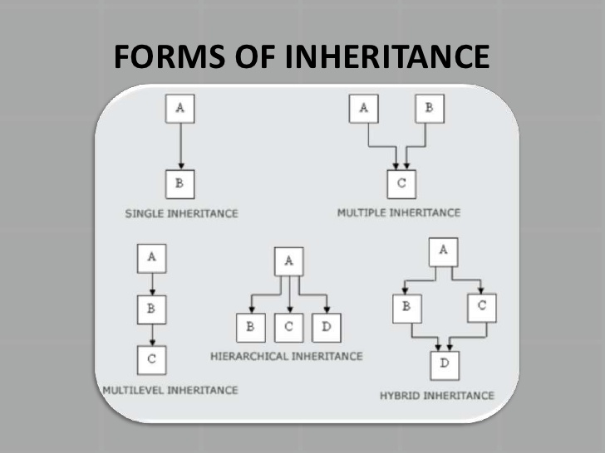

Slide 9
Member functions of a derived class cannot directly access private members of the base class.

Slide 10
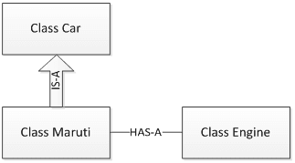
“is-a” vs. “has-a”
  “is-a”
    Inheritance
    Derived class object can be treated as base class object
    Example: Car is a vehicle
      Vehicle properties/behaviors also apply to a car
  “has-a”
    Composition
    Object contains one or more objects of other classes as members
    Example: Car has a steering wheel

Slide 11
Protected Access Control
C++ provides a third access control , protected which serve a limited purpose in inheritance.
A member declared as protected is accessible by member functions within its class and any class immediately derived from it.
It cannot be accessed by the functions outside these two classes.

Slide 12
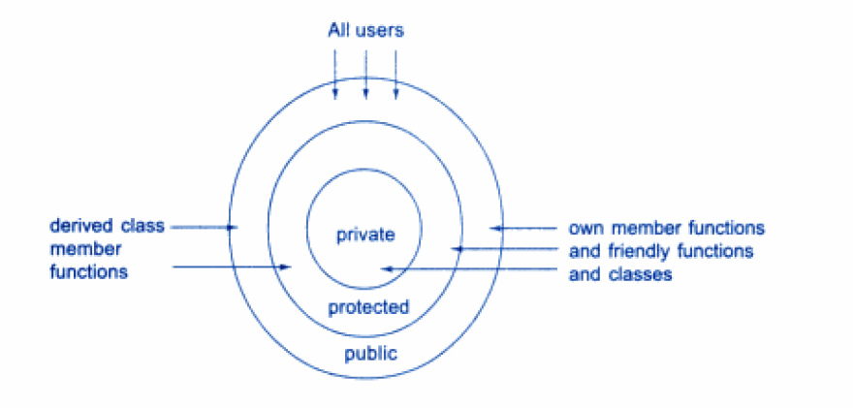
A Simple Access Control to the members of a class

Slide 13
Public
protected
private
Inheritance

Slide 14
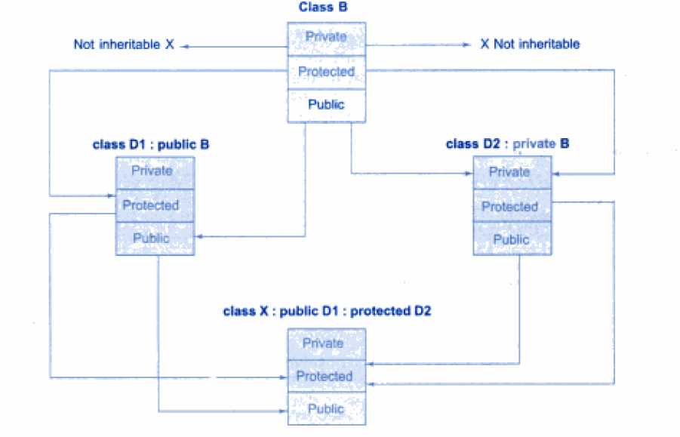

Slide 15
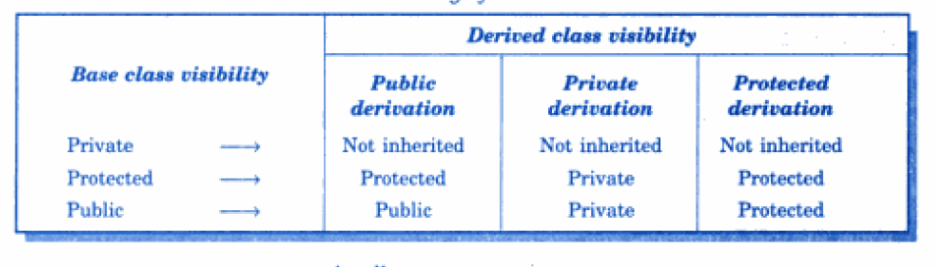
Visibility of Inherited Members

Slide 16
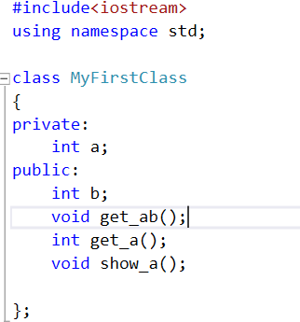
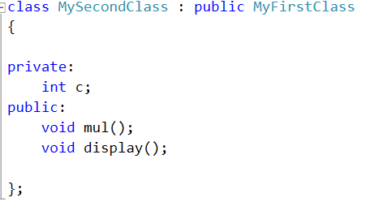
Single Inheritance

Slide 17
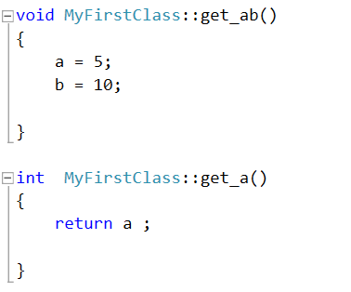
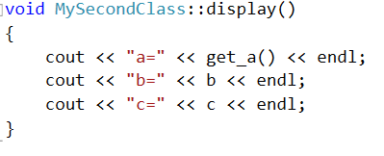
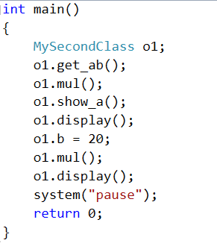
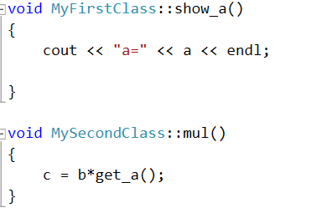

Slide 18
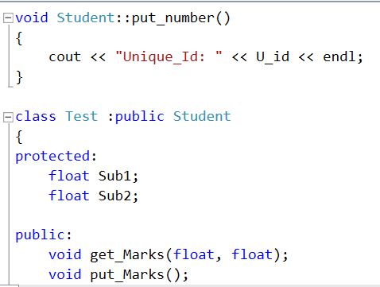
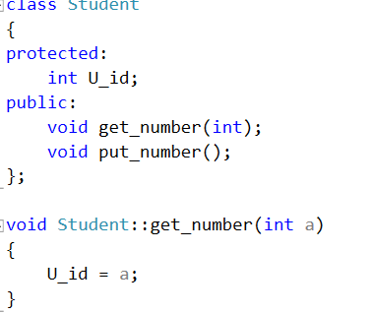
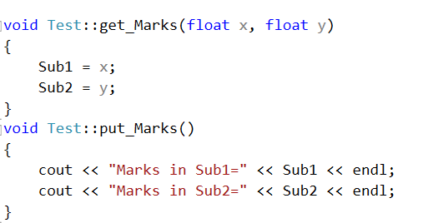
Multilevel Inheritance

Slide 19
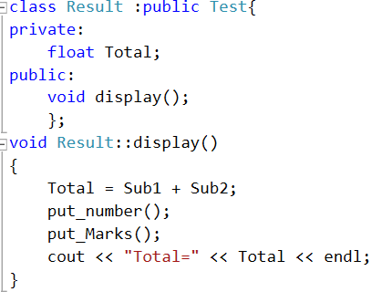
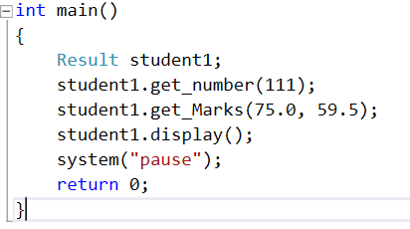

Slide 20
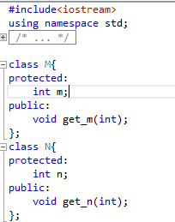
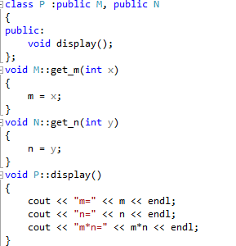
Multiple Inheritance

Slide 21
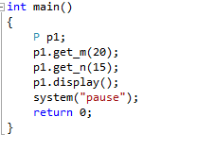

Slide 22
Hierarchical Inheritance
Many programming problems can be cast into a hierarchy where certain features of one level are shared by many others below that level.
In C++ such problems can easily be converted into hierarchies.
The base class will include all the features that are common to the subclasses.
A subclass can serve as a base class for the lower level classes and so on.

Slide 23
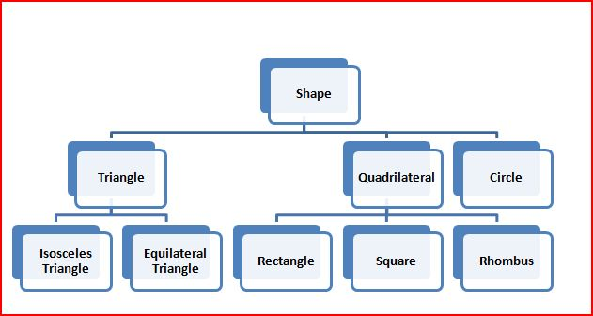

Slide 24
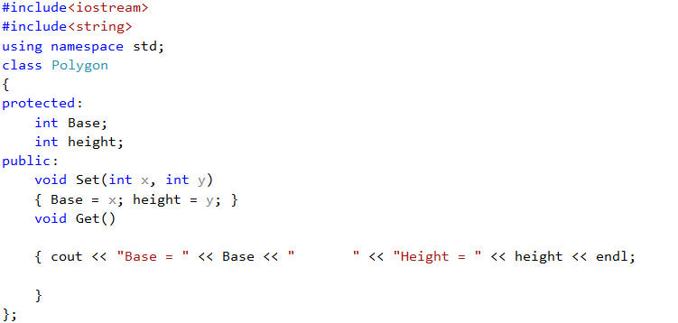
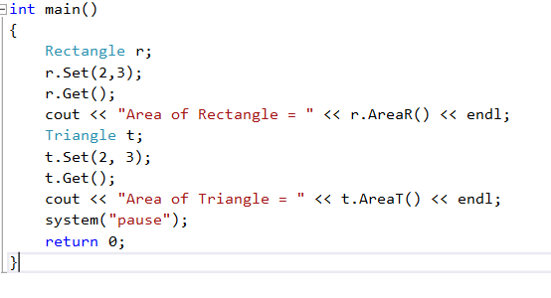
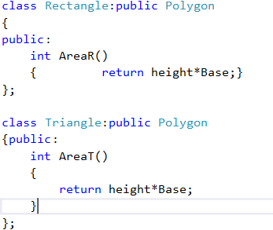
Hierarchical Inheritance

Slide 25
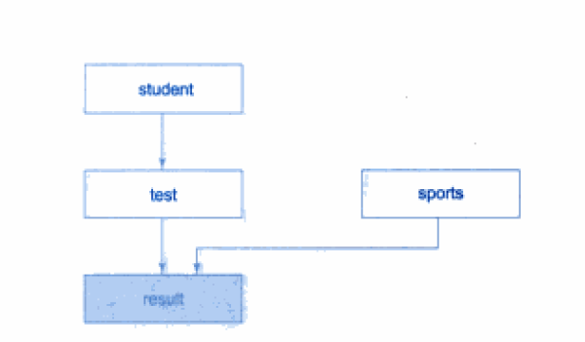
Hybrid Inheritance

Slide 26
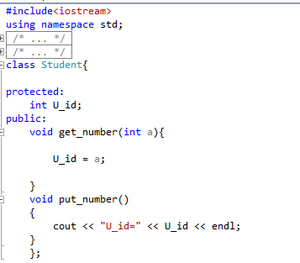
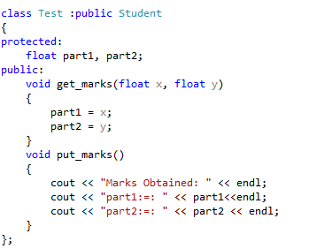
Hybrid Inheritance

Slide 27
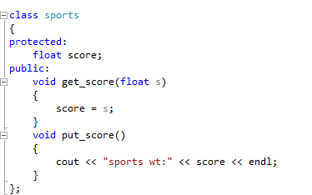
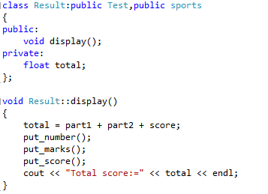

Slide 28
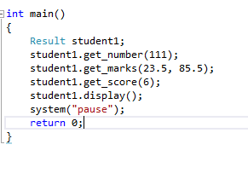

Slide 29
Constructors in Derived class
As long as no base class constructor take any arguments, the derived class need not have a constructor function.
However, if any base class contains a constructor with one or more arguments, then it is mandatory for the derived class to have a constructor and pass the arguments to the base class constructors.
When both the base and derived classes have constructors, the base constructor is executed first and then the constructor in the derived class is executed.
In case of multiple inheritance ,the base classes are constructed in order in which they appear in the declaration of the derived class.
In multilevel inheritance , the constructors will be executed in order of inheritance.

Slide 30
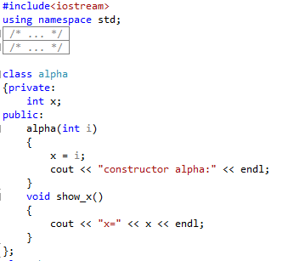
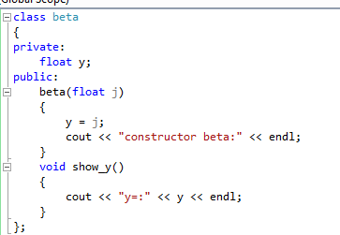

Slide 31
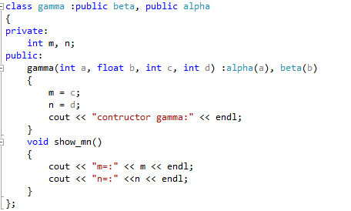
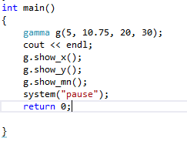

Slide 32
