Slide 1
Week 13: Aggregate Supply and Aggregate Demand
(Based on Chapter 14)

Slide 2
What you will learn in this chapter
➤ How the aggregate supply curve illustrates the relationship between the aggregate price level and the quantity of aggregate output supplied in the economy
➤ Why the aggregate supply curve is different in the short run compared to the long run
➤ How the aggregate demand curve illustrates the relationship between the aggregate price level and the quantity of aggregate output demanded in the economy
➤ The importance of the multiplier, which determines the total change in aggregate output arising from a shift of the aggregate demand curve
➤ How the AS–AD model is used to analyze economic fluctuations
➤ How monetary policy and fiscal policy can stabilize the economy
<number> of 44

Slide 3
Aggregate Supply
The aggregate supply curve shows the relationship between the aggregate price level and the quantity of aggregate output supplied. More specifically, Aggregate supply (AS) denotes the relationship between the total quantity that firms choose to produce and sell and the price level for output, holding the price of inputs fixed.
Profit per unit output =
Price per unit output – Production cost per unit output
Costs, for example, the nominal wage is the dollar amount of the wage paid, and usually are fixed in a short-run.
<number> of 44

Slide 4
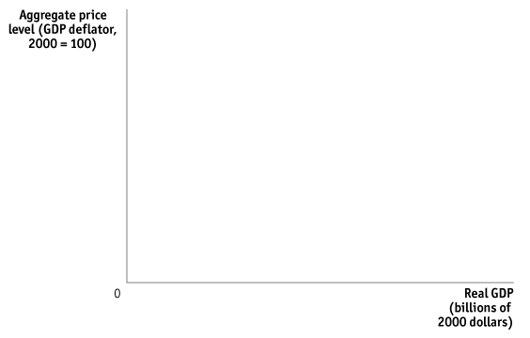
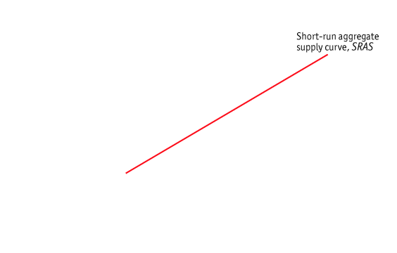
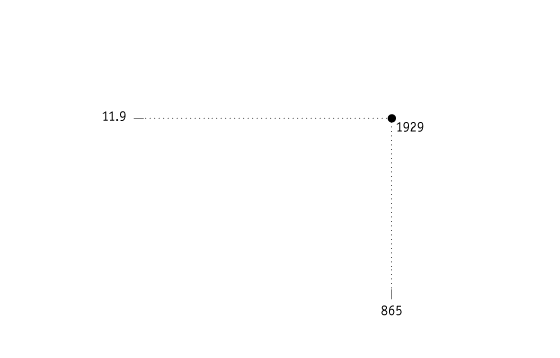
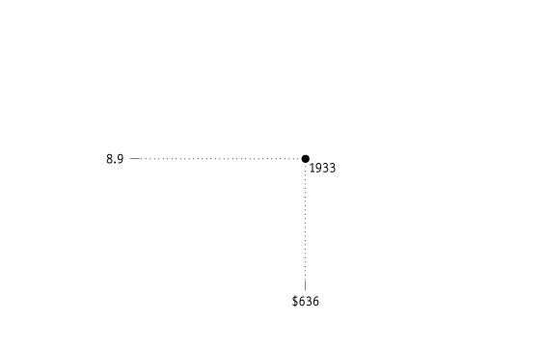
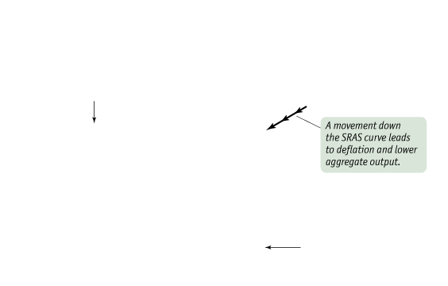
Aggregate Supply
The Short-Run Aggregate Supply Curve
When price level increases while costs are fixed, profits increase. So producers increase supply.
When price level decreases while costs are fixed, profits decrease. So producers decrease supply.
<number> of 44

Slide 5
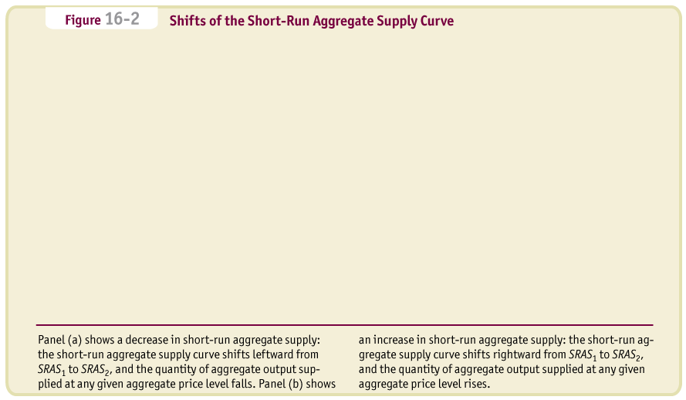
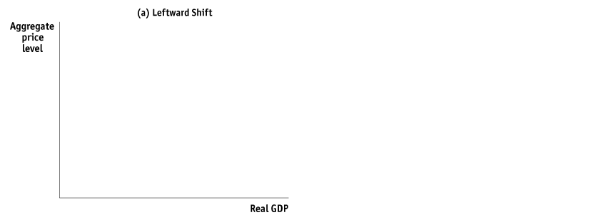


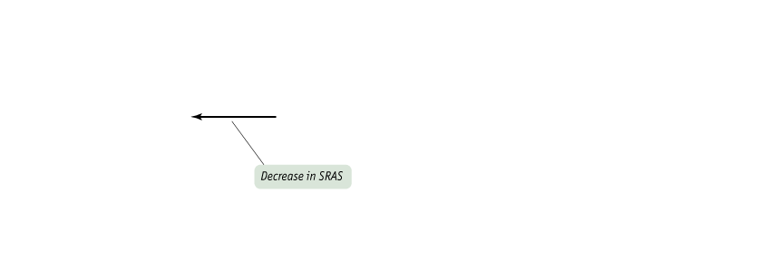
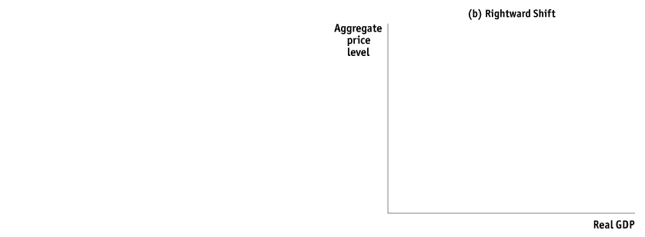

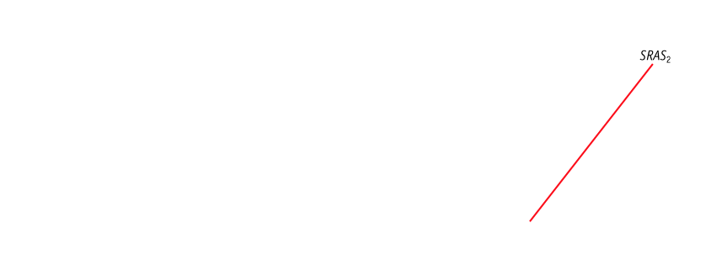
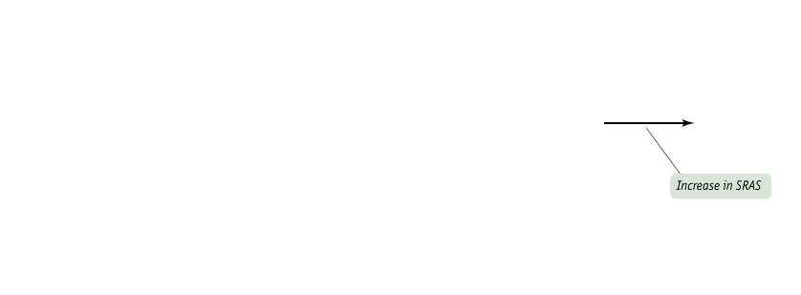
Aggregate Supply
Shifts of the Short-Run Aggregate Supply Curve
<number> of 44

Slide 6
Aggregate Supply
Shifts of the Short-Run Aggregate Supply Curve
The following are important factors that affect producers’ profit per unit and so can lead to shifts of the short-run aggregate supply curve:
Changes in (Input) Commodity Prices such as Oil
Changes in Nominal Wages
Changes in Productivity
<number> of 44

Slide 7
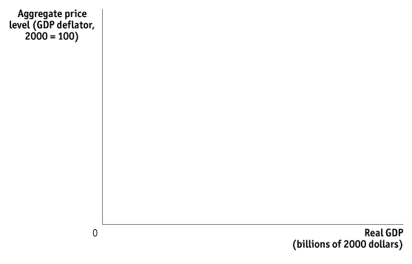
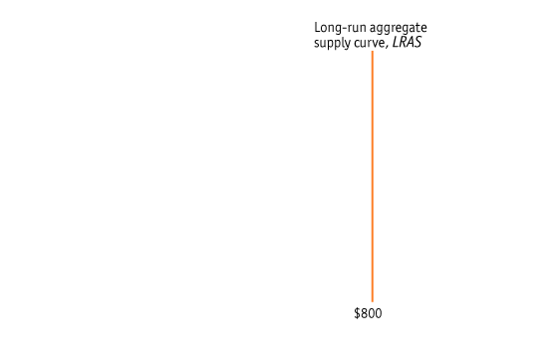
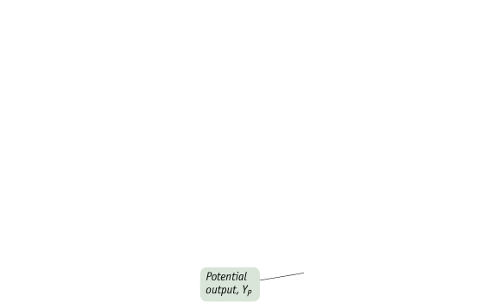

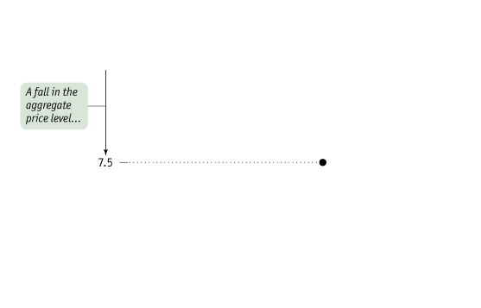
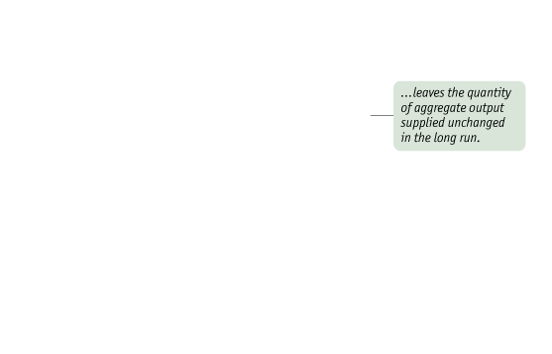
Aggregate Supply
The Long-Run Aggregate Supply Curve
Long-run supply curve is vertical at the ‘potential GDP.’
This curve does not depend on the changes of price level any more because if all the prices including wages change at the same time, there will be no effects on profits.
<number> of 44

Slide 8
Potential Output, or Full Employment GDP
Potential output, or full employment GDP is the level of real GDP the economy would produce if all prices, including nominal wages, were fully flexible.
The maximum quantity that an economy can produce, given its existing levels of labor, physical capital, technology, and institutions.
Over the long run, Increases in physical capital, human capital, labor force, productivity of labor, technological progress make the potential output increase.
<number> of 44

Slide 9
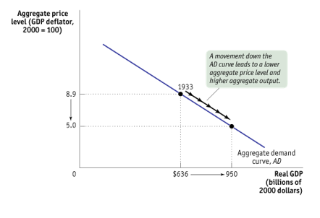
Aggregate Demand
The aggregate demand curve shows the relationship between the aggregate price level and the quantity of aggregate output demanded by households, businesses, the government, and the rest of the world.
Why Is the Aggregate Demand Curve Downward Sloping?
GDP = C + I + G + X – M
<number> of 44

Slide 10
Aggregate Demand
The Wealth Effect:
When the aggregate price level goes down, the purchasing power of consumers’ assets goes up.
The Interest Rate Effect
When the price level goes up, people want to hold more money, probably by selling bonds, or by borrowing money.
This will increase the interest rate. Then consumers will spend less, and firms will invest less. Also when interest rate goes up, exchange rate will go up (domestic currency values more), export prices will go up, making exports less
<number> of 44

Slide 11
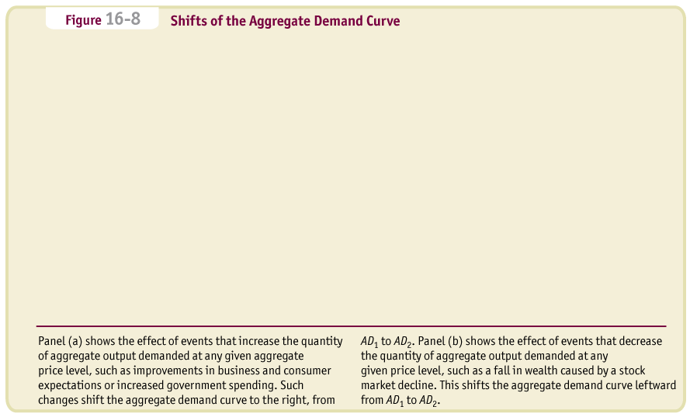
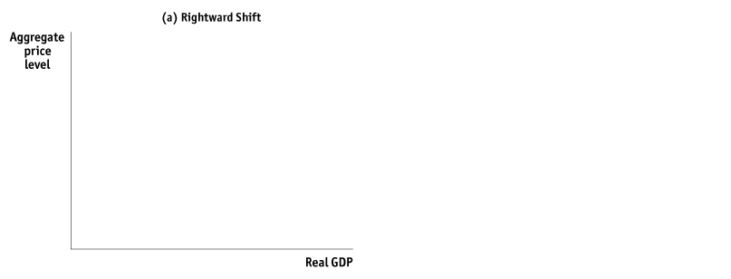



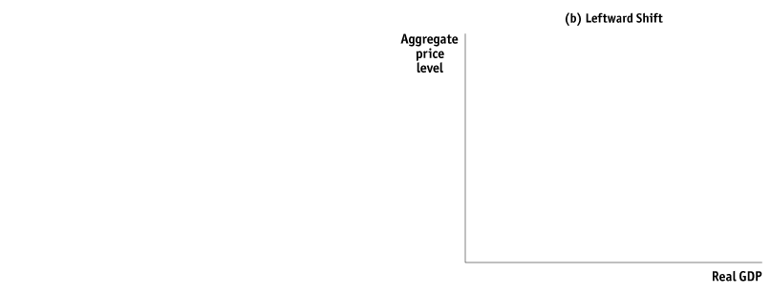


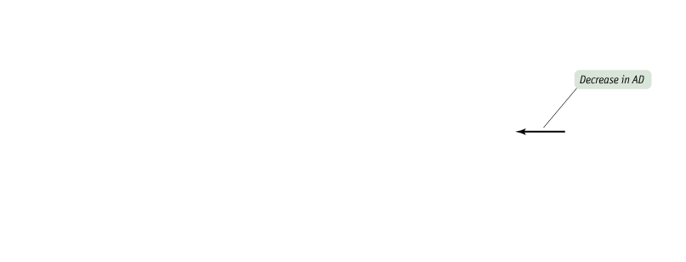
Aggregate Demand
Shifts of the Aggregate Demand Curve
<number> of 44

Slide 12
Aggregate Demand
Shifts of the Aggregate Demand Curve
A number of factors can shift the aggregate demand curve. Among the most important factors are:
Changes in Expectations
Changes in Wealth
Changes in the Size of Existing Stock of Physical Capital
<number> of 44

Slide 13
Aggregate Demand
Government Policies and Aggregate Demand
One of the key insights of macroeconomics is that the government can have a powerful influence on aggregate demand and that, in some circumstances, this influence can be used to improve economic performance.
The two main ways the government can influence the aggregate demand curve are through:
Fiscal Policy: Government spending policy
Government tax policy
Monetary Policy: Interest policy, control of
quantity of money
<number> of 44

Slide 14
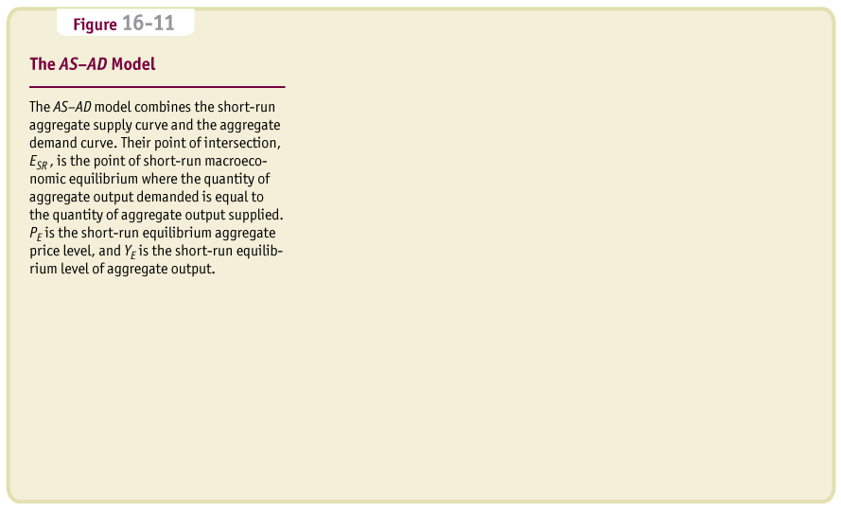
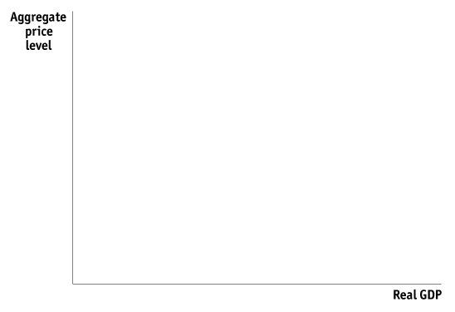

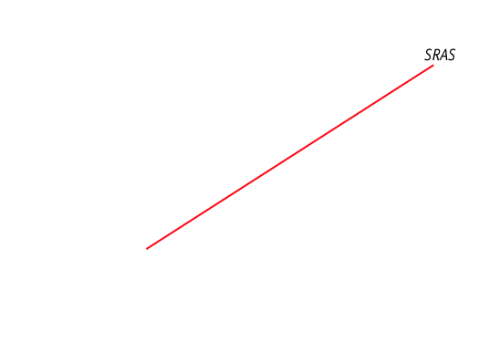
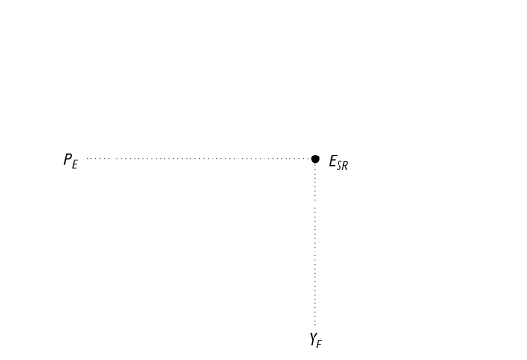
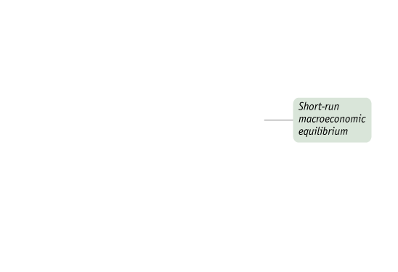
The AS–AD Model
Short-Run Macroeconomic Equilibrium
<number> of 44

Slide 15
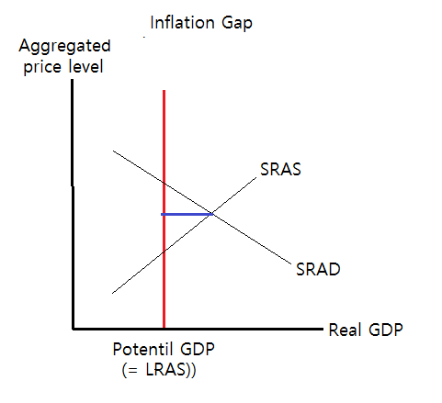
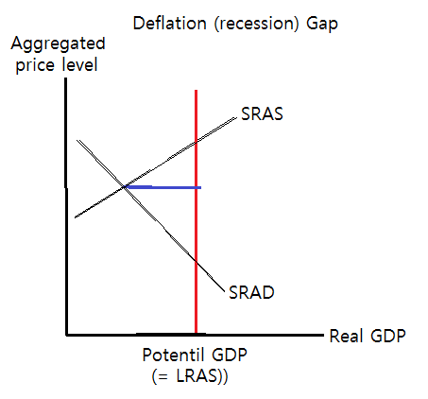
Inflation Gap and Deflation Gap
<number> of 44

Slide 16

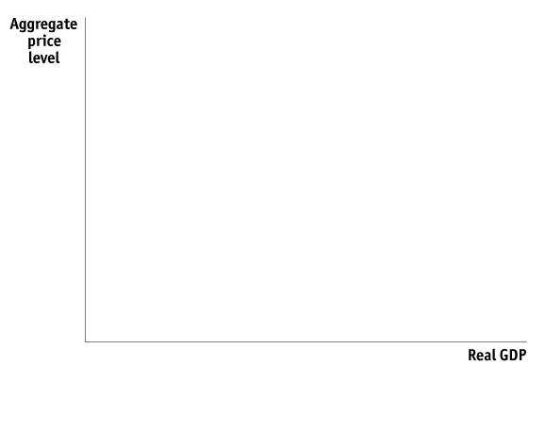
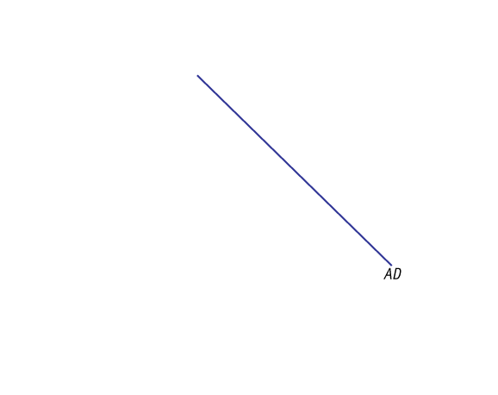
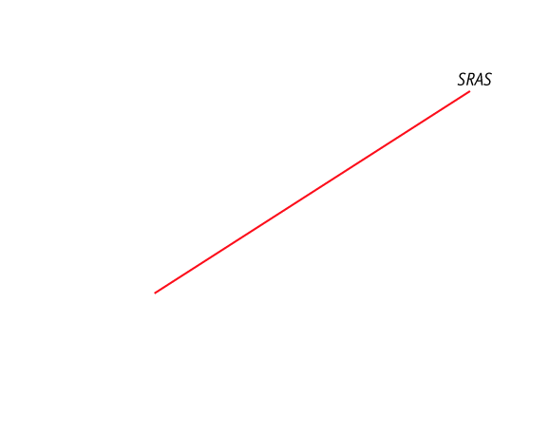
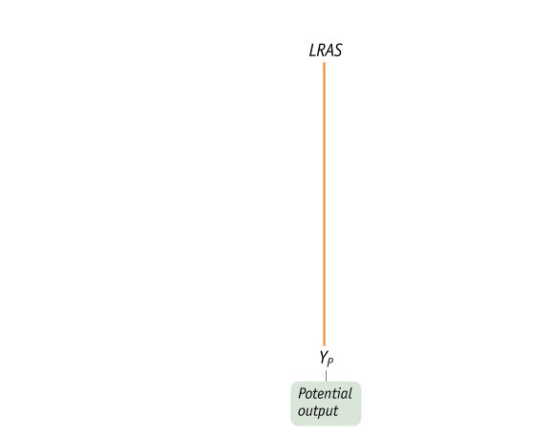
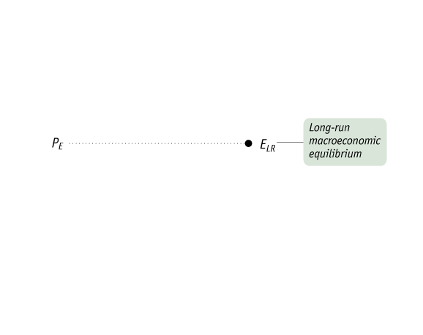
The AS–AD Model
Long-Run Macroeconomic Equilibrium
<number> of 44

Slide 17
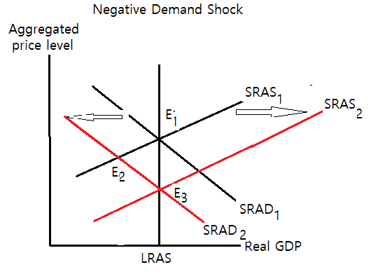
Negative Demand Shock
Aggregate demand decreases (from SRAD1 to SDAD2), output falls, and price level falls. But in the long run, wages fall and this makes aggregate supply curve shifts rightward and brings back to the E3 with lower price level.
<number> of 44

Slide 18
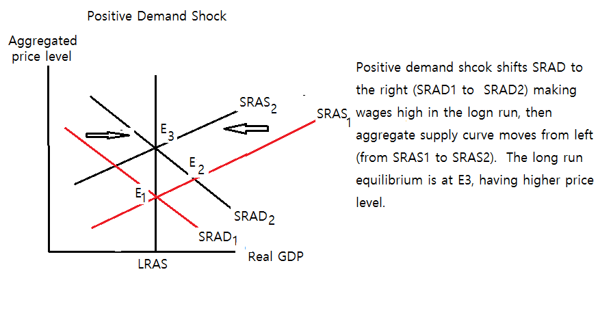
Positive Demand Shock
<number> of 44

Slide 19
Macroeconomic Policy
Policy in the Face of Demand Shocks
Some policy measures to increase aggregate demand, especially those that increase budget deficits, may have long-term costs in terms of lower long-run growth. Furthermore, in the real world policy makers aren’t perfectly informed, and the effects of their policies aren’t perfectly predictable. This creates the danger that stabilization policy will do more harm than good.
Despite these qualifications, most economists believe that a good case can be made for using macroeconomic policy to offset major negative shocks to the AD curve.
<number> of 44

Slide 20
Macroeconomic Policy
Responding to Supply Shocks
In contrast to the aggregate demand curve, there are no easy policies that shift the short-run aggregate supply curve.
Economically advanced nations suffering from the supply shocks of the 1970s chose to stabilize prices.
<number> of 44

Slide 21
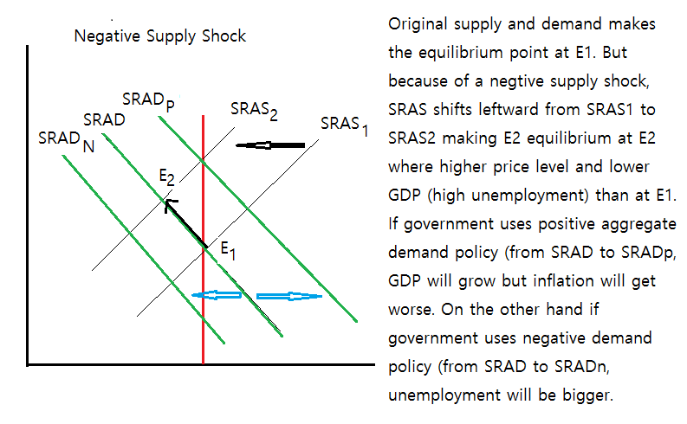
Supply Shock
<number> of 44

Slide 22

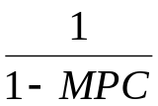
The Multiplier Effect of an Increased Investment
The marginal propensity to consume, or MPC, is the increase in consumer spending when disposable income rises by $1.
The marginal propensity to save, or MPS, is the increase in household savings when disposable income rises by $1.
Total increase in real GDP from $ 1 billion in I
= $1 billion ×
If MPC = 0.8, $1 billion new investment creates $5 billion new GDP !
<number> of 44

Slide 23

Someone’s Spending is Someone’s Income
Initial Spending : $1 billion
So, new income is $1 billion.
But people spend 80% of their increase income: $1 * 0.8 billion. And this becomes someone else’s income. The also spend 80% of their new income : 0.8 * 0.8. This keeps going. So the sum of newly created income is $5 billion:
<number> of 44

Slide 24
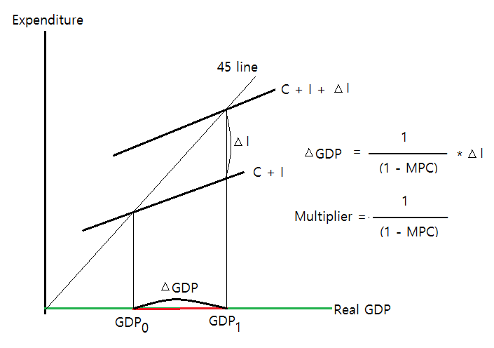
The Multiplier Effect
<number> of 44

Slide 25



The Multiplier
A Simple Model for the National Income Determination
(Keynesian Model)
Income = Expenditure : Y = C + I (1)
Consumption
depends on Income : C = c * Y + d (2)
From (1), Y = C + I (3)
From (2), C = c * Y (4)
Substituting (4) to (3); Y =
The constant c = is the marginal propensity to consumption.
is the multiplier.
<number> of 44

Slide 26
K E Y T E R M S
Aggregate supply curve
Nominal wage
Short-run aggregate supply curve
Long-run aggregate supply curve
Potential output
Aggregate demand curve
Wealth effect of a change in the aggregate price level
Interest rate effect of a change in the aggregate price level
Marginal propensity to consume (MPC)
Marginal propensity to save (MPS)
Autonomous change in aggregate spending
Multiplier
AS–AD model
Short-run macroeconomic equilibrium
Short-run equilibrium aggregate price level
Short-run equilibrium aggregate output
Supply shock
Stagflation
Demand shock
Long-run macroeconomic equilibrium
Recessionary gap
Inflationary gap
Self-correcting
<number> of 44

