Slide 2

What you will learn in this chapter:
➤ The meaning of perfect competition and the characteristics of a perfectly competitive industry
➤ The difference between accounting profit and economic profit, and why economic profit is the correct basis for decisions.
➤ How a price-taking producer determines its profit-maximizing quantity of output
➤ Deriving supply curve from the profit maximization
➤ Deriving industry supply curve from individual supply curves
➤ Why industries behave differently in the short run and the long run
➤ What determines the industry supply curve in both the short run and the long run
<number> of 35

Slide 3
Perfect Competition
Perfectly Competitive Market
All market participants, both consumers and producers, are price-takers.
(The price is determined by the industry demand and the industry supply.)
A price-taking producer is a producer whose actions have no effect on the market price of the good it sells.
A price-taking consumer is a consumer whose actions have no effect on the market price of the good he or she buys.
A perfectly competitive industry is an industry in which producers are price takers.
<number> of 35

Slide 4
Perfect Competition
Two Necessary Conditions for Perfect Competition
None of producers have a large market share. A producer’s market share is the fraction of the total industry output represented by that producer’s output.
A good is a standardized product, also known as a commodity, when consumers regard the products of different producers as the same good.
Free Entry and Exit
There is free entry and exit into and from an industry when new producers can easily enter into or leave that industry.
<number> of 35

Slide 5
Profit Maximization
Profit = Total Revenue - Total Cost.
π(Q) = TR(Q) - TC(Q),
where π(Q) is the profit function,
TR(Q), TC(Q) is the Total Revenue, Total Cost function.
Each function depends on how much the firm produces (sells).
To the π(Q) be maximum,
Marginal Revenue = Marginal Cost
In the perfect competition market, MR = p
So, P = MC is the profit maximization condition under the perfect competition.
<number> of 35

Slide 6
When MR = MC profit(π) becomes the maximum
(Q) (MR) (TR) (FC) (VC) (TC) (MC) (π)
0 18 0 14 0 14 16 -14
1 18 18 14 16 30 4 -12
2 18 36 14 20 34 5 2
3 18 54 14 25 39 17 15
4 18 72 14 42 56 18 16
5 18 90 14 60 74 40 16
6 18 108 14 100 114 30 -6
7 18 126 14 130 144
<number> of 35

Slide 7
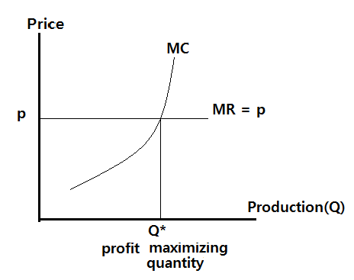
Production and Profits
<number> of 35

Slide 8
Production and Profits
When Is Production Profitable?
■ If P > ATC
(when the price is higher than average total cost, the firm is profitable.)
■ If P = ATC, the firm breaks even.
■ If P < ATC, the firm incurs a loss.
<number> of 35

Slide 9
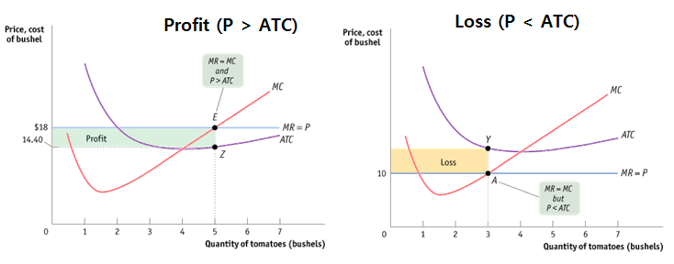
Production and Profits
When Is Production Profitable?
<number> of 35

Slide 10
Production and Profits
When Is Production Profitable?
The break-even price of a price-taking firm is the market price at which it earns zero profits.
The rule for determining whether a producer of a good is profitable depends on a comparison of the market price of the good to the producer’s break-even price—its minimum average total cost:
■ Whenever the market price exceeds minimum average total cost, the producer is profitable.
■ Whenever the market price equals minimum average total cost, the producer breaks even.
■ Whenever the market price is less than minimum average total cost, the producer is unprofitable.
<number> of 35

Slide 11
Should I operate my business even if I get loss?
Fixed Variable Total
Cost Cost Cost Revenue Profit Operate?
a. 1000 2000 3000 5000 2000 Yes
b. 1000 3000 4000 4000 0 Yes
c. 1000 4000 5000 4500 -500 Yes
d. 1000 5000 6000 5000 -1000 Maybe
e. 1000 6000 7000 5500 -1500 No
Case c:
Why you keep operating the business when you lose your money?
If you shut down, you will lose more money because of the fixed cost.
For example, in the case c, you have to pay 1000 even if you shut down the business. However, if you operate, you will lose only 500.
Business Operating Condition: Until - (TR - VC - FC) < FC
Since TR = P*Q, VC = Q* AVC , it becomes P > AVC
<number> of 35

Slide 12
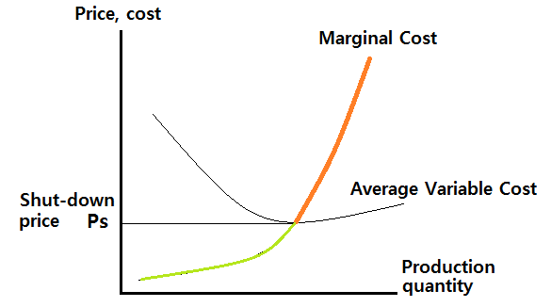
The Short-Run Individual Supply Curve
The short-run supply curve is the part of the marginal oost which satisfies P > Ps , Ps: minimum average cost
<number> of 35

Slide 13
Summary
A firm maximizes profit at the production point where
the MR = MC condition is satisfied.
In the perfect competition industry, individual firm’s
marginal revenue is P.
So the maximum profit condition of perfect competition industry is P = MC
Therefore individual firm’s supply curve is its marginal cost curve
However, a firm will shut down when the market price is less than the average variable cost.
So the supply curve is part of marginal curve where
P > AVC condition meets.
<number> of 35

Slide 14
Production and Profits
Changing Fixed Cost
Although fixed cost cannot be altered in the short run, in the long run the level of fixed cost is a matter of choice.
In most perfectly competitive industries the set of producers, although fixed in the short run, changes in the long run as firms enter or leave the industry.
<number> of 35

Slide 15
Production and Profits
Summing Up: The Perfectly Competitive Firm’s Profitability and Production Conditions
TABLE 8-4
Summary of the Perfectly Competitive Firm’s Profitability and Production Conditions
Profitability Condition (minimum ATC = break-even price) | Result
P > minimum ATC | Firm profitable. Entry into industry in the long run.
P = minimum ATC | Firm breaks even. No entry into or exit from industry in the long run.
P < minimum ATC | Firm unprofitable. Exit from industry in the long run.
Production Condition (minimum AVC = shut-down price) | Result
P > minimum AVC | Firm produces in the short run. If P < minimum ATC, firm covers variable cost and some but not all of fixed cost. If P > minimum ATC, firm covers all variable cost and fixed cost.
P = minimum AVC | Firm indifferent between producing in the short run or not. Just covers variable cost.
P < minimum AVC | Firm shuts down in the short run. Does not cover variable cost.
<number> of 35

Slide 16
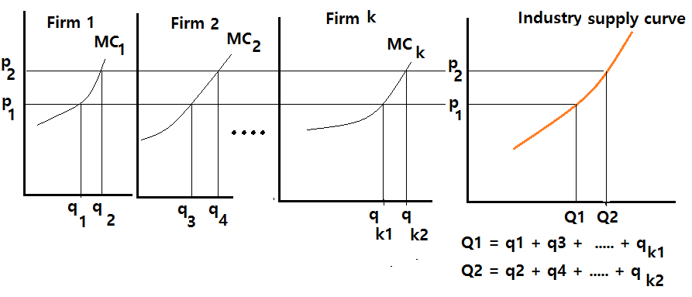
From the Individual supply curves to the Industry Supply Curve
The industry supply curve shows the relationship between the price of a good and the total output of the industry as a whole.
<number> of 35

Slide 17
The Industry Supply Curve
The Short-Run Industry Supply Curve
The short-run industry supply curve shows how the quantity supplied by an industry depends on the market price, given a fixed number of producers.
There is a short-run market equilibrium when the quantity supplied equals the quantity demanded, taking the number of producers as given.
<number> of 35

Slide 18
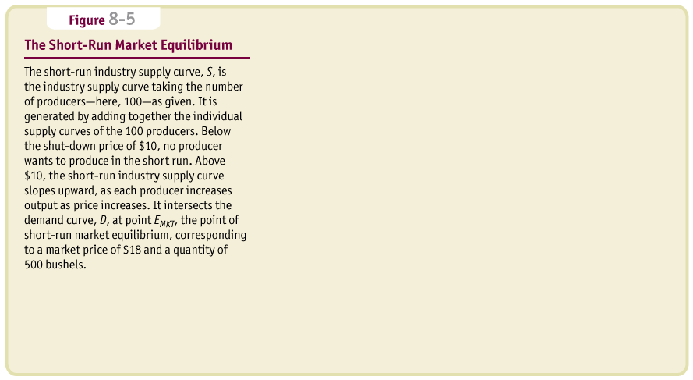
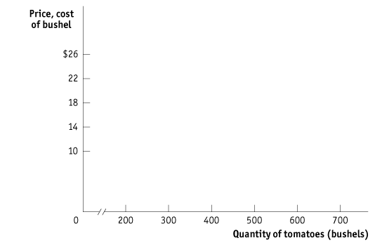
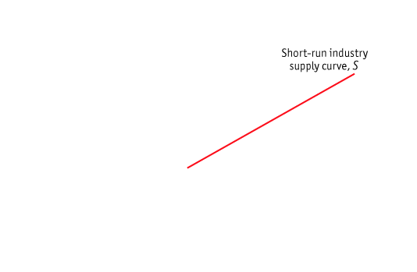
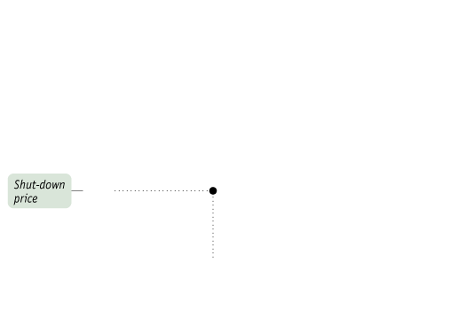
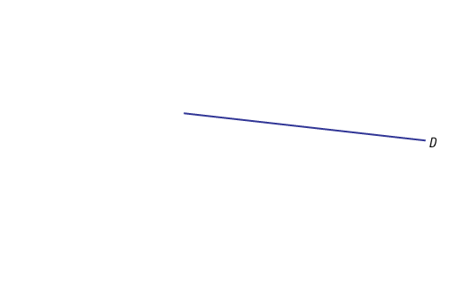
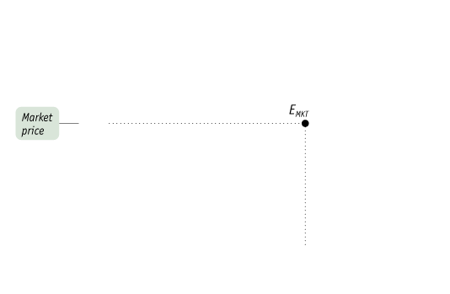
The Industry Supply Curve
The Short-Run Industry Supply Curve
<number> of 35

Slide 19
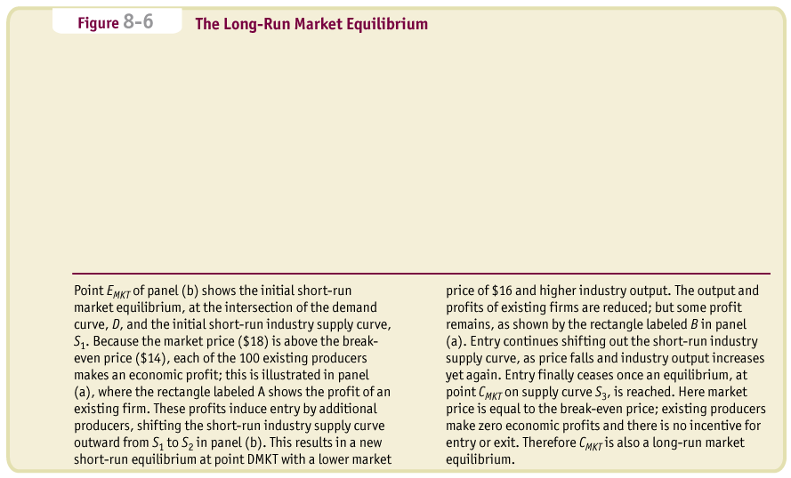


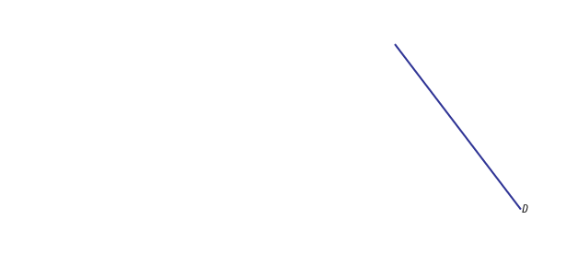
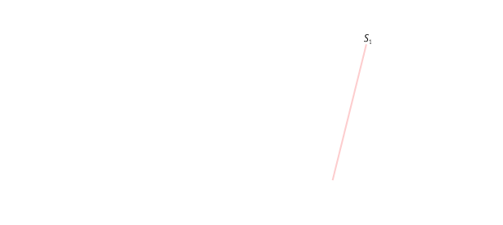

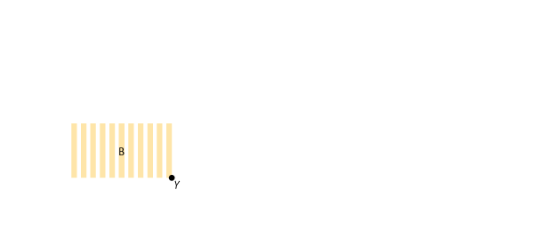
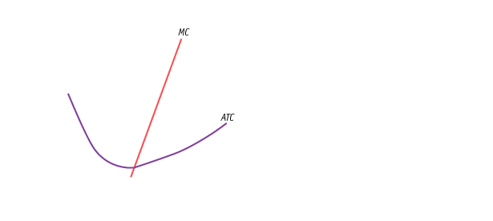
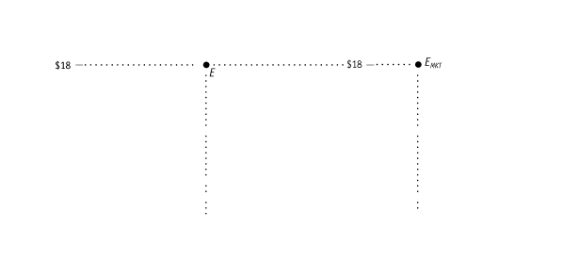
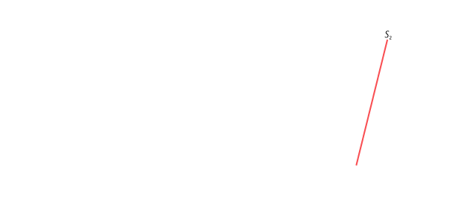
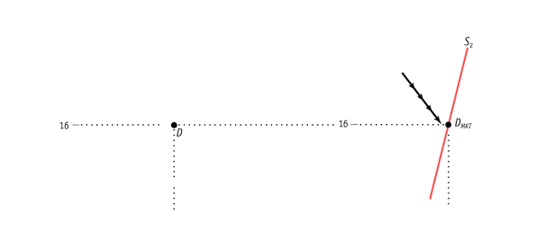
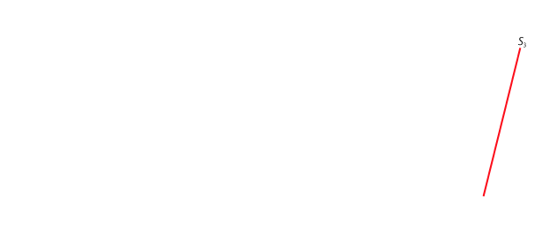
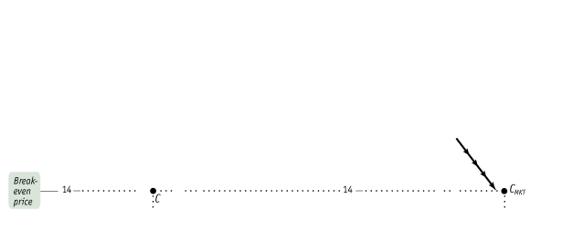
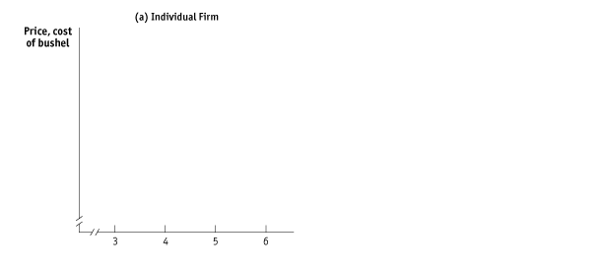
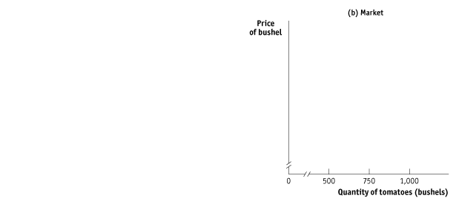
The Industry Supply Curve
The Long-Run Industry Supply Curve
<number> of 35

Slide 20
The Industry Supply Curve
The Long-Run Industry Supply Curve
A market is in long-run market equilibrium when the quantity supplied equals the quantity demanded, given that sufficient time has elapsed for entry into and exit from the industry to occur.
<number> of 35

Slide 21
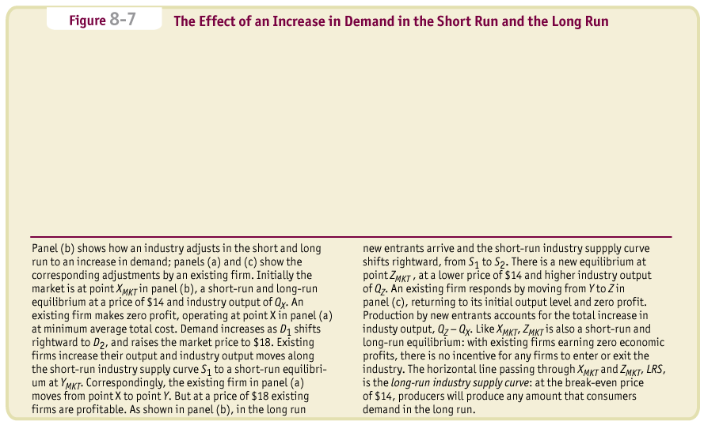
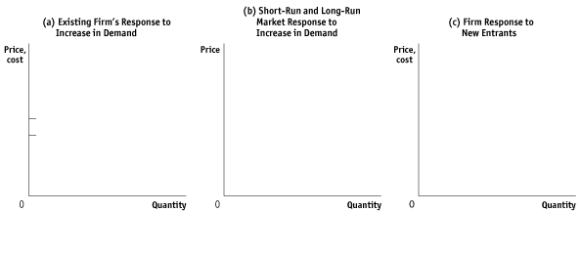
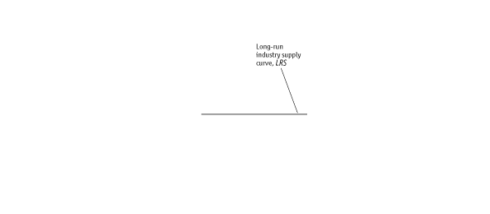
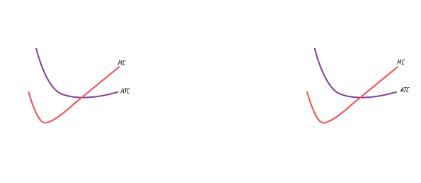
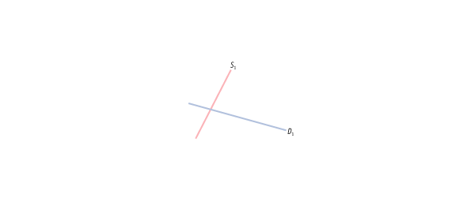
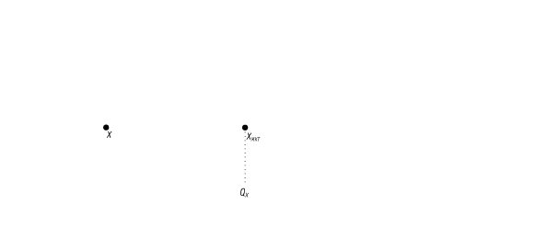
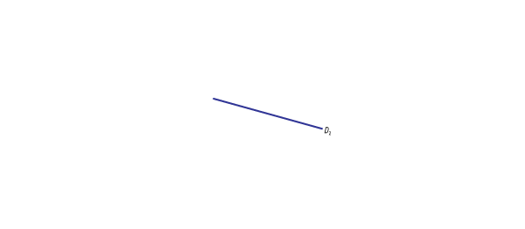
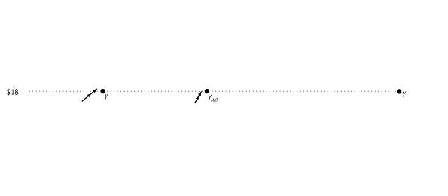

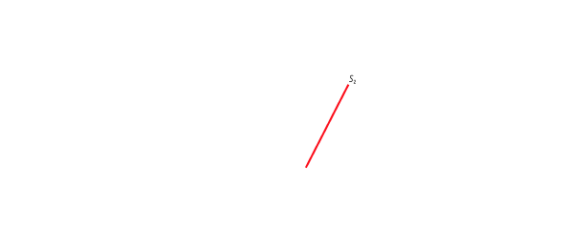
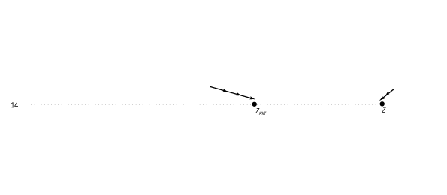
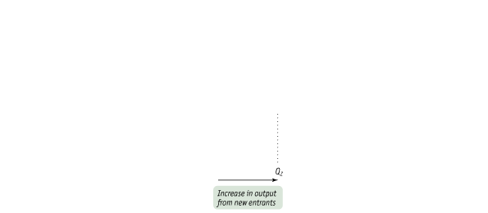
The Industry Supply Curve
The Long-Run Industry Supply Curve
<number> of 35

Slide 22
The Industry Supply Curve
The Long-Run Industry Supply Curve
The long-run industry supply curve shows how the quantity supplied responds to the price once producers have had time to enter or exit the industry.
<number> of 35

Slide 23
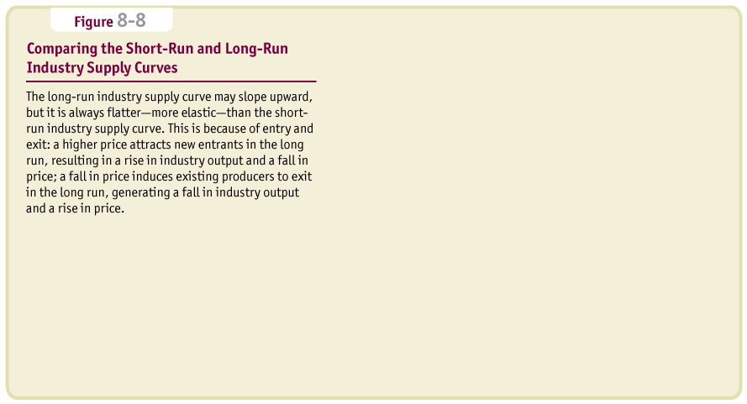
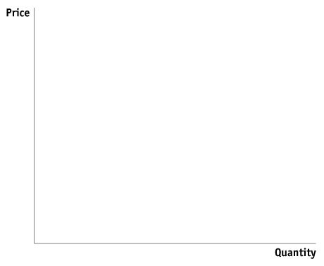
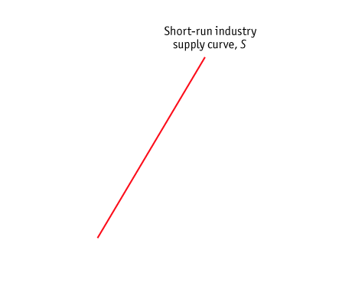
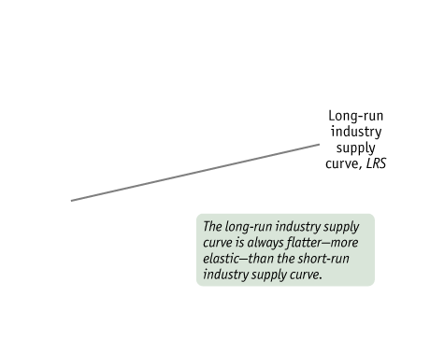
The Industry Supply Curve
The Long-Run Industry Supply Curve
<number> of 35

Slide 24
The Industry Supply Curve
The Cost of Production and Efficiency in Long-run Equilibrium
Our analysis leads us to three conclusions about the cost of production and efficiency in the long-run equilibrium of a perfectly competitive industry.
First, in a perfectly competitive industry in equilibrium, the value of marginal cost is the same for all firms.
Second, in a perfectly competitive industry with free entry and exit, each firm will have zero economic profit in long-run equilibrium.
The third and final conclusion is that the long-run market equilibrium of a perfectly competitive industry is efficient: no mutually beneficial transactions go unexploited.
<number> of 35

Slide 25
K E Y T E R M S
Price-taking producer
Price-taking consumer
Perfectly competitive market
Perfectly competitive industry
Market share
Standardized product
Commodity
Free entry and exit
Principle of marginal analysis
Marginal revenue
Optimal output rule
Price-taking firm’s optimal output rule
Marginal revenue curve
Accounting profit
Economic profit
Capital
Implicit cost of capital
Break-even price
Shut-down price
Sunk costs
Short-run individual supply curve
Industry supply curve
Short-run industry supply curve
Short-run market equilibrium
Long-run market equilibrium
Long-run industry supply curve
<number> of 35

