Slide 1
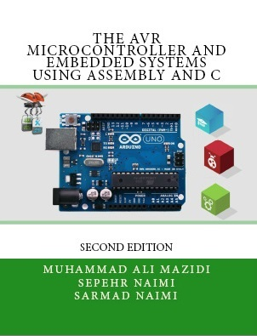

Introduction to Computing
Chapter 0
Sepehr Naimi
www.NicerLand.com
www.MicroDigitalEd.com

Slide 2
Topics
Internal organization of computers
  The different parts of a computer
    I/O
    Memory
    CPU
  Connecting the different parts
    Connecting memory to CPU
    Connecting I/Os to CPU
  How computers work

Slide 3
Internal organization of computers
CPU
Memory
I/O
  Input
    E.g. Keyboard, Mouse, Sensor
  Output
    E.g. LCD, printer, hands of a robot

Slide 4
Memory
Everything that can store, retain, and recall information.
  E.g. hard disk, a piece of paper, etc.

Slide 5
Memory characteristics
Capacity
  The number of bits that a memory can store.
    E.g. 128 Kbits, 256 Mbits
Organization
  How the locations are organized
    E.g. a 128 x 4 memory has 128 locations, 4 bits each
Access time
  How long it takes to get data from memory
4 bits
0
1
2
128 locations
…
127

Slide 6
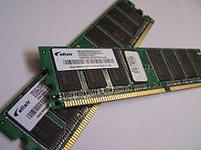
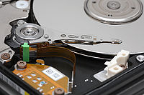
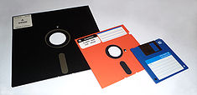
Memory
Semiconductors
Non-semiconductors
The pictures are copied from http://www.wikipedia.org/

Slide 7
Semiconductor memories
ROM
  Mask ROM
  PROM (Programmable ROM)
  EPROM (Erasable PROM)
  EEPROM (Electronic Erasable PROM)
  Flash EPROM
RAM
  SRAM (Static RAM)
  DRAM (Dynamic RAM)
  NV-RAM (Nonvolatile RAM)

Slide 8
Memory\ROM\Mask ROM
Programmed by the IC manufacturer

Slide 9
Memory\ROM\PROM (Programmable ROM)
OTP (One-Time Programmable)
  You can program it only once

Slide 10

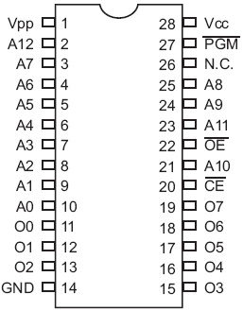
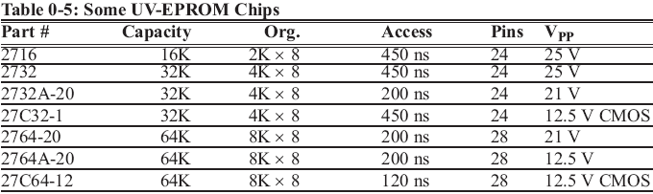
Memory\ROM\EPROM (Erasable Programmable ROM)
UV-EPROM
  You can shine ultraviolet (UV) radiation to erase it
  Erasing takes up to 20 minutes
  The entire contents of ROM are erased
2764

Slide 11
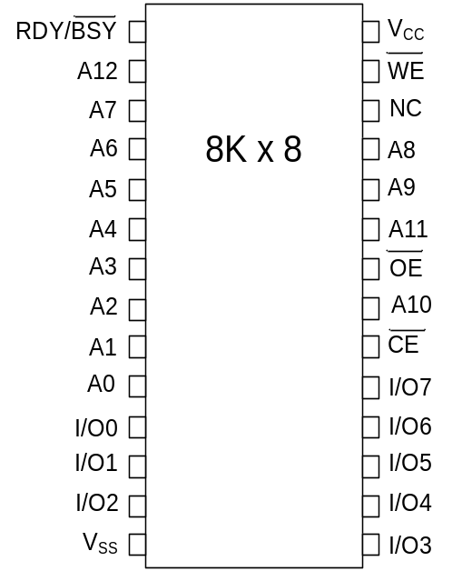
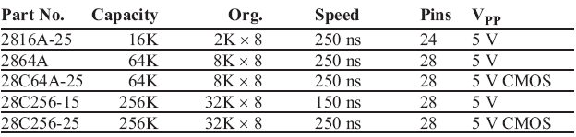
Memory\ROM\EEPROM (Electrically Erasable Programmable ROM)
Erased Electrically
  Erased instantly
  Each byte can be erased separately

Slide 12
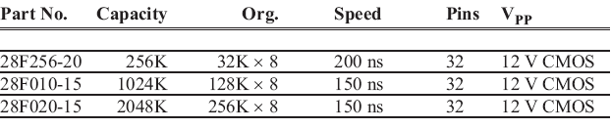
Memory\ROM\Flash ROM
Erased in a Flash
the entire device is erased at once

Slide 13
Semiconductor memories
ROM
  Mask ROM
  PROM (Programmable ROM)
  EPROM (Erasable PROM)
  EEPROM (Electronic Erasable PROM)
  Flash EPROM
RAM
  SRAM (Static RAM)
  DRAM (Dynamic RAM)
  NV-RAM (Nonvolatile RAM)

Slide 14
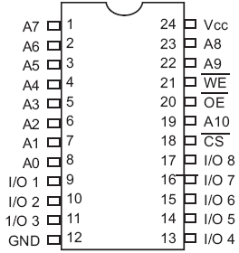
Memory\RAM\SRAM (Static RAM)
Made of flip-flops (Transistors)
Advantages:
  Faster
  No need for refreshing
Disadvantages:
  High power consumption
  Expensive
2K x 8
SRAM

Slide 15
Memory\RAM\DRAM (Dynamic RAM)
Made of capacitors
Advantages:
  Less power consumption
  Cheaper
  High capacity
Disadvantages:
  Slower
  Refresh needed

Slide 16
Memory\RAM\NV-RAM (Nonvolatile RAM)
Made of SRAM, Battery, control circuitry
Advantages:
  Very fast
  Infinite program/erase cycle
  Non-volatile
Disadvantage:
  Expensive

Slide 17
Internal parts of computers\CPU
Tasks:
  It should execute instructions
    It should recall the instructions one after another and execute them

Slide 18
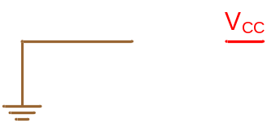
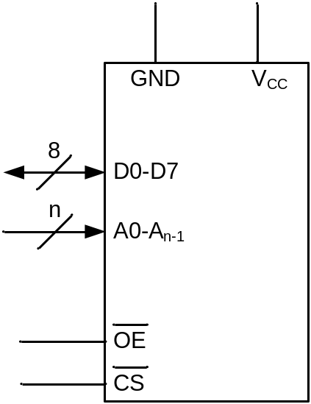

Connecting memory to CPU
Memory pin out

Slide 19
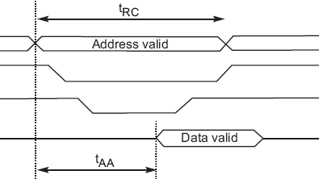
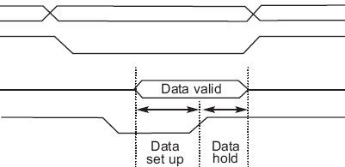
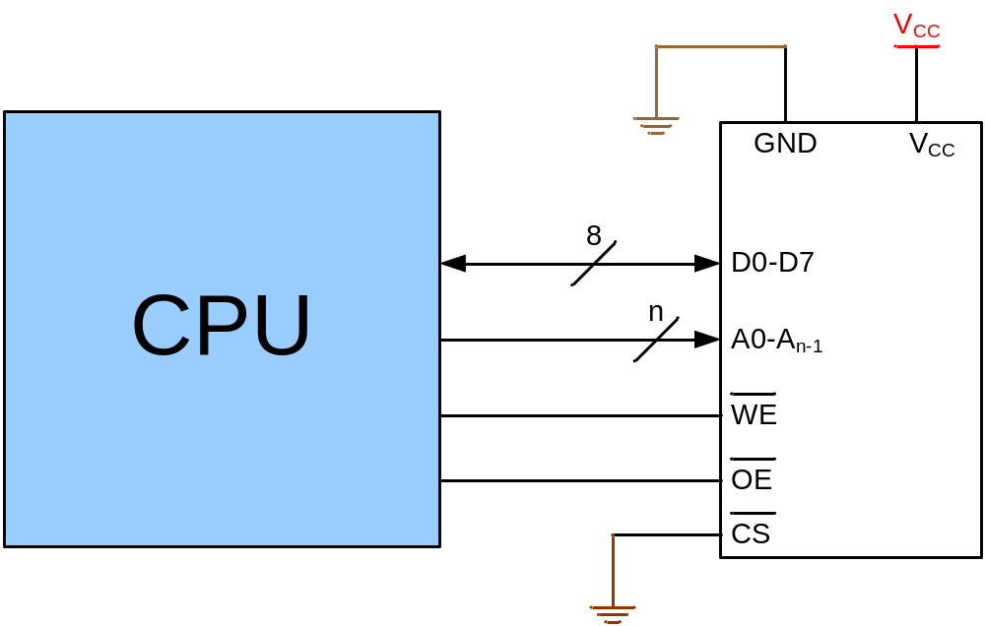
Connecting memory to CPU
Writing to memory
Reading from memory
Address
Address
CS
CS
OE
Data
Data
WE
WE
Time
Time

Slide 20
Connecting I/Os to CPU
CPU should have lots of pins!
Mouse
CPU
Network
Keyboard
Sound Card
Graphic Card

Slide 21
Connecting I/Os to CPU using bus
CPU
Address bus
Data bus
Control bus
Write
Read
I/O 0
I/O 1
I/O 2
I/O n

Slide 22
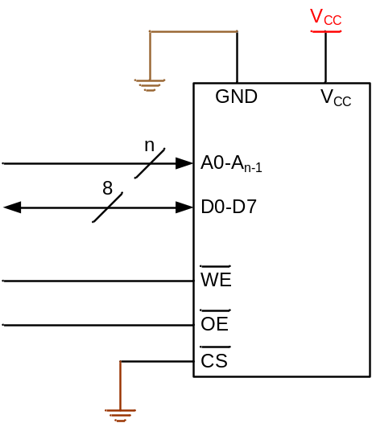
Connecting I/Os and Memory to CPU
CPU
Address bus
Data bus
Control bus
Write
Read
I/O 0
I/O 1
I/O 2
I/O n

Slide 23
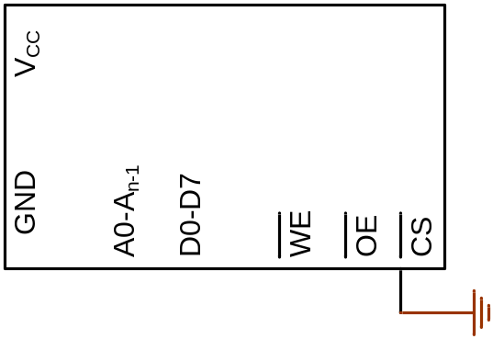
Connecting I/Os and memory to CPU using bus
0
1
2
3
How could we manage it?
CPU
0
Address bus
Data bus
Control bus
Write
Read
I/O 0
I/O 1
I/O 2
I/O n

Slide 24
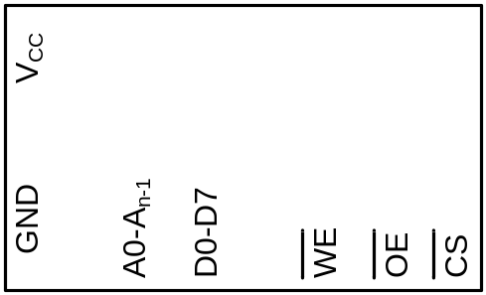
Connecting I/Os and Memory to CPU using bus
(Peripheral I/O)
0
1
..
63
CPU
Address bus
Data bus
Write
Control bus
Read
IO/MEM
I/O 0
I/O 1
I/O 2
I/O n

Slide 25
Connecting I/Os and Memory to CPU using bus
(Memory Mapped I/O)
The logic circuit enables CS when address is between 0 and 15
0
1
..
15
How could we make the logic circuit?
CPU
Logic circuit
Address bus
Data bus
Solution
1. Write the address range in binary
Control bus
Write
Read
2. Separate the fixed part of address
3. Using a NAND, design a logic circuit whose output activates when the fixed address is given to it.
a7
a6
a5
a4
a3
a2
a1
From address 0 ➔
a0
a4
0 0 0 0 0 0 0 0
I/O 17
I/O n
I/O 16
I/O 18
a5
CS
To address15 ➔
0 0 0 0 1 1 1 1
a6
a7

Slide 26
Another example for address decoder
Design an address decoder for address of 300H to 3FFH.
Solution
1. Write the address range in binary
2. Separate the fixed part of address
3. Design the logic circuit.
a10
a7
a6
a5
a3
a8
a9
a11
a8
a11 a10 a9 a8
a4
a2
a1
From address 300H ➔
a0
a9
0 0 1 1 0 0 0 0 0 0 0 0
a10
CS
To address 3FFH ➔
0 0 1 1
a11
0 0 1 1 1 1 1 1 1 1 1 1
An easy way of
designing

Slide 27
Inside the CPU
PC (Program Counter)
Instruction decoder
ALU (Arithmetic Logic Unit)
Registers
CPU
ALU
PC
A
B
C
Instruction decoder
D
registers

Slide 28
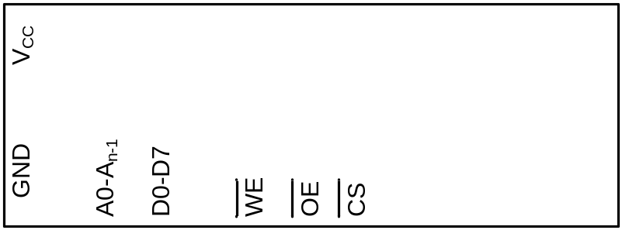
How computers work
31h
C4h
26h
81h
EAh
0h
5h
A← [17]
B ← A
A ← [6]
A←A+B
[7]←A
31
0
1
2
3
4
5
6
7
CPU
Address bus
Logic circuit
Data bus
Control bus
Write
Read
ALU
A
B
PC:
1
C
0
0
D
I/O 16
I/O 17
I/O 18
I/O n
Inst. Dec.
registers

Slide 29
How computers work
31h
C4h
26h
81h
EAh
0h
5h
A← [17]
B ← A
A ← [6]
A←A+B
[7]←A
0
1
2
3
4
5
6
7
CPU
Address bus
17
Logic circuit
Data bus
Control bus
Write
Read
ALU
A
B
PC:
1
C
9
D
I/O 16
I/O 17
I/O 18
I/O n
Inst. Dec.
registers
31

Slide 30
How computers work
31h
C4h
26h
81h
EAh
0h
5h
A← [17]
B ← A
A ← [6]
A←A+B
[7]←A
0
1
2
3
4
5
6
7
C4
26
5
CPU
17
Logic circuit
Address bus
6
Data bus
Control bus
Write
Read
9
ALU
9
A
B
PC:
1
2
2
1
C
3
D
I/O 16
I/O 17
I/O 18
I/O n
Inst. Dec.
registers

Slide 31
How computers work
31h
C4h
26h
81h
EAh
0h
5h
A← [17]
B ← A
A ← [6]
A←A+B
[7]←A
0
1
2
3
4
5
6
7
81
EA
CPU
Address bus
7
Logic circuit
Data bus
Eh
Control bus
Write
Read
E
5
ALU
5
+
A
E
9
9
B
PC:
4
4
3
C
3
5
D
I/O 16
I/O 17
I/O 18
I/O n
Inst. Dec.
registers

Slide 32
How Instruction decoder works
Opcode
Operand
Opcode
Operand
Instruction
Instruction
Operation Code | Meaning
000 | A ← x
001 | A ← [x]
010 | A ← A – register (x)
011 | A ← A + x
100 | A ← A + register (x)
101 | A ← A – x
110 | Register (x_{H}) ← Register (x_{L})
111 | [x] ← A
0011 0001
1100 0100
0010 0110
1000 0001
1110 0111
0000 0000
0000 0101
31h
C4h
26h
81h
EAh
0h
5h
A← [17]
B ← A
A ← [6]
A←A+B
[7]←A
0
1
2
3
4
5
6
7

Slide 33
Von Neumann vs. Harvard architecture
CPU
Code
Memory
Data bus
Data bus
Data
Memory
Address bus
Address bus
Control bus
Control bus
Harvard architecture
Code
Memory
Data
Memory
CPU
Data bus
Address bus
Control bus
Von Neumann architecture

