Slide 1
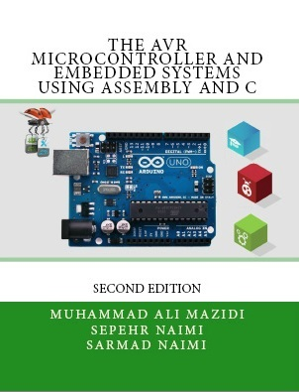

Computer History
Chapter 1
Sepehr Naimi
www.NicerLand.com
www.MicroDigitalEd.com

Slide 2
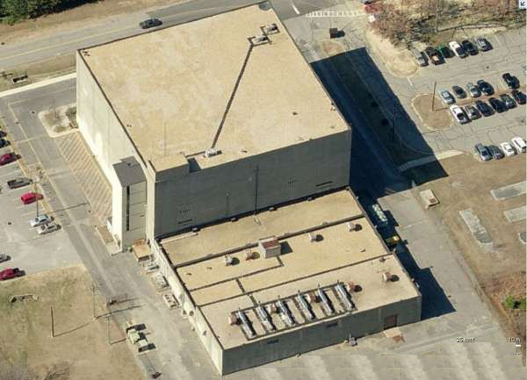
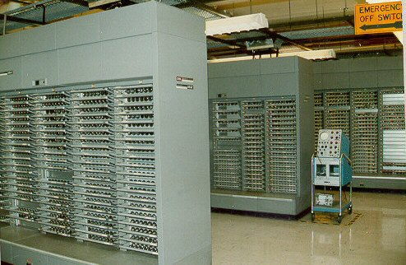
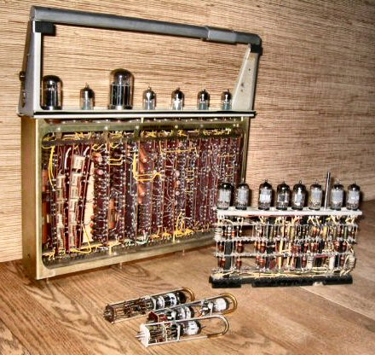
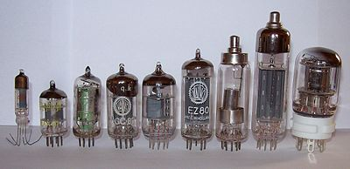
Vacuum tube computers
www.williamson-labs.com/480_cpu.htm
SAGE Blockhouse/Computer:
10,170m², 250 tons, houses More than 200,000 vacuum tubes @ 3,000,000 Watts

Slide 3
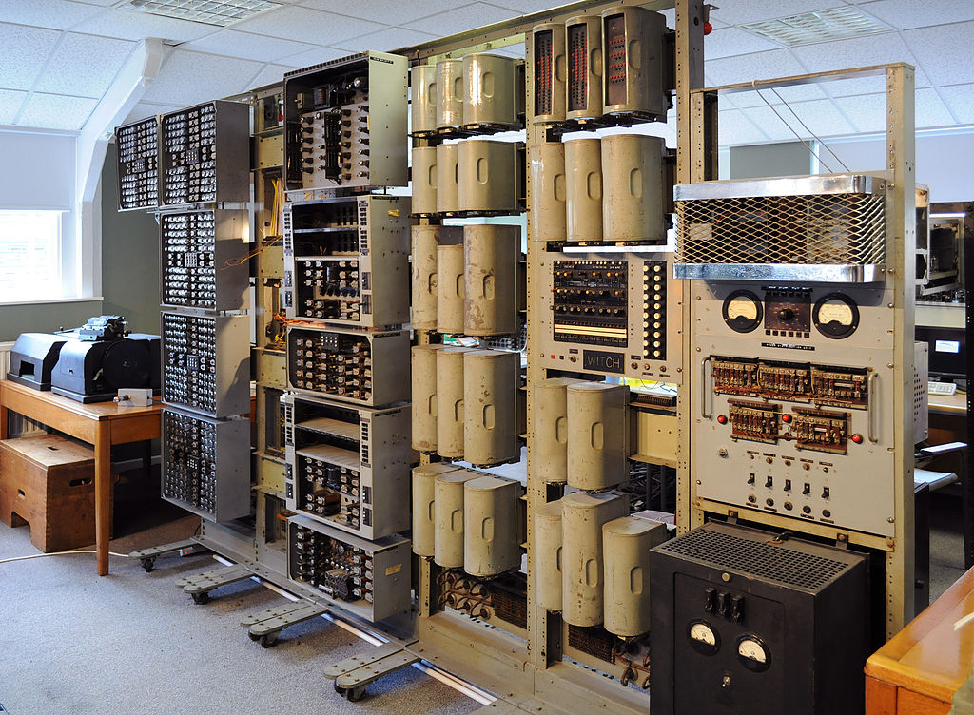
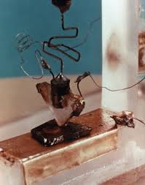
Transistor Computers
2nd Generation
From 1956
Half a room
The Harwell Dekatron Computer under restoration at the British National Museum of Computing

Slide 4
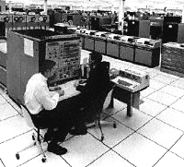
Invention of ICs
3rd generation
IBM 360 made by ICs (1964)

Slide 5
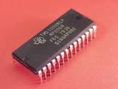
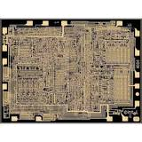
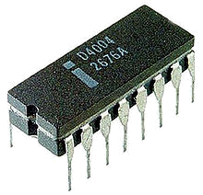
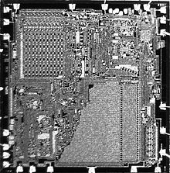
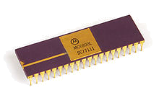
First microprocessors/Microcontrollers
TI TMS1000
4004 (from Intel)
6800 (Motorola)
TI TMS1000
(1971-1974)
http://www.antiquetech.com/
Intel 4004 (1971)
www.computerhistory.org
PICO1 (1971)
http://en.wikipedia.org/wiki/Microprocessor
Motorola MC6800
(1974)
http://en.wikipedia.org/wiki/Motorola_6800

Slide 6


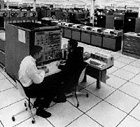
Now!
Vacuum tubes
(1st generation)
1956
Transistors
(2nd generation)
ICs (3rd Gen.)
1971
Microprocessors/MCUs
time

Slide 7
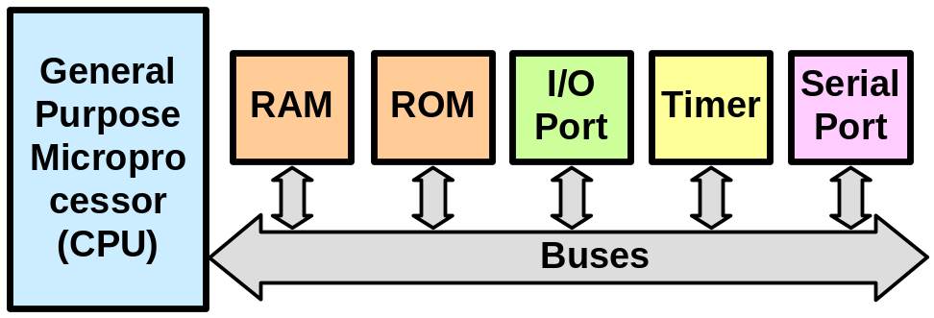
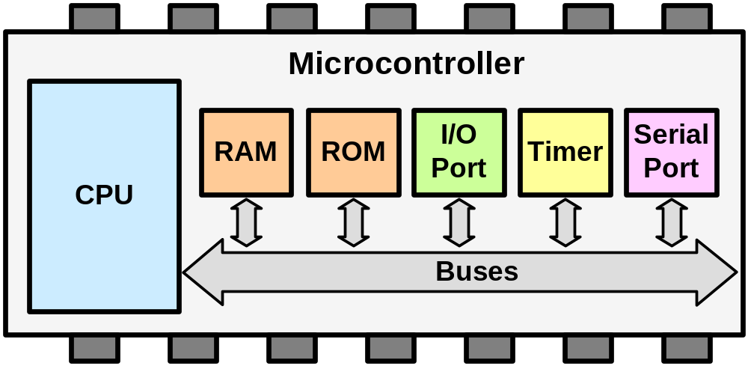
General Purpose Microprocessors vs. Microcontrollers
General Purpose Microprocessors
Microcontrollers

Slide 8


Most common microcontrollers
8-bit microcontrollers
  AVR
  PIC
  HCS12
  8051
32-bit microcontrollers
  ARM
  AVR32
  PIC32
  CodeFire
  PowerPC

Slide 9
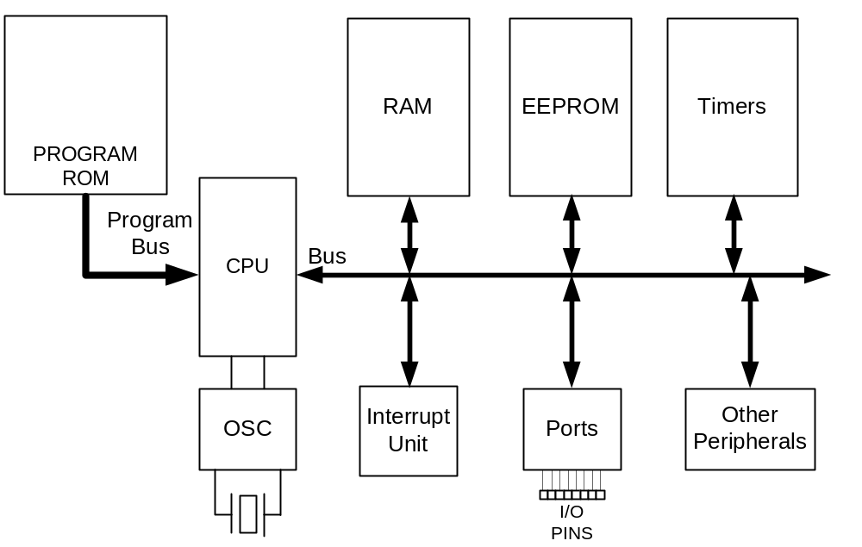
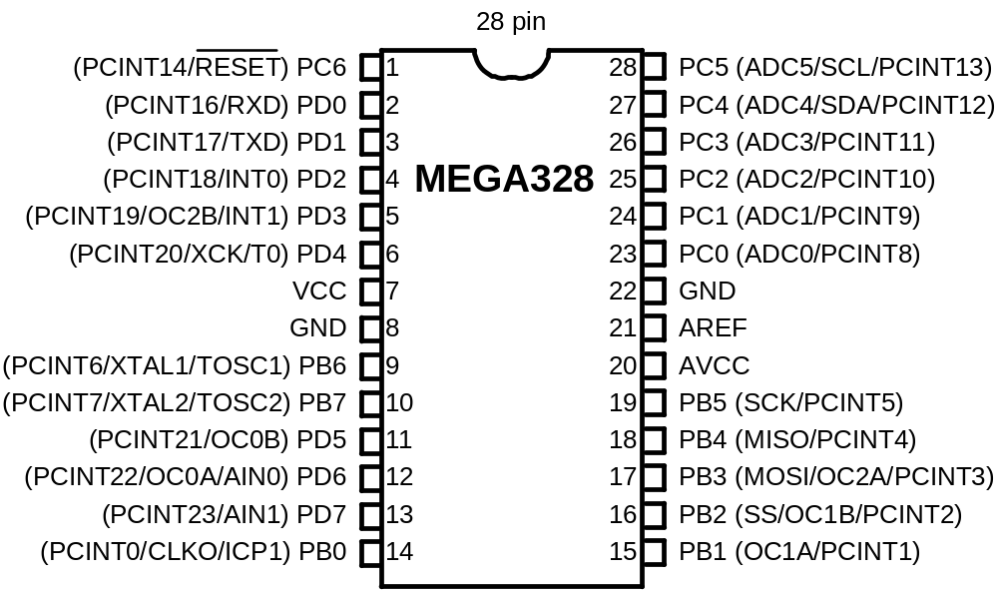
AVR internal architecture

Slide 10
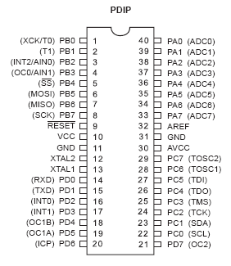
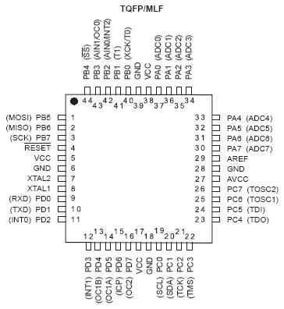
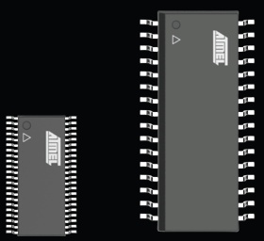
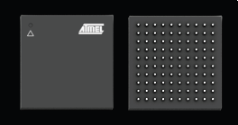
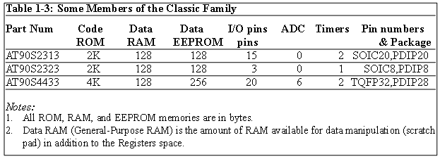
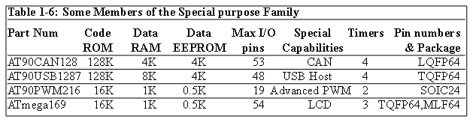
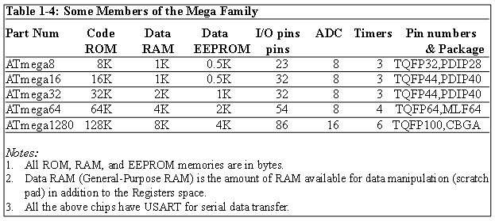
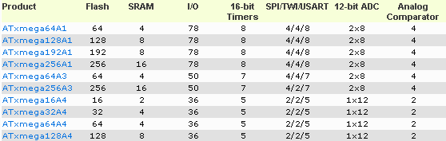
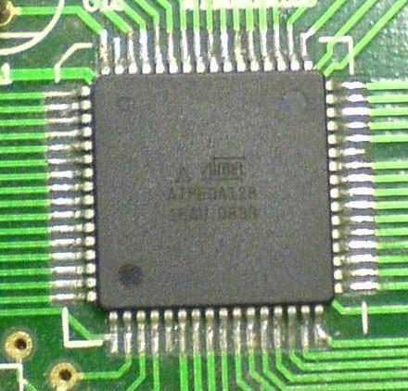
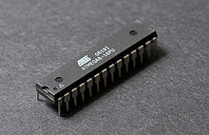
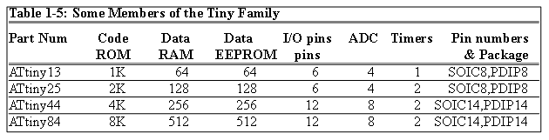
AVR different groups
Classic AVR
  e.g. AT90S2313, AT90S4433
Mega
  e.g. ATmega8, ATmega32, ATmega128
Tiny
  e.g. ATtiny13, ATtiny25
Special Purpose AVR (Application Oriented AVR)
  e.g. AT90PWM216,AT90USB1287
XMega
  New features like DMA, DAC, crypto engine, etc.
CBGA
TSSOP
SOIC

Slide 11
Let’s get familiar with the AVR part numbers
ATmega128
Atmel
group
Flash =128K
ATtiny44
AT90S4433
Atmel
Tiny group
Flash =4K
Atmel
Classic group
Flash =4K

Slide 12
References
https://www.msu.edu/course/lbs/126/lectures/history.html
www.williamson-labs.com/480_cpu.htm
www.computerhistory.org
The AVR Microcontroller and Embedded systems, Mazidi & Naimi
http://www.antiquetech.com/
http://en.wikipedia.org/

