Slide 1
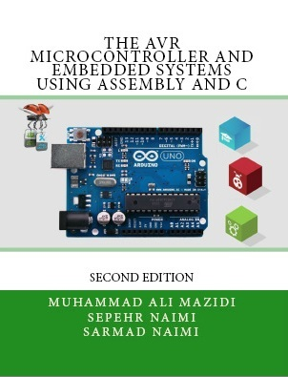

UART Protocol
Chapter 11
Sepehr Naimi
www.NicerLand.com

Slide 2
Topics
Communication theory
  Parallel vs. Serial
  Direction: Simplex, Half duplex, Full duplex
  Synchronization: Synchronous vs. Asynchronous
  Line coding
UART protocol
UART in AVR
  UART Registers
  Some programs

Slide 3
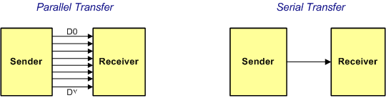
Parallel vs. Serial
Parallel
  For short distances
  Not applicable for long distances
  More expensive
  Cross-talk problem

Slide 4
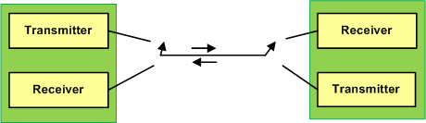
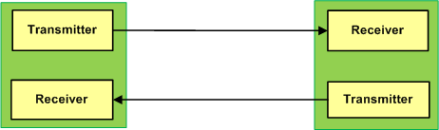
Direction
Simplex
Half Duplex
Full Duplex

Slide 5
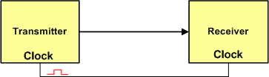

Synchronization
Synchronous
Asynchronous

Slide 6
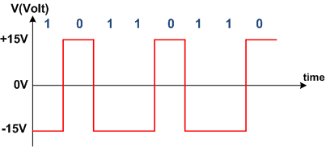
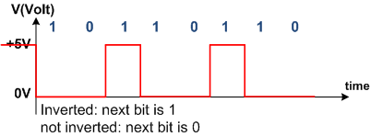
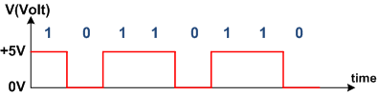
Line coding
Line coding: presenting data using signals
Digital
  NRZ-L: Coding using level of voltage
    TTL
    RS232
  NRZ-I: Inverting or not inverting
Analog: using sine waves
  ASK
  FSK
  PSK
TTL
NRZ-I
RS232

Slide 7
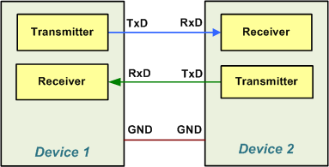
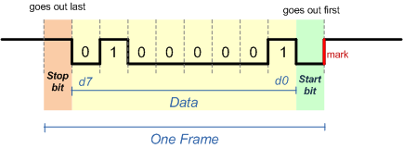
UART Protocol
Serial
Asynchronous
Full duplex

Slide 8
USART (Universal Synchronous Asynchronous Receive Transmit)
USART devices can be used to communicate asynchronously (UART) and synchronously.
Since the synchronous capability of USART is not used nowadays, we concentrate on UART.

Slide 9
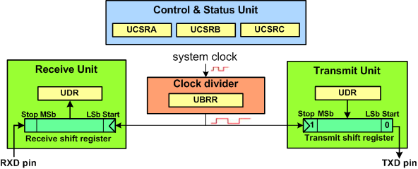
UART in AVR
Control registers: (initialize speed, data size, parity, etc)
  UBRR, UCSRA, UCSRB, and UCSRC
Send/receive register
  UDR
Status register
  UCSRA

Slide 10


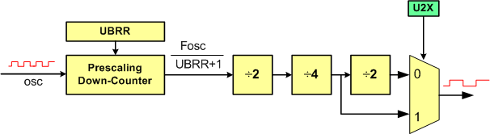
Baud rate
System clock
UART baud rate

Slide 11


Example: Find the UBRR value for 9600bps.
Solution:

Slide 12
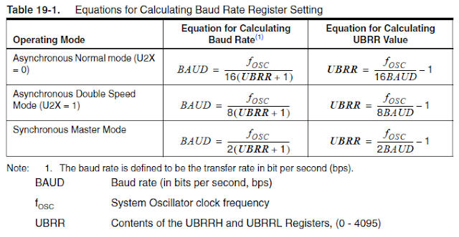
cf. 2M

Slide 13
Some Standard Baud rates
1200
2400
4800
9600
19,200
38,400
57,600
115,200

Slide 14
UCSRB
RXCIE0 (Bit 7): Receive Complete Interrupt Enable
  To enable the interrupt on the RXC0 flag in UCSR0A you should set this bit to one.
TXCIE0 (Bit 6): Transmit Complete Interrupt Enable
  To enable the interrupt on the TXC0 flag in UCSR0A you should set this bit to one.
UDRIE0 (Bit 5): USART Data Register Empty Interrupt Enable
  To enable the interrupt on the UDRE0 flag in UCSR0A you should set this bit to one.
RXEN0 (Bit 4): Receive Enable
  To enable the USART receiver you should set this bit to one.
TXEN0 (Bit 3): Transmit Enable
  To enable the USART transmitter you should set this bit to one.
UCSZ02 (Bit 2): Character Size
  This bit combined with the UCSZ1:0 bits in UCSRC sets the number of data bits (character size) in a frame.
RXB80 (Bit 1): Receive data bit 8
  This is the ninth data bit of the received character when using serial frames with nine data bits.
TXB80 (Bit 0): Transmit data bit 8
  This is the ninth data bit of the transmitted character when using serial frames with nine data bits.

Slide 15
UCSRC
UMSEL01:00 (Bits 7:6): USART Mode Select
  These bits select the operation mode of the USART:
    00 = Asynchronous USART operation
    01 = Synchronous USART operation
    10 = Reserved
    11 = Master SPI (MSPIM)
UPM01:00 (Bit 5:4): Parity Mode
  These bits disable or enable and set the type of parity generation and check.
    00 = Disabled
    01 = Reserved
    10 = Even Parity
    11 = Odd Parity
USBS0 (Bit 3): Stop Bit Select
  This bit selects the number of stop bits to be transmitted.
    0 = 1 bit
    1 = 2 bits
UCSZ01:00 (Bit 2:1): Character Size
  These bits combined with the UCSZ02 bit in UCSR0B set the character size in a frame.
UCPOL0 (Bit 0): Clock Polarity
  This bit is used for synchronous mode.
UCSZ02 | UCSZ01 | UCSZ00 | Char. size
0 | 0 | 0 | 5-bit
0 | 0 | 1 | 6-bit
0 | 1 | 0 | 7-bit
0 | 1 | 1 | 8-bit
1 | 1 | 1 | 9-bit

Slide 16
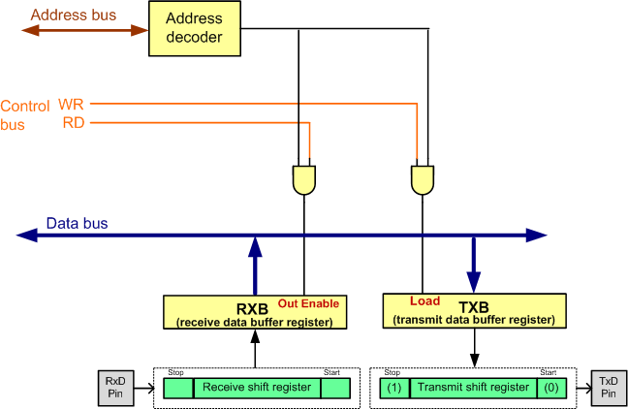
UDR

Slide 17
UCSRA
RXC0 (Bit 7): USART Receive Complete 0
  This flag bit is set when there are new data in the receive buffer that are not read yet. It is cleared when the receive buffer is empty. It also can be used to generate a receive complete interrupt.
TXC0 (Bit 6): USART Transmit Complete 0
  This flag bit is set when the entire frame in the transmit shift register has been transmitted and there are no new data available in the transmit data buffer register (TXB). It can be cleared by writing a one to its bit location. Also it is automatically cleared when a transmit complete interrupt is executed. It can be used to generate a transmit complete interrupt.
UDRE0 (Bit 5): USART Data Register Empty 0
  This flag is set when the transmit data buffer is empty and it is ready to receive new data. If this bit is cleared you should not write to UDR0 because it overrides your last data. The UDRE0 flag can generate a data register empty interrupt.
FE0 (Bit 4): Frame Error 0
  This bit is set if a frame error has occurred in receiving the next character in the receive buffer. A frame error is detected when the first stop bit of the next character in the receive buffer is zero.
DOR0 (Bit 3): Data OverRun 0
  This bit is set if a data overrun is detected. A data overrun occurs when the receive data buffer and receive shift register are full, and a new start bit is detected.
PE0 (Bit 2): Parity Error 0
  This bit is set if parity checking was enabled (UPM1 = 1) and the next character in the receive buffer had a parity error when received.
U2X0 (Bit 1): Double the USART Transmission Speed 0
MPCM0 (Bit 0): Multi-processor Communication Mode 0

Slide 18
 | 7 | 6 | 5 | 4 | 3 | 2 | 1 | 0
UCSRA | RXC | TXC | UDRE | FE | DOR | PE | U2X | MPCM
UCSRB | RXCIE | TXCIE | UDRIE | RXEN | TXEN | UCSZ2 | RXB8 | TXB8
UCSRC | UMSEL1 | UMSEL0 | UPMn1 | UPM0 | USBS | UCSZ1 | UCSZ0 | UCPOL
UBRRH
UBRRL

Slide 19
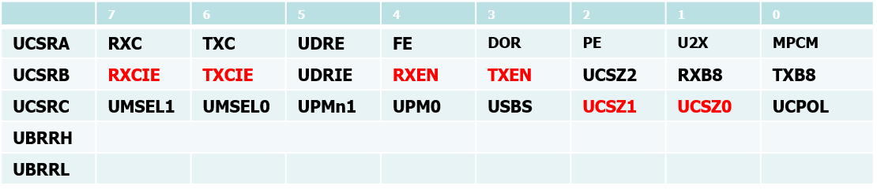
Program: sending character ‘G’ continuously
#include <avr/io.h>
void usart_init (void)
{
UCSR0B = (1<<TXEN0); // transmission enabled
UCSR0C = (1<<UCSZ01)|(1<<UCSZ00); //8-bit
UBRR0L = 103; //baud rate = 9600bps
}
void usart_send (unsigned char ch)
{
while (! (UCSR0A & (1<<UDRE0))); //wait until UDR0 is empty
UDR0 = ch; //transmit ch
}
int main (void)
{
usart_init(); //initialize the USART
while(1) //do forever
usart_send ('G’); //transmit ‘G’ letter
return 0;
}

Slide 20
Program 2: It receives bytes of data serially and puts them on Port B.
#include <avr/io.h>
int main (void)
{
DDRB = 0xFF; //Port B is output
UCSR0B = (1<<RXEN0); //initialize USART0
UCSR0C = (1<<UCSZ01)|(1<<UCSZ00);
UBRR0L = 103;
while(1)
{
while (! (UCSR0A & (1<<RXC0))); //wait until new data
PORTB = UDR0;
}
return 0;
}

Slide 21
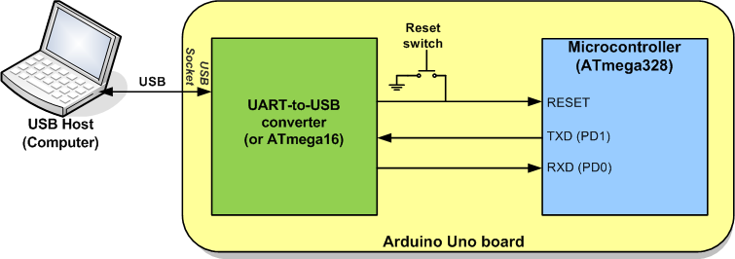
USB to serial converter in Arduino

Slide 22
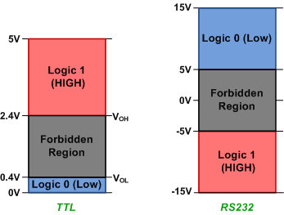
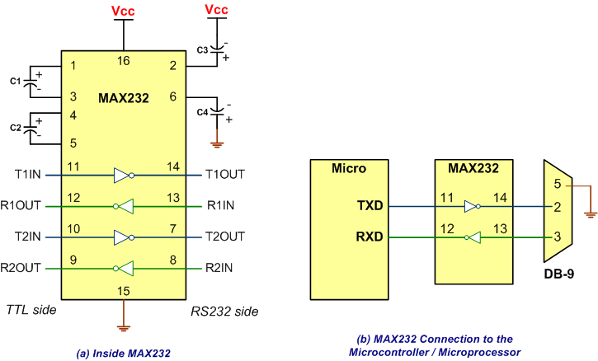
MAX232

