Slide 1
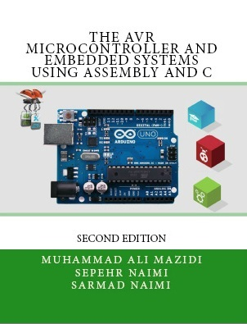

Output
Relay, Optoisolator, and Stepper motor interfacing with AVR
Sepehr Naimi
www.NicerLand.com

Slide 2
Topics
AVR Fan-out
Transistor
ULN2003
Relay
Opto-isolator
Stepper motor

Slide 3
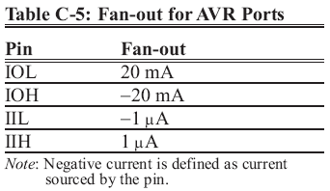
AVR Fan-out
Each I/O port can sink 20 mA at VCC = 5V and 10 mA at VCC = 3V

Slide 4
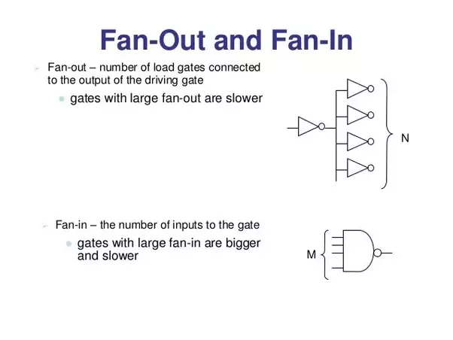

Slide 5
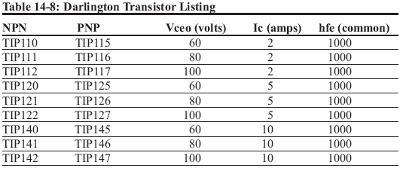
Transistor
We can switch devices using transistors.
Transistor amplifies signals.
VCC
AVR
Load

Slide 6
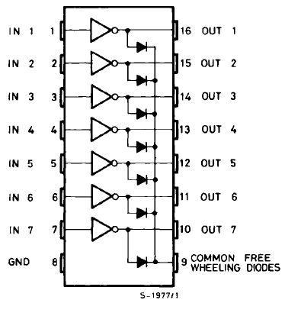
ULN2003
There are 7 Darlington transistors in a ULN2003.

Slide 7
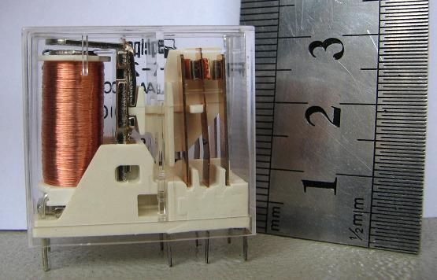
Relay
Relay is an electronic controlled switch.
It isolates two parts of a circuit from each other.
A small amount of current and voltage causes to switch a large amount of voltage and current.
Relay DPDT
Maximum output: 250V 8A ~AC
Input: 24^{V} DC

Slide 8
Relay parts
Relay has the following parts:
  Coil
  Contacts
  Spring

Slide 9
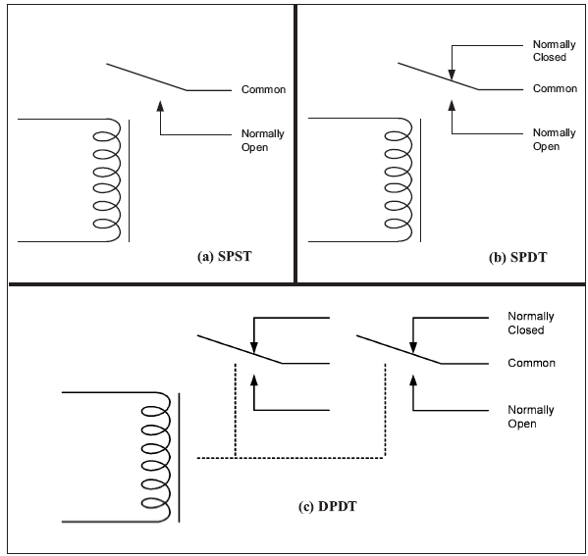
Contacts

Slide 10
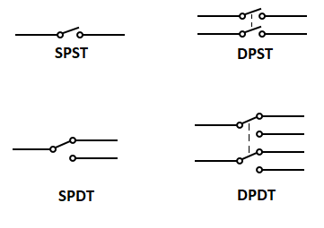

Slide 11
Relay
+
-
~
220^{V}
12^{V}

Slide 12
AVR connection to relay
Micro
Darlington
Relay
Lamp

Slide 13
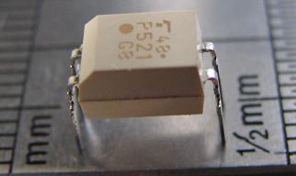
Optoisolator
Opto-isolator isolates two parts of a circuit from each other.
There is an LED in the input, and a photo-transistor in the output. When the LED lights up, the photo-transistor, senses the light and becomes conductor, and passes the current.
can be used in input or output circuits.
TLP521

Slide 14
Opto-isolator
16mA
10mA
TLP521

Slide 15
Controlling 220V devices
AVR
+12V
Analog Ground
Digital
Power
220^{V}
~
ULN2003
Analog
Power
in
out
+5^{V}
Digital Ground

Slide 16
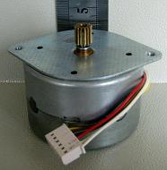
Stepper motor
Stepper motor is a motor, whose rotation angle is proportional to its input pulse.
Rotor
A
tooth
N
COM
S
S
N
N
B
S
Stator
C
COM
D

Slide 17
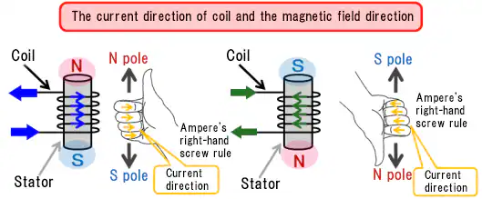

Slide 18
Stepper motor rotation
N
B
S
N
+5^{V}
S
S
N
S
N
S
N
N
D
S
N
S
C
+5^{V}
A

Slide 19
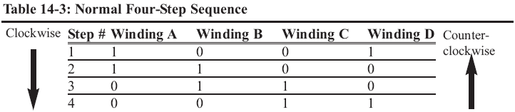
Stepping
N
B
S
N
+5^{V}
S
S
N
S
N
S
N
N
D
S
N
S
C
+5^{V}
A

Slide 20
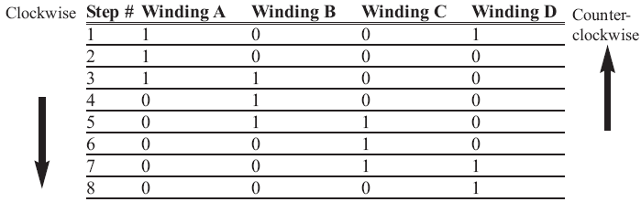
Half stepping
N
B
S
N
+5^{V}
S
S
N
S
N
S
N
N
D
S
N
S
C
+5^{V}
A

Slide 21
Calculations
N
B
S
N
+5^{V}
N
S
N
S
D
S
N
S
Step angle =
90
Num of teeth
A
+5^{V}
C
Steps per revolution =
360
= 4 * Num of teeth
Step angle
Steps per second =
RPM * Steps per revolution
60

Slide 22
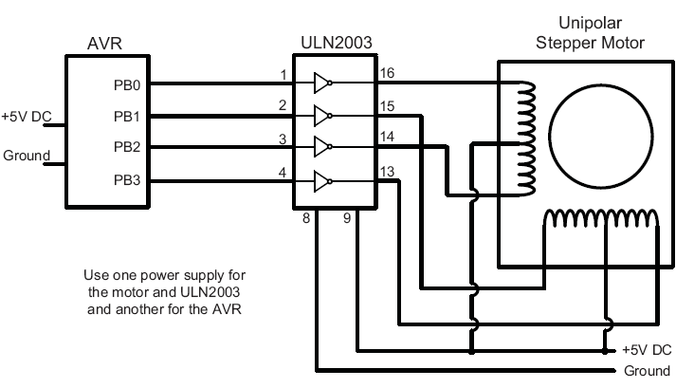
AVR and a Stepper motor

Slide 23
Comparison of Stepper Motor, DC Motor, and Servo Motor
Feature | Stepper Motor | DC Motor | Servo Motor
Movement | Precise, incremental steps; good for position control. | Continuous rotation; not inherently precise. | Precise position and speed control, usually within a limited range.
Control Complexity | Requires stepper motor driver and control signals. | Simple to control; requires a basic power supply and switches for operation. | Requires a control signal (PWM) and a motor driver or control circuit.
Speed | Moderate to low speed; speed decreases as load increases. | High speed, varies with load and power supply. | Moderate to high speed, depending on the control signal.
Torque | High holding torque; weaker at high speeds. | High torque at high speeds; torque reduces at lower speeds. | Moderate torque, typically higher at low speeds.
Accuracy | High; moves in fixed step increments. | Low; requires external encoders for precision. | High; feedback mechanism ensures accurate control.
Feedback | Open-loop system; does not require feedback. | Open-loop system; external feedback devices are needed for closed-loop operation. | Closed-loop system with built-in feedback (e.g., potentiometer or encoder).
Applications | CNC machines, 3D printers, robotics (for precise control). | Fans, toys, automotive applications, pumps. | Robotics, RC vehicles, camera stabilization, automation.
Cost | Moderate; affordable for precise control tasks. | Low; cheapest among the three for basic operation. | Higher; includes additional components for feedback and control.
Durability | Good for precise tasks with light-to-moderate duty cycles. | Durable for continuous operation; depends on the quality of the motor. | Durable but limited by the range of motion and feedback mechanism.
Ease of Use | Requires programming and setup for control; more complex than DC motors. | Easiest to use; requires minimal setup. | Moderate complexity; needs a controller and proper PWM signals.
Power Consumption | Moderate to high; depends on holding torque requirements. | Low to moderate; depends on load and speed. | Moderate; depends on duty cycle and control requirements.

