Slide 1
Wave Generation and Input Capturing

Slide 2
Topics
Wave characteristics
  Music and frequencies
Timer0 review
Wave generating using Timer0
Wave generating using Timer2
Wave generating using Timer1
Capturing

Slide 3
Wave characteristics
Period
  Frequency
Duty cycle
Amplitude
1
T
f =
T
T
t₀
t₀
duty cycle =
×100 =
×100
T
t₀ + t₁
t₀
t₁

Slide 4
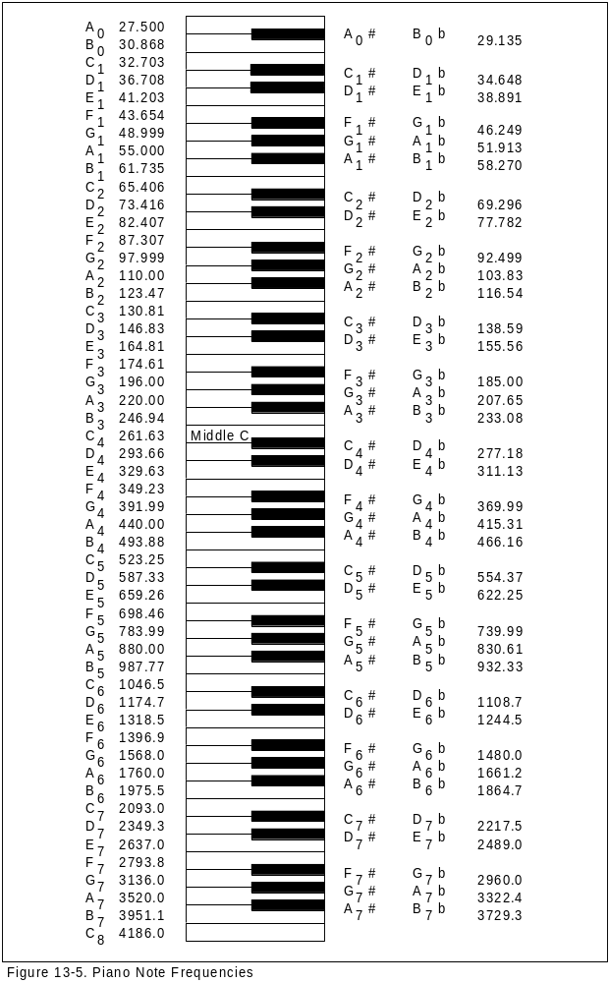
Music and Frequencies
Music

Slide 5
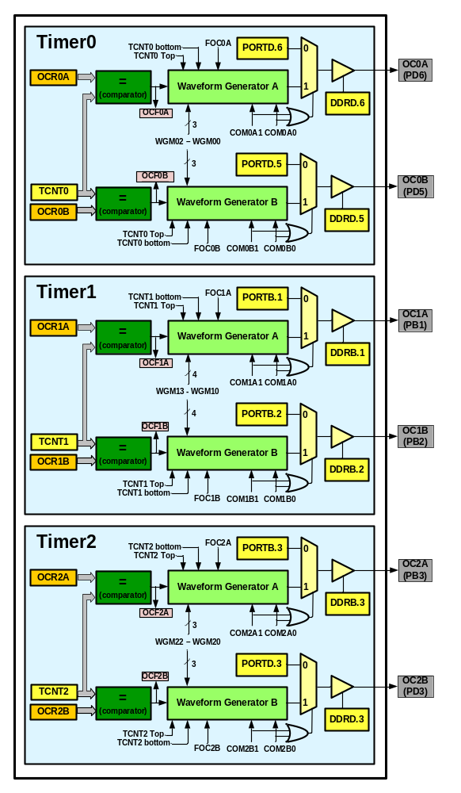
Waveform generators in ATmega328

Slide 6
Timer0 Review
TCCR0A
TCCR0B
OCR0A
TCNT0
OCR0B
TOV0
=
=
OCF0A
OCF0B

Slide 7
Timer Mode (WGM)
WGM02 WGM01 WGM00 Comment
0 0 0 Normal
0 0 1 Phase correct PWM
0 1 0 CTC (Clear Timer on Compare Match)
0 1 1 Fast PWM
1 0 0 Reserved
1 0 1 Phase correct PWM
1 1 0 Reserved
1 1 1 Fast PWM

Slide 8
Normal mode
TCNT0
0xFF
TOV
TOV
TOV
0
time
FF
0
FE
TOV0:
1
2
1
0
TOV0 = 1

Slide 9
CTC (Clear Timer on Compare match) mode
TCNT0
0xFF
OCR0A
OCF0A
OCF0A
OCF0A
0
time
OCR0A
TOV0:
0
xx
2
0
OCF0A:
1
1
0
TOV0 = no change
OCF0A = 1

Slide 10
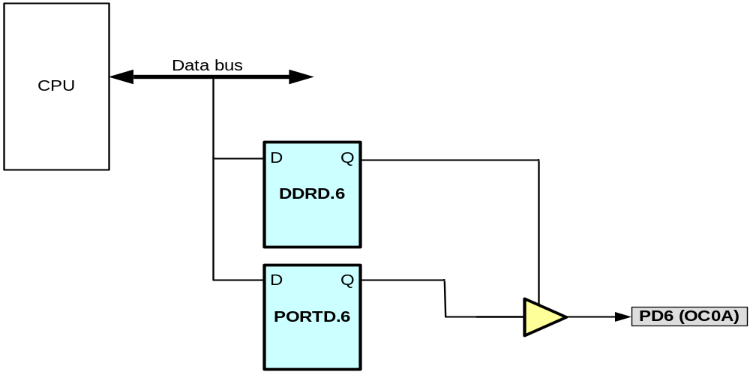
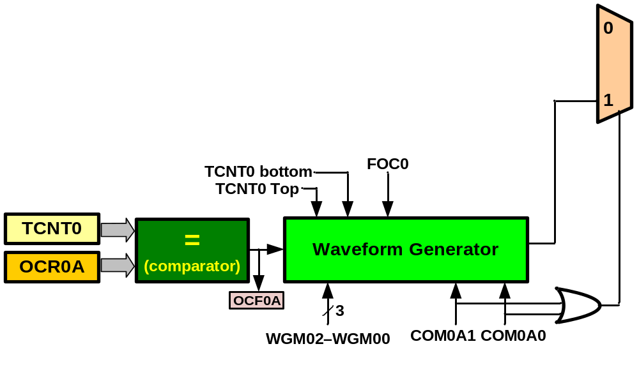
Waveform Generator

Slide 11
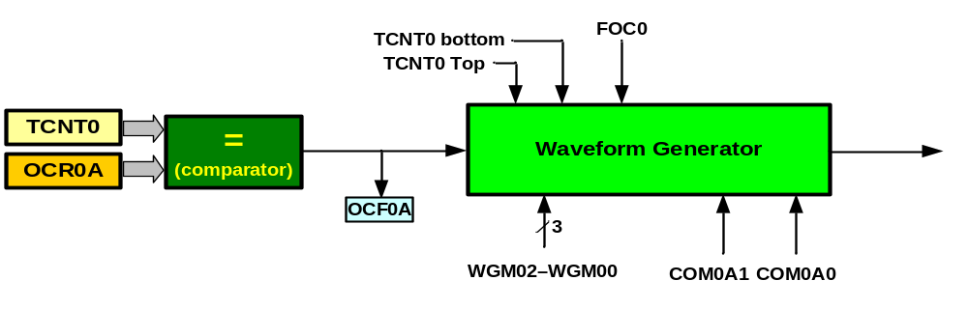
Waveform Generator

Slide 12
TCNT0
CTC, Toggle Mode
Duty cycle = 50%
Frequency = changeable
0xFF
Timer Mode (WGM)
OCR0x
WGM02 WGM01 WGM00 Comment
0 0 0 Normal
0 0 1 Phase correct PWM
0 1 0 CTC (Clear Timer on Compare Match)
0 1 1 Fast PWM
1 0 0 Reserved
1 0 1 Phase correct PWM
1 1 0 Reserved
1 1 1 Fast PWM
OCF0x
OCF0x
OCF0x
0
OC0x
f_{clk}
F_{OC0}=
2N(OCR0x+1)
TCNT0
0xFF
OCR0x
OCF0x
OCF0x
0
COM0x1 | COM0x0 | Description
0 | 0 | Normal port operation, OC0 disconnected
0 | 1 | Toggle OC0 on compare match
1 | 0 | Clear OC0 on compare match
1 | 1 | Set OC0 on compare match
OC0x

Slide 13
Assuming XTAL = 16 MHz, make a pulse with duty cycle = 50% and frequency = 1MHz
f_{clk}
16MHz
16MHz
F_{OC0}=
1MHz=
N(OCR0x+1) =
2N(OCR0x+1)
2N(OCR0x+1)
2MHz
N = 1 and OCR0 = 7
N(OCR0+1) = 8
N = 8 and OCR0 = 0
OCR0A = 7;
TCCR0A = (1<<COM0A0)|(1<<WGM01); //toggle, CTC
TCCR0B = 0x01; //prescaler = 1
OCR0A = 0;
TCCR0A = (1<<COM0A0)|(1<<WGM01); //toggle, CTC
TCCR0B = 0x02; //prescaler = 8

Slide 14
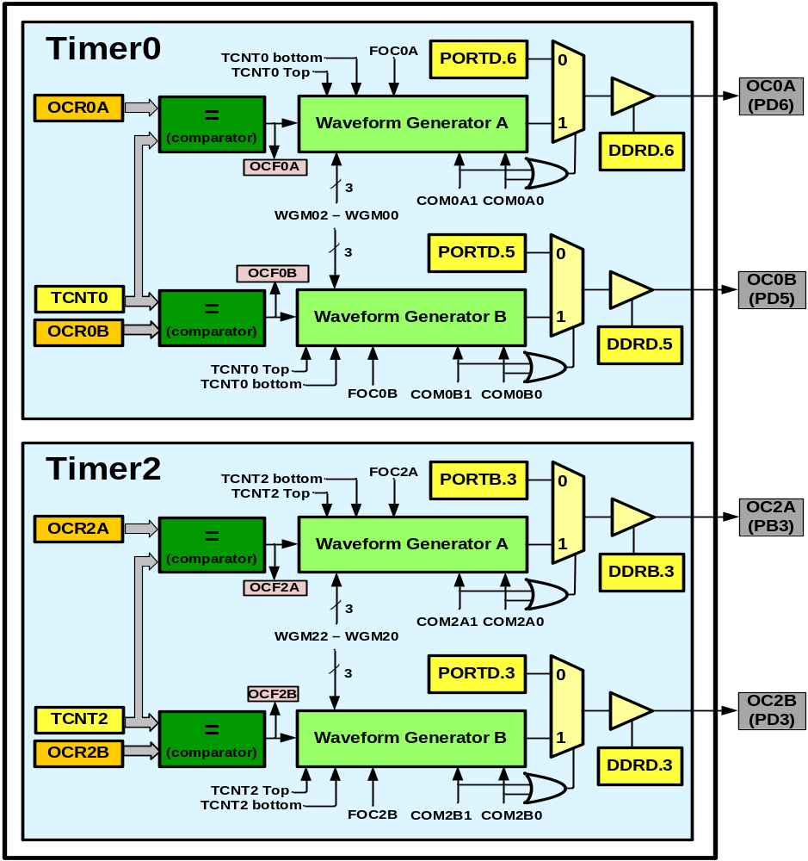
Wave generating in Timer2
Like Timer0

Slide 15
The difference between Timer0 and Timer2
Timer0
Timer2
CS02 CS01 CS00 Comment
0 0 0 Timer/Counter stopped
0 0 1 clk (No Prescaling)
0 1 0 clk / 8
0 1 1 clk / 64
1 0 0 clk / 256
1 0 1 clk / 1024
1 1 0 External clock (falling edge)
1 1 1 External clock (rising edge)
CS22 CS21 CS20 Comment
0 0 0 Timer/Counter stopped
0 0 1 clk (No Prescaling)
0 1 0 clk / 8
0 1 1 clk / 32
1 0 0 clk / 64
1 0 1 clk / 128
1 1 0 clk / 256
1 1 1 clk / 1024

Slide 16
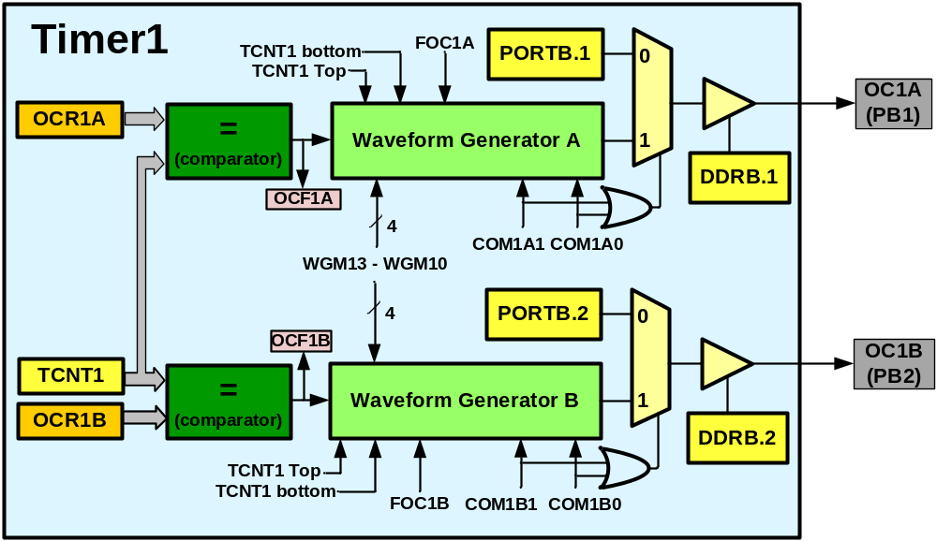
Timer1
Timer1 has two waveform generators

Slide 17
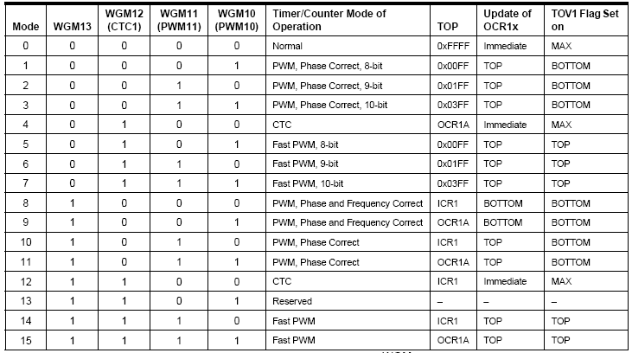
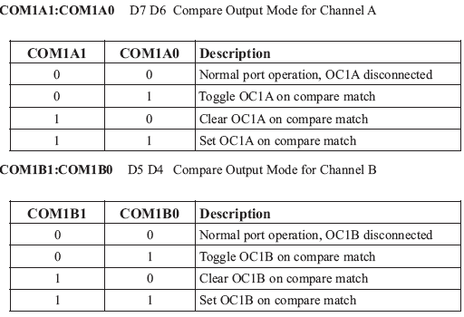
In non PWM modes

Slide 18
Capturing in Timer/counter 1

Slide 19
Capturing
Usages
  Measuring duty cycle
  Measuring period
TCNT1H TCNT1L
ICR1H ICR1L

Slide 20
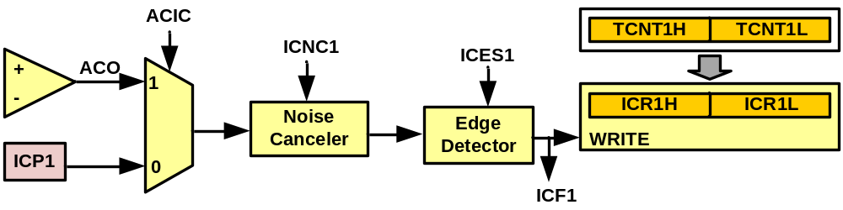
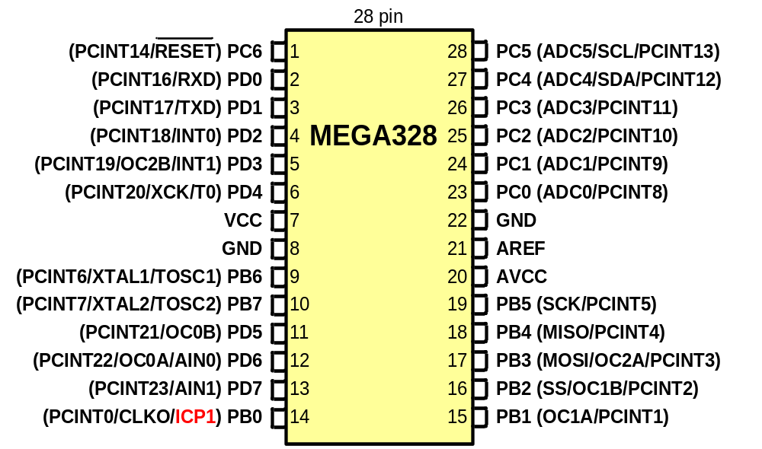
Capturing

Slide 21
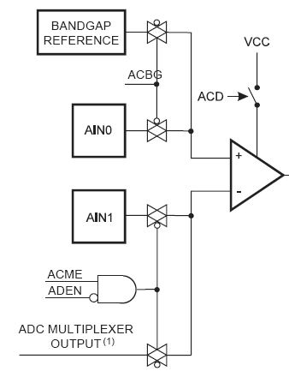
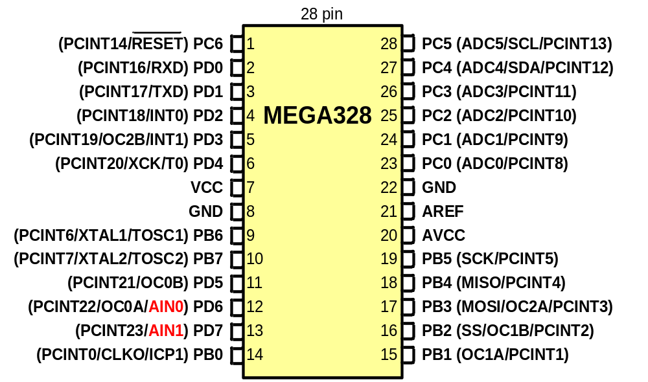
Comparator
Copied from ATmega328 datasheet page 239

Slide 22

ICNC1: Input Capture Noise Canceller
0:disabled
1:Enabled (captures after 4 successive equal valued samples)
ICSES1: Input Capture Edge Select
0: Falling edge
1: Rising edge
ACIC: Analog Comparator Input Capture Enable
0: ICP1 provides the capture signal
1: analog comparator is connected to the capturer

Slide 23
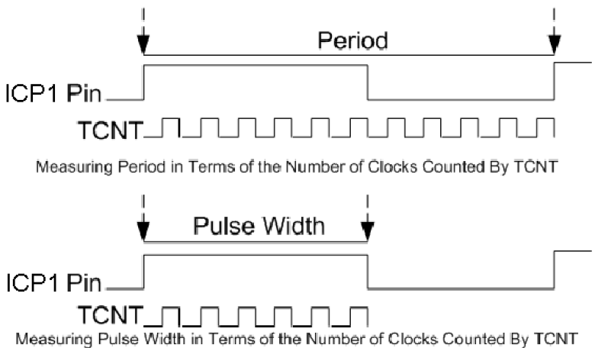
Measuring duty cycle and period

Slide 24
Example: Measuring the frequency of a wave which is between 1 µs and 250 µs.
#include <avr/io.h>
int main ( )
{
unsigned char t1;
DDRD = 0xFF; //Port D as output
PORTB |= (1<<0);
TCCR1A = 0; //Timer Mode = Normal
TCCR1B = 0x42; //rising edge, prescaler = 8, no noise canc.
while ((TIFR1&(1<<ICF1)) == 0);
t1 = ICR1L;
TIFR1 = (1<<ICF1); //clear ICF1 flag
TCCR1B = 0x02; //falling edge
while ((TIFR1&(1<<ICF1)) == 0);
PORTD = ICR1L - t1; //pulse width = falling - rising
TIFR1 = (1<<ICF1); //clear ICF1 flag
while (1); //wait forever
return 0;
}

