Slide 1
DC motor and PWM

Slide 2
Topics
Making Robots with Motors
DC motor
  Unidirectional control
  Bidirectional control
PWM modes
  Wave generating using Fast PWM
  Wave generating using Phase correct PWM

Slide 3
Motors
Feature | DC Motor | Servo Motor | Stepper Motor | Brushless DC Motor (BLDC)
Control | Voltage & H-bridge for direction | PWM signal for position | Sequence of pulses for steps | Electronic controller for phase shifting
Complexity of Control | Low | Medium | High | High
Speed Control | Easy (using PWM) | Limited (fixed positions) | Precise (controlled steps) | Very precise (but complex)
Position Control | Not inherent | High precision | High precision | High precision
Torque | Good at low speeds | Limited, varies with size | High at low speeds | High and efficient across speeds
Efficiency | Moderate | Moderate | Moderate | High
Cost | Low | Medium | Medium | High
Common Uses | Toys, small fans | Robotics, RC vehicles | CNC machines, 3D printers | Drones, Electric vehicles
Power Supply | Direct voltage | Controlled PWM | Controlled sequence voltage | Controlled three-phase voltage
Rotation | Continuous | Limited (0-180° typically) | Step-by-step | Continuous

Slide 4

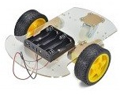

Some robots with 2 DC motors

Slide 5
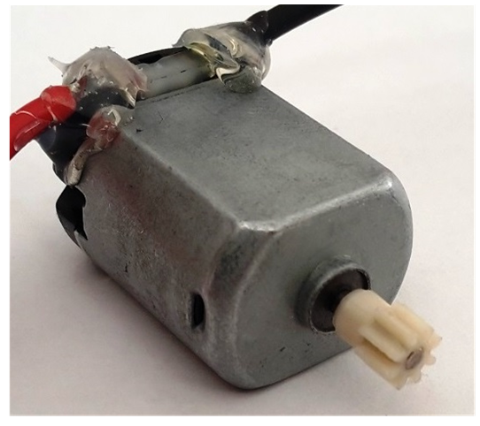

DC motor

Slide 6

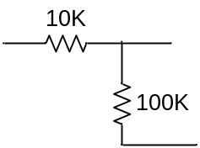
Unidirectional control
+12V
AVR
Analog Ground
M
VCC
Analog
Power
GND
TIP120
+5^{V}
Digital Ground

Slide 7
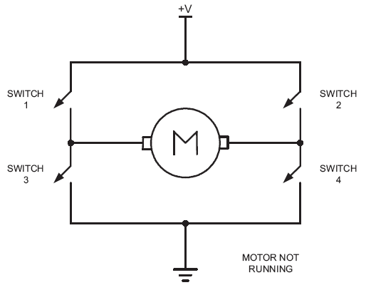
Bidirectional control

Slide 8
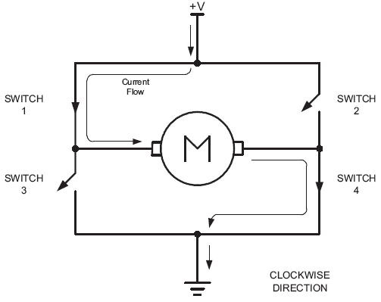
Bidirectional (clock wise)

Slide 9
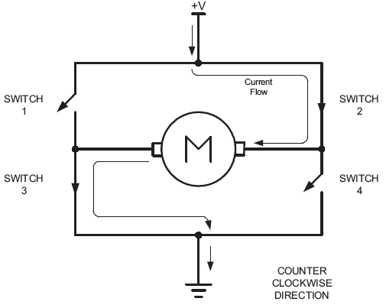
Bidirectional (counter clockwise)

Slide 10
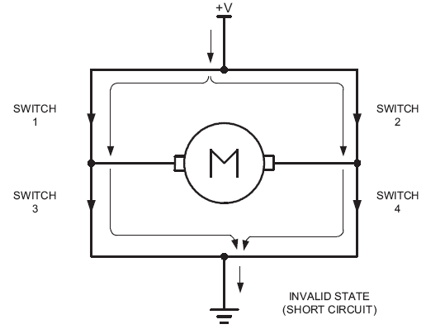
Bidirectional

Slide 11
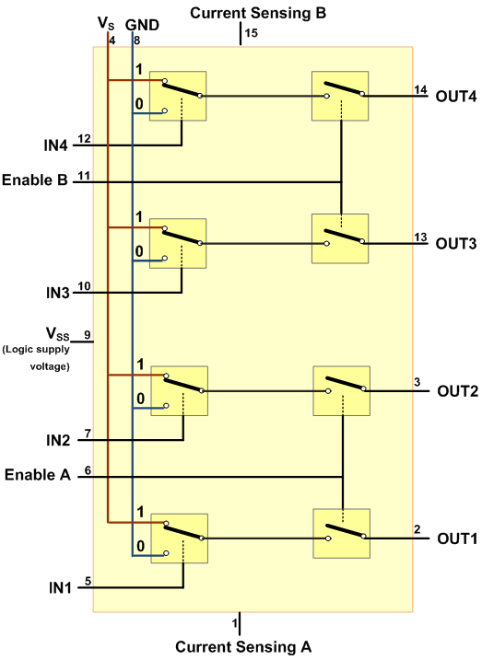
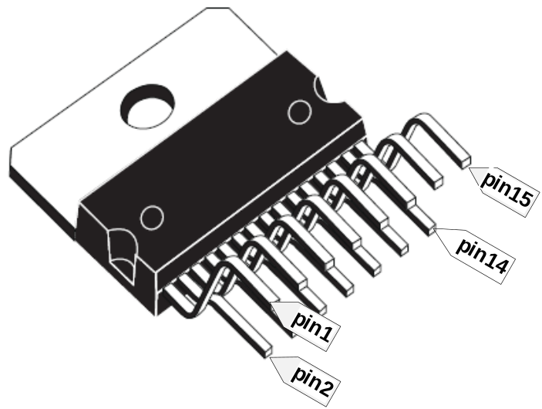
L298

Slide 12
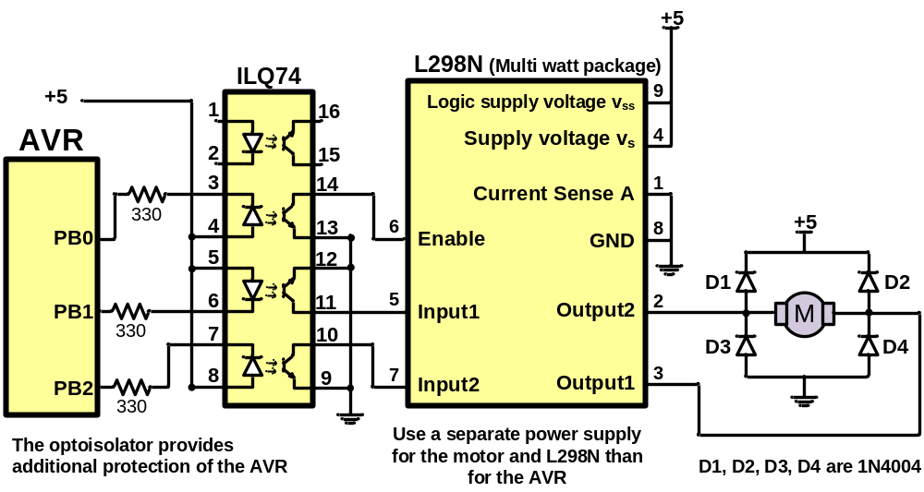
Using L298N

Slide 13
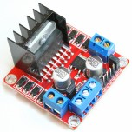
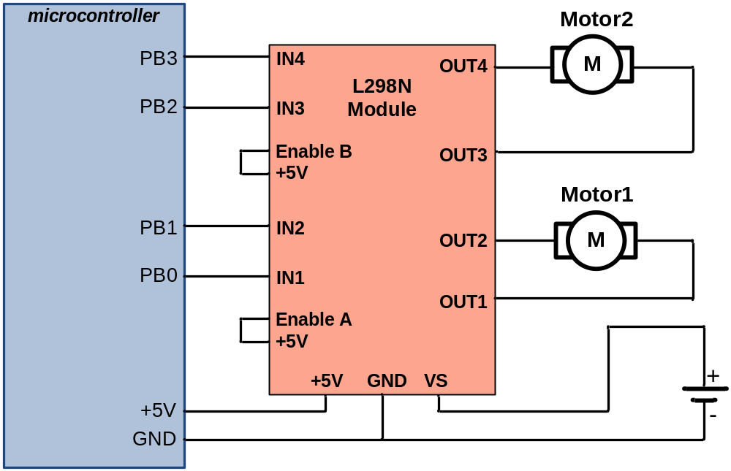
L298 module

Slide 14
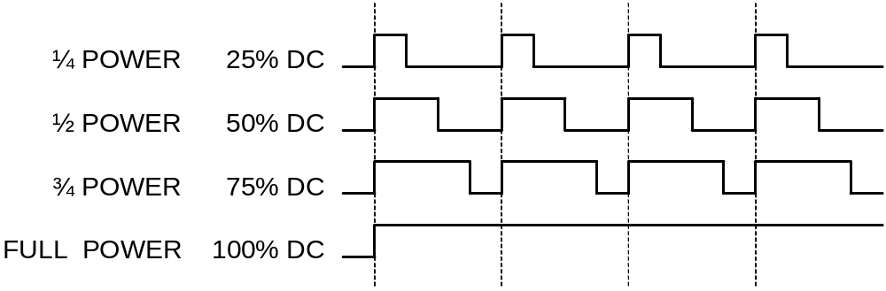
PWM and Duty Cycle

Slide 15
Timer0 Review
TCCR0A
TCCR0B
OCR0A
TCNT0
OCR0B
TOV0
=
=
OCF0A
OCF0B

Slide 16
Timer Mode (WGM)
WGM02 WGM01 WGM00 Comment
0 0 0 Normal
0 0 1 Phase correct PWM
0 1 0 CTC (Clear Timer on Compare Match)
0 1 1 Fast PWM
1 0 0 Reserved
1 0 1 Phase correct PWM
1 1 0 Reserved
1 1 1 Fast PWM

Slide 17
Fast PWM mode
Similar to Normal mode but OCR0x are buffered.
0
TCNT0
TOV0:
1
0xFF
TOV
TOV
TOV
0
time
TCNT0
FF
TOV0
=
OCF0x
FE
OCR0x
2
1
TOV0
0
TOV0 = 1
OCR0x-BUF

Slide 18
Phase Correct PWM mode
Goes up and down like a yo-yo
When TCNT becomes zero, the TOV0 flag sets.
0
TCNT0
TOV0:
1
0xFF
0
TOV
time
FF
TCNT0
FE
TOV0
=
OCF0x
2
OCR0x
TCNT0=0xFF
1
0
TOV0 = 1
OCR0x-BUF

Slide 19
Compare Output Mode (COM)
COM0x1 | COM0x0 | Description
0 | 0 | Normal port operation, OC0 disconnected
0 | 1 | Toggle OC0 on compare match
1 | 0 | Clear OC0 on compare match
1 | 1 | Set OC0 on compare match
CTC or Normal (Non PWM)
COM0x1 | COM0x0 | Description
0 | 0 | Normal port operation, OC0 disconnected
0 | 1 | Reserved
1 | 0 | Clear OC0 on compare match, set OC0 at TOP.
1 | 1 | Set OC0 on compare match, clear OC0 at TOP.
Fast PWM
COM0x1 | COM0x0 | Description
0 | 0 | Normal port operation, OC0 disconnected
0 | 1 | Reserved
1 | 0 | Clear OC0 on compare match when up-counting. Set OC0 on compare match when down-counting.
1 | 1 | Set OC0 on compare match when up-counting. Clear OC0 on compare match when down-counting.
Phase Correct PWM

Slide 20
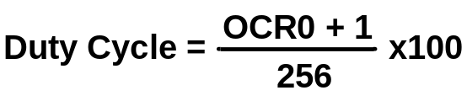
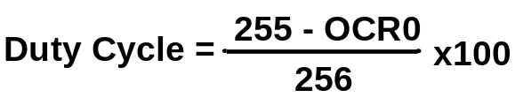
Fast PWM Calculations
Fast PWM
Duty cycle = changeable (0% to 100%)
Frequency = selectable between limited choices
TCNT0
TCNT0
0xFF
0xFF
OCR0x
OCR0x
0
0
OC0x
OC0x
COM=2
COM=2
COM=2
OC0x
OC0x
COM=3
COM=3
COM=3
f_{clk}
F_{OC0}=
N(256)

Slide 21
Assuming XTAL = 16 MHz, make the following pulse duty cycle = 75% and frequency = 62.500KHz
f_{clk}
16MHz
16MHz
F_{OC0}=
62.500KHz=
N =
=1
N(256)
N(256)
62.500K*256
75/100 = (OCR0x+1)/256 ➔ OCR0x+1 = 192 ➔ OCR0x = 191
DDRD |= (1<<6); //PD6 as output
OCR0A = 191;
TCCR0A = (1<<COM0A1)|(1<<WGM01)|(1<<WGM00);
TCCR0B = 0x01; //N = 1 (no prescaler)
SBI DDRD, 6
LDI R20,191
OUT OCR0A,R20
LDI R20, (1<<COM0A1)|(1<<WGM01)|(1<<WGM00)
OUT TCCR0A,R20
LDI R20,0x01
OUT TCCR0B,R20

Slide 22
Compare Output Mode (COM)
COM0x1 | COM0x0 | Description
0 | 0 | Normal port operation, OC0 disconnected
0 | 1 | Toggle OC0 on compare match
1 | 0 | Clear OC0 on compare match
1 | 1 | Set OC0 on compare match
CTC or Normal (Non PWM)
COM0x1 | COM0x0 | Description
0 | 0 | Normal port operation, OC0 disconnected
0 | 1 | Reserved
1 | 0 | Clear OC0 on compare match, set OC0 at TOP.
1 | 1 | Set OC0 on compare match, clear OC0 at TOP.
Fast PWM
COM0x1 | COM0x0 | Description
0 | 0 | Normal port operation, OC0 disconnected
0 | 1 | Reserved
1 | 0 | Clear OC0 on compare match when up-counting. Set OC0 on compare match when down-counting.
1 | 1 | Set OC0 on compare match when up-counting. Clear OC0 on compare match when down-counting.
Phase Correct PWM

Slide 23

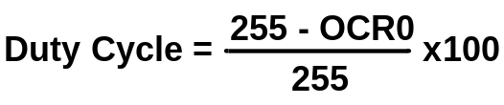
Phase Correct PWM Calculations
Phase Correct PWM
Duty cycle = changeable (0% to 100%)
Frequency = selectable between limited choices
TCNT0
TCNT0
0xFF
0xFF
OCR0x
OCR0x
0
0
OC0x
OC0x
COM=2
OC0x
OC0x
COM=3
f_{clk}
F_{OC0}=
N(510)

Slide 24
Assuming XTAL = 16 MHz, make the following wave: duty cycle = 75% and frequency = 31.372KHz
f_{clk}
16MHz
16MHz
F_{OC0}=
31.372KHz=
N =
=1
N(510)
N(510)
31.372K*510
75/100 = OCR0x / 255 ➔ OCR0x = 191
DDRD |= (1<<6); //PD6 as output
OCR0A = 191;
TCCR0A = (1<<COM0A1)|(1<<WGM00);
TCCR0B = 0x01; //N = 1 (no prescaler)

Slide 25
Unidirectional Speed Control
+12V
AVR
AVR
Analog Ground
M
VCC
VCC
Analog
Power
GND
GND
OC0A
OC0A
TIP120
+5^{V}
Digital Ground

Slide 26
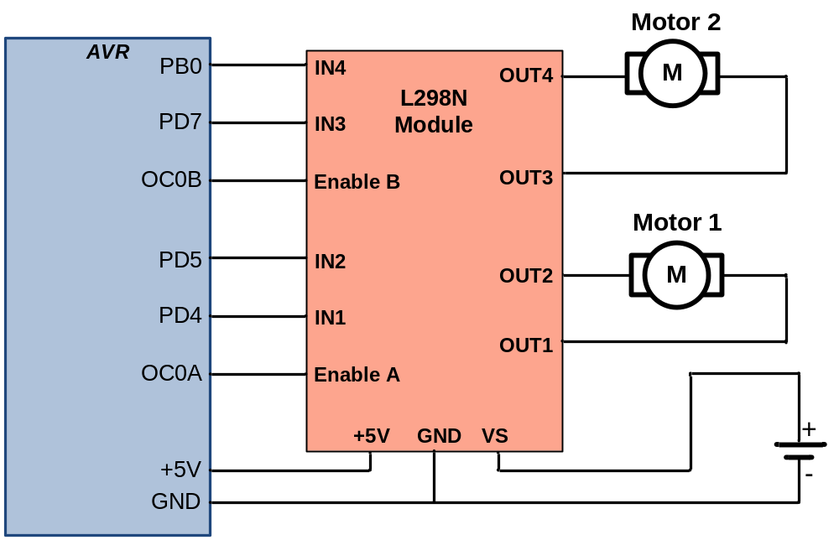
Bidirectional Speed Control

