Slide 1
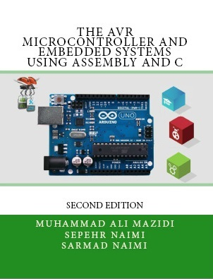

I/O Ports in AVR
Sepehr Naimi
www.NicerLand.com

Slide 2
Topics
AVR pin out
The structure of I/O pins
I/O programming
Bit manipulating

Slide 3
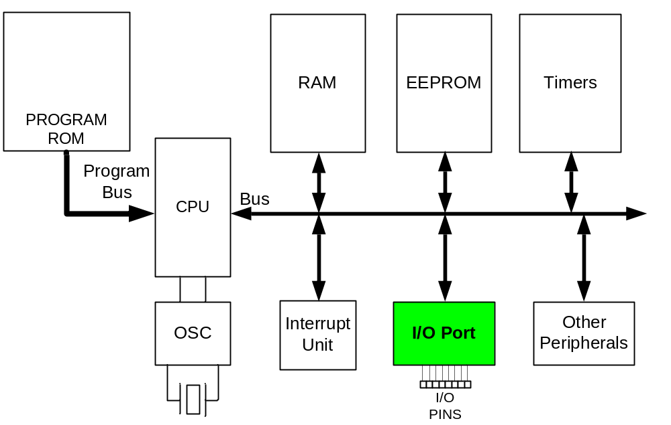
I/O unit in AVR

Slide 4
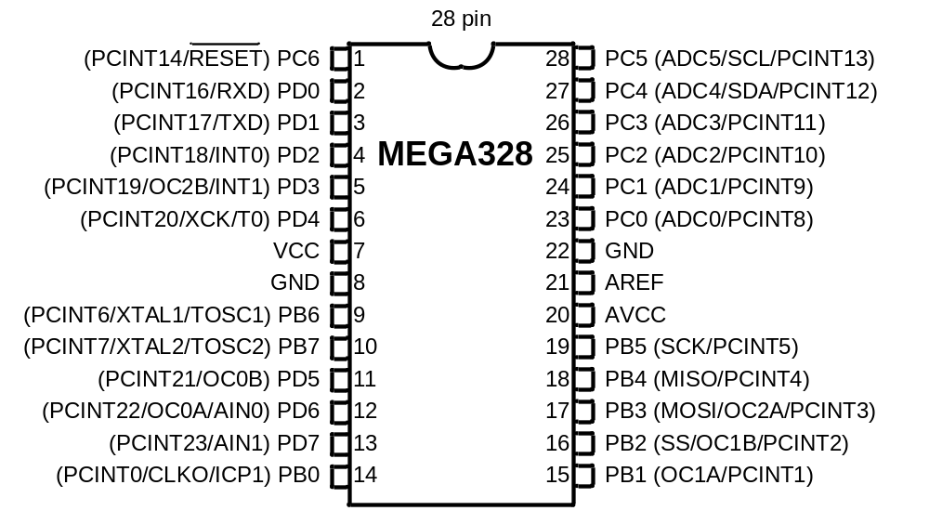

ATmega328 pinout
+5 ^{V}
Vital Pins:
  Power
    VCC
    Ground
  Crystal
    XTAL1
    XTAL2
  Reset
I/O pins
  PORTB, PORTC, and PORTD
Internal ADC pins
  AREF, AVCC, ADCn
+5 ^{V}
+5 ^{V}

Slide 5
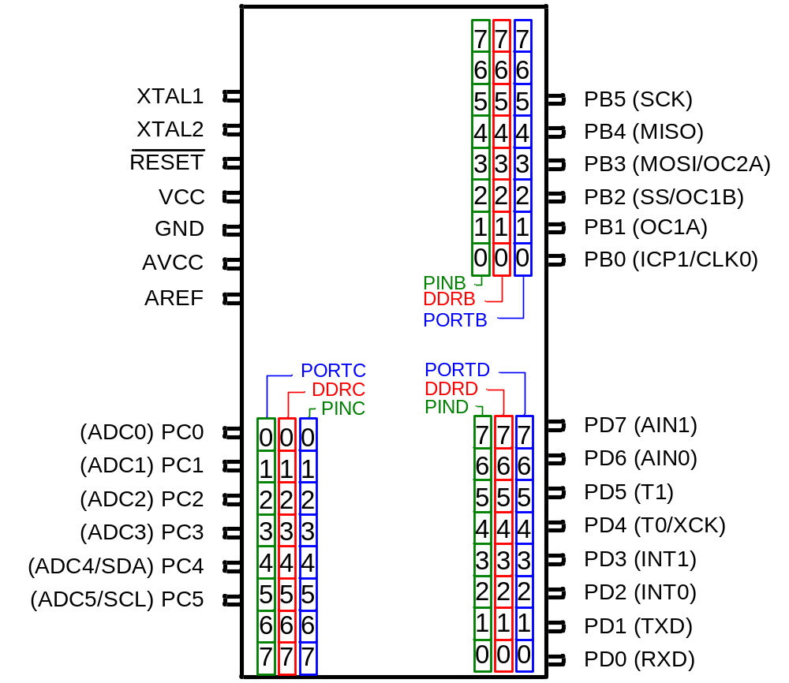
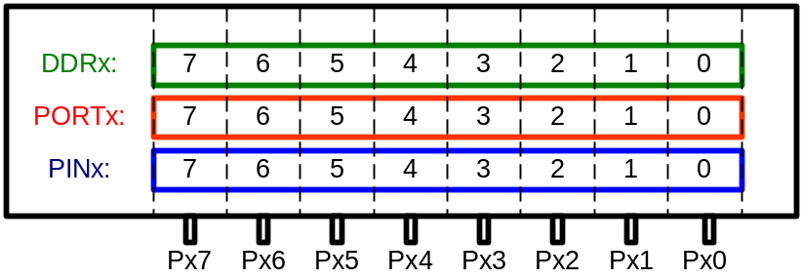
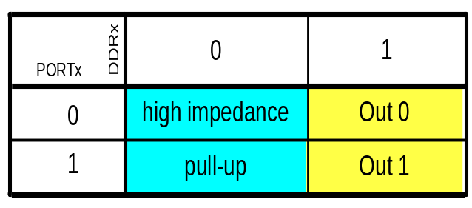
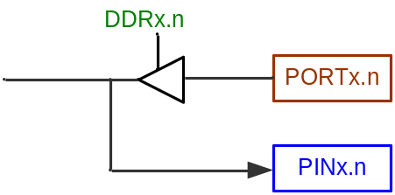
The structure of I/O pins

Slide 6
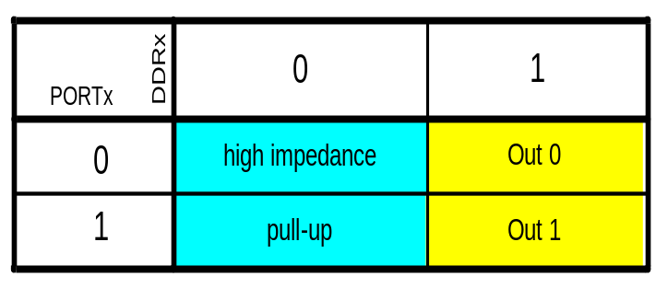
Example 1
Write a program that makes all the pins of PORTB one.
DDRB:
1 1 1 1 1 1 1 1
PORTB:
1 1 1 1 1 1 1 1
LDI R20,0xFF ;R20 = 11111111 (binary)
OUT PORTB,R20 ;PORTB = R20
OUT DDRB,R20 ;DDRB = R20

Slide 7
Example 2
The following code will toggle all 8 bits of Port B forever with some time delay between “on” and “off” states:
LDI R16,0xFF ;R16 = 0xFF = 0b11111111
OUT DDRB,R16 ;make Port B an output port (1111 1111)
L1: LDI R16,0x55 ;R16 = 0x55 = 0b01010101
OUT PORTB,R16 ;put 0x55 on port B pins
CALL DELAY
LDI R16,0xAA ;R16 = 0xAA = 0b10101010
OUT PORTB,R16 ;put 0xAA on port B pins
CALL DELAY
RJMP L1

Slide 8

Example 3
A 7-segment is connected to PORTD. Display 1 on the 7-segment.
DDRD:
1 1 1 1 1 1 1 1
ATmega328
PORTD:
0 0 0 0 0 1 1 0
0
LDI R20,0x06 ;R20 = 00000110 (binary)
OUT PORTD,R20 ;PORTD = R20
LDI R20,0xFF ;R20 = 11111111 (binary)
OUT DDRD,R20 ;DDRD = R20
L1: RJMP L1
8
5
6
1
PORTD
4
2
3

Slide 9

Example 4
A 7-segment is connected to PORTD. Display 3 on the 7-segment.
DDRD:
1 1 1 1 1 1 1 1
ATmega328
PORTD:
0 1 0 0 1 1 1 1
0
LDI R20,0x4F ;R20 = 01001111 (binary)
OUT PORTD,R20 ;PORTD = R20
LDI R20,0xFF ;R20 = 11111111 (binary)
OUT DDRD,R20 ;DDRD = R20
L1: RJMP L1
8
5
6
1
PORTD
4
2
3

Slide 10
Example 5: Input
The following code gets the data present at the pins of port C and sends it to port B indefinitely, after adding the value 5 to it:
LDI R16,0x00 ;R16 = 00000000 (binary)
OUT DDRC,R16 ;make Port C an input port
LDI R16,0xFF ;R16 = 11111111 (binary)
OUT DDRB,R16 ;make Port B an output port(1 for Out)
L2: IN R16,PINC ;read data from Port C and put in R16
LDI R17,5
ADD R16,R17 ;add 5 to it
OUT PORTB,R16 ;send it to Port B
RJMP L2 ;jump L2

Slide 11
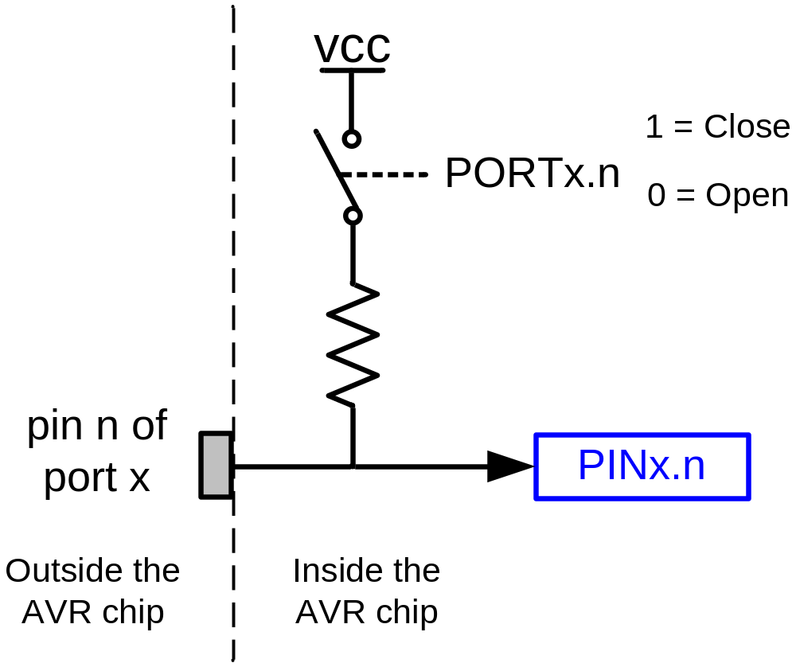
Pull-up resistor

Slide 12
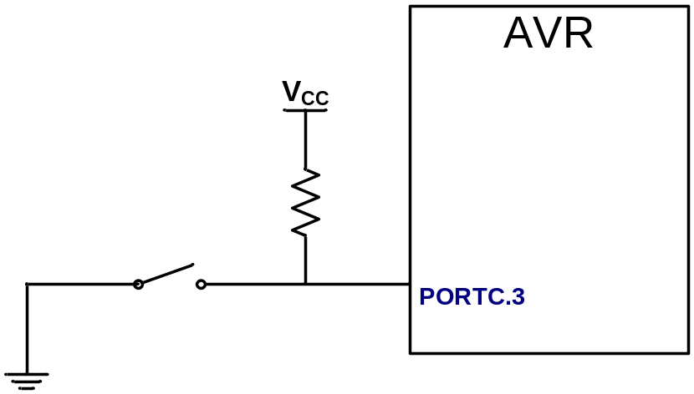
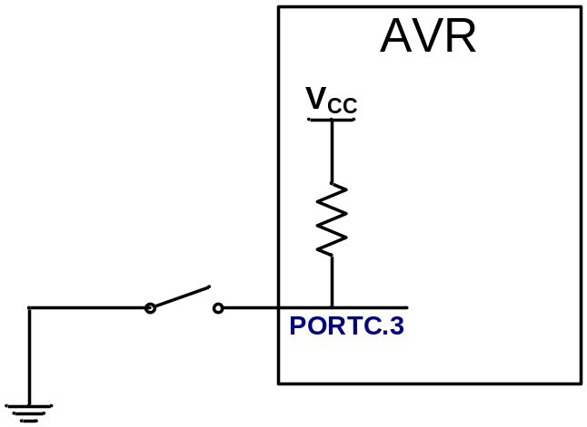
Example

Slide 13
I/O bit manipulation programming

Slide 14
SBI and CBI instructions
SBI (Set Bit in IO register)
  SBI ioReg, bit ;ioReg.bit = 1
  Examples:
    SBI PORTD,0 ;PORTD.0 = 1
    SBI DDRC,5 ;DDRC.5 = 1
CBI (Clear Bit in IO register)
  CBI ioReg, bit ;ioReg.bit = 0
  Examples:
    CBI PORTD,0 ;PORTD.0 = 0
    CBI DDRC,5 ;DDRC.5 = 0

Slide 15
Example
Write a program that toggles PORTB.4 continuously.
SBI DDRB,4
L1: SBI PORTB,4
CBI PORTB,4
RJMP L1

Slide 16
Example
An LED is connected to each pin of Port D. Write a program to turn on each LED from pin D0 to pin D7. Call a delay module before turning on the next LED.
LDI R20, 0xFF
OUT DDRD, R20 ;make PORTD an output port
SBI PORTD,0 ;set bit PD0
CALL DELAY ;delay before next one
SBI PORTD,1 ;turn on PD1
CALL DELAY ;delay before next one
SBI PORTD,2 ;turn on PD2
CALL DELAY
SBI PORTD,3
CALL DELAY
SBI PORTD,4
CALL DELAY
SBI PORTD,5
CALL DELAY
SBI PORTD,6
CALL DELAY
SBI PORTD,7
CALL DELAY

Slide 17
SBIC and SBIS
SBIC (Skip if Bit in IO register Cleared)
  SBIC ioReg, bit ; if (ioReg.bit = 0) skip next instruction
  Example:
    SBIC PORTD,0 ;skip next instruction if PORTD.0=0
    INC R20
    LDI R19,0x23
SBIS (Skip if Bit in IO register Set)
  SBIS ioReg, bit ; if (ioReg.bit = 1) skip next instruction
  Example:
    SBIS PORTD,0 ;skip next instruction if PORTD.0=1
    INC R20
    LDI R19,0x23

Slide 18
Example
Write a program to perform the following:
(a) Keep monitoring the PB2 bit until it becomes HIGH;
(b) When PB2 becomes HIGH, write value $45 to Port C, and also send a HIGH-to-LOW pulse to PD3.
CBI DDRB, 2 ;make PB2 an input
SBI PORTB,2
LDI R16, 0xFF
OUT DDRC, R16 ;make Port C an output port
SBI DDRD, 3 ;make PD3 an output
AGAIN: SBIS PINB, 2 ;Skip if Bit PB2 is HIGH
RJMP AGAIN ;keep checking if LOW
LDI R16, 0x45
OUT PORTC, R16 ;write 0x45 to port C
SBI PORTD, 3 ;set bit PD3 (H-to-L)
CBI PORTD, 3 ;clear bit PD3
HERE: RJMP HERE

Slide 19
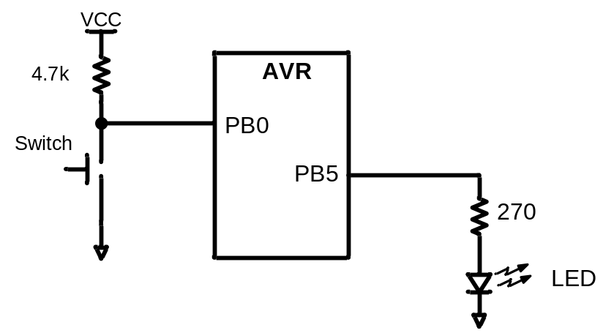
Example
A switch is connected to pin PB0 and an LED to pin PB5. Write a program to get the status of SW and send it to the LED.
CBI DDRB,0 ;make PB0 an input
SBI DDRB,5 ;make PB5 an output
AGAIN: SBIC PINB,0 ;skip next if PB0 is clear
RJMP OVER ;(JMP is OK too)
CBI PORTB,5
RJMP AGAIN ;we can use JMP too
OVER: SBI PORTB,5
RJMP AGAIN ;we can use JMP too

Slide 20
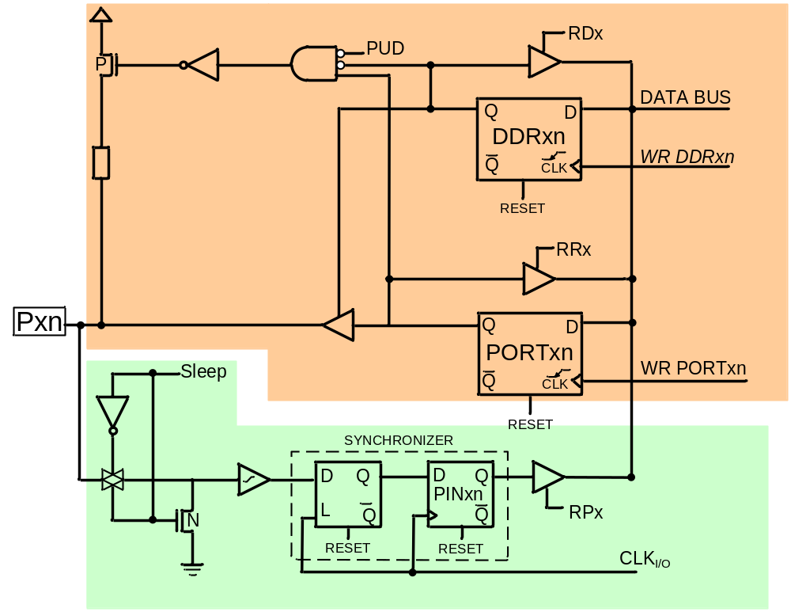
The structure of I/O pins
DDRx.n
OUTPUT
PORTx.n
PINx.n
INPUT

Slide 21
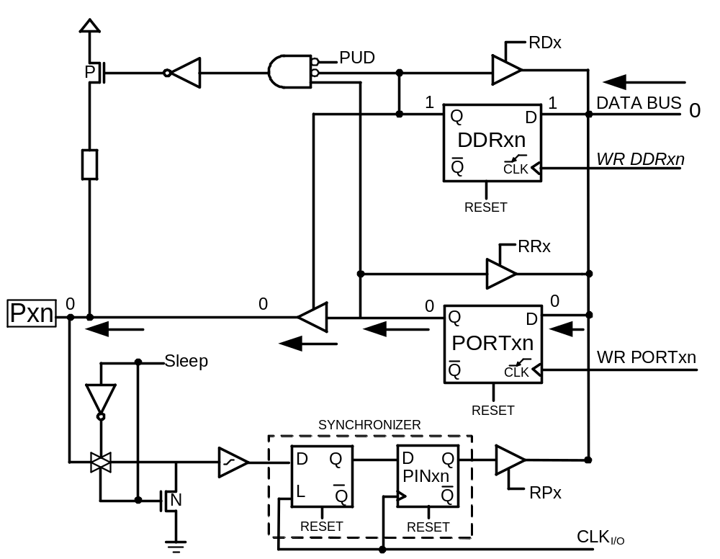
Out 0

Slide 22
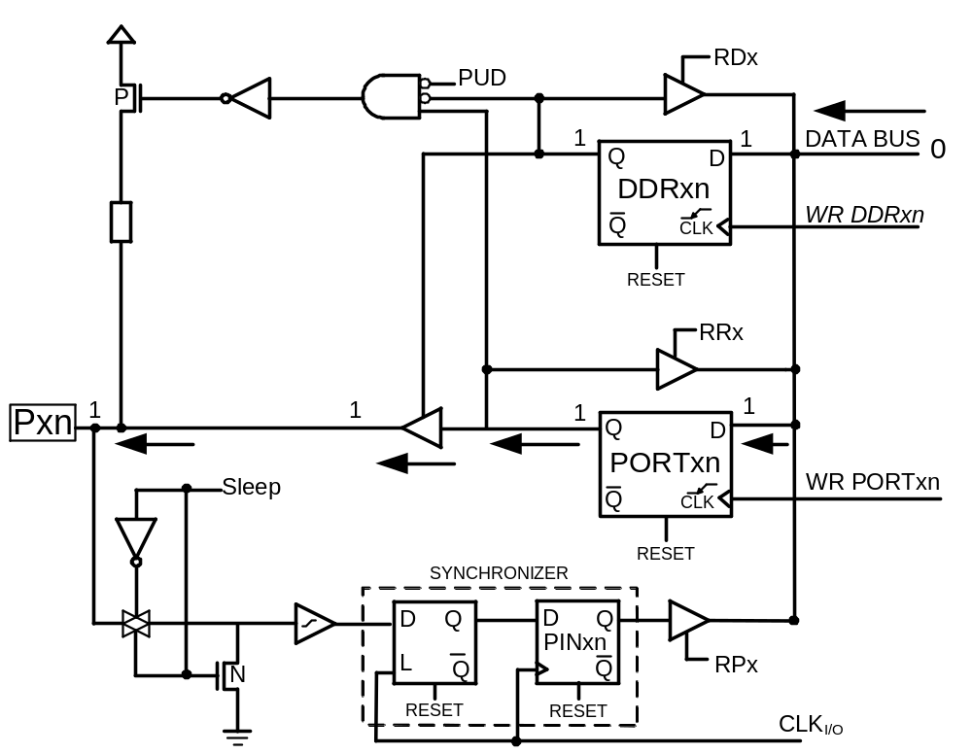
Out 1

Slide 23
The structure of I/O pins

Slide 24
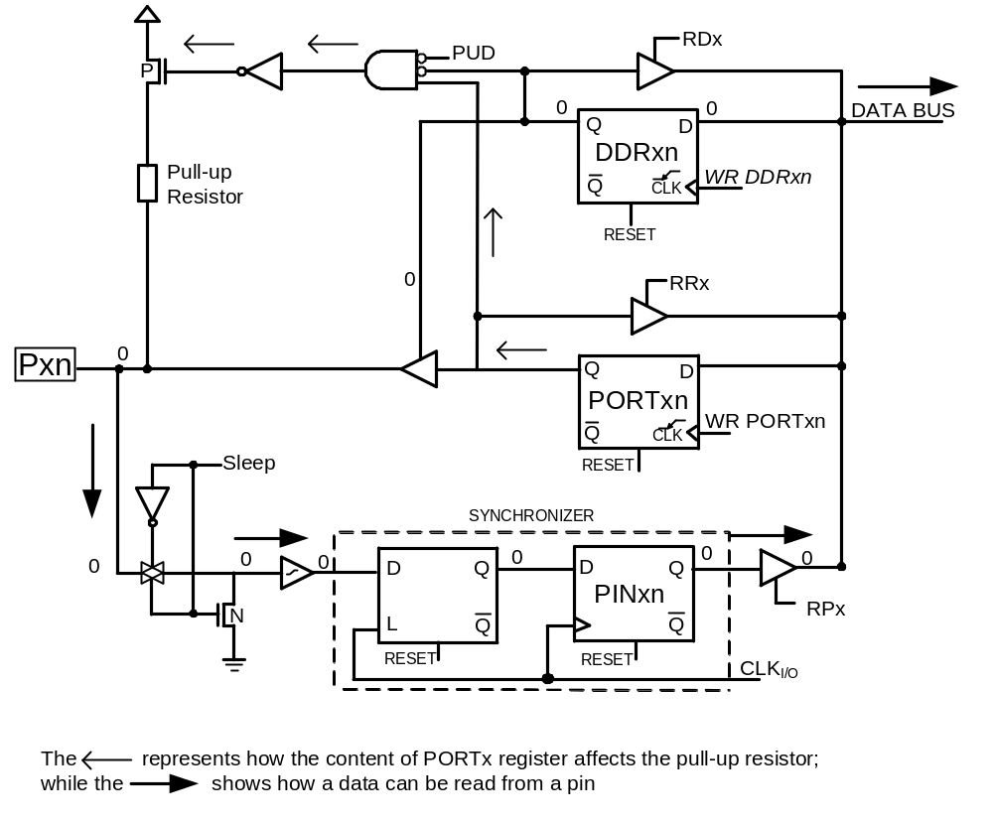
Input (Tri-state vs. pull up)

