Slide 1
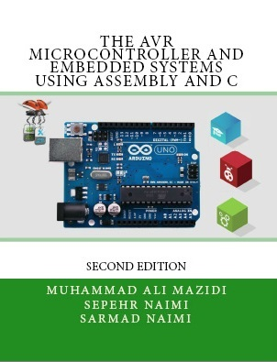

Timer/counter
Sepehr Naimi
www.NicerLand.com

Slide 2
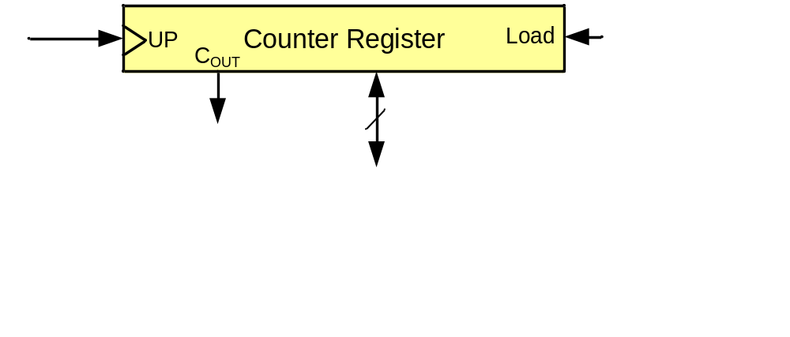
A counter register

Slide 3
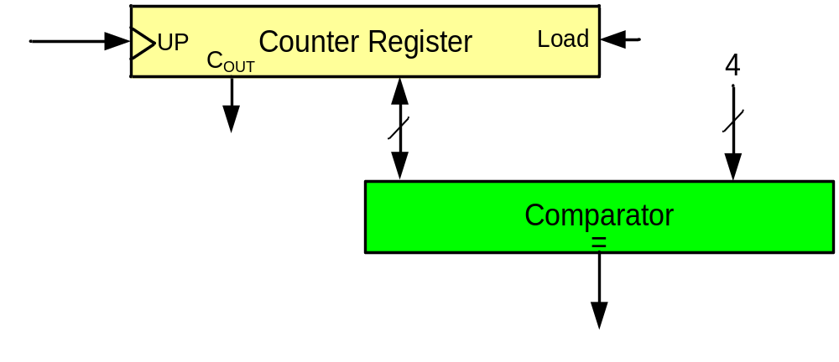
A simple design (counting people)
First design
Sensor

Slide 4
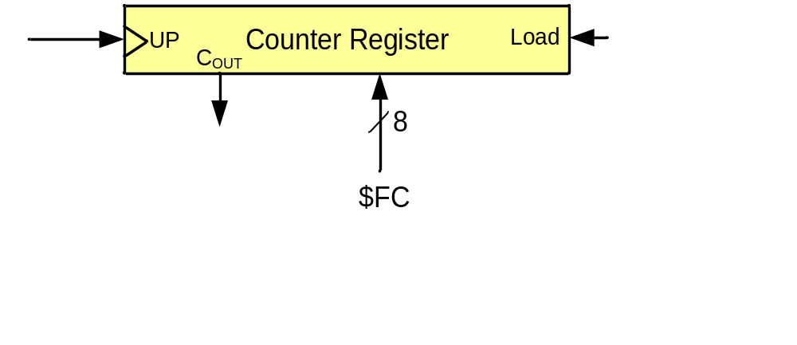
A simple design (counting people)
Second design
Sensor

Slide 5
A simple design (making delay)

Slide 6
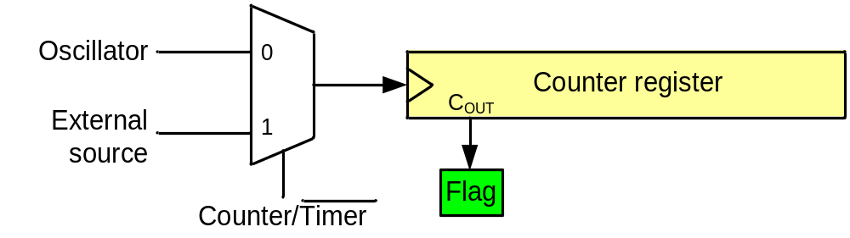
A generic timer/counter
Delay generating
Counting
Wave-form generating
Capturing

Slide 7
Timers in AVR
1 to 6 timers
  3 timers in ATmega328
8-bit and 16-bit timers
  two 8-bit timers and one 16-bit timer in ATmega328

Slide 8
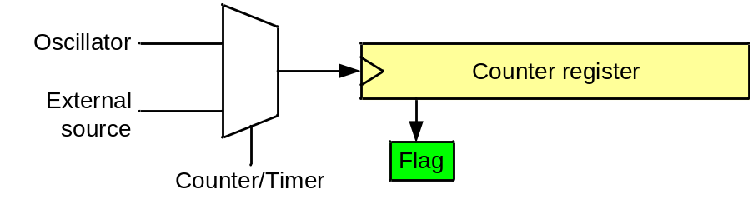
Timer in AVR
TCNTn (Timer/Counter register)
TOVn (Timer Overflow flag)
TCCRn (Timer Counter control register)
OCRn (output compare register)
OCFn (output compare match flag)
TCCRn
TCNTn
OCRn
TOVn
=
Comment:
All of the timer registers are byte-addressable registers
OCFn

Slide 9
Timer 0 (an 8-bit timer)

Slide 10
Timer 0
TCCR0A
TCCR0B
OCR0A
TCNT0
OCR0B
TOV0
=
=
OCF0A
OCF0B

Slide 11
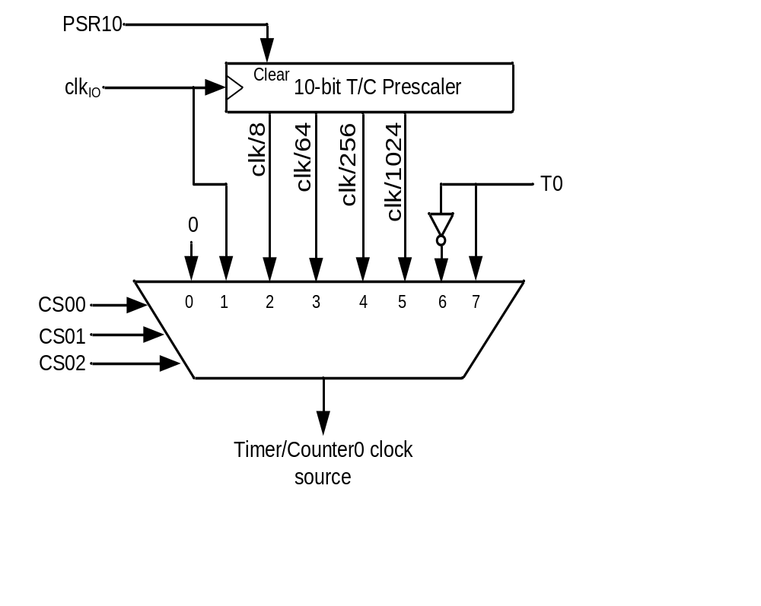
Clock Selector (CS)
Timer Mode (WGM)
CS02 CS01 CS00 Comment
0 0 0 No clock source (Timer/Counter stopped)
0 0 1 clk (No Prescaling)
0 1 0 clk / 8
0 1 1 clk / 64
1 0 0 clk / 256
1 0 1 clk / 1024
1 1 0 External clock source on T0 pin. Clock on falling edge
1 1 1 External clock source on T0 pin. Clock on rising edge
WGM02 WGM01 WGM00 Comment
0 0 0 Normal
0 0 1 Phase correct PWM
0 1 0 CTC (Clear Timer on Compare Match)
0 1 1 Fast PWM
1 0 0 Reserved
1 0 1 Phase correct PWM
1 1 0 Reserved
1 1 1 Fast PWM

Slide 12
Normal mode
TCNT0
0xFF
TOV
TOV
TOV
0
time
FF
0
FE
TOV0:
1
2
1
0
TOV0 = 1

Slide 13
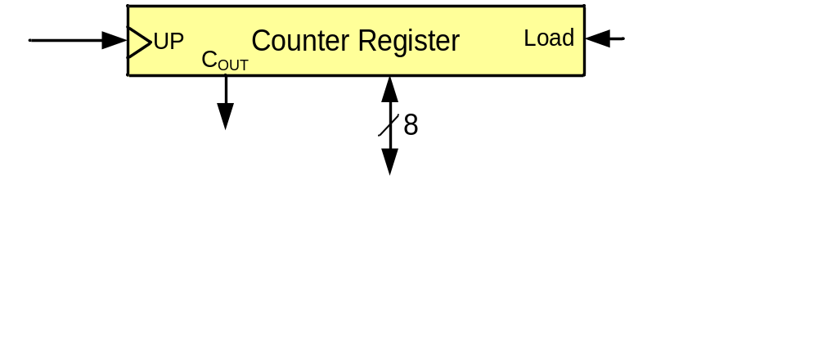
Example 1: Write a program that waits 14 machine cycles in Normal mode.
14 = $0E
$100
-$0E
$F2
$F2
0 0
TCCR0A = 0x00;
TCCR0B = 0x03;
0
0 0 1
Timer Mode (WGM)
WGM02 WGM01 WGM00 Comment
0 0 0 Normal
0 0 1 Phase correct PWM
0 1 0 CTC
0 1 1 Fast PWM
1 0 0 Reserved
1 0 1 Phase correct PWM
1 1 0 Reserved
1 1 1 Fast PWM

Slide 14
Example 1: Write a program that waits 14 machine cycles in Normal mode.
$100
-$0E
$F2
LDI R16,(1<<5) ;R16=0x20
SBI DDRB,5 ;PB5 as an output
LDI R17,0
OUT PORTB,R17
BEGIN: LDI R20,0xF2
OUT TCNT0,R20 ;load timer0
LDI R20,0x0
OUT TCCR0A,R20
LDI R20,0x01
OUT TCCR0B,R20 ;Normal mode, inter. clk
AGAIN: SBIS TIFR0,TOV0 ;if TOV0 is set skip next
RJMP AGAIN
LDI R20,0x0
OUT TCCR0B,R20 ;stop Timer0
LDI R20,(1<<TOV0) ;R20 = 0x01
OUT TIFR0,R20 ;clear TOV0 flag
EOR R17,R16 ;toggle D5 of R17
OUT PORTB,R17 ;toggle PB5
RJMP BEGIN
DDRB = 1<<5;
PORTB &= ~(1<<5); //PB5=0
while (1)
{
TCNT0 = 0xF2;
TCCR0A = 0x00;
TCCR0B = 0x01;
while((TIFR0&(1<<TOV0))==0)
{}
TCCR0B = 0;
TIFR0 = (1<<TOV0);
PORTB ^= (1<<5);
}
Question: How to calculate the delay generated
by the timer?
Answer:
1) Calculate how much a machine clock lasts.
T= 1/f
2) Calculate how many machine clocks it waits.
3) Delay = T * number of machine cycles

Slide 15
In example 1 calculate the delay.
XTAL = 10 MHz.
Solution 1 (inaccurate):
1) Calculating T:
T = 1/f = 1/10M = 0.1µs
Calculating num of machine cycles:
$100
-$F2
$0E = 14
Calculating delay
14 * 0.1µs = 1.4 0µs
LDI R16,0x20
SBI DDRB,5 ;PB5 as an output
LDI R17,0
OUT PORTB,R17
BEGIN: LDI R20,0xF2
OUT TCNT0,R20 ;load timer0
LDI R20,0x0
OUT TCCR0A,R20
LDI R20,0x01
OUT TCCR0B,R20 ;Normal mode, inter. clk
AGAIN: SBIS TIFR0,TOV0 ;if TOV0 is set skip next
RJMP AGAIN
LDI R20,0x0
OUT TCCR0B,R20 ;stop Timer0
LDI R20,(1<<TOV0) ;R20 = 0x01
OUT TIFR0,R20 ;clear TOV0 flag
EOR R17,R16 ;toggle D5 of R17
OUT PORTB,R17 ;toggle PB5
RJMP BEGIN

Slide 16


Accurate calculating
Other than timer, executing the instructions consumes time; so if we want to calculate the accurate delay a program causes we should add the delay caused by instructions to the delay caused by the timer
LDI R16,0x20
SBI DDRB,5
LDI R17,0
OUT PORTB,R17
BEGIN: LDI R20,0xF2 1
OUT TCNT0,R20 1
LDI R20,0x00 1
OUT TCCR0A,R20 1
LDI R20,0x01 1
OUT TCCR0B,R20 1
AGAIN: SBIS TIFR0,TOV0 1 / 2
RJMP AGAIN 2
LDI R20,0x0 1
OUT TCCR0B,R20 1
LDI R20,0x01 1
OUT TIFR0,R20 1
EOR R17,R16 1
OUT PORTB,R17 1
RJMP BEGIN 2
18
Delay caused by timer = 14 * 0.1µs = 1.4 µs Delay caused by instructions = 18 * 0.1µs = 1.8
Total delay = 3.2 µs ➔ wave period = 2*3.2 µs = 6.4 µs ➔ wave frequency = 156.25 KHz

Slide 17
Finding values to be loaded into the timer
Calculate the period of clock source.
  Period = 1 / Frequency
    E.g. For XTAL = 16 MHz ➔ T = 1/16MHz
Divide the desired time delay by period of clock.
Perform 256 - n, where n is the decimal value we got in Step 2.
Set TCNT0 = 256 - n

Slide 18
Example 2: Assuming that XTAL = 10 MHz, write a program to generate a square wave with a period of 10 ms on pin PORTB.3.
For a square wave with T = 10 µs we must have a time delay of 5 µs. Because XTAL = 10 MHz, the counter counts up every 0.1 µs. This means that we need 5 µs / 0.1 µs = 50 clocks. 256 - 50 = 206.
LDI R16,(1<<5) ;R16=0x20
SBI DDRB,5 ;PB5 as an output
LDI R17,0
OUT PORTB,R17
BEGIN: LDI R20,206
OUT TCNT0,R20 ;load timer0
LDI R20,0x0
OUT TCCR0A,R20
LDI R20,0x01
OUT TCCR0B,R20 ;Normal mode, int. clk
AGAIN: SBIS TIFR0,TOV0 ;if TOV0 set skip next
RJMP AGAIN
LDI R20,0x0
OUT TCCR0B,R20 ;stop Timer0
LDI R20,(1<<TOV0) ;R20 = 0x01
OUT TIFR0,R20 ;clear TOV0 flag
EOR R17,R16 ;toggle D5 of R17
OUT PORTB,R17 ;toggle PB5
RJMP BEGIN
DDRB = 1<<3;
PORTB &= ~ (1<<3);
while (1)
{
TCNT0 = 206;
TCCR0A = 0x00;
TCCR0B = 0x01;
while((TIFR0&0x01) == 0)
{}
TCCR0B = 0;
TIFR0 = 1<<TOV0;
PORTB = PORTB ^ (1<<3);
}

Slide 19
Example 3: Modify TCNT0 in Example 2 to get the largest time delay possible with no prescaler. Find the delay in µs. In your calculation, do not include the overhead due to instructions.
To get the largest delay we make TCNT0 zero. This will count up from 00 to 0xFF and then roll over to zero.
LDI R16,(1<<5) ;R16=0x20
SBI DDRB,5 ;PB5 as an output
LDI R17,0
OUT PORTB,R17
BEGIN: LDI R20,0
OUT TCNT0,R20 ;load timer0
LDI R20,0x0
OUT TCCR0A,R20
LDI R20,0x01
OUT TCCR0B,R20 ;Normal mode, int. clk
AGAIN: SBIS TIFR0,TOV0 ;if TOV0 set skip next
RJMP AGAIN
LDI R20,0x0
OUT TCCR0B,R20 ;stop Timer0
LDI R20,(1<<TOV0) ;R20 = 0x01
OUT TIFR0,R20 ;clear TOV0 flag
EOR R17,R16 ;toggle D5 of R17
OUT PORTB,R17 ;toggle PB5
RJMP BEGIN
DDRB = 1 << 3;
PORTB &= ~(1<<3);
while (1)
{
TCNT0 = 0x00;
TCCR0A = 0x00;
TCCR0B = 0x01;
while((TIFR0&(1<<TOV0))==0){}
TCCR0B = 0;
TIFR0 = 0x01;
PORTB = PORTB^(1<<3);
}
Solution
1) Calculating T:
T = 1/f = 1/10MHz = 0.1µs
2) Calculating delay
256 * 0.1µs = 25.6µs

Slide 20
Generating Large Delays
Using loop
Prescaler
Bigger counters

Slide 21
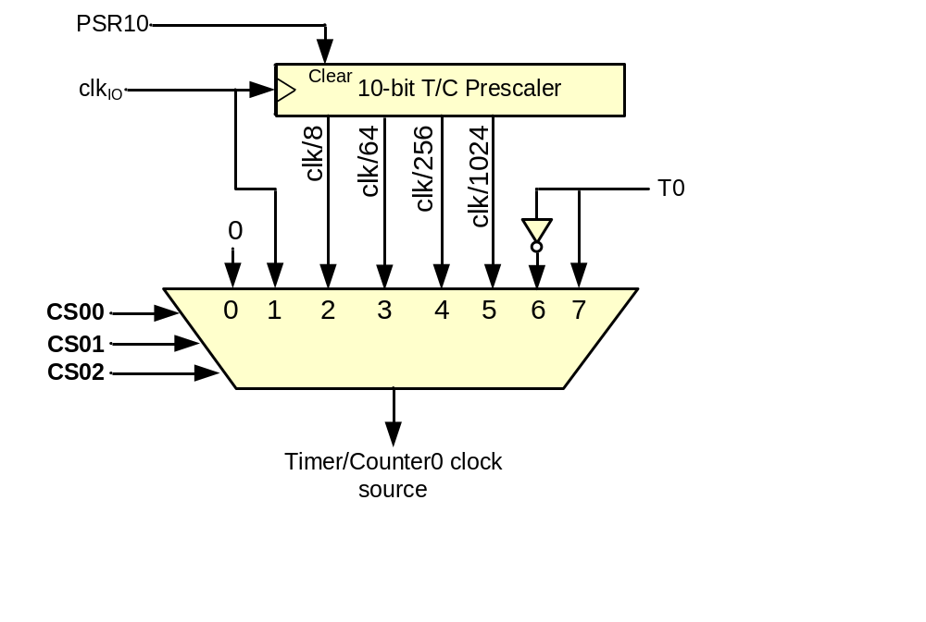
Prescaler and generating a large time delay

Slide 22
CTC (Clear Timer on Compare match) mode
TCNT0
0xFF
OCR0
OCF0
OCF0
OCF0
0
time
OCR0
xx
0
TOV0:
2
0
1
OCF0:
1
0
TOV0 = no change
OCF0 = 1

Slide 23
CTC mode (Cont.)
1 0
0
Timer Mode (WGM)
WGM02 WGM01 WGM00 Comment
0 0 0 Normal
0 0 1 Phase correct PWM
0 1 0 CTC
0 1 1 Fast PWM
1 0 0 Reserved
1 0 1 Phase correct PWM
1 1 0 Reserved
1 1 1 Fast PWM

Slide 24
Rewrite example 2 using CTC
(Assuming XTAL = 10MHz, write a program to generate a square wave with a period of 10 ms.)
Example 4: Rewrite example 2 using CTC
For a square wave with T = 10 µs we must have a time delay of 5 µs. Because XTAL = 10 MHz, the counter counts up every 0.1 µs. This means that we need 5 µs / 0.1 µs = 50 clocks. Therefore, we have OCR0A= 49.
LDI R16,(1<<3) ;R16 = 0x08
SBI DDRB,3 ;PB3 as an output
LDI R17,0
OUT PORTB,R17
LDI R20,49
OUT OCR0A,R20 ;load OCR0A
BEGIN: LDI R20,(1<<WGM01) ;TCCR0A=0x02
OUT TCCR0A,R20 ;CTC mode, int. clk
LDI R20,1 ; TCCR0B = 1
OUT TCCR0B,R20 ; N = 1
AGAIN: SBIS TIFR0,OCF0A ;if OCF0 is set skip next
RJMP AGAIN
LDI R20,0x0
OUT TCCR0B,R20 ;stop Timer0
LDI R20,1<<OCF0A
OUT TIFR0,R20 ;clear OCF0A flag
EOR R17,R16 ;toggle D3 of R17
OUT PORTB,R17 ;toggle PB3
RJMP BEGIN
DDRB |= 1<<3;
while (1)
{
OCR0A = 49;
TCCR0A = (1<<WGM01); //CTC
TCCR0B = 1; //N = 1
while((TIFR0&(1<<OCF0A))==0)
{ }
TCCR0B = 0; //stop timer0
TIFR0 = 1<<OCF0A;
PORTB ^= 1<<3; //toggle PB3
}

Slide 25
Timer2 vs. Timer0
Timer0
Timer2
TCCR0A
TCCR0B
TCCR2A
TCCR2B
OCR0A
TCNT0
OCR0B
OCR2A
TCNT2
OCR2B
TOV0
TOV2
=
=
=
=
OCF0A
OCF0B
OCF2A
OCF2B

Slide 26
The difference between Timer0 and Timer2
Timer0
Timer2
CS02 CS01 CS00 Comment
0 0 0 Timer/Counter stopped
0 0 1 clk (No Prescaling)
0 1 0 clk / 8
0 1 1 clk / 64
1 0 0 clk / 256
1 0 1 clk / 1024
1 1 0 External clock (falling edge)
1 1 1 External clock (rising edge)
CS22 CS21 CS20 Comment
0 0 0 Timer/Counter stopped
0 0 1 clk (No Prescaling)
0 1 0 clk / 8
0 1 1 clk / 32
1 0 0 clk / 64
1 0 1 clk / 128
1 1 0 clk / 256
1 1 1 clk / 1024

Slide 27
Timer 1
TCCR1A
TCCR1B
TCCR1C
OCR1AH OCR1AL
TCNT1H TCNT1L
OCR1BH OCR1BL
TOV1
=
=
OCF1A
OCF1B

Slide 28
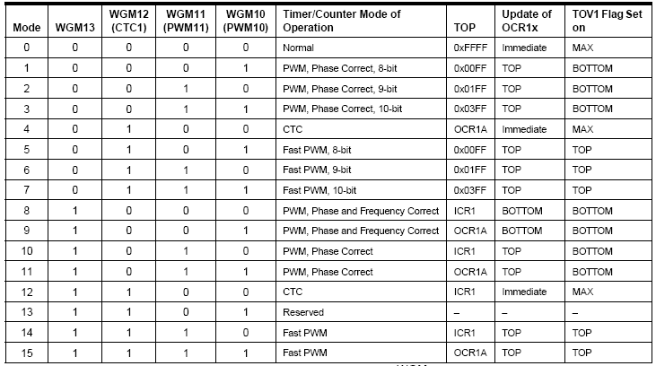

Clock Selector (CS)
CS12 CS11 CS10 Comment
0 0 0 No clock source (Timer/Counter stopped)
0 0 1 clk (No Prescaling)
0 1 0 clk / 8
0 1 1 clk / 64
1 0 0 clk / 256
1 0 1 clk / 1024
1 1 0 External clock source on T0 pin. Clock on falling edge
1 1 1 External clock source on T0 pin. Clock on rising edge

Slide 29
Assuming XTAL = 10 MHz write a program that toggles PB5 once per millisecond, using Normal mode.
LDI R16,HIGH(RAMEND) ;init stack pointer
OUT SPH,R16
LDI R16,LOW(RAMEND)
OUT SPL,R16
SBI DDRB,5 ;PB5 as an output
BEGIN:SBI PORTB,5 ;PB5 = 1
RCALL DELAY_1ms
CBI PORTB,5 ;PB5 = 0
RCALL DELAY_1ms
RJMP BEGIN
DELAY_1ms:
LDI R20,0xD8
STS TCNT1H,R20 ;TEMP = 0xD8
LDI R20,0xF0
STS TCNT1L,R20 ;TCNT1L = 0xF0, TCNT1H = TEMP
LDI R20,0x0
STS TCCR1A,R20 ;WGM11:10=00
LDI R20,0x1
STS TCCR1B,R20 ;WGM13:12=00,CS=CLK
AGAIN:SBIS TIFR1,TOV1 ;if TOV1 is set skip next instruction
RJMP AGAIN
LDI R20,1<<TOV1
OUT TIFR1,R20 ;clear TOV1 flag
LDI R19,0
STS TCCR1B,R19 ;stop timer
STS TCCR1A,R19 ;
RET
XTAL = 10 MHz ➔ 1/10 MHz = 0.1 µs
Num. of machine cycles = 1 ms / 0.1 µs = 10,000
TCNT1 = 65,536 – 10,000 = 55,536 = $D8F0
TCNT1H
TCNT1L
LDI R20,HIGH(-10000)
STS TCNT1H,R20
LDI R20, ,LOW(-10000)
STS TCNT1L,R20 ;Timer1 overflows after 10000 machine cycles

Slide 30
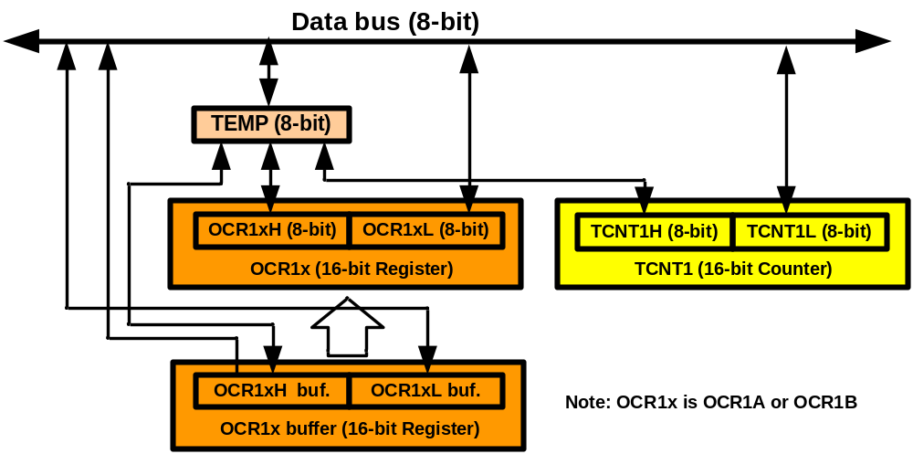
TEMP register
LDI R20,0xF3
STS TCNT1H,R20
LDI R20,0x53
STS TCNT1L,R20
LDS R20,TCNT1L
LDS R21,TCNT1H
TCNT1H = 0xF3;
TCNT1L = 0x53;
a = TCNT1L;
b = TCNT1H;

Slide 31
Assuming XTAL = 10 MHz, write a program that toggles PB5 once per millisecond, using CTC mode.
LDI R16,HIGH(RAMEND)
OUT SPH,R16
LDI R16,LOW(RAMEND)
OUT SPL,R16
SBI DDRB,5 ;PB5 as an output
BEGIN:SBI PORTB,5 ;PB5 = 1
RCALL DELAY_1ms
CBI PORTB,5 ;PB5 = 0
RCALL DELAY_1ms
RJMP BEGIN
DELAY_1ms:
LDI R20,0x00
STS TCNT1H,R20 ;TEMP = 0
STS TCNT1L,R20 ;TCNT1L = 0, TCNT1H = TEMP
LDI R20,0x27
STS OCR1AH,R20 ;TEMP = 0x27
LDI R20,0x0F
STS OCR1AL,R20 ;OCR1AL = 0x0F, OCR1AH = TEMP
LDI R20,0x00
STS TCCR1A,R20 ;WGM11:10=00
LDI R20,0x09
STS TCCR1B,R20 ;WGM13:12=01,CS=CLK
AGAIN:
SBIS TIFR1,OCF1A ;if OCF1A is set skip next instruction
RJMP AGAIN
LDI R19,0
STS TCCR1B,R19 ;stop timer
STS TCCR1A,R19 ;
LDI R20,1<<OCF1A
OUT TIFR1,R20 ;clear OCF1A flag
RET
#include <avr/io.h>
void delay1ms();
int main(){
DDRB |= 1<<5;
while (1) {
delay1ms();
PORTB ^= (1<<5); //toggle PB5
}
}
void delay1ms()
{
TCNT1 = 0;
OCR1A = 10000-1;
TCCR1A = 0; //WGM=0100 (CTC)
TCCR1B = 0x09; //N = 1
while((TIFR1&(1<<OCF1A))==0)
{ } //wait until OCF1A is set
TCCR1B = 0; //stop timer1
TIFR1 = 1<<OCF1A;//clear flag
}

Slide 32
Counting

Slide 33
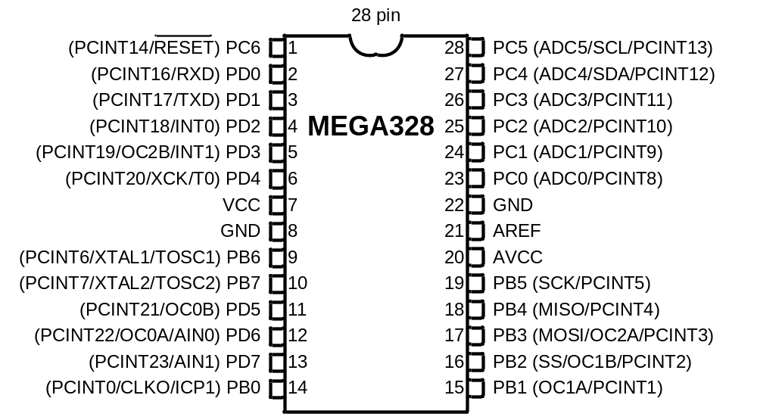
Counting
T0
6
7

Slide 34
Assuming that clock pulses are fed into pin T0, write a program for counter 0 in normal mode to count the pulses on falling edge and display the state of the TCNT0 count on PORTC.
CBI DDRD,4 ;make T0 (PD4) input
LDI R20,0xFF
OUT DDRC,R20 ;make PORTC output
LDI R20,0x00
OUT TCCR0A,R20
LDI R20,0x06
OUT TCCR0B,R20 ;counter, falling edge
AGAIN:
IN R20,TCNT0
OUT PORTC,R20 ;PORTC = TCNT0
RJMP AGAIN ;keep doing it
#include <avr/io.h>
int main()
{
DDRC = 0xFF;
TCCR0A = 0; //WGM=0000 (Normal)
TCCR0B = 0x06; //CS=6 (Count on fall)
while (1)
{
PORTC = TCNT0; //read TCNT0
}
}

Slide 35
Assuming that clock pulses are fed into pin T1. Write a program for Counter1 in CTC mode to make PORTC.0 high every 100 pulses.
CBI DDRD,5 ;make T1 (PD5) input
SBI DDRC,0 ;PC0 as an output
LDI R20,0x00
OUT TCCR1A,R20
LDI R20,0x0E ;CS=6 (falling edge counter)
OUT TCCR1B,R20 ;CTC
AGAIN:
LDI R20,0
OUT OCR1AH,R20 ;TEMP = 0
LDI R20,99
OUT OCR1AL,R20 ;ORC1L = R20, OCR1H = TEMP
L1:
SBRS TIFR1,OCF1A
RJMP L1 ;keep doing it
LDI R20,1<<OCF1A ;clear OCF1A flag
OUT TIFR1, R20
SBI PORTC,0 ;PC0 = 1
CBI PORTC,0 ;PC0 = 0
RJMP AGAIN ;keep doing it
#include <avr/io.h>
int main()
{
DDRD &= ~(1<<5);
DDRC |= 1<<0;
TCCR1A = 0; //WGM=0100 (CTC)
TCCR1B = 0x0E; //CS=6 (Count on fall)
OCR1A = 99;
while (1)
{
while((TIFR1&(1<<OCF1A)) == 0);
TIFR1 = (1<<OCF1A);
PORTC |= (1<<0); //PC0 = 1
PORTC &= ~(1<<0); //PC0 = 0
}
}

