Slide 1
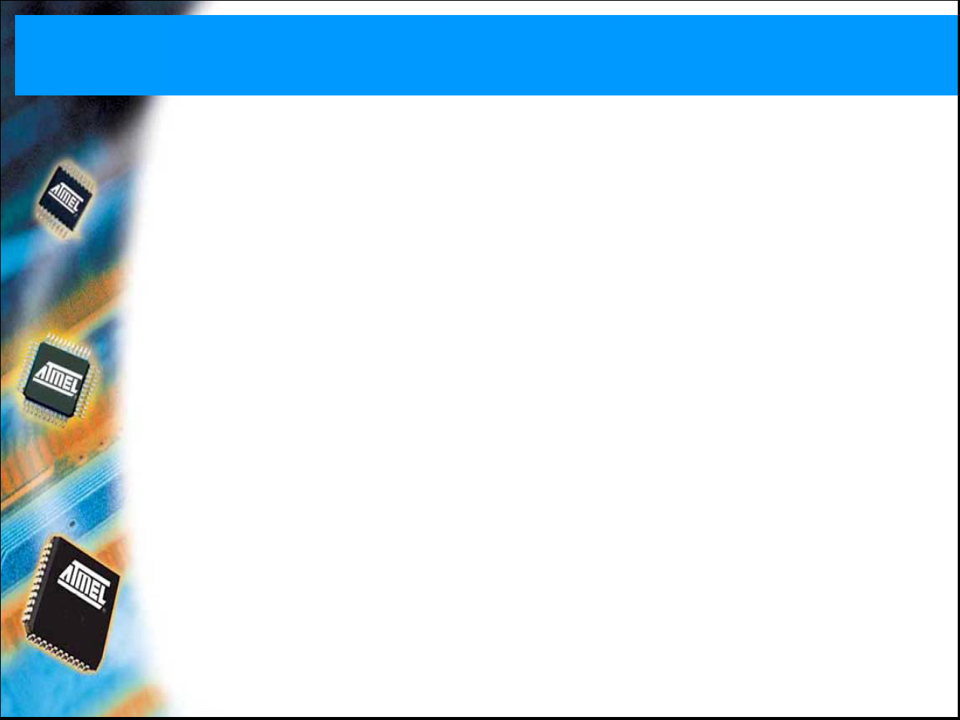
AVR ATmega128 microcontroller

Slide 2
Topics
ATmega128 hardware
Assembly
Specialties
  I/O ports
  Interrupts
  Timing
Development tools

Slide 3
ATmega128 hardware
CPU:
  8 bit, 16 MHz
  133 RISC instructions
  Typically 1 clk/instruction
  (except branch)
Memory:
  128K Flash (program)
  4K EEPROM + 4K internal SRAM (data)
  32 register (16 upper special, 3 register pairs)
Harvard-architecture

Slide 4
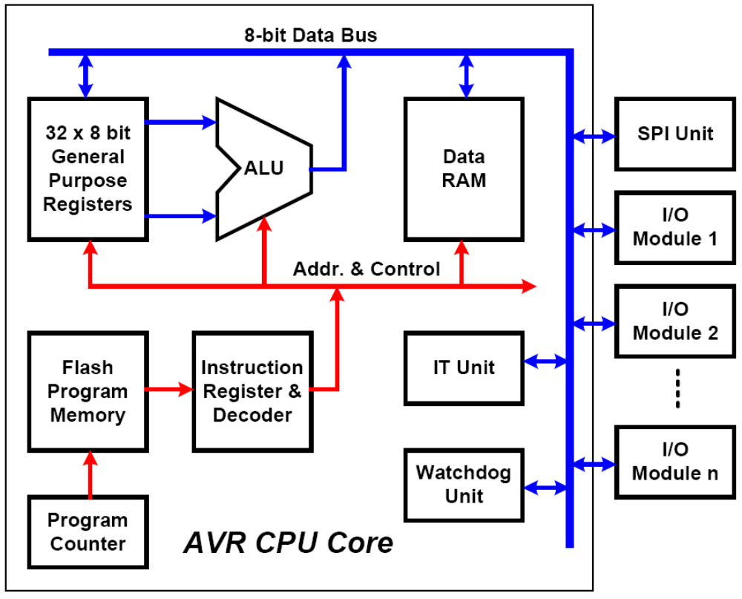
AVR block diagram
Notes:
Harvard-architektúra

Slide 5
ATmega128 programming
AVR: Atmel RISC processor family,
ATmega128: AVR processor 128K flash memory
(„Advanced Virtual RISC”)
Development tool: AVRStudio
  Assembly és C language (AVR-GCC, WinAVR)
  Programming (ISP, In System Programming) and debug (JTAG-ICE, In Circuit Emulation)
  Simulation environment (mikrocontroller + integrated peripherals)

Slide 6
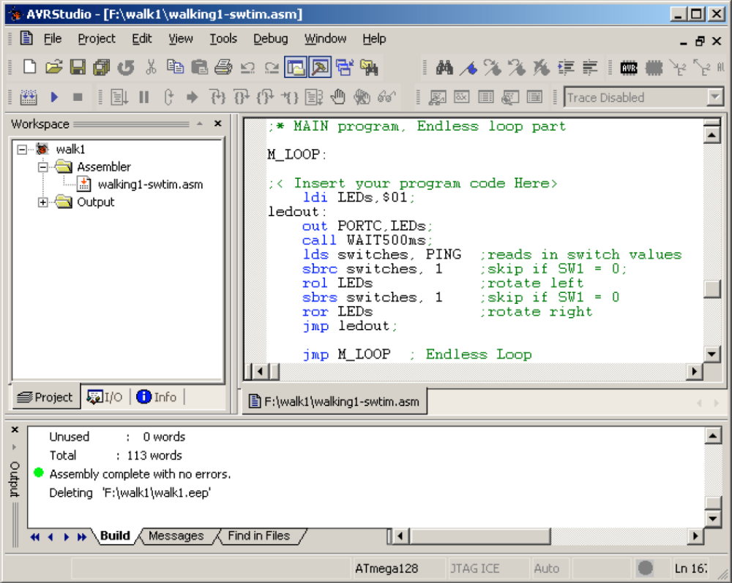
AVRStudio IDE
(IDE: Integrated Development Environment)

Slide 7
Topics
ATmega128 hardware
Assembly
Specialties
  I/O ports
  Interrupts
  Timing
Development tools

Slide 8
Compiling
C code
Preprocessor
C source (makros (#define; #include…)
gcc –E prog.c
Compiler
Assembly code (architecture dependant, optimized)
gcc –S prog.c
Assembler
Object code
Libraries
Linker
Executable
(.com, .exe, ELF…)

Slide 9
Assembly introduction
Low-level programming language
Architecture dependant (pl. x86, PPC, AVR…)
Between C and machine code – compact,
Application: mainly small embedded systems (pl. PIC, AVR)
For large projects: asm is expensive, inflexible, hard to manage; C compilers are well-optimized
  Low-level routines
  Computations intensive tasks (mathematics, graphics)
  reverse engineering

Slide 10
AVR assembly - registers
RISC instruction set, load/store architecture:
Registers:
  32, 8 bit wide (r0…r31)
  All operations are done through registers
  Last six serves as register pairs
    Implement 3 16 bit registers (X, Y, Z)

Slide 11
AVR assembly – special registers
Stastus register (SREG) - flags
  Carry, Zero, Global Interrupt Enable/Disable…
  Some instructions set the flags (e.g. arithmetic), other allow branching based on flag value
  mapped to I/O address space, therefore should be save in the IT routine:
      PUSH temp
    PUSH SREG helyett IN temp, SREG
    PUSH temp
Notes:
TODO: interruptrutin miatti mentés

Slide 12
AVR assembly – special registers
Stack pointer
  To store return address of subroutines, or save/restore variables (push, pop)
  Grows from higher to lower addrress
  2 byte register
  Stack stored in the data
  SRAM
  FILO
Program Counter
  Address of the actual instruction
  During CALL or IT it is save to the heap; RET/RETI loads from heap at the end of a subroutine/IT routine
ldi temp, LOW(RAMEND)
out SPL, temp
ldi temp, HIGH(RAMEND)
out SPH, temp

Slide 13
AVR assembly - instructions
mnemonic
arguments (operands)
ldi temp, 0xA5 ; 10100101
out PORTC, temp ; port write
comment
!!!!!

Slide 14
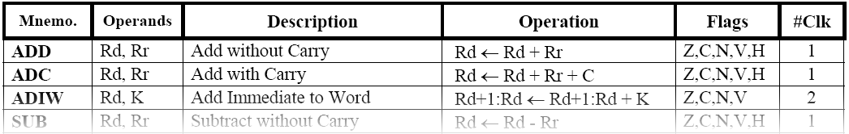
AVR assembly - instructions
instruction
arguments
ldi temp, 0xA5 ; 10100101
out PORTC, temp ; port write
SREG

Slide 15
AVR assembly – instr. types
Arithmetic and logic
Branch, jump
Data movement
Bit manipulation, bit test
Notes:
TODO: ellenőrizni hogy helyes-e a felosztás

Slide 16
AVR assembly – instructions
Arithmetic
and logic
Move
Bit op.,
others
reg1=reg2 | MOV
reg=17 | LDI
reg=mem | LDS
reg=*mem | LD
mem=reg | STS
*mem=reg | ST
periperal | IN
peripheral | OUT
heap | PUSH
heap | POP
… | …
a+b | ADD
a-b | SUB
a&b | AND
a|b | OR
a++ | INC
a-- | DEC
-a | NEG
a=0 | CLR
… | …
a<<1 | LSL
a>>1 | LSR,
Ø C (not avail. In C) | ROL, ROR
Status bits | SEI, CLI, CLZ...
No op. | NOP
… | …

Slide 17
AVR assembly - jumps
JMP: unconditional jump
E.g. forever loop:
CALL, RET: subroutine call, return (HEAP)
RETI: return from IT
Subroutine:
Construct in C:
M_LOOP: …instructions… jmp M_LOOP | while (1) { ...instructions... }
M_LOOP: … CALL FV … FV:…instructions… RET | void fv() { …instructions… return; } void main () {… fv(); }

Slide 18
AVR assembly – conditional jump
Equality test
CPSE (compare, skip if equal) skips the next instruction (L2) if the two opernads are equal, otherwise executed normally (L1).
Easy to mess up - DRAW A FLOWCHART!
M_LOOP: ; compare, CPSE a, b ; skip if eq. JMP L2 L1:… ; a == b JMP M_LOOP L2:… ; a != b JMP M_LOOP | if (a==b) { (L1) } else { (L2) }

Slide 19
AVR assembly – branch
switch / case
M_LOOP: .. CP ch, 65 ; compare->ZeroF BREQ L1 ; branch if eq. CP ch, 66 BREQ L2 ... JMP VEGE L1:… JMP VEGE L2:… (JMP VEGE) VEGE: ... | switch (ch) { case 'A': (L1) break; case 'B': (L2) break; ... } (VEGE)
Note: BREQ can only jump 64 bytes!

Slide 20
AVR assembly – „for”
Long „for” cycle (more than 1 byte):
LDI temp0, 0x20 ; LSW LDI temp1, 0x4E ; MSW LOOP: ... DEC temp0 BRNE LOOP ; branch if !=0 DEC temp1 BRNE LOOP | for (int a=0; i<0x4e20; i++) { // == 20000 ... };
Using 2 byte instructions is also possible (SBIW vagy ADIW).

Slide 21
AVR assembly – directives
.include "m128def.inc"
  ATmega128 registers and bit specification file
.def temp = r16
  register r16 renamed to temp
.equ tconst = 100
  Defining a constant value
.org $0046
  defining the memory adress of the next instruction
M_LOOP:
  Label (e.g. for jumps)

Slide 22
Topics
ATmega128 hardware
Assembly
Specialties
  I/O ports
  Interrupts
  Timing
Development tools

Slide 23
I/O ports
3 I/O registers per port, bitwise configuration
DDRx: direction (1: out, 0: in)
PORTx:
  DDR=out: output data
  DDR=in: pullup resistor or floating
PINx: actual value of the PIN!
  DDR=out: DDRx (with 1 clk latency)
  DDR=in: input data
IN, OUT instructions for I/O addresses, LDS, STSfor memory mapped (PORTG)

Slide 24
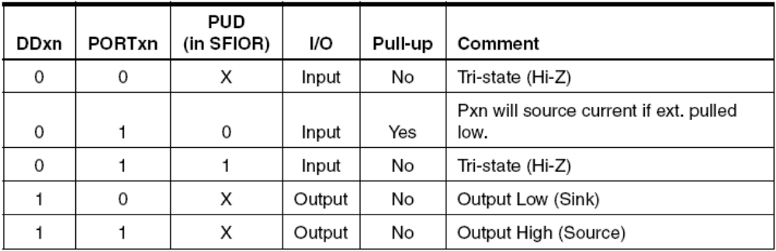
I/O ports
direction
DDRx
DDRx value
Output value /
pullup
PORTx
PORTx value
(out/) input value
PINx

Slide 25

I/O ports
Writing output data (e.g. LEDs):
ldi temp, 0xff ; 8 bit output
out DDRC, temp
out PORTC, temp ; turn on all LEDs
Reading data (PORTG, e.g. switch):
ldi temp, 0xFF
sts PORTG, temp ; non tri-state
ldi temp, 0x00 ; input
sts DDRG, temp ;
lds temp, PING ; read PIN
SW0 | PG0
SW1 | PG1
SW2 | PG4
SW3 | PG1
L
H

Slide 26
Interrupts
Single-level IT
Incoming IT clears the IT enable bit, RETI re-enables it – DO NOT do these in your IT routine!
IT vector table
Enable the different interrupt sources
Enable global interrupt: SEI
In the IT routine:
  Save the status register
  Save all used registers
  Do the IT routine
  Restore the saved registers
  Restore status register

Slide 27
IT vector table
.org $0000 ; Define start of Code segment
jmp RESET ; Reset Handler, jmp is 2 word instruction
reti ; INT0 Handler on $0002, dummy
nop
reti ; INT1 Handler, if INTn used, 'reti' and 'nop'
; will be replaced by 'jmp INTn_Handler_Address'
nop
reti ; INT2 Handler
nop
...
reti ; Timer1 Compare Match B Handler
nop
reti ; Timer1 Overflow Handler
nop
reti
nop
reti ; Timer0 Overflow Handler
nop
.org $0046 ; MAIN program...
jmp TIMER_IT; Timer0 Compare Match Handler

Slide 28
IT routine
TIMER_IT:
; save status register and temp register into heap
push temp
in temp, SREG
push temp
<...IT-handling...>
; restore temp and then status
pop temp
out SREG, temp
pop temp
reti ; return

Slide 29
Timing
Without IT:
    „For loop” – delay loop
    Polling timer counter (peripheral)
      Easy to debug, realize
      Imprecise, occupies all CPU time
Using timer IT
    Prescaler for less-frequent IT
    Enable timer IT
    SW counter is required for large delays

Slide 30
Timing with IT
; ***** Timer 0 init *****
; prescaler
ldi temp,0b00001111
; 0....... ; FOC=0
; .0..1... ; WGM=10 (clear timer on compare match)
; ..00.... ; COM=00 (output disable)
; .....111 ; CS0=111 (CLK/1024)
out TCCR0,temp ; Timer 0 TCCR0 register
; compare register
ldi temp,108 ; 11059200Hz/1024 = 108*100
out OCR0,temp ; Timer 0 OCR0 register
; Timer 0 IT enabled, others disabled
ldi temp,0b00000010
; 000000.. ; Timer2,1 IT disabled
; ......1. ; OCIE0=1 - match
; .......0 ; TOIE0=0 - overflow
out TIMSK,temp ; Timer IT Mask register
sei ; global IT enabled

