Slide 1
Finite Fields

Slide 2
Introduction
Increasing importance in cryptography
  AES, Elliptic Curve, IDEA, Public Key
concern operations on “numbers”
  where what constitutes a “number” and the type of operations varies considerably
start with concepts of groups, rings, field.s from abstract algebra

Slide 3
Field
a set of numbers with two operations:
  abelian group for addition: commutative for addition
  abelian group for multiplication (ignoring 0): commutative for multiplication
  It is a ring
(A1-5, M1-6), F is an integral domain.
M7: Multiplicative inverse. For each a ∈F, except 0, there is an element a⁻¹∈F such that aa⁻¹ = (a⁻¹)a = 1
Notes:
Familiar examples of fields are the rational numbers, the real numbers, and the complex numbers.
Note that the set of all integers is not a field, because not every element of the set has a multiplicative inverse; in fact, only the elements 1 and -1 have multiplicative inverses in the integers.
These are terms we use for different sorts of "number systems", ones obeying different sets of laws. From group to ring to field we get more and more laws being obeyed. As a memory aid, can use the acronym for groups is CAIN (Closure Associative Identity iNverse) & ABEL. Mostly we need to compute with Rings, if not Fields. When we do arithmetic modulo a prime, we have a field.

Slide 4
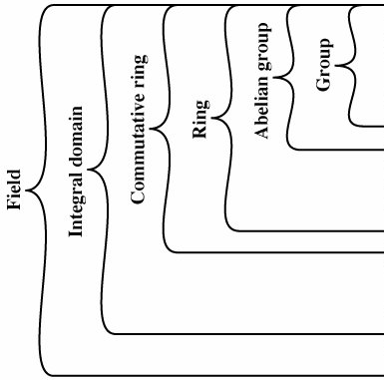
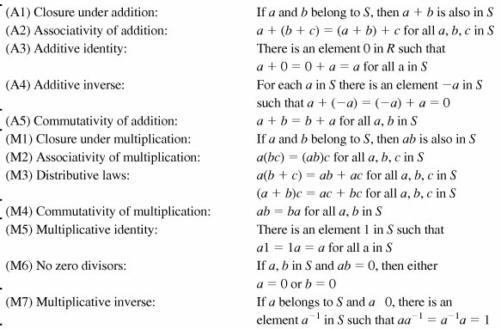

Slide 5
Galois Fields
Galois fields are for polynomial equations (group theory, number theory, Euclidian geometry): Algebraic solution to a polynomial equation is related to the structure of a group of permutations associated with the roots of the polynomial, and an equation could be solvable in radicals if one can find a series of normal subgroups of its Galois group which are abelian, or its Galois group is solvable.
The finite field of order p^{n} is written GF(p^{n}).

Slide 6
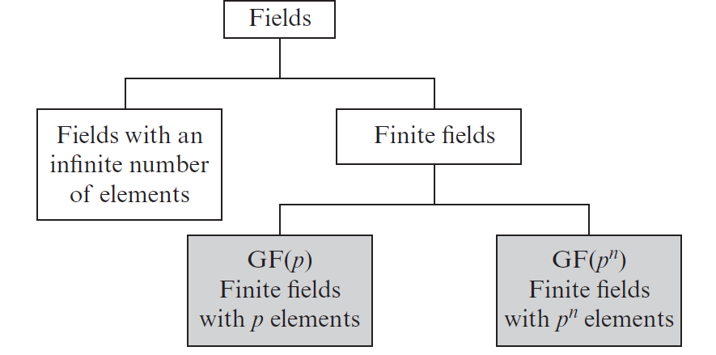
Types of Fields

Slide 7
A field Z_{n} = {0,1,...,n-1} is a commutative ring in which every nonzero element is assumed to have a multiplicative inverse. ‘a’ is multiplicative inverse to n, iff integer a is relatively prime to n.
Definition: If n is a prime p, then GF(p) is defined as the set of integers Z_{p}={0, 1,..., p-1}, + operations in mod(p), then we can say the set Z_{n} of integers {0,1,...,n-1}, + operations in mod(n), is a commutative ring. “Well-behaving”: the results of operations obtained are confined in the field of GF(p)
We are interested in two finite fields of p^{n}, where p is prime,
  GF(p)
  GF(2^{n})

Slide 8



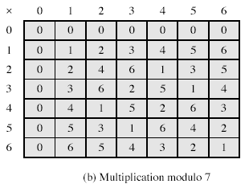
GF(7)
The simplest finite field is GF(2).
Notes:
From Stallings Table 4-3b.

Slide 9
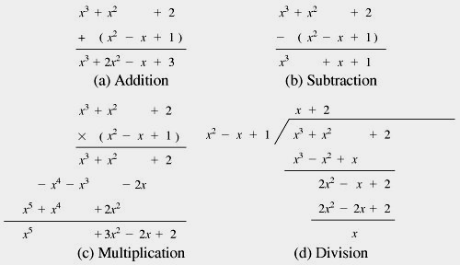
Ordinary Polynomial Arithmetic

Slide 10
Polynomial Arithmetic in Z_{p}
Polynomial in which the coefficients are elements of some field F, is referred as a polynomial over the field F.
Such polynomials set is referred to as a polynomial ring.
Division is possible if the polynomial operations are performed on polynomials over a field, but exact division might not be possible. Tricky?..!!
Within a field, two elements a and b, the quotient a/b is also an element of the field. However, given a ring R that is not a field, division will result in a quotient and a remainder; this is not exact division.
5, 3 within a set S. If S is the set of rational numbers, which is a field, then the result is simply expressed as 5/3 and is an element of S???. Suppose that S is the field Z₇. p=7. In this case, 5/3 = (5 x 3⁻¹) mod 7 = (5 x 5) mod 7 = 4 which is an exact solution. Suppose that S is the set of integers, which is a ring but not a field. Then 5/3 produces a quotient and a remainder: 5/3 = 1 + 2/3; 5 = 1 x 3 + 2, division is not exact over the set of integers.
Division is not always defined, if it is over a coefficient set that is not a field.

Slide 11

Polynomial Arithmetic in Z_{p} if r(x) = 0, g(x)|f(x), g(x) is divisor.
If the coefficient set is the integers, then (5x²)/(3x) does not have a solution, since not in the coefficient set.
Suppose it is performed over Z₇. Then (5x²)/(3x) = 4x which is a valid polynomial over Z₇.
Suppose, degree of f(x) is n, and of g(x) is m, n ≥ m, then degree of the quotient q(x), is (m-n) and of remainder is at most (m–1). Polynomial division is possible if the coefficient set is a field.
  r(x) = f(x) mod g(x)
f(x) = x³ + x² + 2 and g(x) = x² - x + 1
q(x)g(x) + r(x) = (x + 2)(x² - x + 1) + x = (x³ + x² - x + 2) + x = x³ + x² + 2 = f(x)
Not convenient for logical operations such as XOR.
Notes:
what is the operation undoes (inverse of this operation that leads to identity) xor and of opretaion xor.. a-+(-a)=, operation +, identity 0..

Slide 12
GF(7)
The simplest finite field is GF(2).
Notes:
From Stallings Table 4-3b.

Slide 13
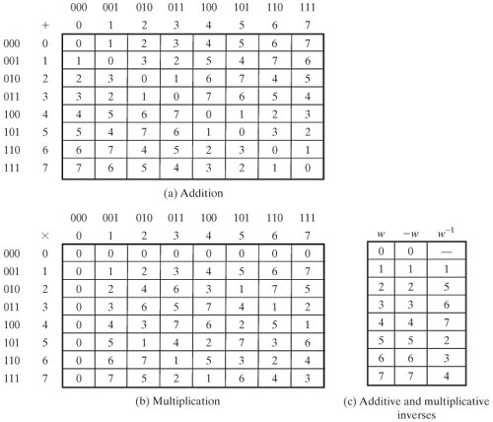
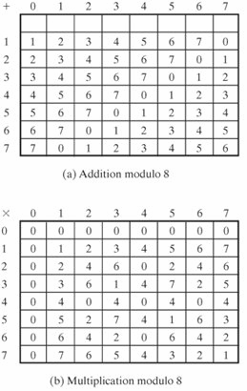
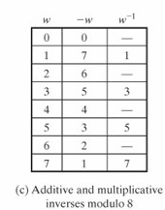
Integer
Occurrences in Z₈
Occurrences in GF(2³)
1 2 3 4 5 6 7
4 8 4 12 4 8 4
7 7 7 7 7 7 7
Z₈
GF(2³)

Slide 14
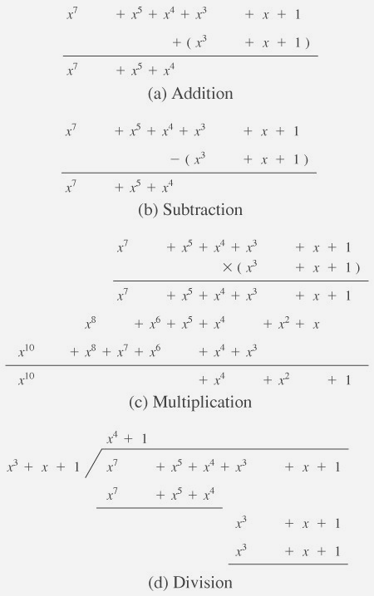
In GF(2), addition and multiplication are equivalent to the XOR, and the logical AND, respectively. Addition and subtraction are equivalent.
Therefore GF(2^{n}) is of most interest in.

Slide 15

Consider the set S of all polynomials of degree n-1 or less over the field Z_{p}. Thus, each polynomial has the form
where each a_{i} takes on a value in the set {0, 1,..., p -1}. There are a total of p^{n} different polynomials in S.
For p = 3 and n = 2, the 3² = 9 polynomials in the set are
0 x 2x
1 x + 1 2x + 1
2 x + 2 2x + 2
For p = 2 and n = 3, the 2³ = 8 the polynomials in the set are
0 x + 1 x² + x
1 x² x² + x + 1
X x² + 1

Slide 16
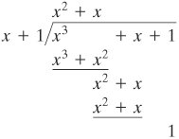
mod 2:
1 + 1 = 1-1 = 0;
1 + 0 = 1 - 0 = 1;
0 + 1 = 0 - 1 = 1.
if f(x) has no divisors other than itself & 1 it is said irreducible (or prime) polynomial, an irreducible polynomial forms a field.
f(x) = x⁴ + 1 over GF(2) is reducible,
  because x⁴ + 1 = (x + 1)(x³ + x² + x + 1)
f(x) = x³ + x + 1 is irreducible residual 1.
eg. let f(x) = x³ + x² and g(x) = x² + x + 1
f(x) + g(x) = x³ + x + 1
f(x) x g(x) = x⁵ + x²

Slide 17
Finite Fields Of the Form GF(2^{n})
Polynomials over p^{n}, with n > 1, operations modulo p^{n} do not produce a field. There are structures satisfies the axioms for a field in a set with p^{n} elements, and concentrate on GF(2^{n}).
Motivation Virtually all encryption algorithms, both symmetric and public key, involve arithmetic operations on integers with divisions.
For efficiency: integers that fit exactly into a given number of bits, with no wasted bit patterns, integers in the range 0 through 2^(n)-1, fitting into an n-bit word. Z₂₅₆ versus Z₂₅₁

Slide 18

GF(2³)

Slide 19
Modular Polynomial Arithmetic
can compute in field GF(2^{n})
  polynomials with coefficients modulo 2
  whose degree is less than n
  hence must reduce modulo an irreducible poly of degree n (for multiplication only)
form a finite field
can always find an inverse
  can extend Euclid’s Inverse algorithm to find

Slide 20
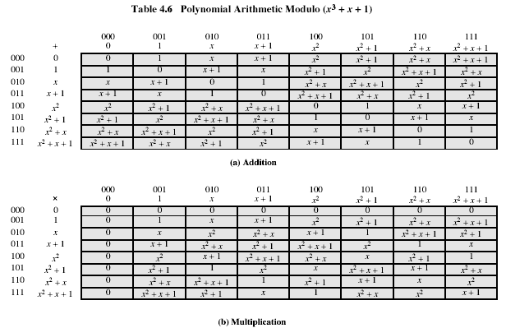
Example GF(2³)
Notes:
Stallings Table 4-6.

Slide 21
Computational Considerations
since coefficients are 0 or 1, can represent any such polynomial as a bit string
addition becomes XOR of these bit strings
multiplication is shift & XOR
  cf long-hand multiplication
modulo reduction done by repeatedly substituting highest power with remainder of irreducible poly (also shift & XOR)
Notes:
See text for additional discussion. Reduction comes from observation that if in GF(2^{n}) then irreducible poly g(x) has highest term x^{n} , and if compute x^{n} mod g(x) answer is g(x)- x^{n}

Slide 22
Example
why mod(x³+x+1)!!! for gf(2^3)
in GF(2³) have (x²+1) is 101₂ & (x²+x+1) is 111₂
so addition is
  (x²+1) + (x²+x+1) = x
  101 XOR 111 = 010₂
and multiplication is
  (x+1).(x²+1) = x.(x²+1) + 1.(x²+1)
  = x³+x+x²+1 = x³+x²+x+1
  011.101 = (101)<<1 XOR (101)<<0 =
  1010 XOR 101 = 1111₂
polynomial modulo reduction (get q(x) & r(x)) is
  (x³+x²+x+1 ) mod (x³+x+1) = 1.(x³+x+1) + (x²) = x²
  1111 mod 1011 = 1111 XOR 1011 = 0100₂
Notes:
Show here a few simple examples of addition, multiplication & modulo reduction in GF(2³).
Note the long form modulo reduction finds p(x)=q(x).m(x)+r(x) with r(x) being the desired remainder.

