Slide 1


Computer Security
Modular Arithmetic

Slide 2

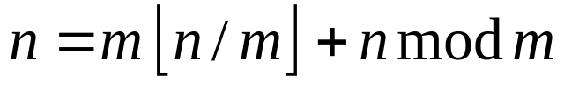
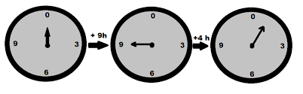
Modular Arithmetic
Modular Arithmetic is one of the main tools provided by number theory
  The quotient of n divided by m is , where m and n are positive integers
  The remainder of this division is called 'n mod m'
  So, the following holds:
  where the first term is the quotient and the second the remainder.

Slide 3
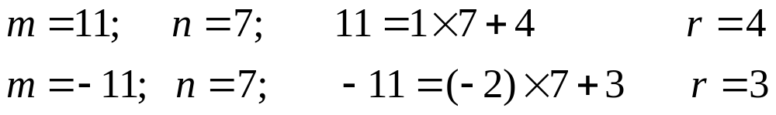
Modular Arithmetic
Another way of putting this is:
  Given any positive integer n and any integer m, if we divide m by n, we get an integer quotient, q, and integer remainder, r, that obey the following relationship:
  The remainder, r, is often referred to as a residue of m modulo n, and is the smallest non-negative integer that differs from m by a multiple of n.
    For example,

Slide 4

Modular Arithmetic
Two integers, a and b are said to be congruent (denoted by) if:
that is, "a is congruent to b modulo m“
Alternatively, in arithmetic modulo m, a and b are equivalent if their difference, (a - b), is a multiple of m; that is, m | (a - b)
The set of integers Z_{m} = {0,1, ... m - 1} form the complete set of residues modulo m -- there are only m different integers, mod m
The operation a mod m denotes the residue of a, such that the residue is some integer from 0 to m - 1. This operation is known as a modular reduction.
  Example:

Slide 5
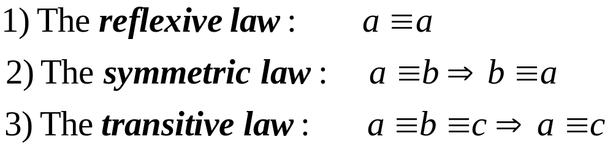
Modular Arithmetic
Congruence is an equivalence relation that is, it satisfies:
Finding the smallest non-negative integer to which k is congruent modulo n is called reducing k modulo n

Slide 6
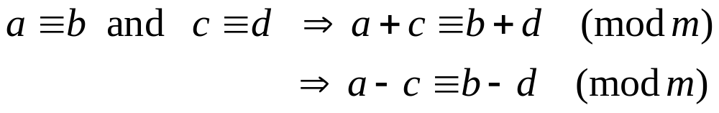
Modular Arithmetic
We can also add and subtract congruent elements without losing congruence:
Multiplication also works:

Slide 7
Modular Arithmetic
Modular arithmetic is like ordinary arithmetic. It is:
  commutative (for addition and multiplication)
    a + b = b + a
  associative
    (a + b) + c = a + (b + c)
and
  distributive
      a(b + c) = (ab) + (ac)
    and
      (b + c)a = (ba) + (ca)

Slide 8
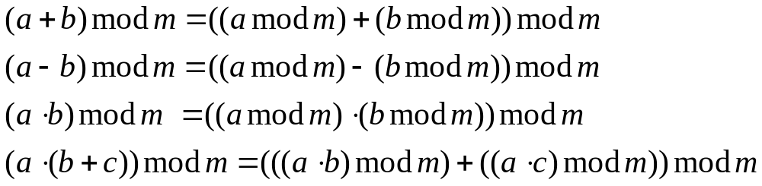
Modular Arithmetic
A very important property of modular arithmetic is:
  Reducing each intermediate result modulo m yields the same result as doing the entire calculation, and then reducing the result to modulo m:
  This means that we can do modular arithmetic without worrying about whether we will exceed some large arithmetic bound -- so such calculations can be done on computers, even for large integer values.

Slide 9
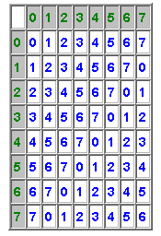
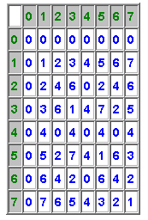
Modular Arithmetic
Here are the possible values of (a + b) mod 8:
and (a·b) mod 8:
Try a Java applet which demonstrates modular arithmetic

Slide 10
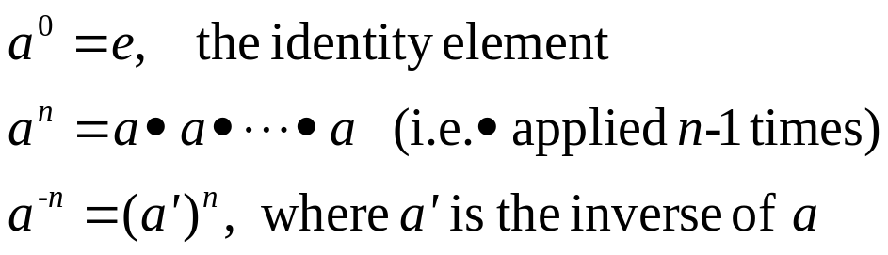
Modular Arithmetic: Exponentiation
Recall that exponentiation is defined:
  In ordinary arithmetic, exponentiation rapidly produces very large numbers
  However, because of the important property of modular arithmetic that intermediate results can be computed mod m, then is possible in mod m arithmetic to do powerful exponentiation without producing very large numbers
  Remember, in cryptography, we'll be dealing with very large values of m, so this is important.

Slide 11

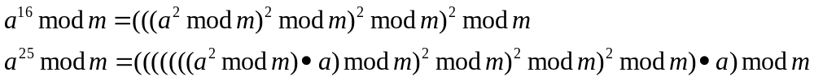
Modular Arithmetic: Exponentiation
For example, instead of performing the calculation:
we can instead perform fewer multiplications and use intermediate modular reductions.
  Let's take a specific case of a⁸ mod n. We can calculate it:
  Similarly:

Slide 12

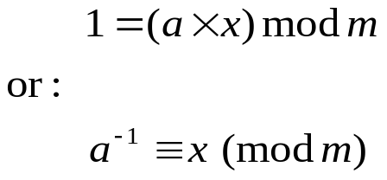
Modular Arithmetic: Division
So far, for mod m arithmetic, we have addition, subtraction (defined through an additive inverse), and multiplication.
What about division?
  Division is defined through a multiplicative inverse.
  In regular arithmetic:
    The multiplicative inverse of 5 is 1/5, because 5·1/5 = 1
  In modular arithmetic, things are not so easy:
  which is equivalent to finding an x and a k (both integers) such that:
      5x = 7k + 1
  The general problem is to find x such that:

Slide 13
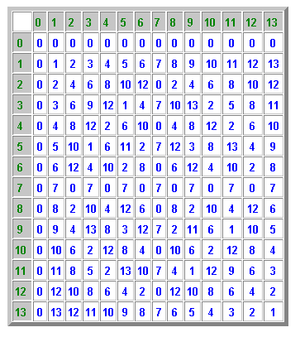

Modular Arithmetic: Multiplicative Inverse
Sometimes the modular multiplicative inverse has a solution, and sometimes it doesn't:
  The inverse of 5, mod 14, is 3
    5*3 mod 14 = 1
  The inverse of 2, mod 14, doesn't exist.
    Look at the row for 2, at right;
    It does not contain a value 1
It turns out that has a solution iff a and n are relatively prime.
  For example, look at the rows to the right.
  The only rows that contain a 1 are for values that are relatively prime to 14:
    1, 3, 5, 9, 11, 13
The mod 14 multiplication table.

Slide 14
Modular Arithmetic: Multiplicative Inverse
One way of finding the inverse of a modulo m is to extend Euclid's greatest common divisor algorithm:
  The Extended Euclidean Algorithm:
    While computing gcd(a, m), we can also find two integers u and v such that:
        gcd(a, m) = ua + vm
    If a and m are relatively prime, then the gcd(a, m) = 1, and:
        1 = ua + vm = ua (mod m) (performing a reduction mod m)
    and then, multiplying both sides by a⁻¹:
        a⁻¹ = ua·a⁻¹ = u
    So, if gcd(a, m) = 1, then u is the multiplicative inverse of a mod m;
    otherwise, there is no multiplicative inverse

Slide 15
Finite, or Galois Fields
A finite field (also known as a Galois* Field) is a field with a finite number of elements. Finite fields are critical to the success of many cryptographic algorithms.
  The finite fields are completely known:
    It can be shown that the order of a finite field (number of elements in the field) must be a power of a prime, p^{n}, where n is a positive integer.
For a given prime, p, the finite field of order p, GF(p) is defined as the set Z_{p} of integers {0, 1, ... , p - 1}, together with the arithmetic operations modulo p.
*Evariste Galois (1811-1832), French mathematician

Slide 16


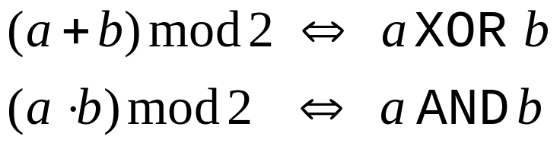
Modular Arithmetic
Here are the values for (a + b) mod 2:
and (a·b) mod 2:
Notice anything?
Try a Java applet which demonstrates modular arithmetic

Slide 17
Modular Arithmetic
Another useful feature of arithmetic mod 2 is:
  In the field Z₂, ({0, 1}), there is only one inversion possible:
        1/1 = 1
  so division is the same operation as multiplication!
Not surprisingly, the field Z₂ is an important tool to analyze certain cryptographic algorithms by computer.

Slide 18
Modular Arithmetic
Cryptography uses modular arithmetic a great deal, because:
  Calculating discrete logarithms and square roots mod n can be hard problems.
  It's easier to work with on computers, because it restricts the range of all intermediate values and results
    For a k-bit modulus, n, the intermediate results of any addition, subtraction, or multiplication will not exceed 2k bits in length.
    We can perform modular exponentiation without generating huge intermediate results
    Arithmetic operations, mod 2, are natural for computers, because of the equivalence of addition with XOR, and multiplication with AND, etc.

Slide 19
Z_{n}*
Z is the set of all integers
We've seen that Z_{n} is the set of integers mod n
  Z₁₀ = {0,1,2,3,4,5,6,7,8,9}
Z_{n}* is defined as the set of mod n integers that are relatively prime to n
  Z₁₀* = {1,3,7,9} (0 is missing because gcd(0, 10) = 10)

Slide 20
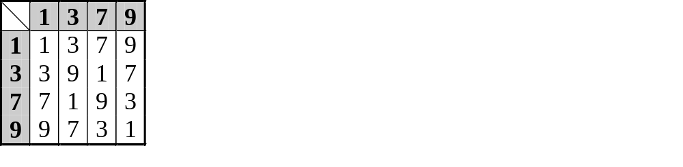
Z_{n}*
The multiplication table for Z₁₀* provides some surprises:
Notice anything?
Every element in Z₁₀* is present in the table, and no other elements other than those are present.
Furthermore, every element in Z₁₀* is present in every row of the table.
  What does this mean for Z₁₀*?
It turns out that this is true for all n:
  Z_{n}* is closed under multiplication mod n

Slide 21
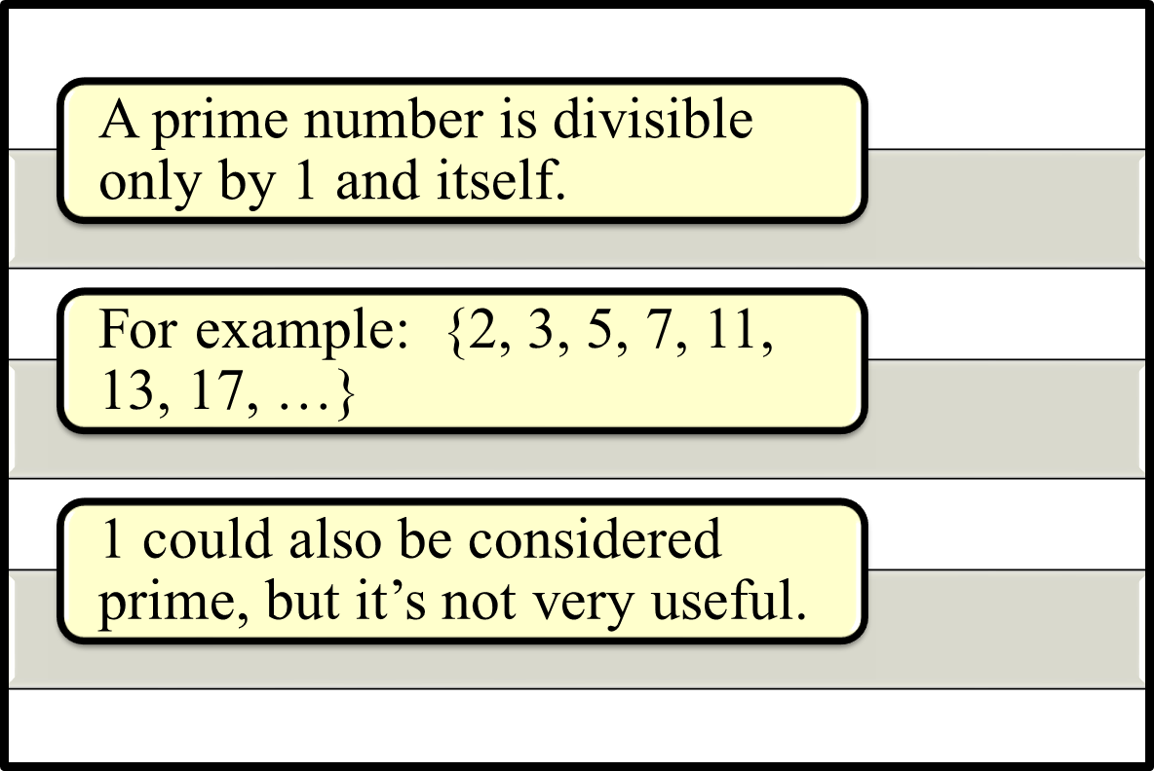
PRIME NUMBERS

Slide 22
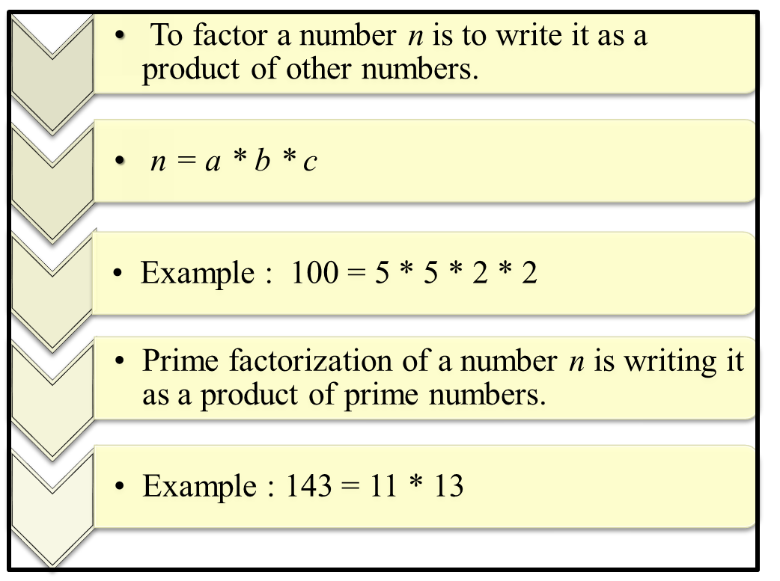
PRIME FACTORIZATION

Slide 23
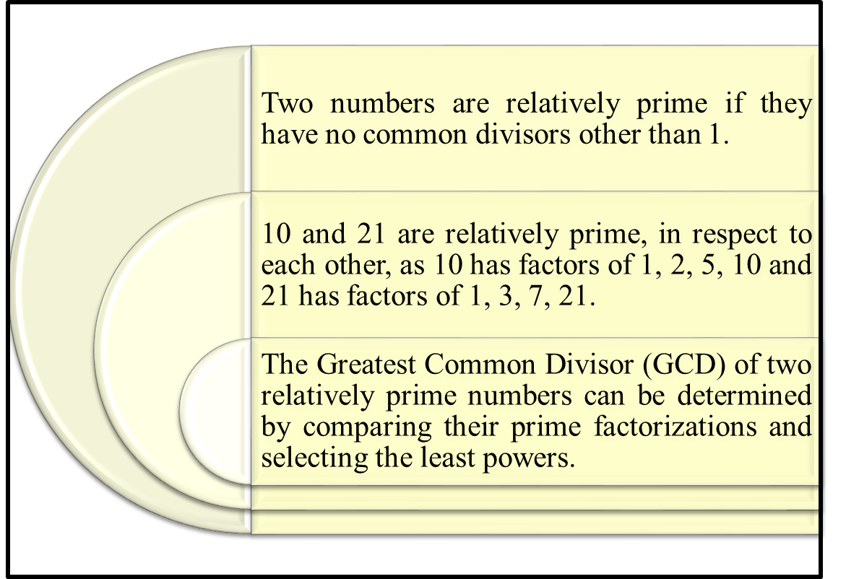
RELATIVELY PRIME NUMBERS

Slide 24
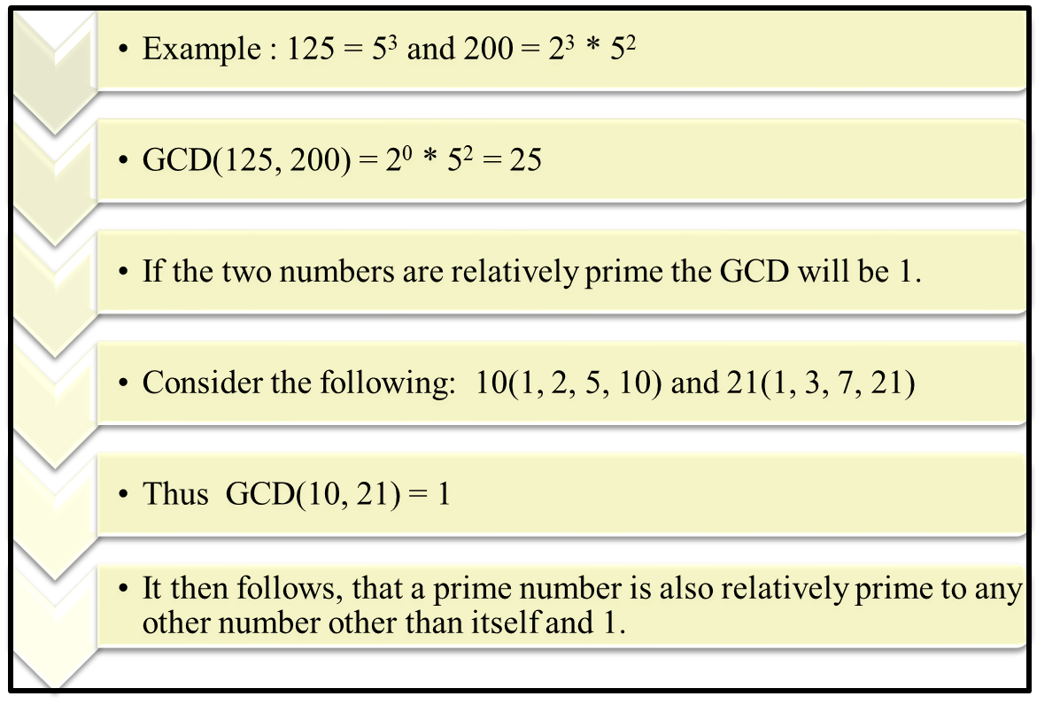
GREATEST COMMON DIVISOR (GCD)

Slide 25
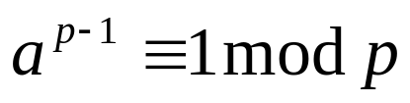
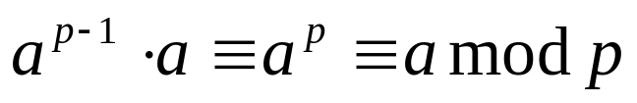
Fermat's Little Theorem
This theorem also plays an important role in the derivation of the famous RSA algorithm for public-key cryptography .
Another application of this theorem will be in the speedup of the modular exponentiation algorithm .
Fermat's Little Theorem states:
  If p is prime and a is a positive integer not divisible by p, then:
  multiplying both sides by a, we can come up with an alternative form:

Slide 26
FERMAT’S THEOREM PROOF :
Consider a set of positive integers less than ‘p’ : {1,2,3,…..,(p-1)} and multiply each element by ‘a’ and ‘modulo p’ , to get the set
X = {a mod p, 2a mod p,…, (p-1)a mod p}
No elements of X is zero and equal, since p doesn’t divide a.
Multiplying the numbers in both sets (p and X) and taking the result mod p yields

Slide 27



FERMAT’S THEOREM PROOF :
a * 2a *…* (p-1)a [1 * 2 * 3 *…* (p-1)] (mod p)
Thus on equating (p-1)! term from both the sides, since it is relatively prime to p, result becomes,
An alternative form of Fermat’s Theorem is given as

Slide 28

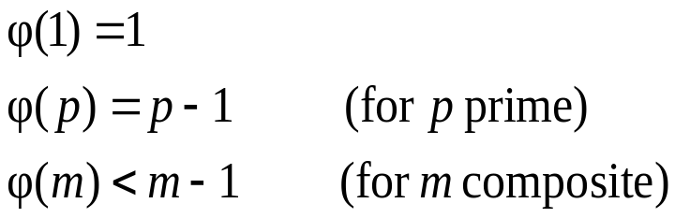
Euler's Totient Function
An important quantity in number theory is *Euler's Totient Function:
  The number of positive integers less than n, that are relatively prime to n.
It is written :
In other words, Euler's Totient Function is the number of elements in Z_{n}*
*Leonhard Euler (1707 - 1783), Swiss mathematician

Slide 29
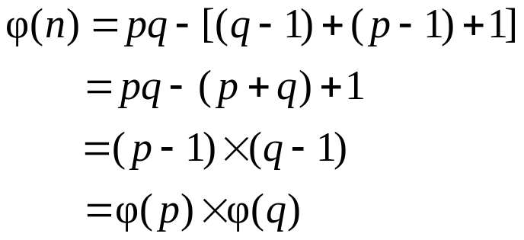
Euler's Totient Function
Assume we have two distinct prime numbers, p and q, and an integer n = pq
  Then:
  The set of residues in Z_{n} i s{0,1,...,(pq - 1)}
  The residues that are not relatively prime to n are:
    The set {p, 2p, ... ,(q - 1)p}, the set {q, 2q, ... ,(p - 1)q}, and 0
  So:

Slide 30
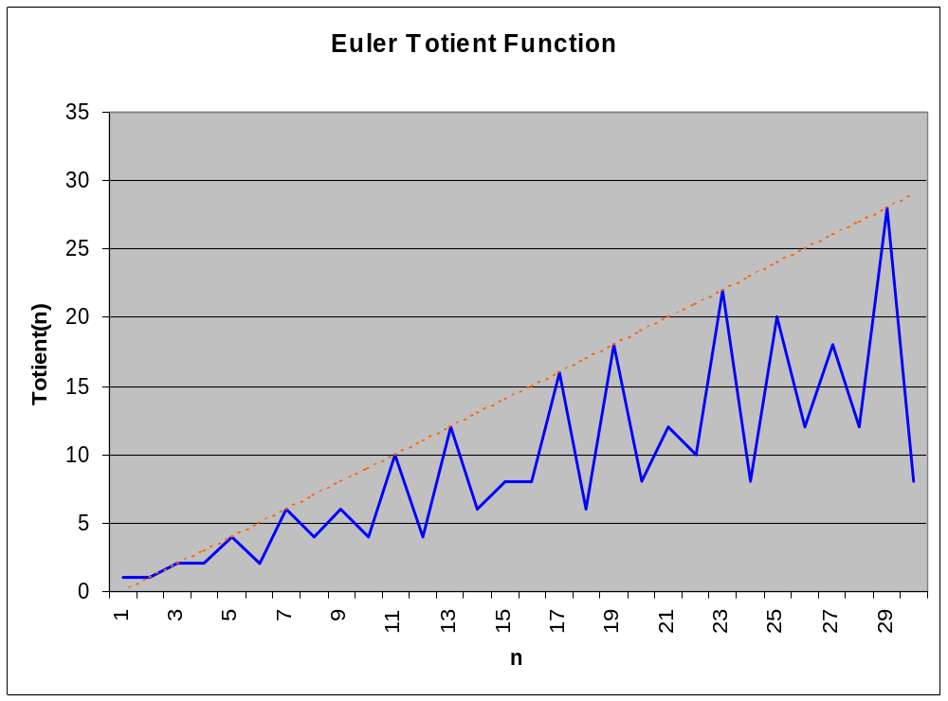
Euler's Totient Function
Here is what the Euler Totient Function values look like for small values of n. (The dotted red line is the line f(n) = n - 1)

Slide 31
Summary
Whew! That's all the math we're going to do for now!
We'll relate this to the cryptographic algorithms we're going to study in the near future.

