Slide 1

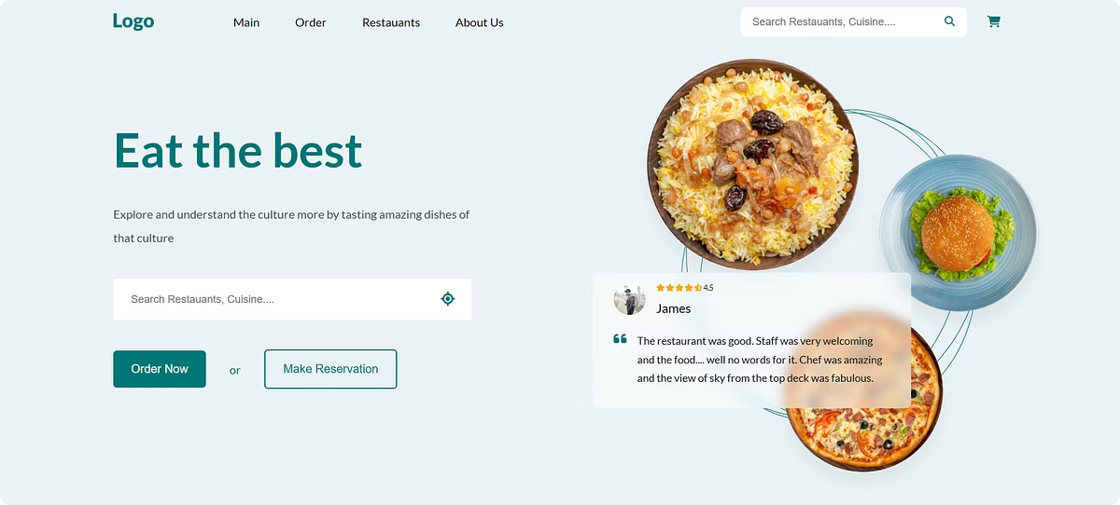
Final Project: Food ordering website
Introduction to Internet and Web
Abduvaliev Javohir

Slide 2


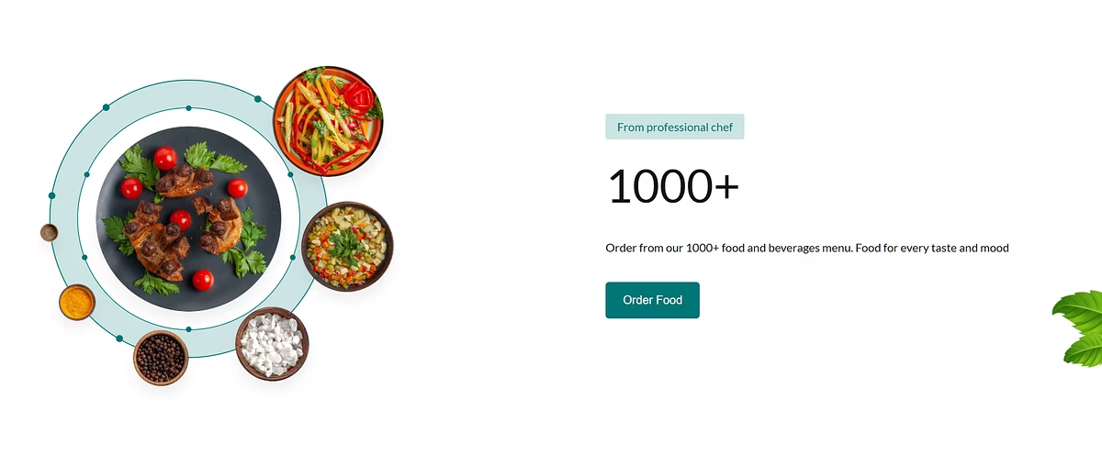


Main Features
Cart Management:
Easily add, remove, or update items in your cart before checkout.
Total Amount Calculation:
Automatically calculates subtotal and final amount.
Payment Simulation:
Simulate the payment process for testing or demo purposes.

Slide 3
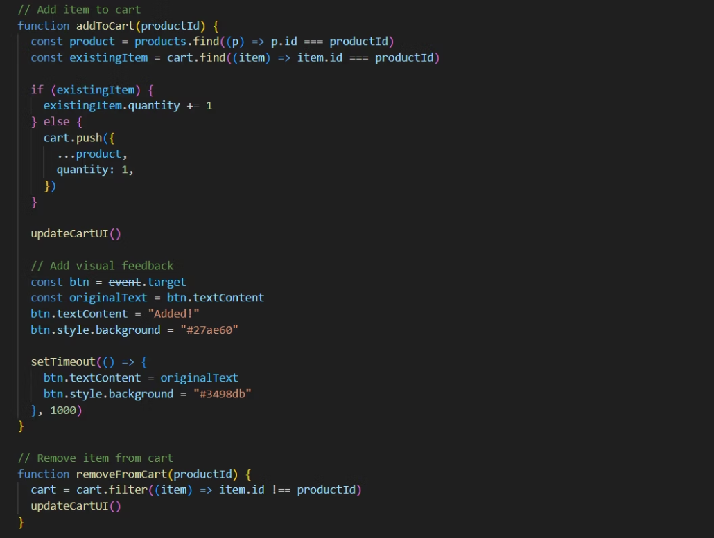
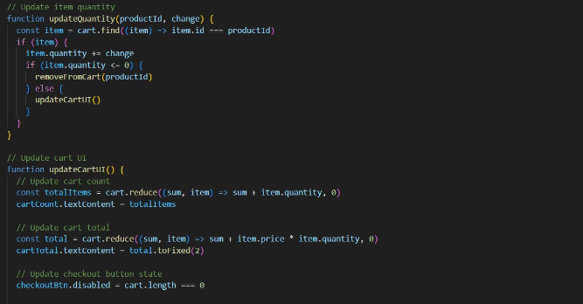
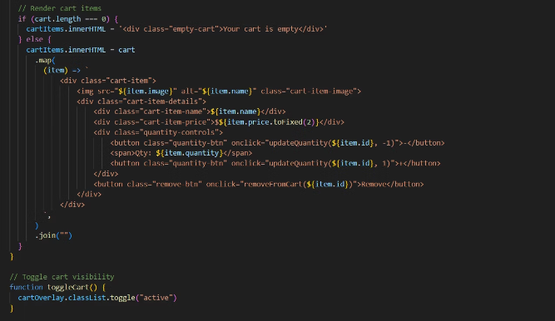
JavaScript Code: Main Features

Slide 4
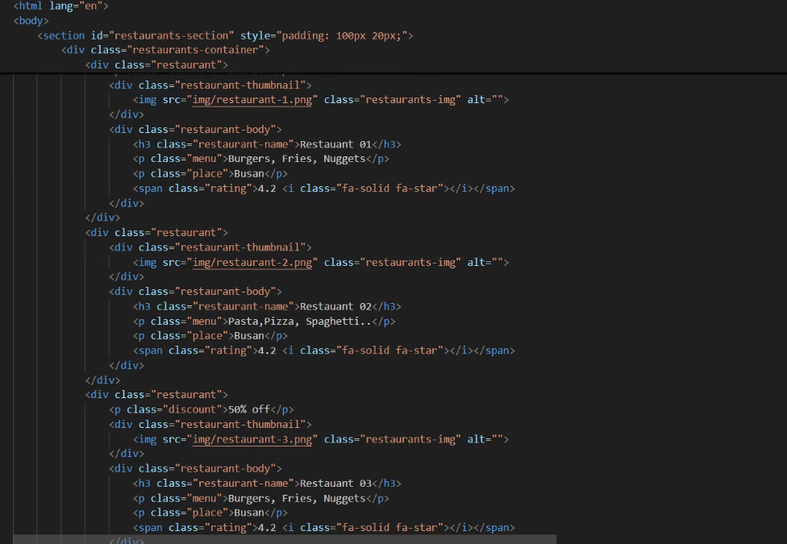
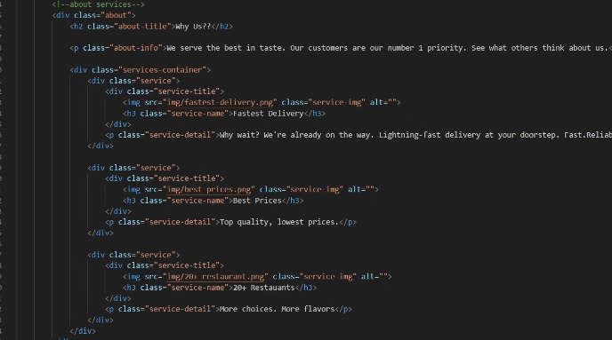
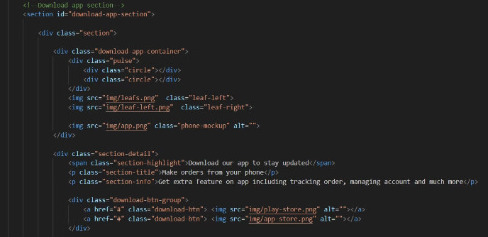
HTML Code: Main, Restaurant, About Us

Slide 5
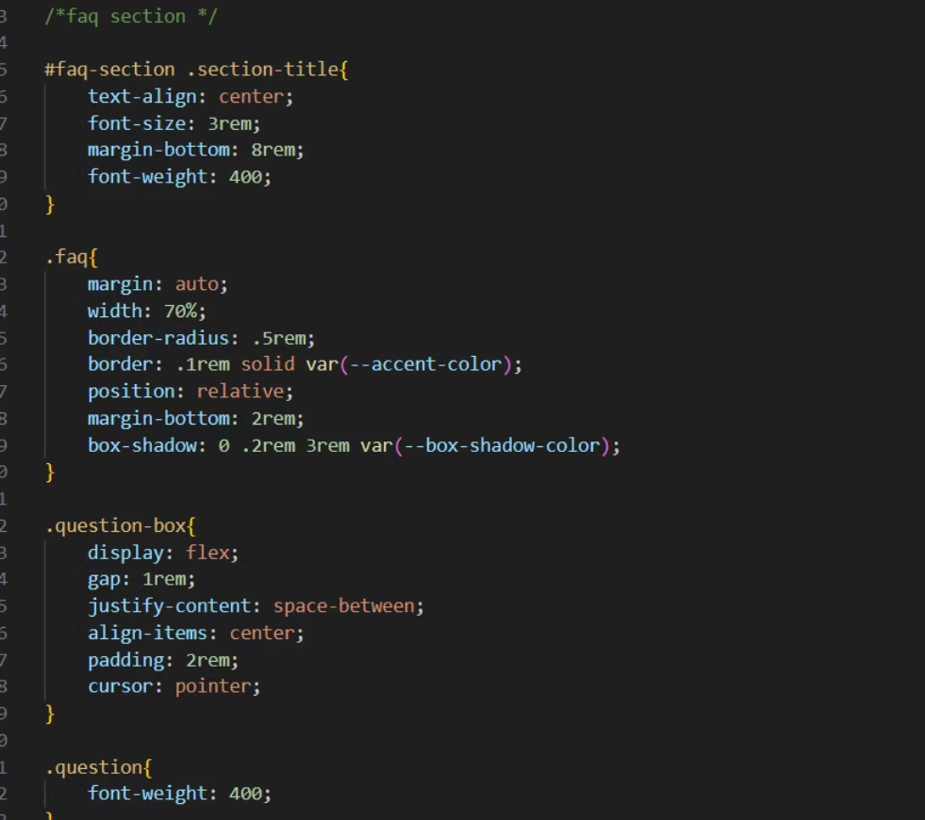
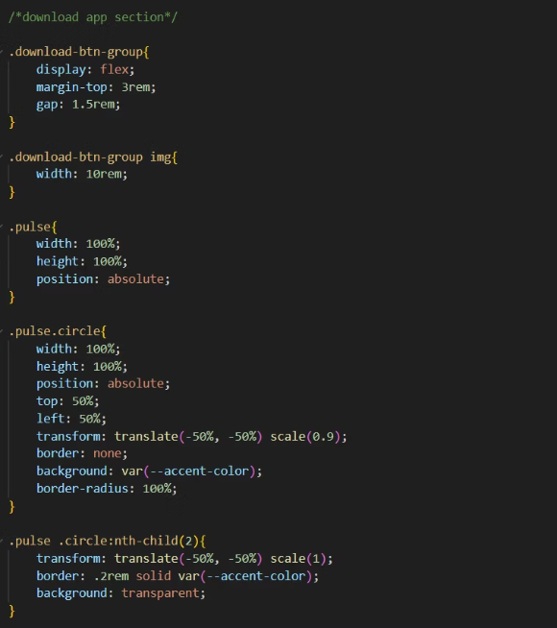
CSS Code: FAQ , App Download.

Slide 6
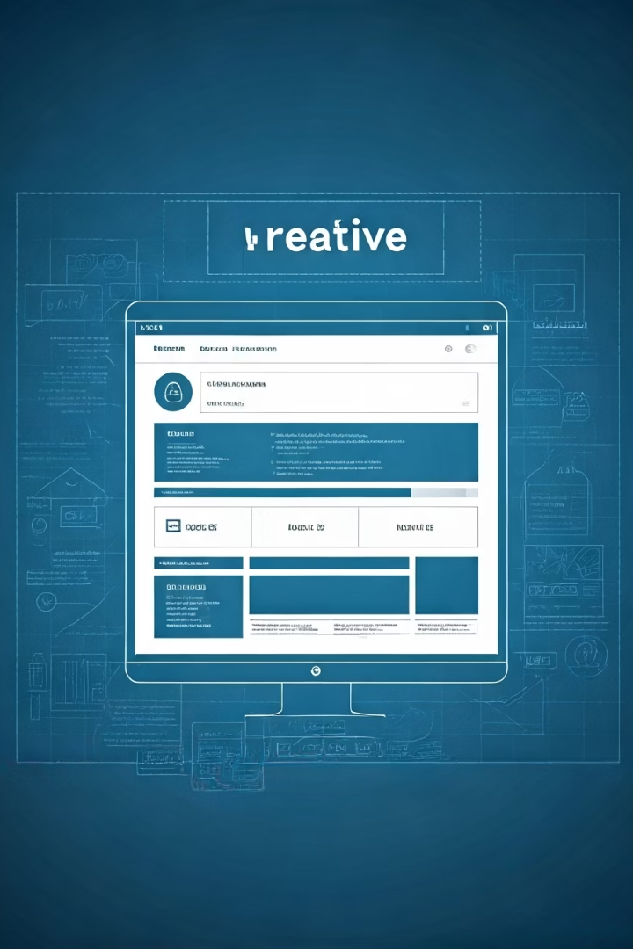
Future Improvements
I plan to enhance the website further. Performance and design will also be improved. This will make the site even better.
Adding More Features:
Real-Time Order Tracking
Restaurant Listings
Smart Search & Filters
User Accounts & Order History
Dark Mode Option
Provide a toggle for a dark theme interface.

Slide 7
Thank You!
Thank you for your time and attention today. I hope you enjoyed this presentation.

