Slide 1
BOOKSWAGON
TEAM-2
JAVVAJI BHAVITHA

Slide 2
OBJECTIVE:
The main objective of BooksWagon project is to work on
Register and Login.
Personal Settings.
Shopping Cart.
Search/ Refine your Search.
Award Winners/Sort By.
Request A Book.
My Wishlist.
Add Address.

Slide 3
AGENDA
Test case Design
Selenium + Cucumber Scripts
POM + Framework
Logs & Reports
TesNG

Slide 4
ARCHITECTURE
STEP DEFINITION
GHERKIN SCRIPT(FEATURE FILE)
TEST CASE DESIGN
BOOKSWAGON
TESTNG
PAGE OBJECT MODEL(POM)
REPORTS
LOG4J

Slide 5
TestCase Design
TestCase : Detailed set of instructions for testing
A specific functionality. Which includes,
Test Scenario ID
Test Case ID
Test Description
Steps to be Executed
Test Data
Expected Result
Actual Result
Test Result
Why TestCase?
Consistency
Traceability
Documentation
Debugging
Training
How implemented Test case Design in Project?
Requirement Analysis
Test Scenarios
Test Case ID
RTM
Defect Report

Slide 6
Selenium
Selenium: is an opensource framework used for automating web browsers
How implemented the selenium in project?
Used selenium webdriver to interact with the browsers

Slide 7
PAGE OBJECT MODEL(POM)
PAGE OBJECT MODEL:
Design Pattern
Code Reusability
Easy Maintenance
Increased Readability
Improved Test Stability
Enhanced Organization
Encapsulation
How POM implemented in our project:
Instantiated the WebDriver
Used locators: id, name, xpath, CSSSelector
Designed the script page by page
We used individual class for every functionality
We used:
Hybrid Framework
Behaviour Driven Framework
Cucumber Framework
Page Object Model

Slide 8
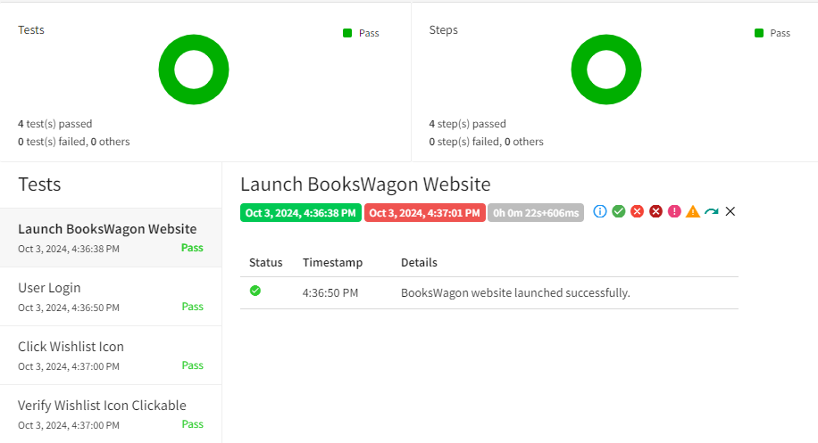
REPORTS
EXTENT REPORTS:
Extent Reports is an open-source reporting library useful for test automation
How we implemented the extent reports:
We used two classes to implement the extent reports in step definition class as follows,
ExtentReports , ExtentTest
The ExtentReports class generated HTML reports
The ExtentTest class logs test steps onto the previously generated HTML report.
The generated extent report looks like,
package stepdefination;
import static org.junit.Assert.assertEquals;
import static org.junit.Assert.assertTrue;
import org.apache.log4j.Logger;
import org.openqa.selenium.By;
import org.openqa.selenium.WebDriver;
import org.openqa.selenium.WebElement;
import org.openqa.selenium.chrome.ChromeDriver;
import com.pages.RLL_240Testing_BooksWagon.LoginPage;
import com.pages.RLL_240Testing_BooksWagon.MyWishlistPage;
import com.aventstack.extentreports.ExtentReports;
import com.aventstack.extentreports.ExtentTest;
import com.aventstack.extentreports.reporter.ExtentHtmlReporter;
import io.cucumber.java.After;
import io.cucumber.java.en.Given;
import io.cucumber.java.en.Then;
import io.cucumber.java.en.When;
public class WishlistSteps {
// WebDriver instance for browser interactions
private WebDriver driver;
// Page object for login actions
private LoginPage loginPage;
// Logger instance for logging information
Logger log;
// Extent Reports instances
private ExtentReports extent;
private ExtentTest test;
// Locators for elements used in this step definition
private By wishlistCountLabel = By.xpath("//label[@id='ctl00_lblWishlistCount']");
private By productTitle = By.xpath("//span[@id='ctl00_phBody_ProductDetail_lblTitle']");
// Expected title for the 7th card
private String expectedTitle = "White Nights";
// Constructor to initialize WebDriver and LoginPage
public WishlistSteps() {
// Initialize the WebDriver (ensure the appropriate driver executable is in your path)
driver = new ChromeDriver();
loginPage = new LoginPage(driver);
log = Logger.getLogger(WishlistSteps.class);
// Set up Extent Reports
ExtentHtmlReporter htmlReporter = new ExtentHtmlReporter("reports/extentReport.html");
extent = new ExtentReports();
extent.attachReporter(htmlReporter);
}
// Step definition: Launches the BooksWagon website
@Given("the user launches the BooksWagon website")
public void the_user_launches_the_bookswagon_website() {
log.info("Launching the BooksWagon website...");
test = extent.createTest("Launch BooksWagon Website");
loginPage.launchBooksWagon();
log.info("BooksWagon website launched successfully.");
test.pass("BooksWagon website launched successfully.");
}

Slide 9
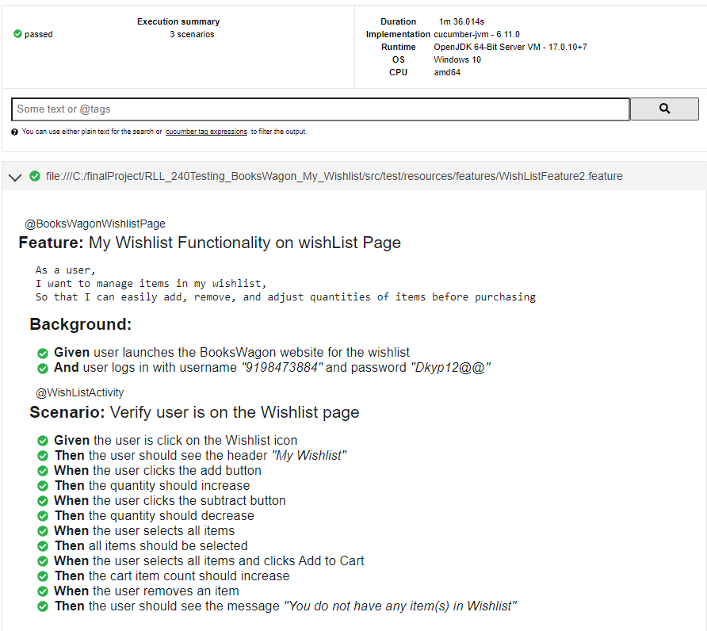
REPORTS
CUCUMBER REPORT(cucumber-reports.html):
Cucumber reports are generated to provide detailed summaries
of test execution results when using the Cucumber framework
These reports help in understanding the outcomes of your test scenarios, making it easier to identify issues and track progress
We generated cucumber report in TestNG class like this,
package stepdefination;
import io.cucumber.testng.AbstractTestNGCucumberTests;
import io.cucumber.testng.CucumberOptions;
@CucumberOptions(
features = { "src\\test\\resources\\features\\WishlistFeature.feature", "src\\test\\resources\\features\\WishListFeature2.feature"},
glue = "stepdefination", // Adjust to your package
plugin = {"pretty", "html:target/cucumber-reports.html"}
)
public class RunnerTest extends AbstractTestNGCucumberTests {
}

Slide 11
TESTNG
TestNG is a testing framework inspired by JUnit and NUnit but designed to make test automation more
powerful and easier to use.
We used TestNG to work with the Runner file
We created TestNG class as follows,
package com.RunnerArtifacts;
import io.cucumber.testng.AbstractTestNGCucumberTests;
import io.cucumber.testng.CucumberOptions;
@CucumberOptions(
features = { "src\\test\\resources\\features\\WishlistFeature.feature“},
glue = "stepdefination", // Adjust to your package
plugin = {"pretty", "html:target/cucumber-reports.html"}
)
public class RunnerTest extends AbstractTestNGCucumberTests {
}

Slide 12
LOGS
“Logs are records of events or messages generated by software applications or systems to provide information about their operation.”
How we implemented the logs in our project:
We used log4j in our script as follows,
Logger log;
log = Logger.getLogger(HomeSteps.class);
Log.info(“The user is on homepage”);
The above code we implemented in step definition file
Why we used logs in our project:
Debugging
Monitoring
Audit Trail
Performance Analysis

Slide 13
PAGE OBJECT MODEL(POM)
We used:
Hybrid Framework
Behaviour Driven Framework
Cucumber Framework
Page Object Model
How POM implemented in our project:
Used Xpath
Designed the script page by page
We used individual class for every functionality
Created TestNG class to run the

Slide 14
TestCase Design
TestCase : Detailed set of instructions for testing
A specific functionality. Which includes,
Test Scenario ID
Test Case ID
Test Description
Steps to be Executed
Test Data
Expected Result
Actual Result
Test Result
Why TestCase?
Consistency
Traceability
Documentation
Debugging
Training

