Slide 1






Women in Tech Program
Python 1
Home
Content
Contact
Introduction to
DRINKSLAUNCH
Student: Jawa Dayoub
Tutor: Laila Abbas
Mentor: Azab Ahmad

Slide 2


Women in Tech Program
Home
Content
Contact
Welcome to DrinksLaunch – a smart, interactive store management and ordering system. From real-time stock tracking across multiple stores to instant receipt generation and dynamic pricing, DrinksLaunch brings convenience and control right to your fingertips. Let’s explore how it transforms both employee management and customer experience!
DRINKSLAUNCH

Slide 3
Women in Tech Program
Home
Content
Contact
Track drink availability across multiple stores in real-time.
Simplify customer ordering with instant receipts.
Allow employees to easily manage inventory.
OBJECTIVES
&
GOALS
Ensure accurate stock and pricing.
Speed up order processing and improve customer experience.
Showcase Python skills with a modern, interactive terminal app.

Slide 4


Women in Tech Program
Home
Content
Contact
This is Jawa
She is working in a drinks store
She often struggled to
know which drinks were available at each store.
Keeping track of stock, updating prices, and making sure nothing ran out was confusing and stressful.
Sometimes, customers waited too long or received wrong orders, and she wanted a better way to manage everything.
So she created DrinksLaunch: a smart, interactive system that lets her track inventory in real-time, manage stock easily, and provide customers with fast, accurate orders and instant receipts.
WHO IS HER TARGET AUDIENCE?
Herself as a Store Manager and an Employee: To manage inventory effortlessly.
Customers like her friends: To get quick, reliable orders.
Employees in her team: To make stock updates simple and error-free.

Slide 5
Women in Tech Program
Home
Content
Contact
Real-time stock updates: She always knows exactly what’s available, avoiding delays and mistakes.
All-in-one management: Employees can add, edit, or delete products instantly—no more messy spreadsheets.
Instant receipts for customers: No waiting, no confusion—orders are accurate and fast.
Multi-store oversight: She can track inventory across multiple locations effortlessly.
User-friendly and visually appealing: Makes ordering and management simple and enjoyable for everyone.
Unlike other stores or ordering systems, she built DrinksLaunch with her own challenges in mind:
COMPETITIVE ADVANTAGE
In short, DrinksLaunch solves problems the way she experienced them, making it smarter, faster, and more reliable than traditional systems.

Slide 6

Women in Tech Program
Home
Content
Contact
Problem-Driven Design
She started by identifying the real challenges she faced: stock confusion, slow ordering, and messy inventory updates.
System Planning & Structure
She mapped out the flow for employees and customers, created store dictionaries, pricing logic, and receipt generation.
METHODOLOGY AND TECHNOLOGIES USED
Incremental Development
The app was built step-by-step—first basic functions, then store selection, ordering, validation, and receipt printing.
User-Centered Testing
She tested every feature from both the employee side and customer side to ensure clarity, speed, and ease of use.
Continuous Improvement
Whenever she discovered a problem (missing stock, invalid input, unclear messages), she refined the system to make it smarter and smoother.

Slide 7


Women in Tech Program
Home
Content
Contact
Python
Core programming language used to build all system logic.
METHODOLOGY AND TECHNOLOGIES USED
Dictionaries & Functions
For dynamic storage, product management, and modular features.
datetime module
To generate real-time receipts with GMT+3 timestamps.
Input Validation
To ensure users enter correct and safe data.
Loops & Conditional Statements
To manage menus, choices, and system flow.
pyfiglet library
For stylish, professional ASCII banners and a better user experience.

Slide 8
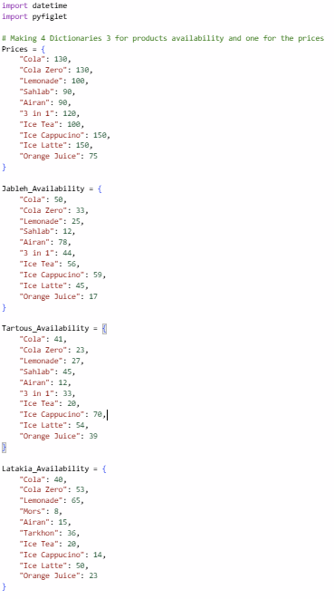
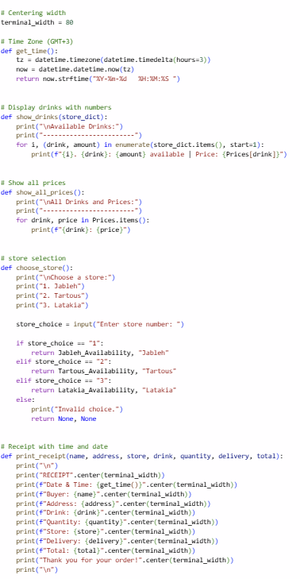
Women in Tech Program
Home
Content
Contact
THE FUNDEMENTALS
Here we have the basis of the whole code:
On the left we have the dictionaries we are using to detect the products in Jableh, Latakia and Tartous stores and a dictionary to show the prices
On the right we have the functions: for changing the time, showing the prices, selecting stores by number and printing a receipt with the time and date

Slide 9
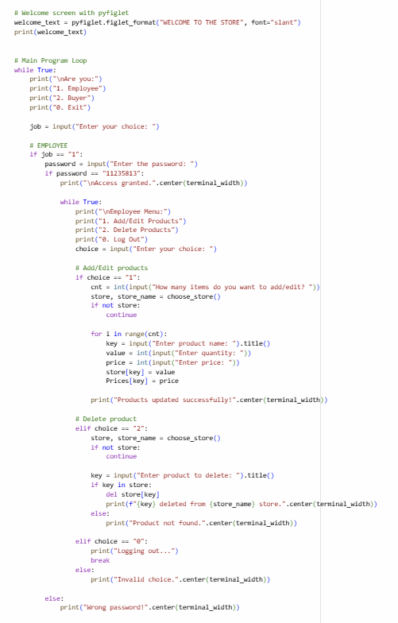
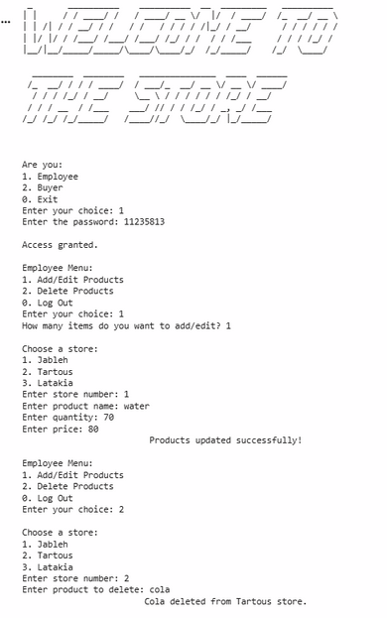
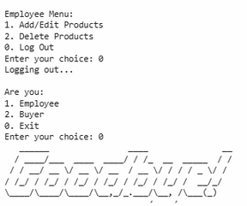
Women in Tech Program
Home
Content
Contact
Multi-Store Inventory Tracking
The system manages three stores (Jableh, Tartous, Latakia) with separate availability for each product.
Add / Edit Products
Employees can instantly update product quantities and prices for any store.
Delete Products
Items can be removed from the store’s inventory with one command.
THE EMPLOYEE MENU

Slide 10
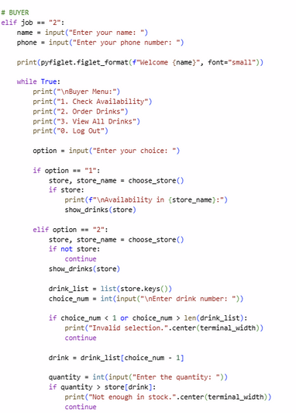
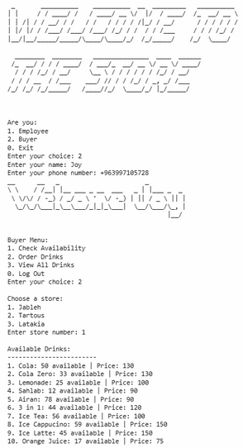
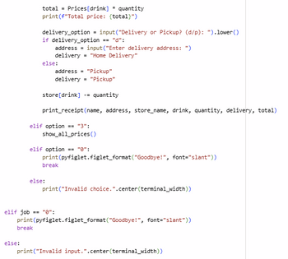
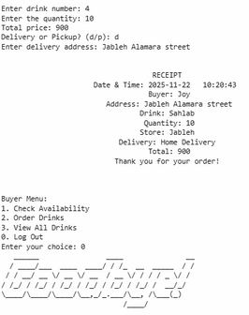
Women in Tech Program
Home
Content
Contact
THE BUYER MENU
Live Drink Availability
Instant access to stock and prices for every store.
Fast & Simple Ordering
Choose a drink, set quantity, and get automatic total calculation.
Instant Receipts
Auto-generated with time, date, and full order details.
Clean, Modern Interface
pyfiglet banners and clear menus enhance the user experience.
Delivery or Pickup
Flexible options for every customer.

Slide 11
Women in Tech Program
Home
Content
Contact
She started building DrinksLaunch with a simple idea:
one system that could manage many stores, help employees work faster, and make ordering easier for buyers.
But making all of this run smoothly wasn’t simple…
KEY CHALLENGES
Managing 3 different stores
She had to separate each store’s availability while keeping all prices connected in one place. This required reorganizing dictionaries multiple times.
Creating a clean experience for both employees and buyers
Different menus, different functions, and shared data — connecting everything without breaking one side was a major puzzle.
Building the Add / Edit / Delete system
Inputs, validation, updating stock, syncing prices… one wrong line and everything crashed. She fixed it step by step until each feature worked smoothly.
Handling orders and stock changes correctly
Making sure availability updated right, preventing negative stock, and linking prices with quantities took careful logic.
Designing the receipt system
Centering text, formatting details, handling delivery vs pickup, and applying GMT+3 correctly all needed multiple fixes.
HOW SHE OVERCAME THEM?
With every bug she solved, she rewrote functions to be cleaner, reused logic instead of repeating code, and organized everything into small, stable parts.
Bit by bit, the system became faster, clearer, and more professional — turning her idea into a real working program.

Slide 12

Women in Tech Program
Home
Content
Contact
Added Value
Central system for all three stores
Real-time stock updates after every order
Fast employee tools (add/edit/delete products)
Automatic, clean, time-stamped receipts
ADDED VALUE & INNOVATION
Innovation
Multi-branch management using simple, efficient Python structures
Dual-mode design for employees and buyers in one program
Fully automated ordering workflow from selection to receipt
Professional touch with GMT+3 timestamps and styled pyfiglet interface

Slide 13
Women in Tech Program
Home
Content
Contact
Start & Welcome Screen
Show the pyfiglet welcome banner
Briefly explain the main menu (Employee / Buyer)
Buyer Demo
Enter name and phone
Check availability in a chosen store
Place an order (choose drink, quantity, delivery/pickup)
Show stock decreasing automatically
LIVE DEMONSTRATION PLAN
Employee Demo
Enter the correct password
Add a new product to one store
Edit an existing product
Delete a product
Show updated inventory
Receipt Showcase
Display the generated receipt with centered formatting and GMT+3 timestamp
Final Overview
Quick recap of how the system manages stores, updates stock, and automates orders efficiently.

Slide 14
Women in Tech Program
Home
Content
Contact
JAWA WANTS TO LEARN MORE, SO SHE CAN IMPLEMENT THE ENHANCEMENT SHE IS THRIVING FOR
Graphical User Interface (GUI)
Transition from terminal-based interaction to a modern, user-friendly interface using Tkinter or a web dashboard.
Centralized Database System
Replace dictionaries with an SQL database to securely store inventory, prices, users, and order history across all branches.
User Accounts & Authentication
Add logins for employees and buyers, with roles, permissions, and personalized dashboards.
Order History & Analytics
Track past orders, generate sales reports, and visualize inventory trends for smarter decision-making.
Online Ordering & Delivery Tracking
Allow customers to order from a mobile app or website and follow their delivery in real time.
Notifications System
Send low-stock alerts to employees and order confirmations to buyers via SMS or email.
Multi-language Support
Offer Arabic, English, and Russian interfaces for wider accessibility.

Slide 15
Women in Tech Program
Home
Content
Contact
DrinksLaunch successfully simplifies multi-store drink management by providing a fast, reliable, and user-friendly system for both employees and buyers.
Through automation, clear workflows, and real-time inventory updates, the project demonstrates how simple code can solve real operational problems and create a smoother experience for everyone involved.
I would like to sincerely thank my tutor and mentor for their continuous guidance and patience, and the Paper Airplanes team for their support throughout this learning journey.
CONCLUSION & ACKNOWLEDGMENTS
And finally — a special thanks to the 1C Enterprise interface, which, despite being one of the most challenging and confusing systems I’ve ever worked with, inspired me to create an app that’s actually intuitive, modern, and enjoyable to use.

Slide 16




Women in Tech Program
Home
Content
Contact
REFERENCES
Python Standard Library
WiT program resources
W3Schools Python Tutorials
ChatGPT: Changing the time zone to GMT +3

