Slide 1
Masked Face Recognition System
Ahmad Jawabreh
Zaid Mohtaseb
Ferhat Bal

Slide 2
Pareto Diagram
Quality Issue | 1 | 2 | 3 | 4 | 5 | 6 | Total
Number of Defects | 5 | 5 | 4 | 3 | 4 | 3 | 24
% Occurrence | 20.83% | 20.83% | 16.67% | 12.50% | 16.67% | 12.50% | 100%
Cumulative % Occurrence | 20.83% | 41.67% | 58.33% | 70.83% | 87.50% | 95.83%

Slide 3
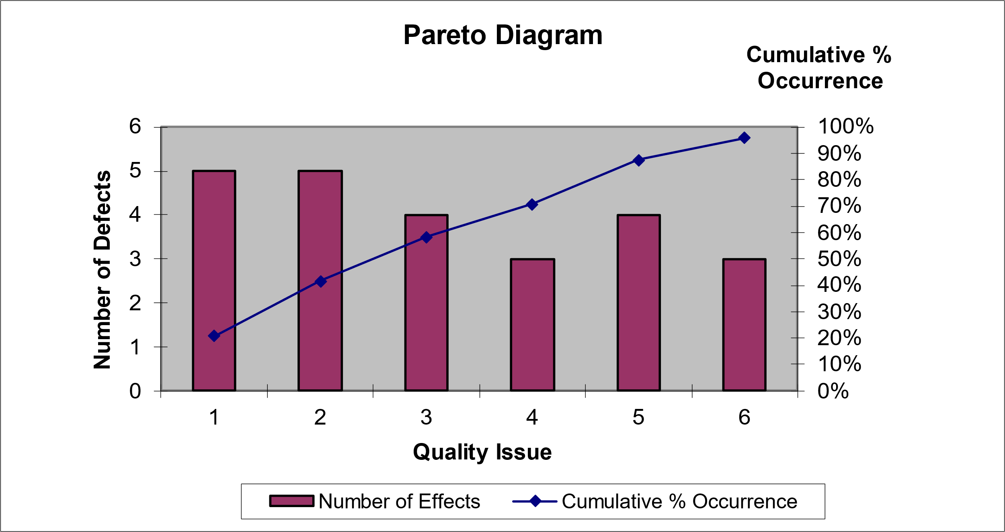
Cont.

Slide 4
Resource Histogram
Resource | 1 | 2 | 3 | 4 | 5 | 6 | 7
Ahmad | 1 | 0 | 1 | 1 | 1 | 1 | 0
Zaid | 0 | 1 | 1 | 0 | 0 | 1 | 0
Ferhat | 0 | 0 | 0 | 0 | 1 | 1 | 1

Slide 5
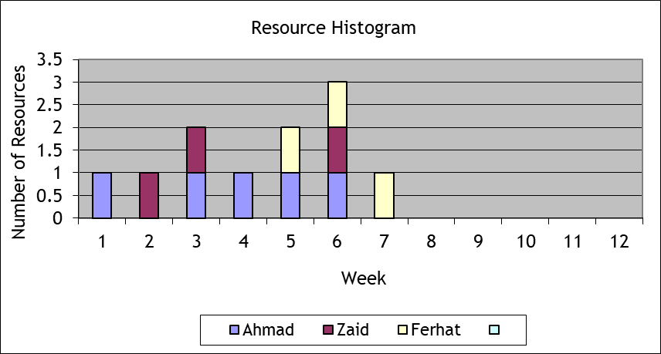
Resource Requirements

Slide 6
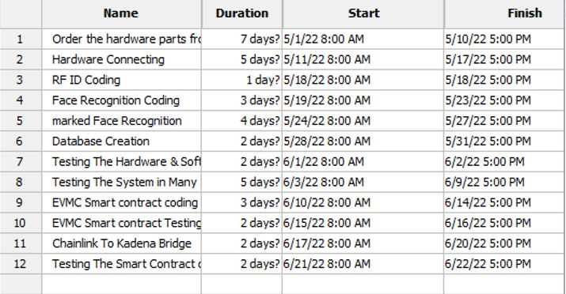
Gant Chart

Slide 7
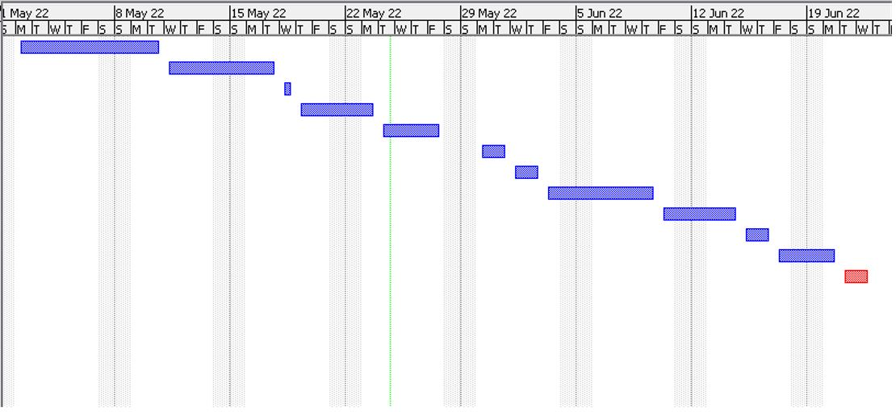
Cont.

Slide 8
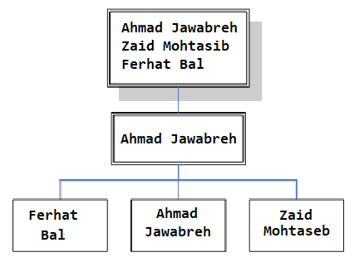
Project Organization
Name | Role | Phone Number | Email Address
Ahmad Jawabreh | Project Manager Hardware Specialist Smart Contract Developer | +972592675704 | Ahmadjawabreh@protonmail.com
Zaid Mohtasib | Software Engineer | +97256937208 | Zaidmoh@protonmail.com
Ferhat Bal | QA Specialist | +905338817935 | ferhatbal@protonmail.com

Slide 9
Resource Assignment
Task ID | Task | Team member
1 | Hardware connecting | Ahmad (P)
2 | Coding | Zaid (P)
3 | Database creation | Zaid (P)
4 | Smart contract development | Ahmad (P)
5 | Testing | Ferhat (P)

Slide 10
Resource Constraints
Experts from Chainlink Labs have already been hired, who are responsible for creating the smart contract (bridge) that will connect the KADENA network with the Chainlink network, and the same experts have been asked to help the team to solve a problem that we encountered in the truffle environment.

Slide 11
Contingency Plans
15% of the company’s net profits will be continuously deducted and placed in the company’s treasury to serve as the company’s reserve in case we face any financial problem that requires liquidity.

Slide 12
Training Requirements
Hardware Team:
Bachelors Degree in Computer Engineering, Electrical and Electronic Engineering or a related technical discipline.
Extensive experience with Arduino, RaspberryPi and Microcontrollers.
Software Team :
Bachelors Degree in Software Engineering, Computer Science or a related technical discipline.
Extensive experience with Python.
Smart contract team:
Write well-documented, performant, clean, and re-usable Solidity code.
Familiar with EVM environments
Familiar with Pact and Plutus programming languages.

Slide 13
HR Change Management Process
Changes will be overlooked carefully. But before the changes, it will be discussed as to why the change is needed and if that change is even enough to fix the main problem and we will also look for the risks revolving around the said change and then it will be implemented upon approval. The changes will be implemented in the simple following 4 steps:
Preparing for Change
Initiating Change
Putting Change in Place
Stabilizing Change

Slide 14
Plan Modification Rules
Any changes on the plan need the project manager approval.
Changes related to the financial issues needs the approval of the finance department with the project manager approval.
Changes related to the hardware work needs the approval of the hardware department with the project manager approval.
Changes related to the software work needs the approval of the software department with the project manager approval

Slide 15
Achievement of Project Objectives
Project objectives
Find a solution to recognize masked faces.
Find alternative authentication method based on touch less.
Decentralization of processing the data.
Project outputs:
Masked Face Recognition System.
Alternative authentication method, RFID system.
Blockchain connection to data transfer and validation

Slide 16
Project Performance
Cost: In the cost estimation was 1880TL but in face the project costs us 2300TL
Time: The project was done on the time without any changes

Slide 17
Approved Changes
One of the team members left the team, the tasks assigned to each team member were restructured by dividing the tasks of the member who left on the rest of the team members to complete the project within the specified time.

Slide 18
Post Implementation Review
A review after implementation began with a comprehensive evaluation of the actual cost of the project compared to the Cost Estimation and a review of the reasons that led to an increase in the cost. The review also included an evaluation of the time, as the project was completed on time actually, and the last review was for the quality of the product and to ensure that the product can perform its function with the highest limit of permissible errors.

