Slide 1

Deep Learning-Based Image Classification on CIFAR10 Dataset
Evaluating Custom CNNs vs. Transfer Learning (MobileNetV2)
Jawad ALHARAKE
14/07/2026

Slide 2






Project Objective
The primary goal of this project is to comparatively analyze two distinct approaches to deep learning image classification using the CIFAR-10 dataset:
🏗
🧩
⚖
Baseline Establishment: Build, train, and optimize a Custom Convolutional Neural Network (CNN) entirely from scratch to understand foundational feature extraction.
Advanced Implementation: Implement Transfer Learning using a pre-trained MobileNetV2 backbone, modifying its classification head for our specific 10-class task.
Comparative Analysis: Evaluate both models based on accuracy, loss stabilization, computational efficiency (CPU training time), and resistance to overfitting.

Slide 3

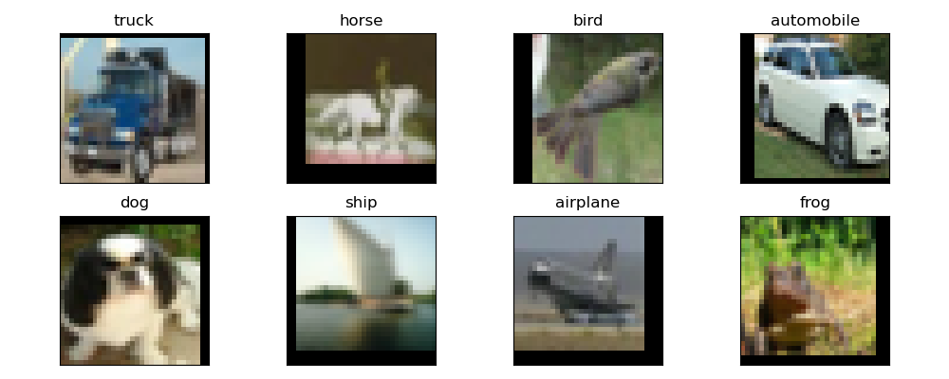

The Challenge: CIFAR-10 Dataset
The CIFAR-10 dataset presents a unique challenge for computer vision models due to its structure:
Contains 60,000 color images divided into 10 mutually exclusive classes (e.g., cars, birds, cats, ships).
Low Resolution (32x32): Because the images are extremely small, models cannot rely on high-definition textures and must instead learn to classify based on coarse, granular shapes and silhouettes.
A visual snapshot of a preprocessed training batch sample of the CIFAR10 dataset showcasing different target classes.
Data augmentation strategy: Presence of slight shifts and black padding boundaries on the edges of the images (like the horse, bird, and airplane) --> artificially enhance dataset variety to prevent overfitting.
train_transform = transforms.Compose([transforms.RandomCrop(32, padding=4)]

Slide 4
Dataset Distribution & Split Strategy
Total Data Pool: 60,000 total images
📚
🎛
📝
1. Training Set (66.6% | 40,000 Images): The "study material" for the networks.
2. Validation Set (16.6% | 10,000 Images): The "practice exam" run automatically at the end of every single epoch.
3. Test Set (16.6% | 10,000 Images): The final "unseen exam" locked away until training is entirely finished.
Used directly by the models to adjust internal weights, learn edge detection, and map out class-specific geometries.
Provides an unbiased look at model generalization. This is the data that the Early Stopping mechanism monitors to detect and prevent overfitting.
Never used to tweak the models; used strictly to calculate the final accuracy metrics and render the final confusion matrices.

Slide 5
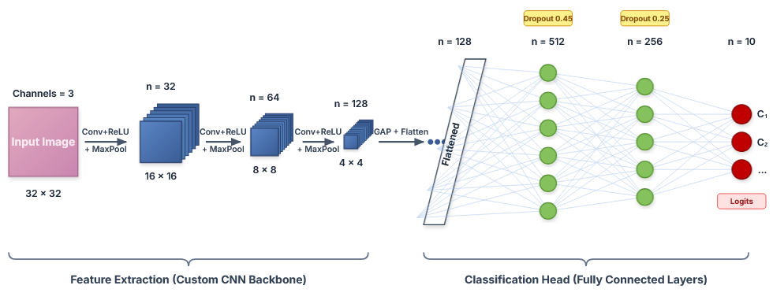


Custom CNN: Architecture & Dimensions
PyTorch Framework
self.classifier=nn.Sequential(
# Fully Connected Layer 1
nn.Linear(128, 512),
nn.ReLU(inplace=True),
nn.Dropout(p=0.45),
# Fully Connected Layer 2
nn.Linear(512, 256),
nn.ReLU(inplace=True),
nn.Dropout(p=0.25),
# Final Output Layer
nn.Linear(256, num_classes)
)
Linear
ReLU
Linear
ReLU
Linear
Optimization (Adam)
Output Activation (Logits)
Uses Adam optimizer for adaptive learning rates per parameter, ensuring faster convergence than standard SGD.
No explicit softmax is added to the final layer. Unlike Keras, PyTorch handles the Softmax math internally within nn.CrossEntropyLoss for numerical stability.

Slide 6
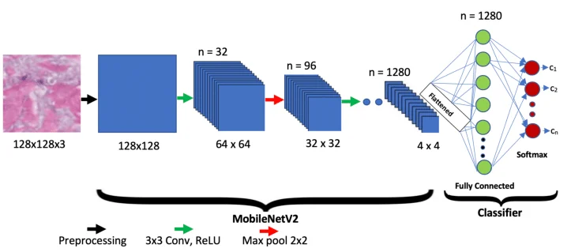
Transfer Learning: MobileNetV2
Frozen Parameters
for param in model.features.parameters():
param.requires_grad = False
if isinstance(module, nn.BatchNorm2d) and not any(p.requires_grad for p in module.parameters()):
module.eval()
Original Head
num_ftrs = model.classifier[1].in_features
model.classifier[1] = nn.Linear(num_ftrs, num_classes)
Akay, Metin & Du, Yong & Sershen, Cheryl & Wu, Minghua & Chen, Ting & Assassi, Shervin & Mohan, Chandra & Akay, Yasemin. (2021). Deep Learning Classification of Systemic Sclerosis Skin Using the MobileNetV2 Model. IEEE Open Journal of Engineering in Medicine and Biology. 2. 104-110. 10.1109/OJEMB.2021.3066097.

Slide 7
Number of Parameters used
Parameter Category | Custom CNN (From Scratch) | MobileNetV2 (Transfer Learning)
Original Full Model | N/A | 3,504,872
Removed Original Head | N/A | -1,281,000
Frozen Parameters | 0 | 2,223,872
Trainable Parameters | 293,194 | 12,810
Total Active Parameters | 293,194 | 2,236,682

Slide 8
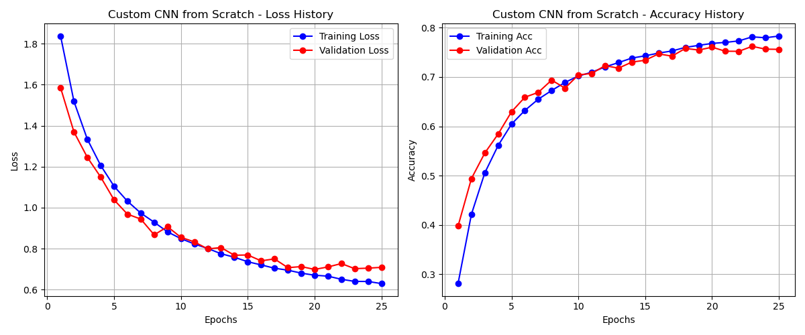
Training & Validation Sets - Custom CNN

Slide 9
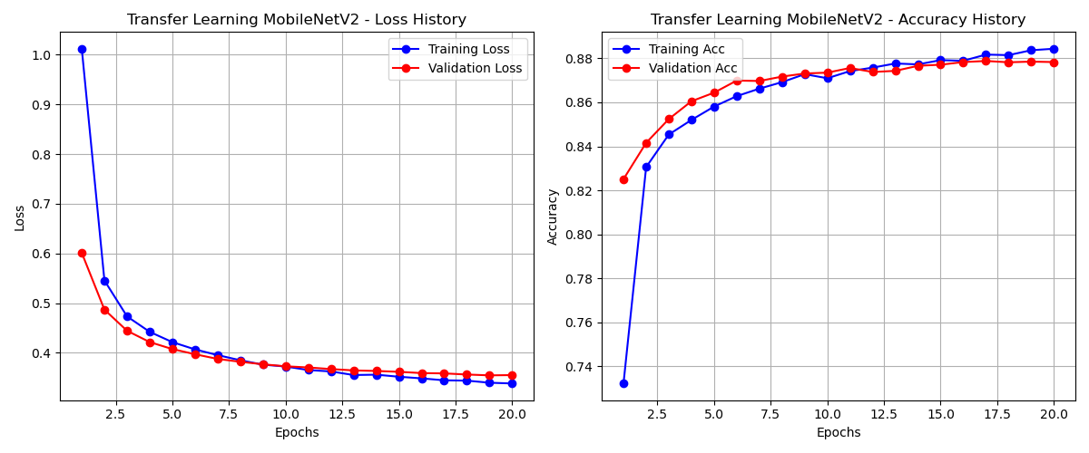
Training & Validation Sets - Transfer Learning
Conclusion: MobileNetV2 achieved 82.5% validation accuracy in its very first epoch. In contrast, it took Custom CNN 18 full epochs of intense training just to cross the 75% mark. This proves that MobileNetV2 didn't just learn faster; it arrived already knowing how to extract complex features, requiring only minor classification adjustments to immediately master our specific dataset.

Slide 10
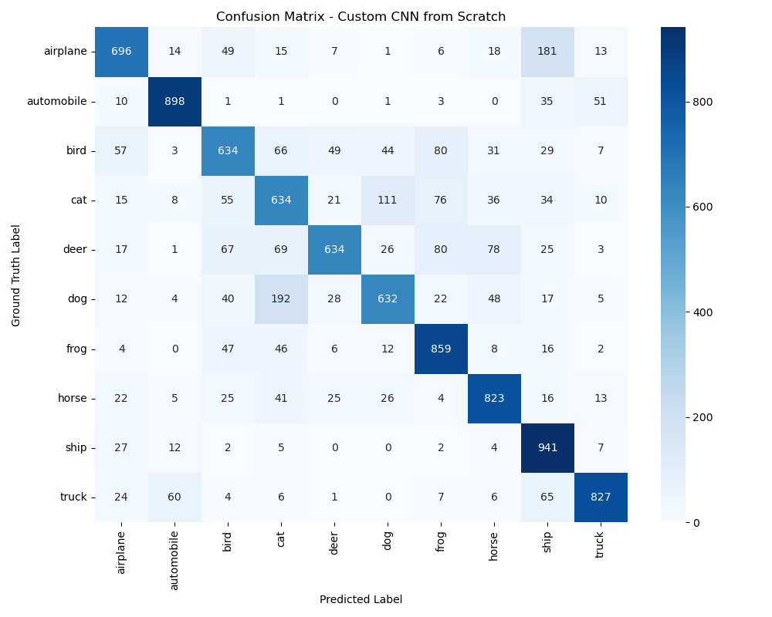
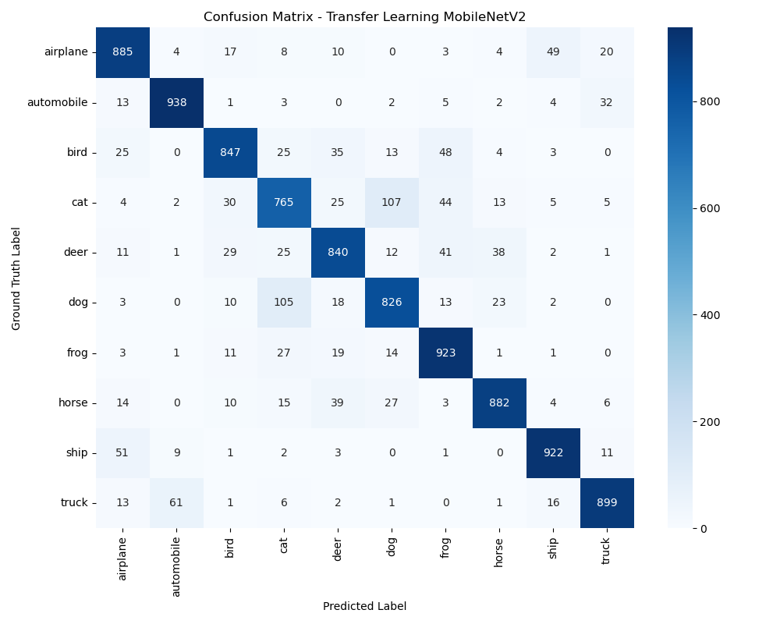
Confusion Matrix of Test Set

Slide 11
Final Performance Metrics
Metric | Custom CNN (From Scratch) | MobileNetV2 (Transfer Learning)
Total Epochs Run | 25/30 Epochs (Early Stopped) | 20 Epochs (Completed)
Total Training Time (CPU) | ~22 minutes | ~76 minutes
Final Test Accuracy | 76% | 87%
Best Class Performance | Automobile (90%) | Automobile (93%)
Weakest Class Performance | Cat (61%) | Cat (77%)

Slide 12
Project Challenges and Solutions
Challenge | Solution
Overfitting and Class Confusion (Custom CNN Focus) | Data Augmentation (random crops and horizontal flips) Dropout regularization (up to 45%) to the dense layers Implemented an Early Stopping safety net
Strict Hardware Limitations (Custom Transfer Learning Focus) | Selected MobileNetV2 instead of ResNet or VGG16 Froze over 2.2 million parameters in the pre-trained feature extractor, reducing trainable weights to just 12,810 Resized the photos to 128x128 instead of 224x224

Slide 13
Thank You !

