Slide 1


Slide 2

Project Context and Objectives
Context: The rapid spread of misinformation requires automated, scalable solutions to flag deceptive content.
Objective: Build an NLP machine learning pipeline to classify news headlines as either Real (1) or Fake (0).

Slide 3
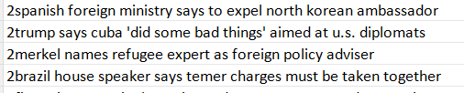
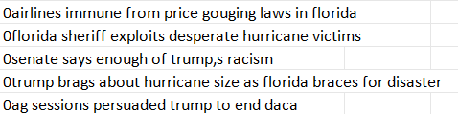
Dataset Overview
Training Set:
Before dropping duplicates: 34,152 headlines with an almost perfect 51/49 balanced class distribution.
After dropping duplicates: 32,206 headlines remain with an almost 50/50 balanced class distribution.
Testing Set: 9,984 unlabeled headlines containing a dummy label (2) to be overwritten.
Data is read with tab separator to separate the two columns correctly.
train_df=pd.read_csv(train_path, sep='\t', header=None, names=['label', 'headline'])

Slide 4
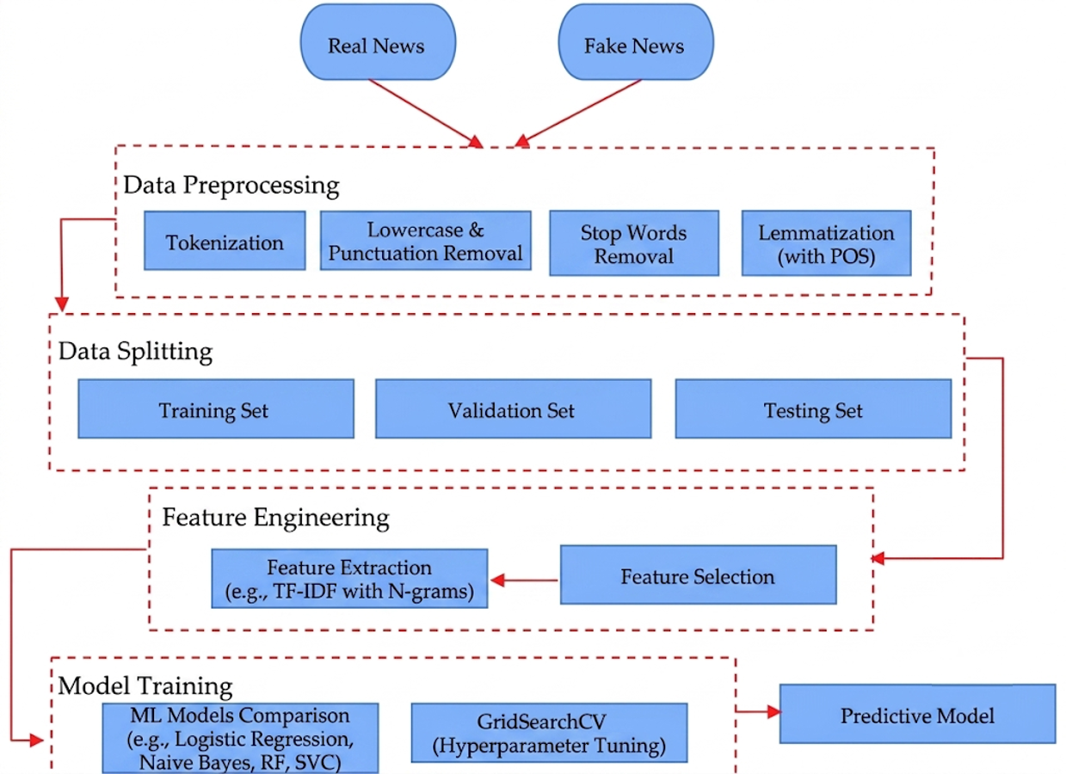
Pipeline Workflow & Architecture
Automated Execution: The pipeline strictly follows linear progression from ingestion to prediction.
Final Retraining: Before export, the model trains on 100% of the dataset to maximize vocabulary exposure.

Slide 5
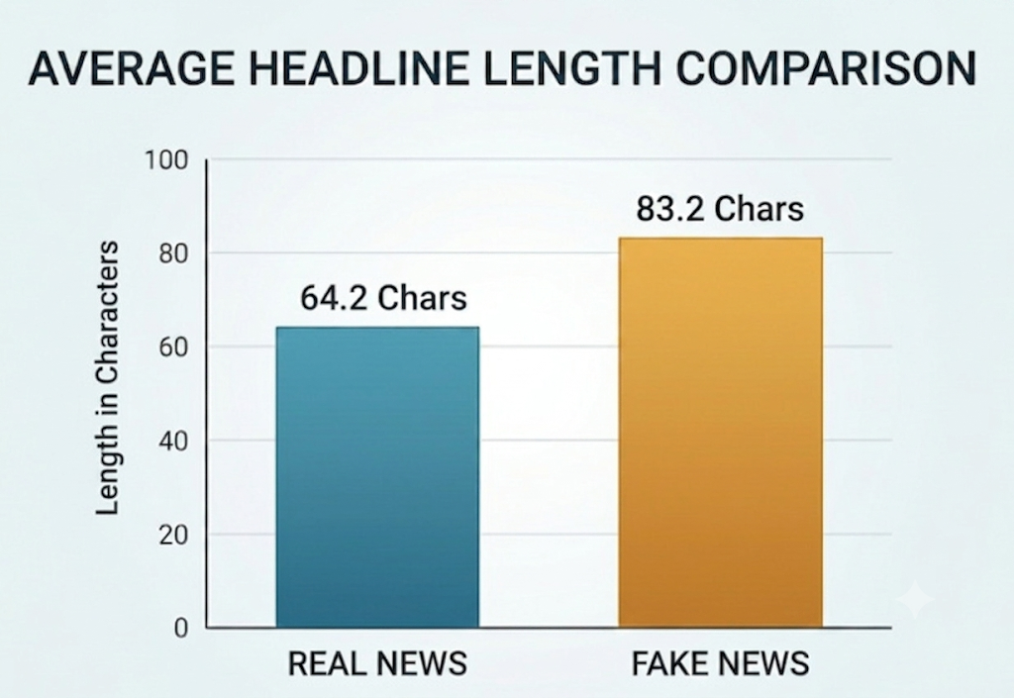
Exploratory Data Analysis
Analyzed headline lengths to find behavioral differences:
Real News Average: 64.2 characters.
Fake News Average: 83.2 characters.
Insight: Fake news headlines are structurally longer, likely relying on sensationalism and descriptive adjectives to grab attention.

Slide 6
Text Pre-processing
Regex Filtering: Replaced tabs, stripped non-alphanumeric characters, and squashed multiple spaces.
Stop Words: Removed structural noise (e.g., "the", "and") using NLTK corpora.
# 1. Convert to lowercase
text=str(text).lower()
# 2. Replace tabs and breaklines with space
text=re.sub(r"[\t\n]", " ", text)
# 3. Remove punctuation and non-alphanumeric characters
text=re.sub(r"[^a-zA-Z0-9\s]", " ", text)
# 4. Remove numbers
text=re.sub(r'\d+', ' ', text)
# 5. Remove standalone single characters (e.g. 's' after removing apostrophe)
text=re.sub(r'\s+[a-zA-Z]\s+', ' ', text)
text=re.sub(r'^[a-zA-Z]\s+', ' ', text)
# 6. Substitute multiple spaces with a single space and strip edges
text=re.sub(r'\s+', ' ', text).strip()
# 7. Tokenize, remove stopwords, and Lemmatize
words=text.split()
POS Tagging: Extracted grammatical context to distinguish nouns from verbs for the lemmatizer.
def get_wordnet_pos(word):
tag = pos_tag([word])[0][1][0].upper()
tag_dict = {"J": wordnet.ADJ,
"N": wordnet.NOUN,
"V": wordnet.VERB,
"R": wordnet.ADV}
return tag_dict.get(tag, wordnet.NOUN)

Slide 7
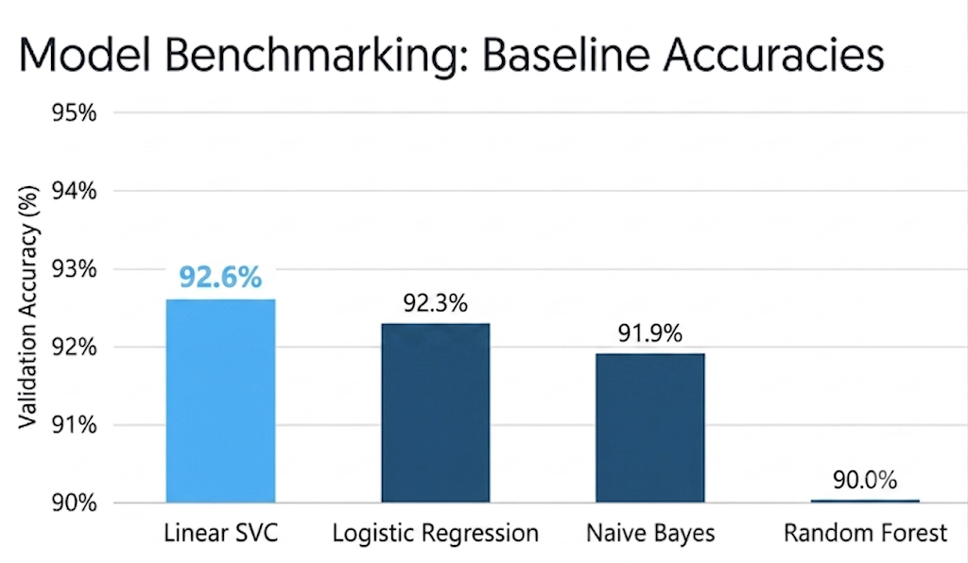
Benchmarking Models
The models rely exclusively on lexical features extracted from the text. They were evaluated on an 80/20 train-validation split using 5000 TF-IDF features (most significant terms):
Unigrams & Bigrams: Evaluate single words and two-word pairings (e.g., "election" vs. "election fraud").
TF-IDF Weights: Words frequent in one headline but rare overall receive higher mathematical weights, filtering out common noise.

Slide 8
Hyperparameter Tuning
Built a Scikit-Learn Pipeline combining the TF-IDF Vectorizer and the Classifier.
Used GridSearchCV with 3-fold cross-validation across 12 unique parameter combinations (total: 36 model fits).
Best Parameters Discovered:
ngram_range: (1, 3) (Using unigram, bigram and trigrams).
max_df: 0.75 (Ignoring words that appear in over 75% of headlines).
C: 10 (lower regularization, weaker penalty on coefficients --> less constrained on how large its weights can be).
def tune_best_model(X_train, y_train):
pipeline=Pipeline([
('tfidf', TfidfVectorizer()),
('clf', LogisticRegression(max_iter=1000))
])
param_grid= {
'tfidf__max_df': [0.75, 1.0],
'tfidf__ngram_range': [(1, 2), (1, 3)],
'clf__C': [0.1, 1, 10]
}
grid_search=GridSearchCV(pipeline, param_grid, cv=3, n_jobs=-1, verbose=1)
grid_search.fit(X_train, y_train)
return grid_search.best_estimator_

Slide 9
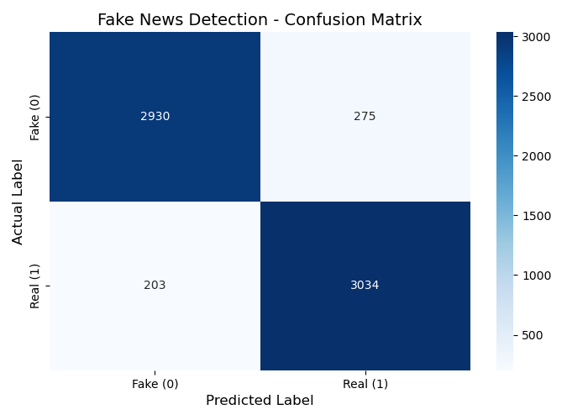
Model Evaluation & Results
The tuned model achieved exceptional, balanced results across both classes.
Overall Accuracy: ~92.5%
Precision: ~91.6%
Recall: ~93.7%
F1-Score: ~92.7%
The model perfectly balances catching fake news without accidentally penalizing real news.

Slide 10
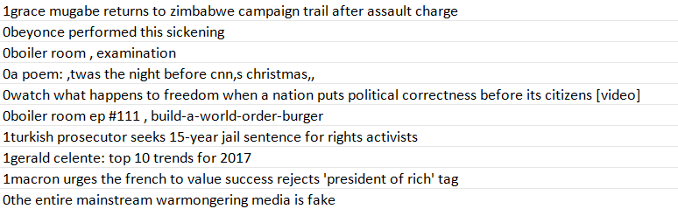
Final Output & Delivery
Retrained the finalized, tuned pipeline on 100% of the training dataset to maximize vocabulary exposure.
Processed the testing_data.csv through the exact same NLP cleaning pipeline.
Successfully predicted the labels and exported predicted_testing_data.csv while preserving the original tab-separated format without headers.

Slide 11
Conclusion
Preprocessing Matters: NLP preprocessing (like regex cleaning) has an important, measurable impact on model accuracy.
Efficiency of Baselines: Linear models combined with TF-IDF remain highly powerful and fast for semantic text classification.
Strategic Progression: Establishing strong, lightweight baseline models is a crucial first step before considering more computationally expensive approaches.

Slide 12
Thank You !

