Slide 1
Idea
A management system that helps manage the inventory and point of sale
Useful for:
Managing inventory
Tracking cash flow
Knowing which item is low on stock

Slide 2
Scenario
A friend asked me to build a management system for his pharmacy.
He wants to be able to:
Manage inventory
Manage invoices and sales
Track expenses
Have information on distributors and companies
Print invoices
Emailing System
Backup data
Track expiries and low stock

Slide 3
Design
Structure: Windows Forms application and Class Library
Data: SQL database
Language: C#
Users: One at a time
Tools: Visual Studio 2013 and MS SQL Server 2014
Key Concepts
Data Models and Class Library
Email
Backup
Error Handling
Interfaces

Slide 4
Mapping the Data
Items
Item Name
Item Category
Item Distributor
Item Company
Item Stock
Item Price
Category
Category Name
Batch
Batch Name
Batch Expiry
Item Batches
Batch ID
Item ID
Invoice
Invoice Date
Customer ID
Invoice Items
Item ID
Invoice ID
Item Quantity
Total
Customer
Customer Name
Customer Contact
User
Username
Password
Distributor
Distributor Name
Company
Company Name

Slide 5
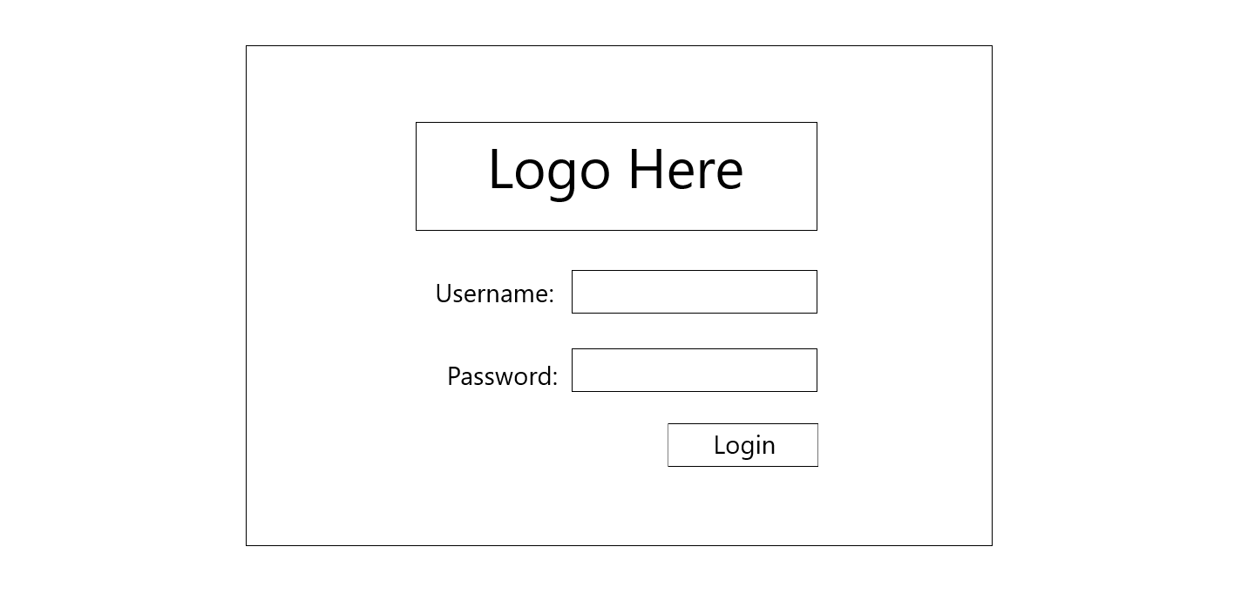
Login Form

Slide 6
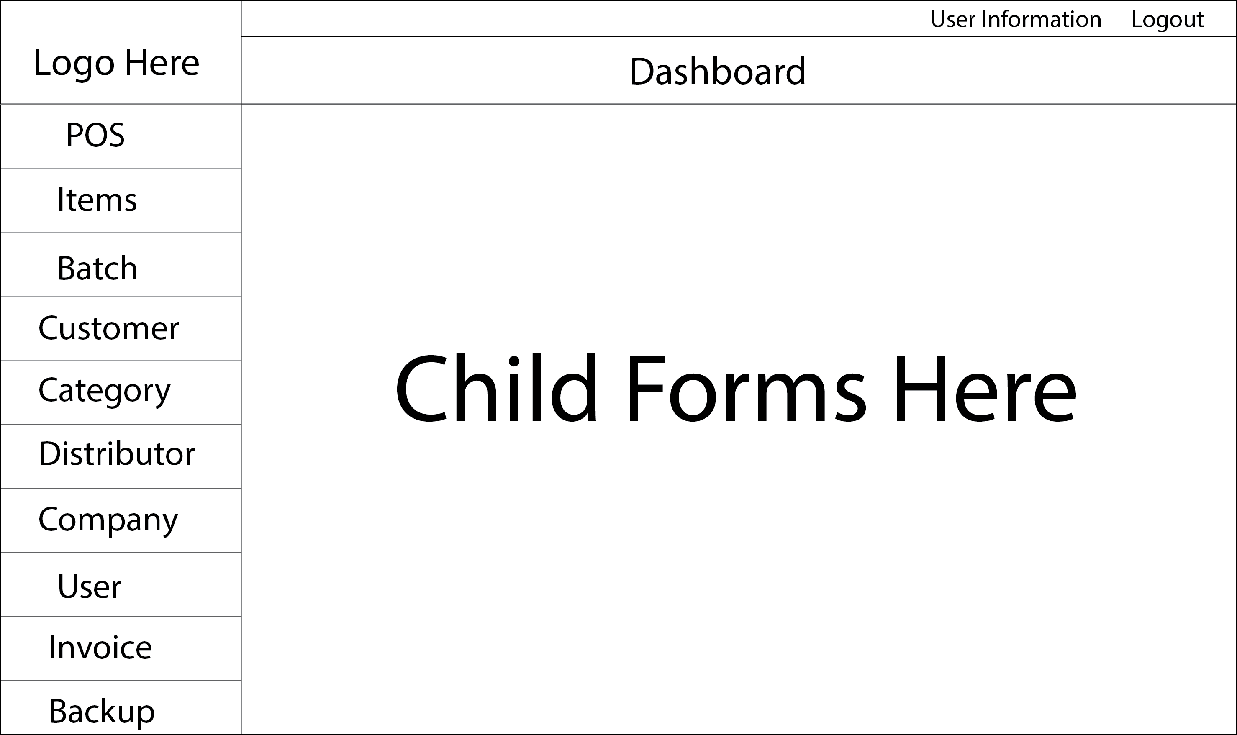
Dashboard Form

Slide 7
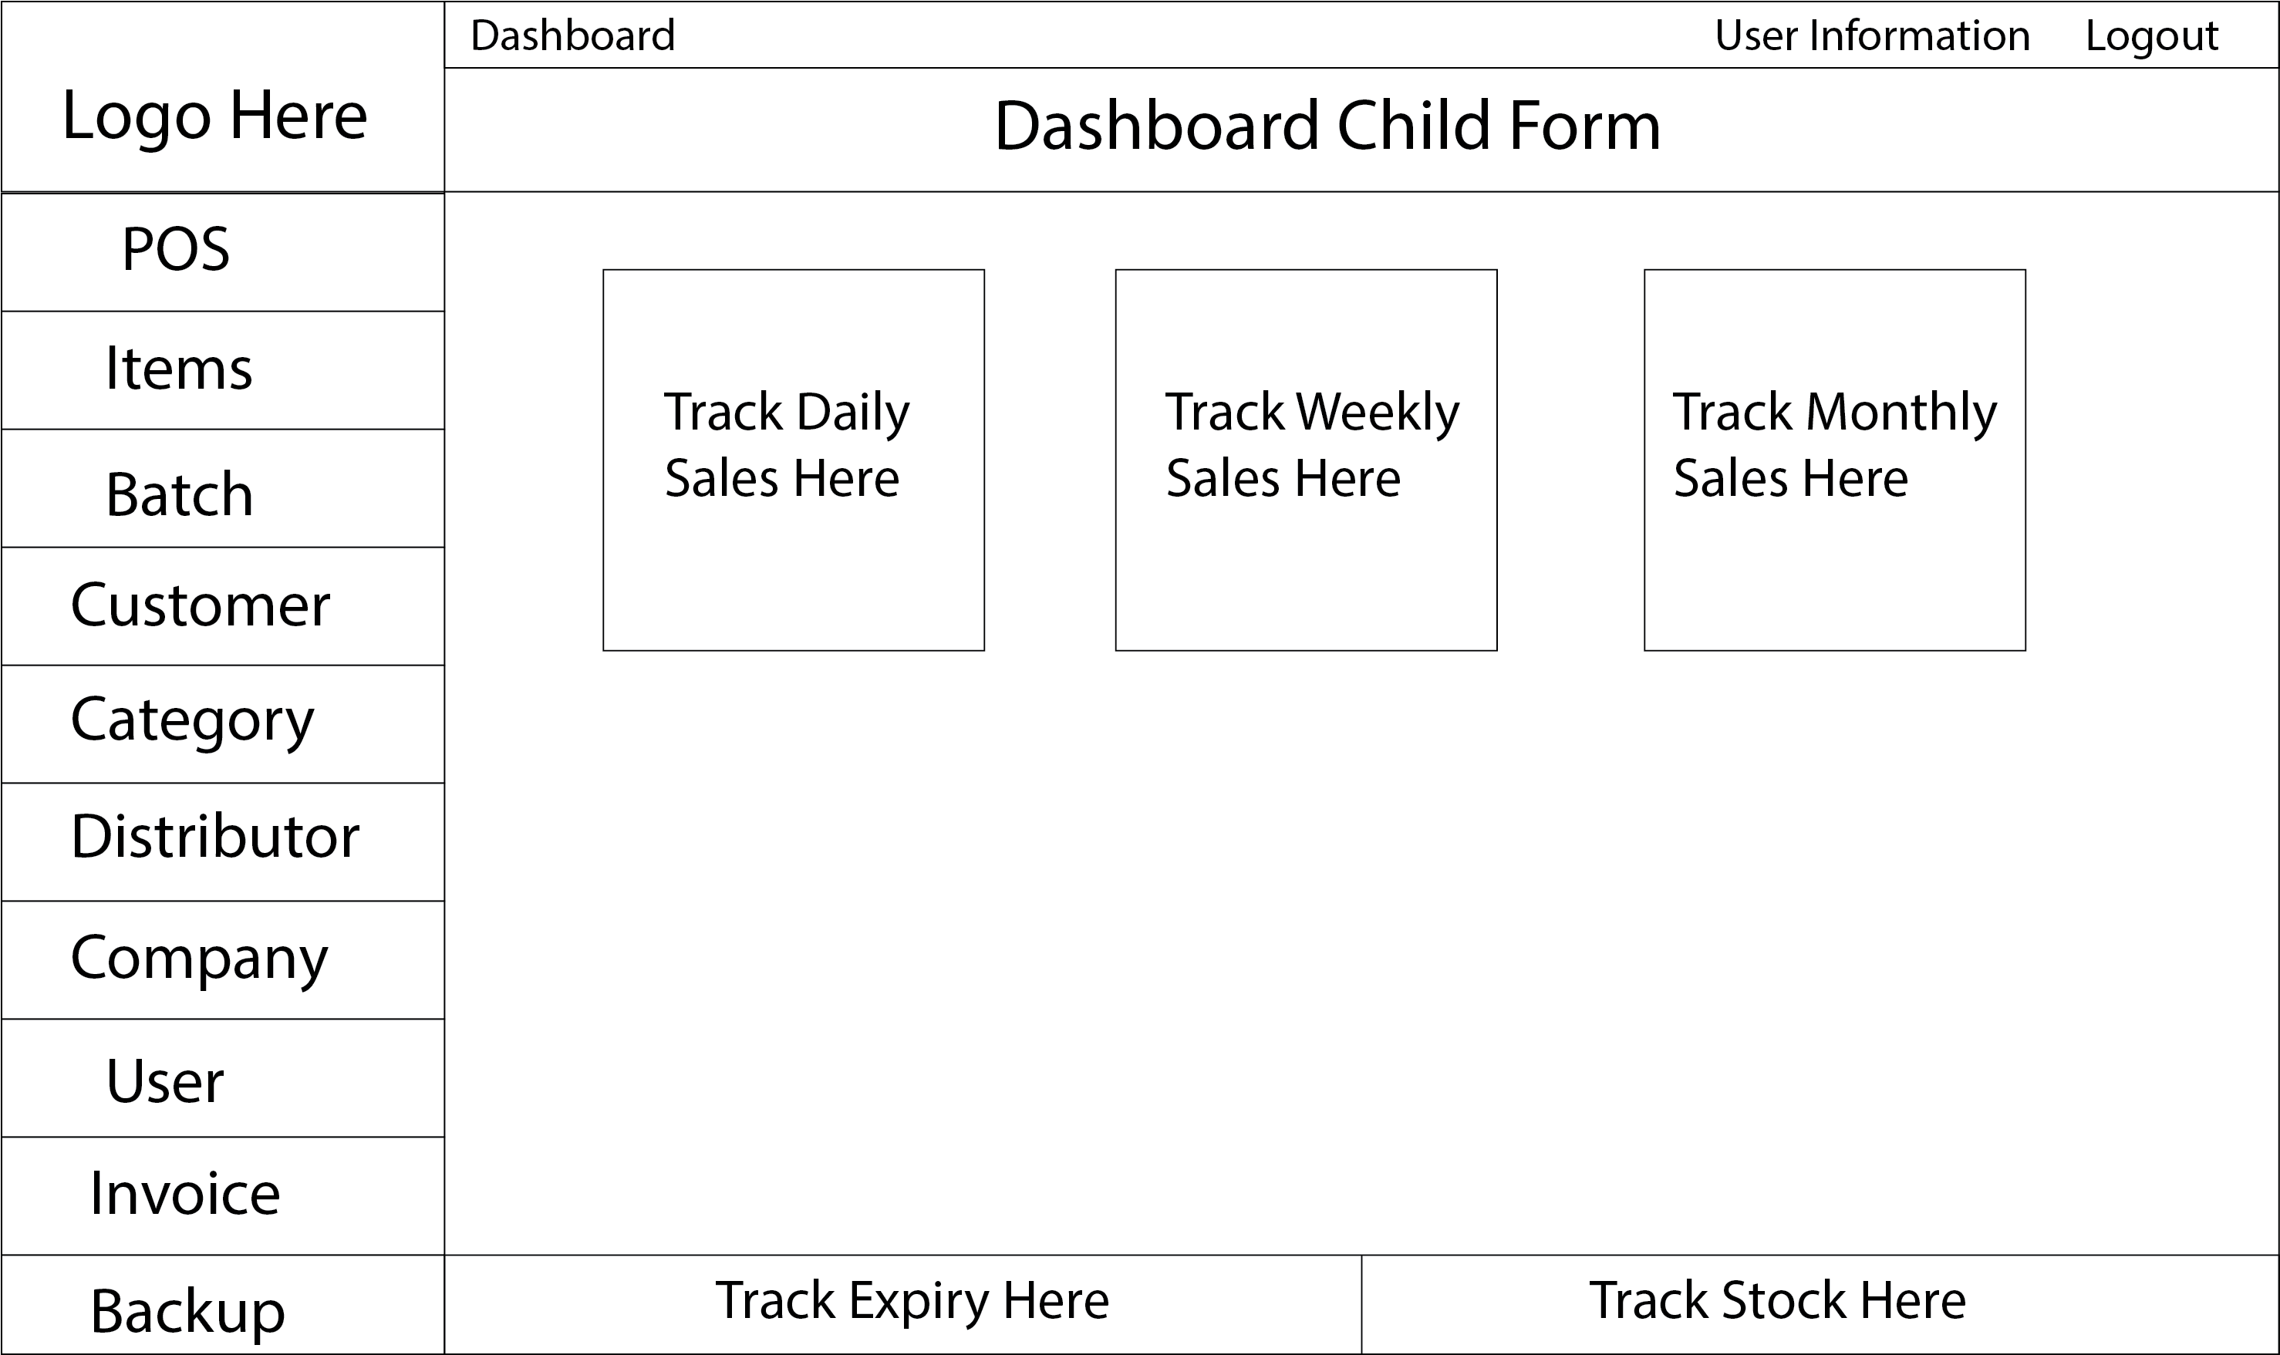
Dashboard Child Form

Slide 8
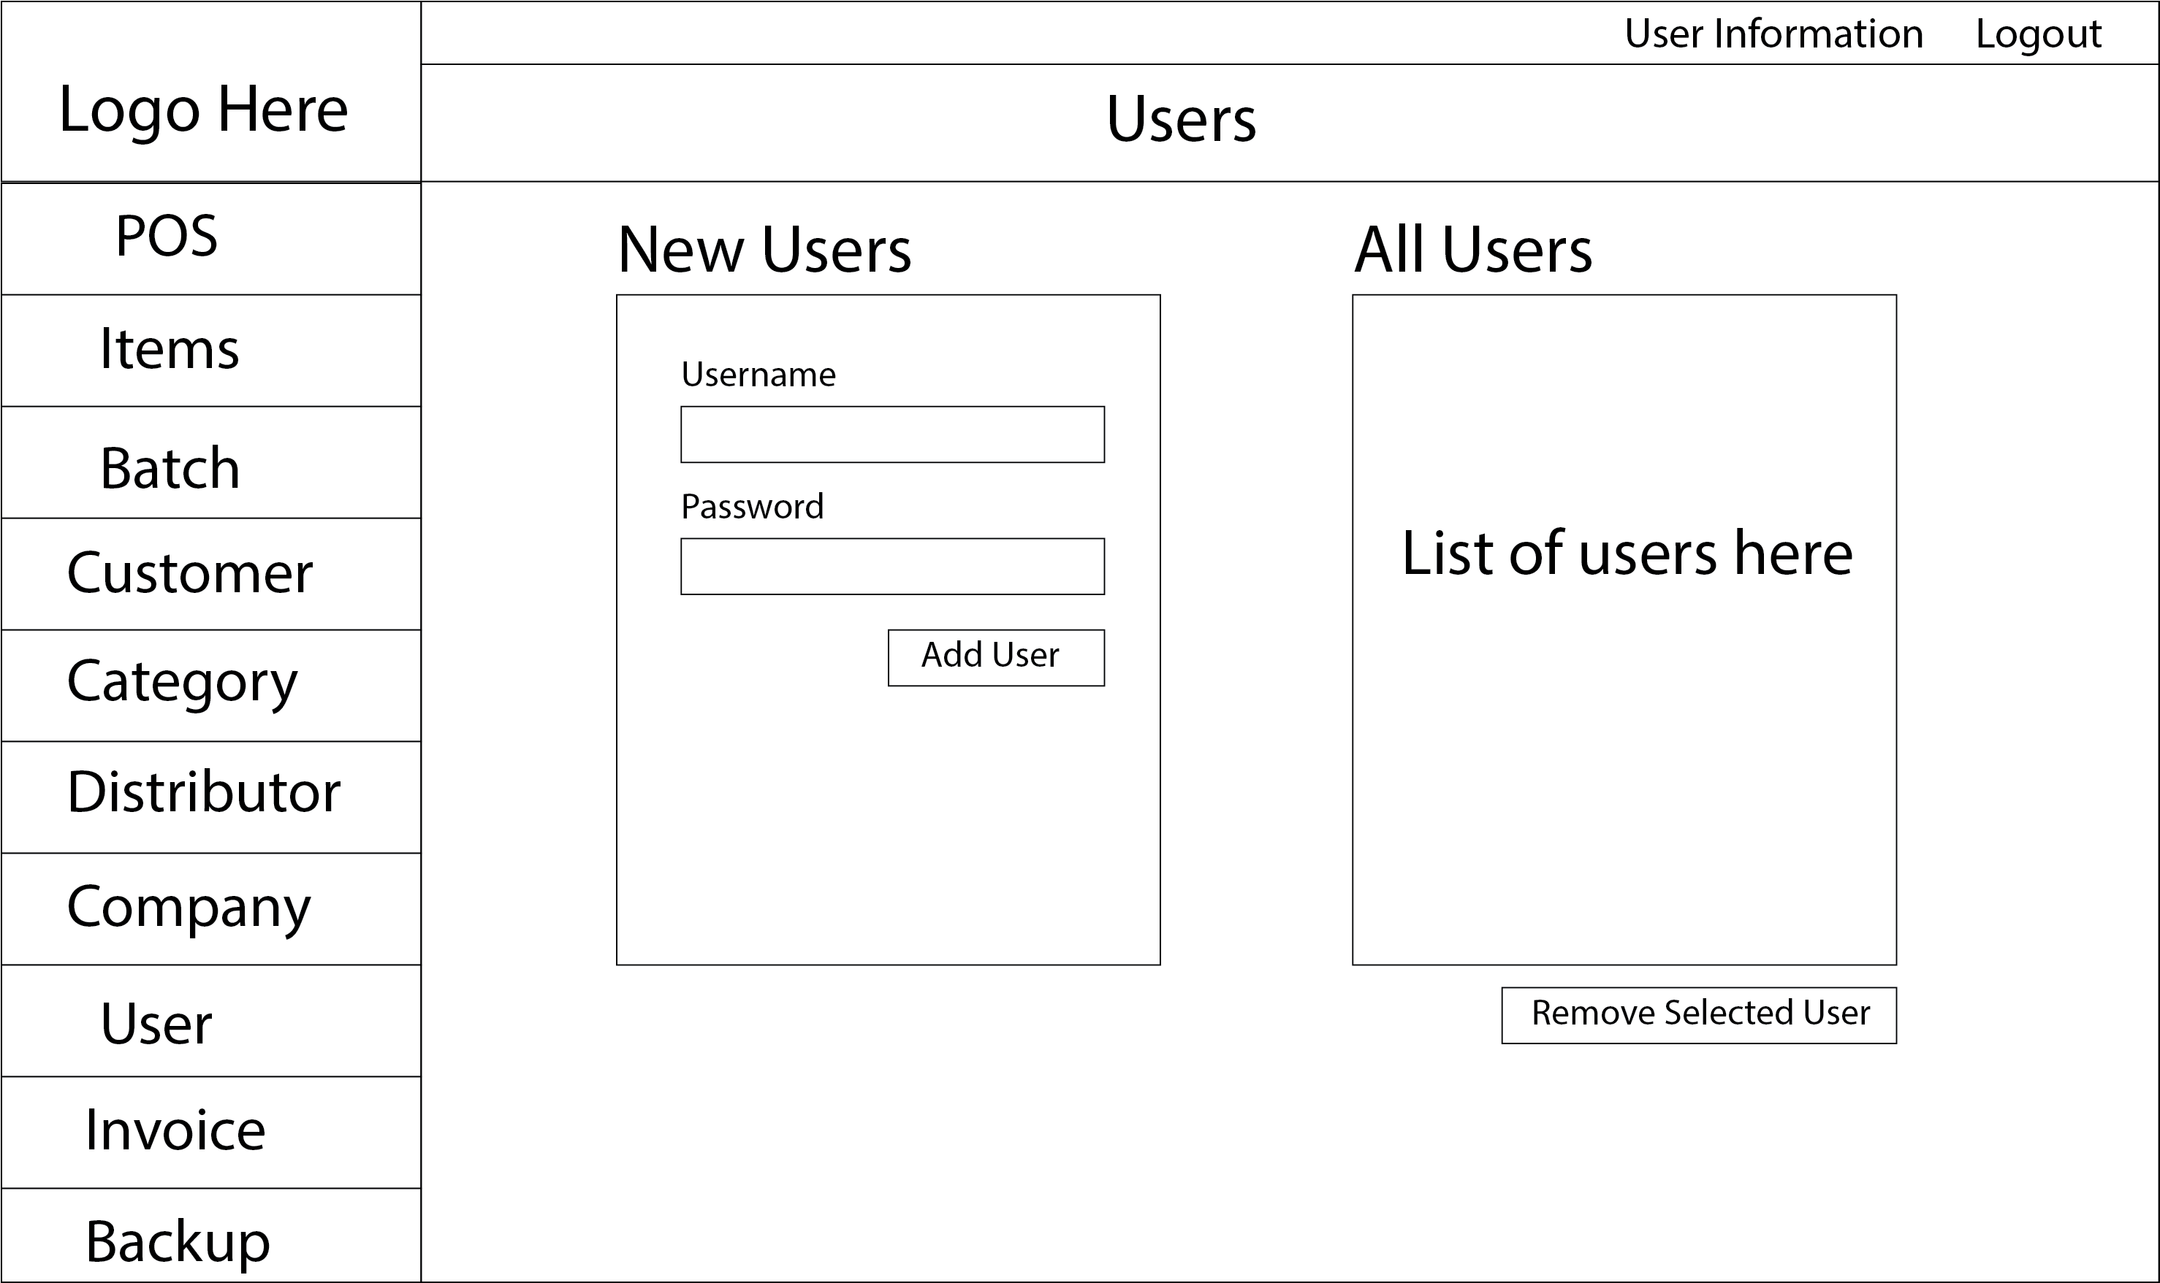
Users Form
Almost same form for:
Company,
Distributor,
Category,
Customer

Slide 9
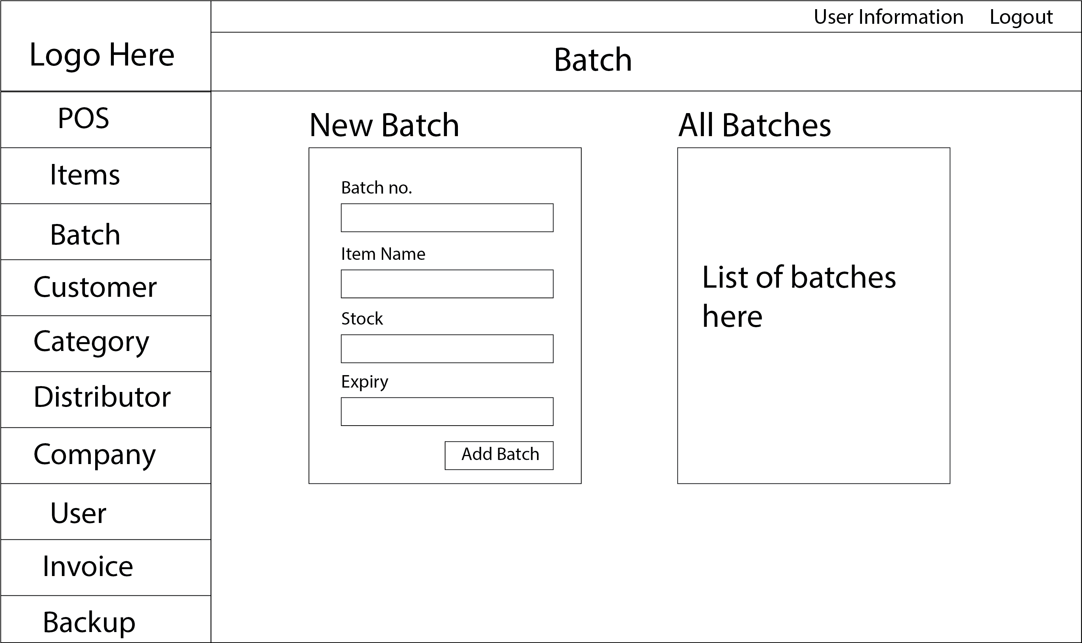
Batch Form

Slide 10
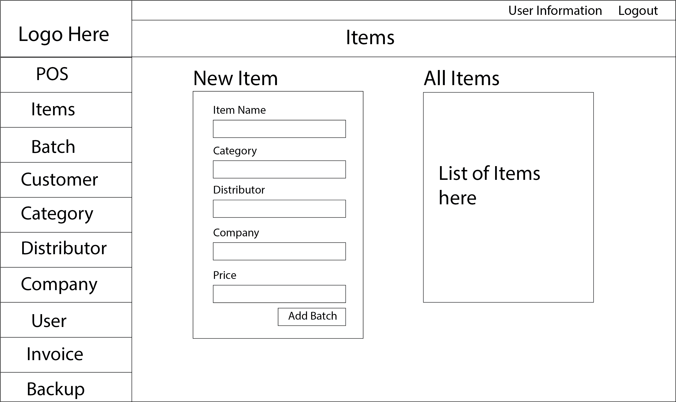
Items Form

Slide 11
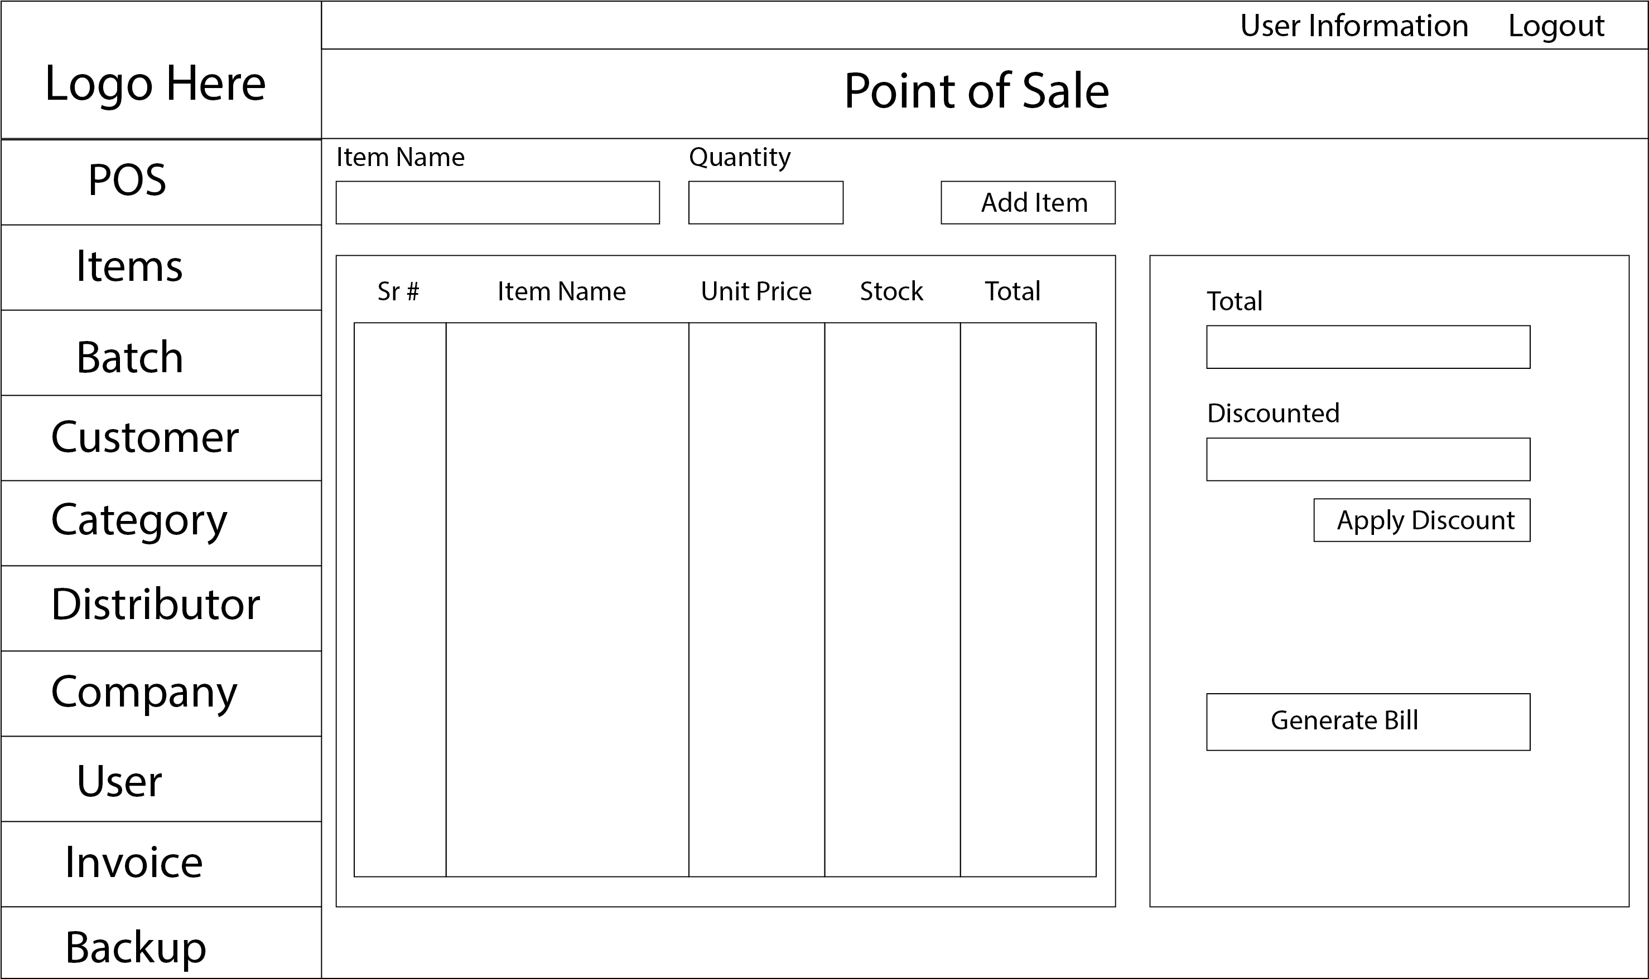
Point of Sale Form

Slide 12
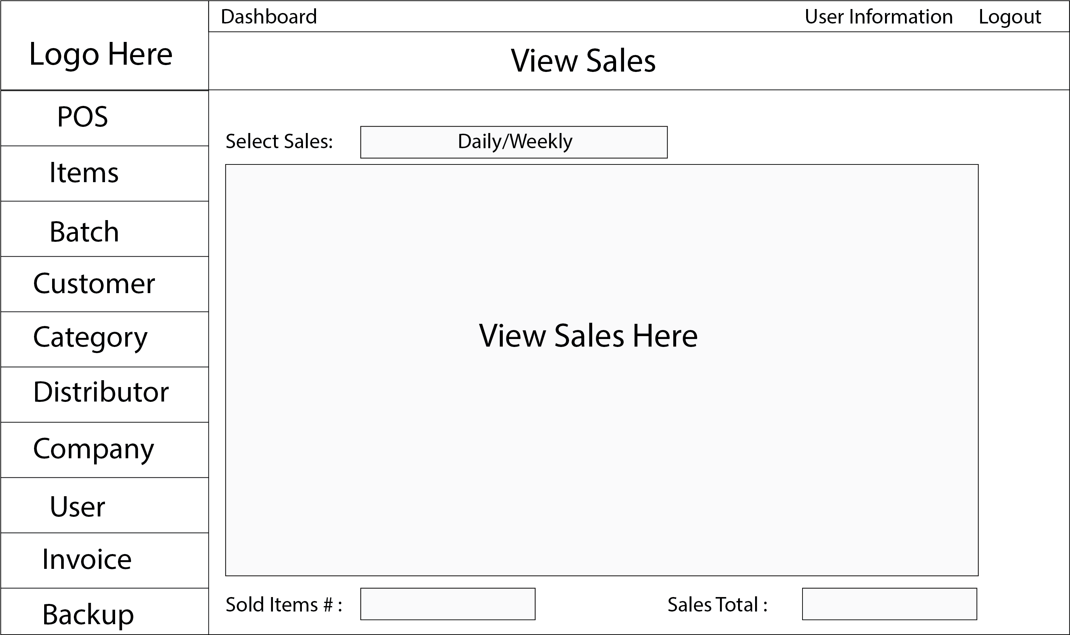
View Sales Form

