Slide 1






A new generation
of tech specialists
Group 8

Slide 2
Syria SolarScope / Group 8
Jawad Osama Alshepli Azzam,
Hadi Alkhaier,
Ibrahim Solaiman,
Mahmoud Mamo,
Mohamad Fattouh,
Mohammad Zain Kabbany

Slide 3
Problem & Research Question
Problem: severe electricity shortages push households and businesses toward solar, but owners lack location-specific production estimates, which leads to poorly sized and costly installations
Output varies by governorate and season, heat reduces panel efficiency, and buyers are unsure of the long-term cost per kWh (LCOE)
Research question: How do solar irradiance and temperature-adjusted PV output vary across Syria's 14 governorates and months (2015–2025), and what are the expected monthly yield ranges and LCOE for standard system sizes at different upfront costs?

Slide 4
Dataset
NASA POWER daily data, 2015–2025: https://power.larc.nasa.gov/data-access-viewer/
Variables: ALLSKY_SFC_SW_DWN (solar irradiance, kWh/m²/day), T2M (mean air temperature, °C) and T2M_MAX (maximum temperature, °C, used to estimate panel temperature)
14 governorates × 4,018 days = 56,252 daily records, downloaded through the NASA POWER API
Preparation: no missing values found (rule: gaps up to 3 days interpolated, others dropped); irradiance checked to be physically plausible (observed 0.3–9.0 kWh/m²/day)
Grid tariffs for comparison: Syrian Ministry of Energy tiers effective 1 Nov 2025

Slide 5
Python Approach
pandas and requests: download, inspect and clean the data; numpy: calculations; matplotlib: charts; Streamlit: web app
Physics: daily panel temperature → heat loss → daily yield per kWp, with 14% other losses (inverter, wiring, dust)
Aggregation: expected monthly and yearly output with a low–high range (10th–90th percentile of years) and year-to-year variability
Analyses: governorate ranking, seasonal variation, heat-loss quantification, days with high heat loss, correlation
Economics: function lcoe() over 20 years, 8% discount rate, 0.7%/year degradation, maintenance 2% (no batteries) or 10% (with batteries)

Slide 6
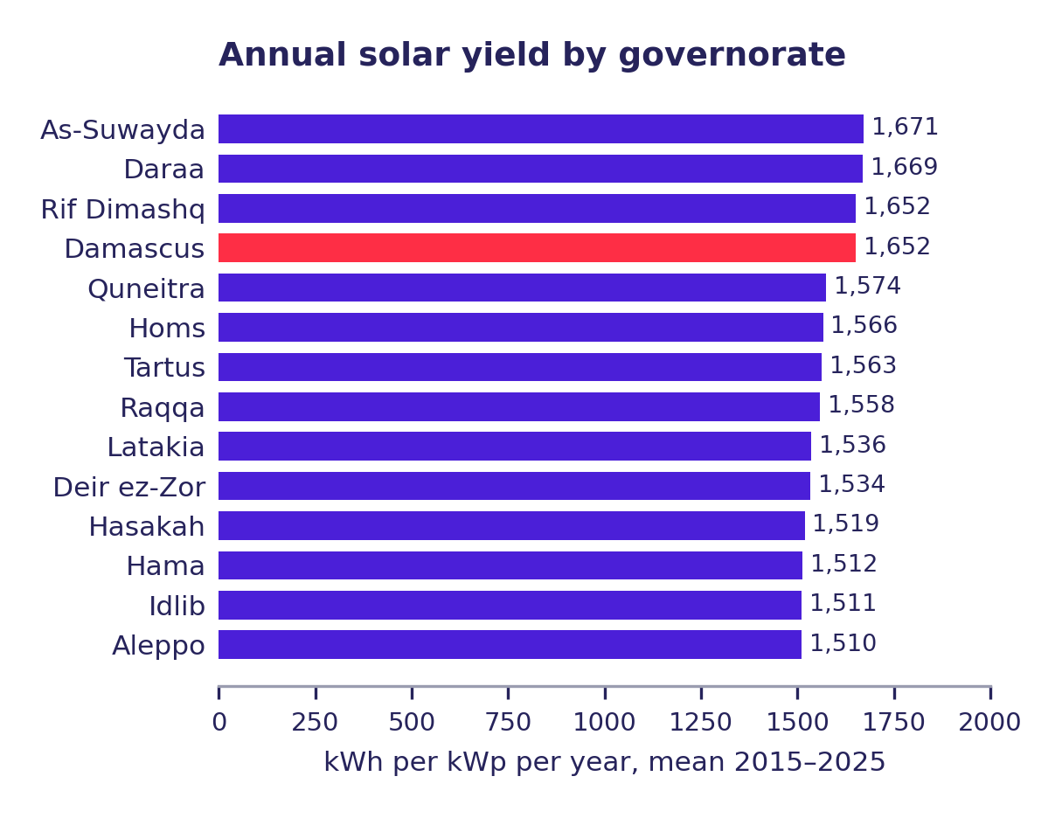
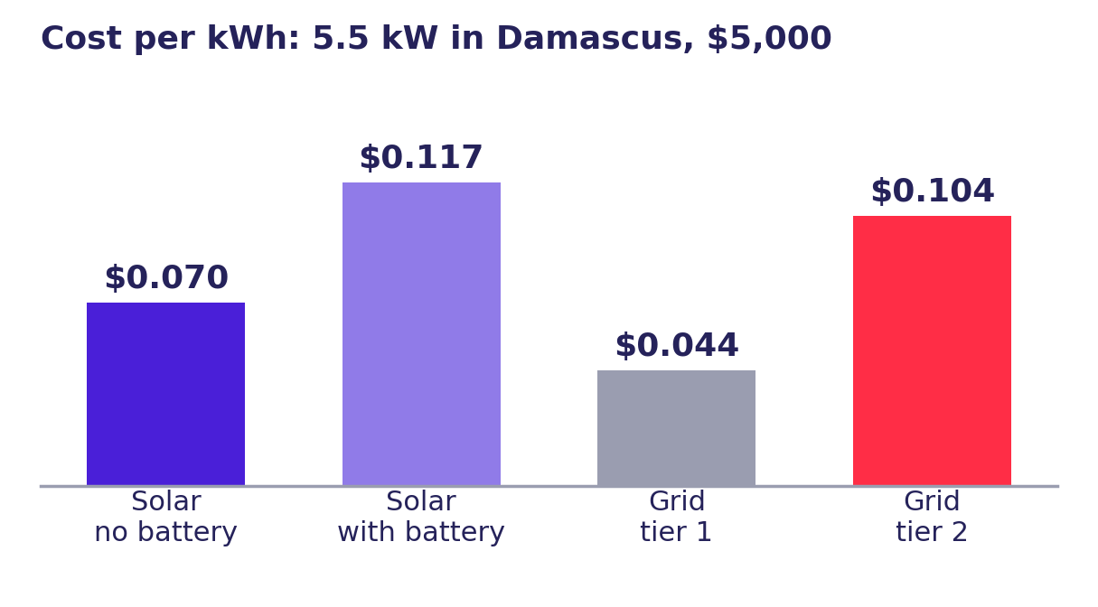
Main Results & Visualisations
Ranking: As-Suwayda (1,671 kWh/kWp/yr) and Daraa (1,669) lead, Aleppo (1,510) is lowest – a 10.7% spread across governorates
Example: 10 panels (5.5 kW) in Damascus, $5,000, no batteries – about 9,080 kWh/year (typical-year range 8,970–9,240)
Heat cuts annual output by 5.0–6.7%; July is the worst month (10.0% average loss), January the best (0%)
LCOE: $0.070/kWh without batteries (32% below grid tier 2 at $0.104) and $0.117/kWh with batteries (about 12% above)
Cost assumptions matter more than weather: O&M 2%→10% raises LCOE by about 66%, discount rate 4%→12% by about 62%, year-to-year weather by only about 3%

Slide 7
Impact / Proposed Solution
Solution: web-based decision-support tool (Syria SolarScope) – the user selects a governorate, system size (kW or panels) and capital cost
The tool returns expected energy production with a low–high range, monthly profile, heat loss and the levelized cost per kWh compared with the grid tariffs
Impact: better-sized and better-priced solar installations, supporting a shift from fossil-fuel generation to clean energy (SDG 7 Affordable and Clean Energy, SDG 13 Climate Action)
Users: households, small businesses and anyone comparing quotes from solar sellers

Slide 8
Limitations & Next Steps
Limitations: ~0.5° data resolution – Damascus/Rif Dimashq, Daraa/As-Suwayda and Hama/Idlib share one NASA grid cell (14 governorates, 11 distinct cells); horizontal-surface radiation; estimated panel temperature; dust and maintenance assumptions; changing USD prices and tariffs; planning estimate, not a price quote
Next steps: validate against PVGIS / Global Solar Atlas
Next steps: compare with diesel-generator electricity cost and add panel tilt
Next steps: use live Syrian prices for panels and batteries, update tariffs automatically, compare governorates side by side

Slide 9


Thank you!

