Slide 1
ACADEMIC PROJECT PRESENTATION • DEVOPS
Selenium-Tested Performance Review Portal
Automated Employee Appraisal Platform with Continuous Testing, Dockerization & Ansible Provisioning
CANDIDATE DETAILS
Student Name: Jawad Shaikh
Program / Branch: Computer Engineering / IT
Specialization: DevOps & Software Quality Engineering
Project Repo: github.com/JawadSk12/selenium-performance-review-portal
ACADEMIC & EVALUATION DETAILS
Academic Year: 2025 – 2026
College Name: [Your College / University Name Placeholder]
Department: Department of Computer Engineering
Project Guide: [Project Guide / Mentor Name Placeholder]
Selenium-Tested Performance Review Portal | Full-Stack & DevOps Engineering
Slide 1 of 10

Slide 2
SLIDE 2 • PROJECT OVERVIEW
Introduction to Performance Review Portal
Modernizing enterprise employee appraisal through full-stack development and DevOps automation
What is the Performance Review Portal?
• A secure, web-based enterprise evaluation system designed for modern organizations.
• Facilitates structured, periodic performance reviews between employees and managers.
• Replaces disorganized paper appraisals and loose spreadsheets with a centralized database.
• Features two strictly segregated portals: Employee Portal and Manager Workspace.
• Delivers transparent self-ratings, feedback documentation, and status tracking.
Why DevOps & Quality Automation?
• Eliminates manual testing risks by automating end-to-end user journeys using Selenium WebDriver.
• Implements a continuous quality gate: builds must pass 100% of tests before deployment.
• Packages the application into immutable Docker container images for zero environment drift.
• Automates server provisioning and configuration management using idempotent Ansible playbooks.
• Demonstrates complete software development life cycle (SDLC) from commit to live runtime.
Key Takeaway: The project combines robust Spring Boot web development with real-world DevOps practices — automated regression testing, CI/CD pipelines, containerization, and configuration management.
Selenium-Tested Performance Review Portal | Full-Stack & DevOps Engineering
Slide 2 of 10

Slide 3
SLIDE 3 • THE CHALLENGE
Problem Statement & Industry Context
Why traditional employee appraisal and manual deployment practices fail in modern IT teams
1. Manual & Unstructured Appraisals
2. Subjectivity & Review Bottlenecks
3. Fragile Releases & Environment Drift
Spreadsheet Chaos & Data Loss
• Performance reviews are conducted via disconnected spreadsheets, emails, and PDFs.
• Lack of centralized tracking causes lost records, skipped reviews, and audit failures.
• Employees have zero visibility into review status or historical performance growth.
Lack of Standard Metrics & Queues
• Evaluations lack standardized scoring categories (technical vs teamwork vs delivery).
• Managers receive unsorted appraisal requests with no filtering or status management.
• Delay in approvals frustrates employees and slows promotion/increment cycles.
Manual Deployment Risks
• Web applications deployed without automated UI regression tests break silently in production.
• 'Works on my machine' syndrome creates discrepancies between dev, staging, and live servers.
• Manual server configuration leads to configuration drift, security flaws, and downtime.
Selenium-Tested Performance Review Portal | Full-Stack & DevOps Engineering
Slide 3 of 10

Slide 4
SLIDE 4 • GOALS & TARGETS
Project Objectives & Key Outcomes
Specific targets established for application development, automated testing, and DevOps deployment
1
Role-Based Web Application
Develop two dedicated portals: Employee Self-Appraisal Portal and HR Manager Review Dashboard with strict HTTP interceptor route protection.
2
Standardized Evaluation Matrix
Implement a 1–10 numerical scoring system across 4 key competencies (Technical, Communication, Teamwork, Problem-Solving) plus qualitative feedback.
3
Automated Quality Assurance Gate
Author 23 comprehensive automated tests (Spring Boot unit/integration tests + Selenium WebDriver browser tests) running on every build.
4
Full CI/CD Pipeline Integration
Implement a multi-stage Jenkins pipeline that automates checkout, compilation, packaging, continuous testing, and artifact deployment.
5
Containerization & Isolation
Dockerize the application into a standalone Linux container with PostgreSQL integration, ensuring zero dependency conflicts.
6
Automated Server Provisioning
Author idempotent Ansible playbooks (site.yml & week14-provision.yml) to configure production target nodes and verify reliability.
Selenium-Tested Performance Review Portal | Full-Stack & DevOps Engineering
Slide 4 of 10

Slide 5
SLIDE 5 • TECHNICAL APPROACH
Proposed Solution & System Architecture
How the implemented system addresses all appraisal, testing, and deployment requirements
End-to-End System Workflow
Step 1: Employee Self-Appraisal: Employee logs in at /login, scores themselves (1–10) across 4 categories, records achievements and goals, and submits.
Step 2: Database Persistence & Queue: Review is saved with status 'PENDING' in PostgreSQL and immediately routed to the manager's review queue.
Step 3: Manager Evaluation & Decision: Manager logs in at /manager/login, inspects KPIs, filters candidates, provides feedback, and clicks Approve or Reject.
Step 4: Real-time Status Audit: Employee history page updates with final decision, feedback notes, and timestamps for a complete audit trail.
Step 5: Automated Testing Quality Gate: Selenium WebDriver simulates real browser actions verifying login, submission, and logout on every commit.
1. Separate Authentication Interceptors
Independent session interceptors ensure employees cannot access /manager/** and unauthenticated users are redirected to login.
2. Clean Spring Boot MVC Architecture
Strict separation of concerns: Model (Entities), View (Thymeleaf Templates), Controller (REST/Web handlers), and Service layer.
3. Continuous Quality Assurance
23 automated Maven tests execute on every build. If any Selenium UI test fails, the CI pipeline halts immediately.
4. Immutable Docker Deployment
Packaged as a standalone container image (performance-review-portal:week11) on port 8082 with reproducible runtime.
Selenium-Tested Performance Review Portal | Full-Stack & DevOps Engineering
Slide 5 of 10

Slide 6
SLIDE 6 • FUNCTIONAL CAPABILITIES
Key Features Implemented in the Portal
Practical modules delivered for employees, HR managers, and system administrators
Employee Portal (/login)
• Dedicated Employee Auth: Clean login screen with credential validation and session state management.
• 4-Factor Self-Review Form: Quantitative rating (1–10) across Technical, Communication, Teamwork, and Problem Solving.
• Qualitative Accomplishments: Detailed multi-line inputs for yearly achievements and future professional goals.
• Live Status Indicators: Dynamic status badge on dashboard indicating 'Pending Review', 'Completed', or 'No Reviews'.
• Audit History View: Historical table displaying all submitted reviews, manager ratings, and feedback comments.
Manager Workspace (/manager/login)
• Executive KPI Dashboard: Instant overview of Total Reviews, Pending Approvals, Approved, and Rejected reviews.
• Instant Employee Search: Client-side JavaScript search filter that filters pending reviews by employee name in real time.
• Comprehensive Review View: Detailed evaluation view (/manager/review/{id}) showing employee self-scores and goals.
• Approval Decision Gate: One-click 'Approve' or 'Reject' workflow with required managerial comment recording.
• Secure Route Protection: ManagerAuthInterceptor redirects unauthorized URL tampering directly back to login.
Selenium-Tested Performance Review Portal | Full-Stack & DevOps Engineering
Slide 6 of 10

Slide 7
SLIDE 7 • TOOLS & TECHNOLOGIES
Technology Stack & Development Ecosystem
A full-stack, enterprise Java technology stack paired with industry-standard DevOps tools
Backend Framework
Frontend & Presentation
Database & Testing
DevOps & Infrastructure
CORE APPLICATION ENGINE
Java 17 (LTS)
Modern, high-performance object-oriented foundation
Spring Boot 3.3.3
Rapid enterprise MVC framework with embedded Tomcat
Spring Data JPA
Object-relational mapping for PostgreSQL entities
Hibernate 6
ORM provider handling schema generation and transactions
USER INTERFACE & AESTHETICS
Thymeleaf Engine
Server-side HTML rendering with dynamic expressions
HTML5 & Vanilla CSS
Custom responsive styling and modern cards
Bootstrap 5.3
Responsive layout grid and modern UI components
Vanilla JavaScript
Client-side instant search filtering and validations
PERSISTENCE & QUALITY GATES
PostgreSQL 16
ACID-compliant relational database on port 5432
Selenium WebDriver
Automated browser end-to-end testing (v4.19.1)
JUnit 5 & Mockito
Unit and integration test runner with mocking
Maven Surefire
Automated test execution and XML report generation
CI/CD & PROVISIONING
Jenkins CI/CD
Automated 6-stage build and testing pipeline (port 8080)
Docker & Compose
Container packaging (port 8082) & multi-container setup
Ansible (WSL)
Idempotent server provisioning (site.yml, week14-provision)
Git & GitHub
Source version control with develop branch workflow
Selenium-Tested Performance Review Portal | Full-Stack & DevOps Engineering
Slide 7 of 10

Slide 8
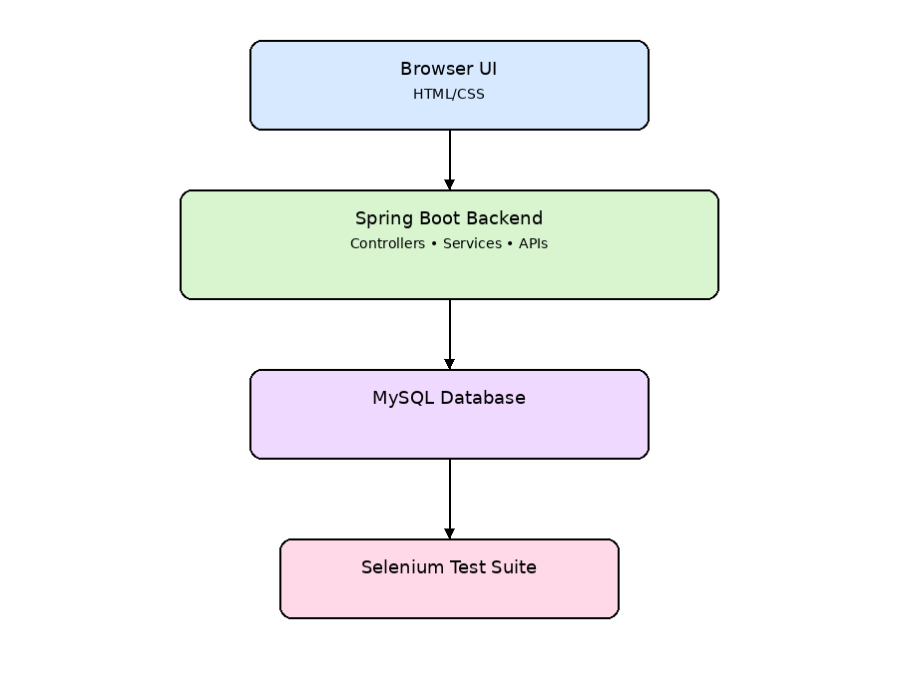
SLIDE 8 • SYSTEM DESIGN & CI/CD
System Architecture & DevOps Pipeline
High-level MVC system architecture and automated continuous delivery workflow
6-Stage Automated CI/CD Pipeline
Stage 1: Checkout: Jenkins pulls clean code from GitHub develop branch via SCM plugin.
Stage 2: Build: Executes 'mvn clean compile' to verify Java syntax and class compilation.
Stage 3: Prepare Test App: Packages WAR and deploys to Tomcat on port 8081 for live test execution.
Stage 4: Continuous Testing: Runs unit tests and Selenium browser tests ('mvn test') — 100% pass required.
Stage 5: Test Reports: Publishes JUnit test XML reports to Jenkins dashboard as permanent build artifacts.
Stage 6: Docker & Provisioning: Builds Docker image week11 (port 8082) and verifies server with Ansible.
Figure 1: High-Level Architecture showing Client Browser, Spring MVC Controllers, Services, and PostgreSQL Database.
Selenium-Tested Performance Review Portal | Full-Stack & DevOps Engineering
Slide 8 of 10

Slide 9
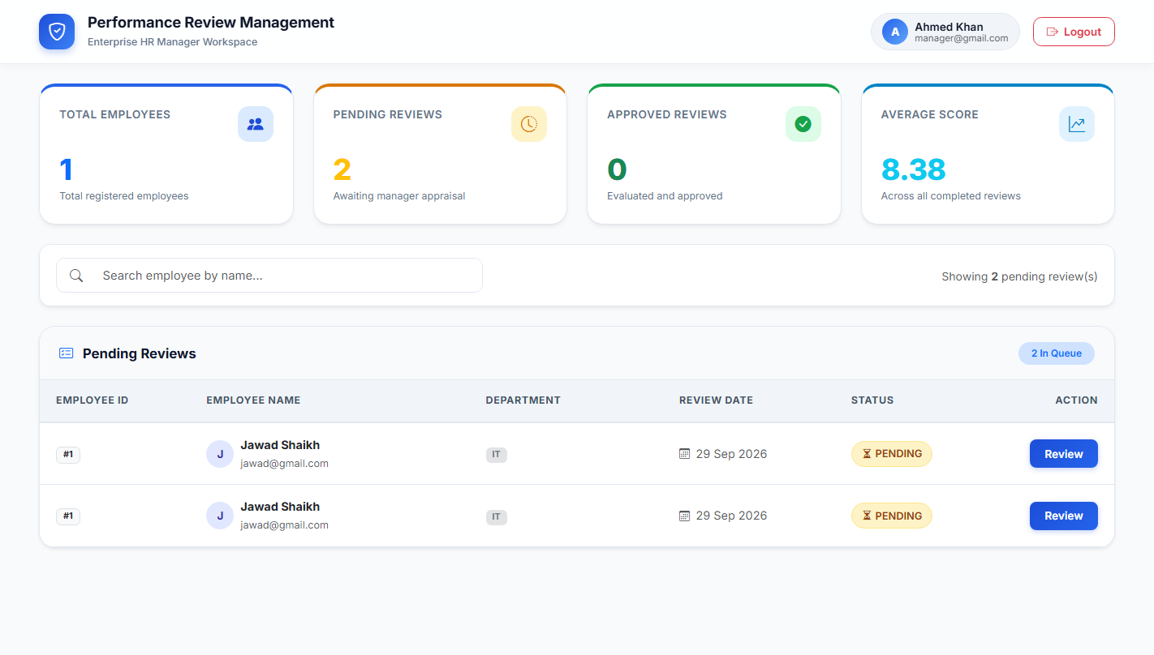
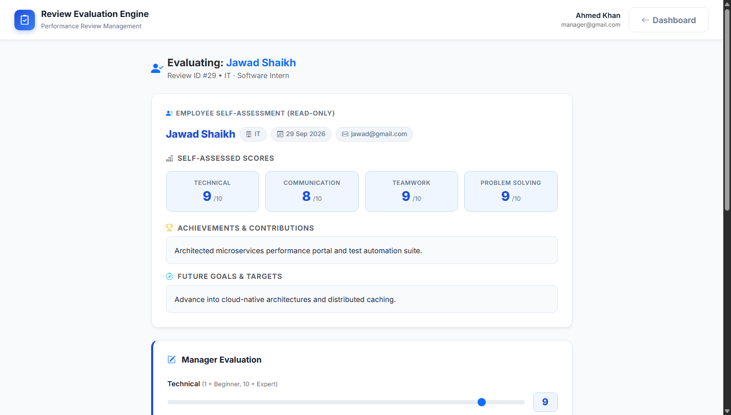
SLIDE 9 • VERIFICATION & OUTPUTS
Implementation Results & Test Evidence
Live application screenshots, 100% automated test pass rate, and container health verification
Output 1: Manager Workspace (/manager/dashboard) with live KPI cards and pending review queue
Output 2: Detailed Manager Evaluation Interface (/manager/review/{id}) with Approve/Reject decision gate
23 / 23 Tests Passed
0 Failures, 0 Errors across JUnit & Selenium
Port 8082 Dockerized
performance-review-portal:week11 active
Ansible Idempotency
ok=24, changed=0 on repeat play execution
Selenium-Tested Performance Review Portal | Full-Stack & DevOps Engineering
Slide 9 of 10

Slide 10
SLIDE 10 • SUMMARY & LOOKING AHEAD
Conclusion & Future Enhancements
Project achievements, future feature scope, and closing remarks
Key Project Achievements
✓ Delivered a fully functional, secure web application with separate Employee and Manager portals.
✓ Implemented strict route protection and session isolation preventing cross-role access.
✓ Created an automated quality gate with 23 JUnit and Selenium tests (100% pass rate).
✓ Orchestrated a 6-stage Jenkins CI pipeline automating packaging and testing on every commit.
✓ Successfully containerized with Docker and verified server configuration using Ansible.
Future Scope & Enhancements
• Automated Email / Slack Alerts: Send immediate notifications to managers when reviews are submitted.
• 360-Degree Peer Feedback: Expand evaluation matrix to allow multi-directional reviews from peer engineers.
• AI-Powered Performance Insights: Integrate LLM summarization to generate objective review syntheses.
• Kubernetes Production Deployment: Auto-scale container pods on AWS EKS / Kubernetes clusters.
• Single Sign-On (SSO / OAuth2): Integrate corporate Google Workspace and Azure Active Directory login.
Thank You! Questions & Discussion
Presented by: Jawad Shaikh • Selenium-Tested Performance Review Portal
Selenium-Tested Performance Review Portal | Full-Stack & DevOps Engineering
Slide 10 of 10

