Slide 1
Amazon EC2 Quick Start adapted from http://docs.aws.amazon.com/AWSEC2/latest/UserGuide/EC2_GetStarted.html

Slide 2
Amazon Elastic Compute Cloud (EC2)
Amazon Machine Images (AMIs) are the basic building blocks of Amazon EC2
An AMI is a template that contains a software configuration (operating system, application server and applications) that can run on Amazon’s computing environment
AMIs can be used to launch an instance, which is a copy of the AMI running as a virtual server in the cloud.

Slide 3
Getting Started with Amazon EC2
Step 1: Sign up for Amazon EC2
Step 2: Create a key pair
Step 3: Launch an Amazon EC2 instance
Step 4: Connect to the instance
Step 5: Customize the instance
Step 6: Terminate instance and delete the volume created

Slide 4
Creating a key pair
AWS uses public-key cryptography to encrypt and decrypt login information.
AWS only stores the public key, and the user stores the private key.
There are two options for creating a key pair:
Have Amazon EC2 generate it for you
Generate it yourself using a third-party tool such as OpenSSH, then import the public key to Amazon EC2

Slide 5
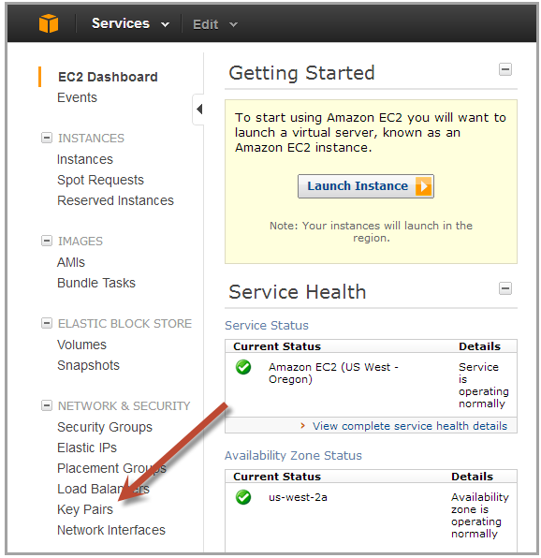
Generating a key pair with Amazon EC2
Open the Amazon EC2 console at http://console.aws.amazon.com/ec2/
On the navigation bar select region for the key pair
Click Key Pairs in the navigation pane to display the list of key pairs associated with the account

Slide 6
Generating a key pair with EC2 (cont.)
Click Create Key Pair
Enter a name for the key pair in the Key Pair Name field of the dialog box and click Create
The private key file, with .pem extension, will automatically be downloaded by the browser.

Slide 7
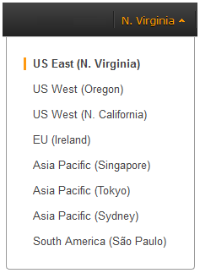
Launching an Amazon EC2 instance
Sign in to AWS Management Console and open the Amazon EC2 console at http://console.aws.amazon.com/ec2/
From the navigation bar select the region for the instance

Slide 8
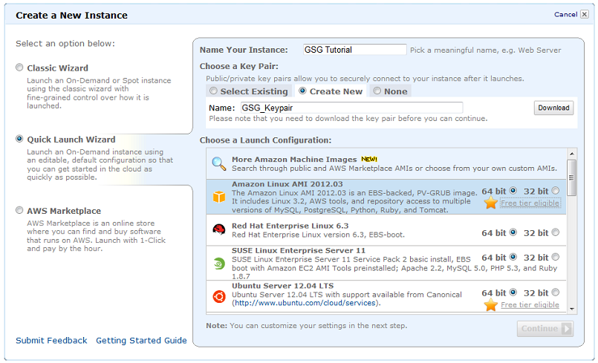
Launching an Amazon EC2 instance (cont.)
From the Amazon EC2 console dashboard, click Launch Instance

Slide 9
Launching an Amazon EC2 instance (cont.)
On the Create a New Instance page, click Quick Launch Wizard
In Name Your Instance, enter a name for the instance
In Choose a Key Pair, choose an existing key pair, or create a new one
In Choose a Launch Configuration, a list of basic machine configurations are displayed, from which an instance can be launched
Click continue to view and customize the settings for the instance

Slide 10
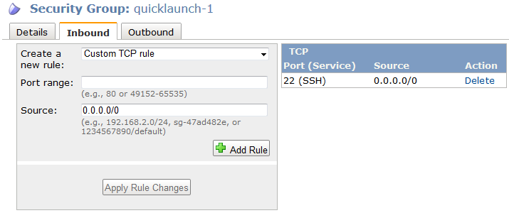
Launching an Amazon EC2 instance (cont.)
Select a security group for the instance. A Security Group defines the firewall rules specifying the incoming network traffic delivered to the instance. Security groups can be defined on the Amazon EC2 console, in Security Groups under Network and Security

Slide 11
Launching an Amazon EC2 instance (cont.)
Review settings and click Launch to launch the instance
Close the confirmation page to return to EC2 console
Click Instances in the navigation pane to view the status of the instance. The status is pending while the instance is launching
After the instance is launched, its status changes to running

Slide 12
Connecting to an Amazon EC2 instance
There are several ways to connect to an EC2 instance once it’s launched.
Remote Desktop Connection is the standard way to connect to Windows instances.
An SSH client (standalone or web-based) is used to connect to Linux instances.

Slide 13
Connecting to Linux/UNIX Instances from Linux/UNIX with SSH
Prerequisites:
Most Linux/UNIX computers include an SSH client by default, if not it can be downloaded from openssh.org
Enable SSH traffic on the instance (using security groups)
Get the path the private key used when launching the instance
In a command line shell, change directory to the path of the private key file
Use the chmod command to make sure the private key file isn’t publicly viewable

Slide 14
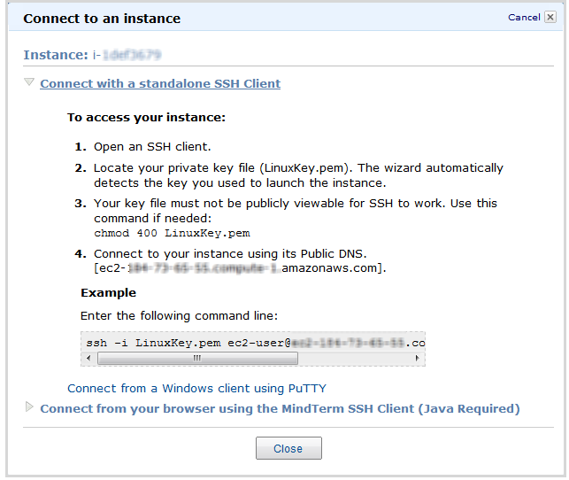
Connecting to Linux/UNIX Instances(cont.)
Right click on the instance to connect to on the AWS console, and click Connect.
Click Connect using a standalone SSH client.
Enter the example command provided in the Amazon EC2 console at the command line shell

Slide 15
Transfering files to Linux/UNIX instances from Linux/UNIX with SCP
Prerequisites:
Enable SSH traffic on the instance
Install an SCP client (included by default mostly)
Get the ID of the Amazon EC2 instance, public DNS of the instance, and the path to the private key
If the key file is My_Keypair.pem, the file to transfer is samplefile.txt, and the instance’s DNS name is ec2-184-72-204-112.compute-1.amazonaws.com, the command below copies the file to the ec2-user home

Slide 16
Terminating Instances
If the instance launched is not in the free usage tier, as soon as the instance starts to boot, the user is billed for each hour the instance keeps running.
A terminated instance cannot be restarted.
To terminate an instance:
Open the Amazon EC2 console
In the navigation pane, click Instances
Right-click the instance, then click Terminate
Click Yes, Terminate when prompted for confirmation

Slide 17
Google App Engine Quick Start adapted from https://developers.google.com/appengine/docs/whatisgoogleappengine

Slide 18
Google App Engine (GAE)
GAE lets users run web applications on Google’s infrastructure
GAE data storage options are:
Datastore: a NoSQL schemaless object datastore
Google Cloud SQL: Relational SQL database service
Google Cloud Storage: Storage service for objects and files
All applications on GAE can use up to 1 GB of storage and enough CPU and bandwidth to support an efficient application serving around 5 million page views a month for free.
Three runtime environments are supported: Java, Python and Go.

Slide 19
Developing Java Applications on GAE
The easiest way to develop Java applications for GAE is to use the Eclipse development environment with the Google plugin for Eclipse.
App Engine Java applications use the Java Servlet standard for interacting with the web server environment.
An application’s files, including compiled classes, JARs, static files and configuration files, are arranged in a directory structure using the WAR standard layout for Java web applications.

Slide 20
Running a Java Project
The App Engine SDK includes a web server application to test applications. The server simulates the complete GAE environment.
The project can be run using the “Debug As > Web Application” option of Eclipse or using Ant.
After running the server, the application can be tested by visiting the server’s URL in a Web browser.

Slide 21
Uploading an Application to GAE
Applications are created and managed using the Administration Console at https://appengine.google.com.
Once an application ID is registered for an application, the application can be uploaded to GAE using the Eclipse plugin or a command-line tool in the SDK.
After uploading, the application can be accessed from a Web browser. If a free appspot.com account was used for registration, the URL for the application will be http://app_id.appspot.com/, where app_id the application id assigned during registration.

