Slide 1
Insurance Premium Prediction
Course Project
Data Science Tools for Experimental Research
Course Instructor: Dr. Lopamudra giri
Group Members
Aditya Prakash ch21btech11002
Bhere Amol Sanjay ch21btech11006
Banothu Jawaharlal ch21btech11037
Ekshan Raj Verma ch20btech11012

Slide 2
OBJECTIVE
The objective of this analysis is to build a predictive model that accurately estimates medical insurance expenses based on the provided dataset.
EXPECTED OUTCOME
The model that will predict the premium for personal health insurance.

Slide 3
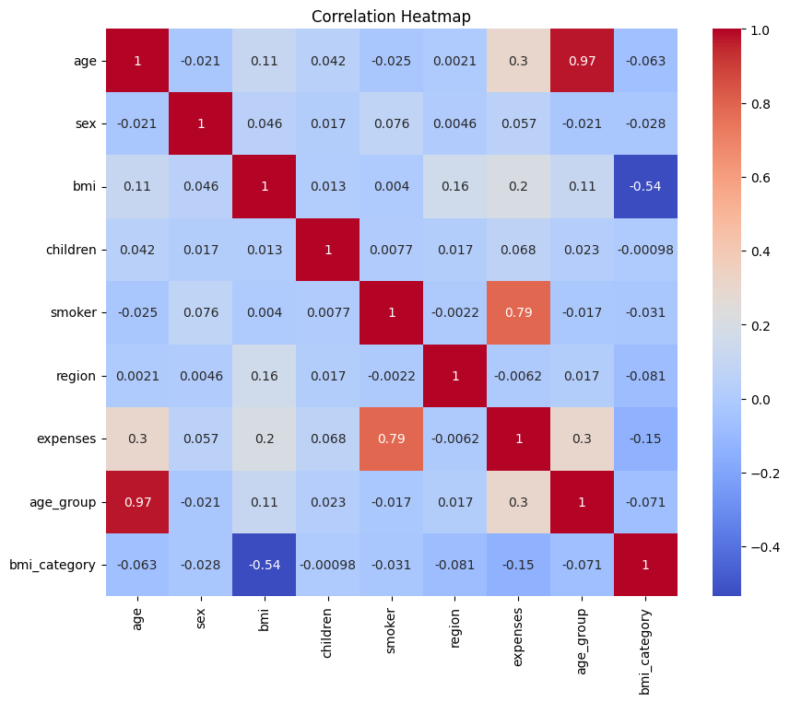
Data Visualization
We used heatmap for data visualization which is a graphical representation of data where values in a matrix are represented as colors.

Slide 4
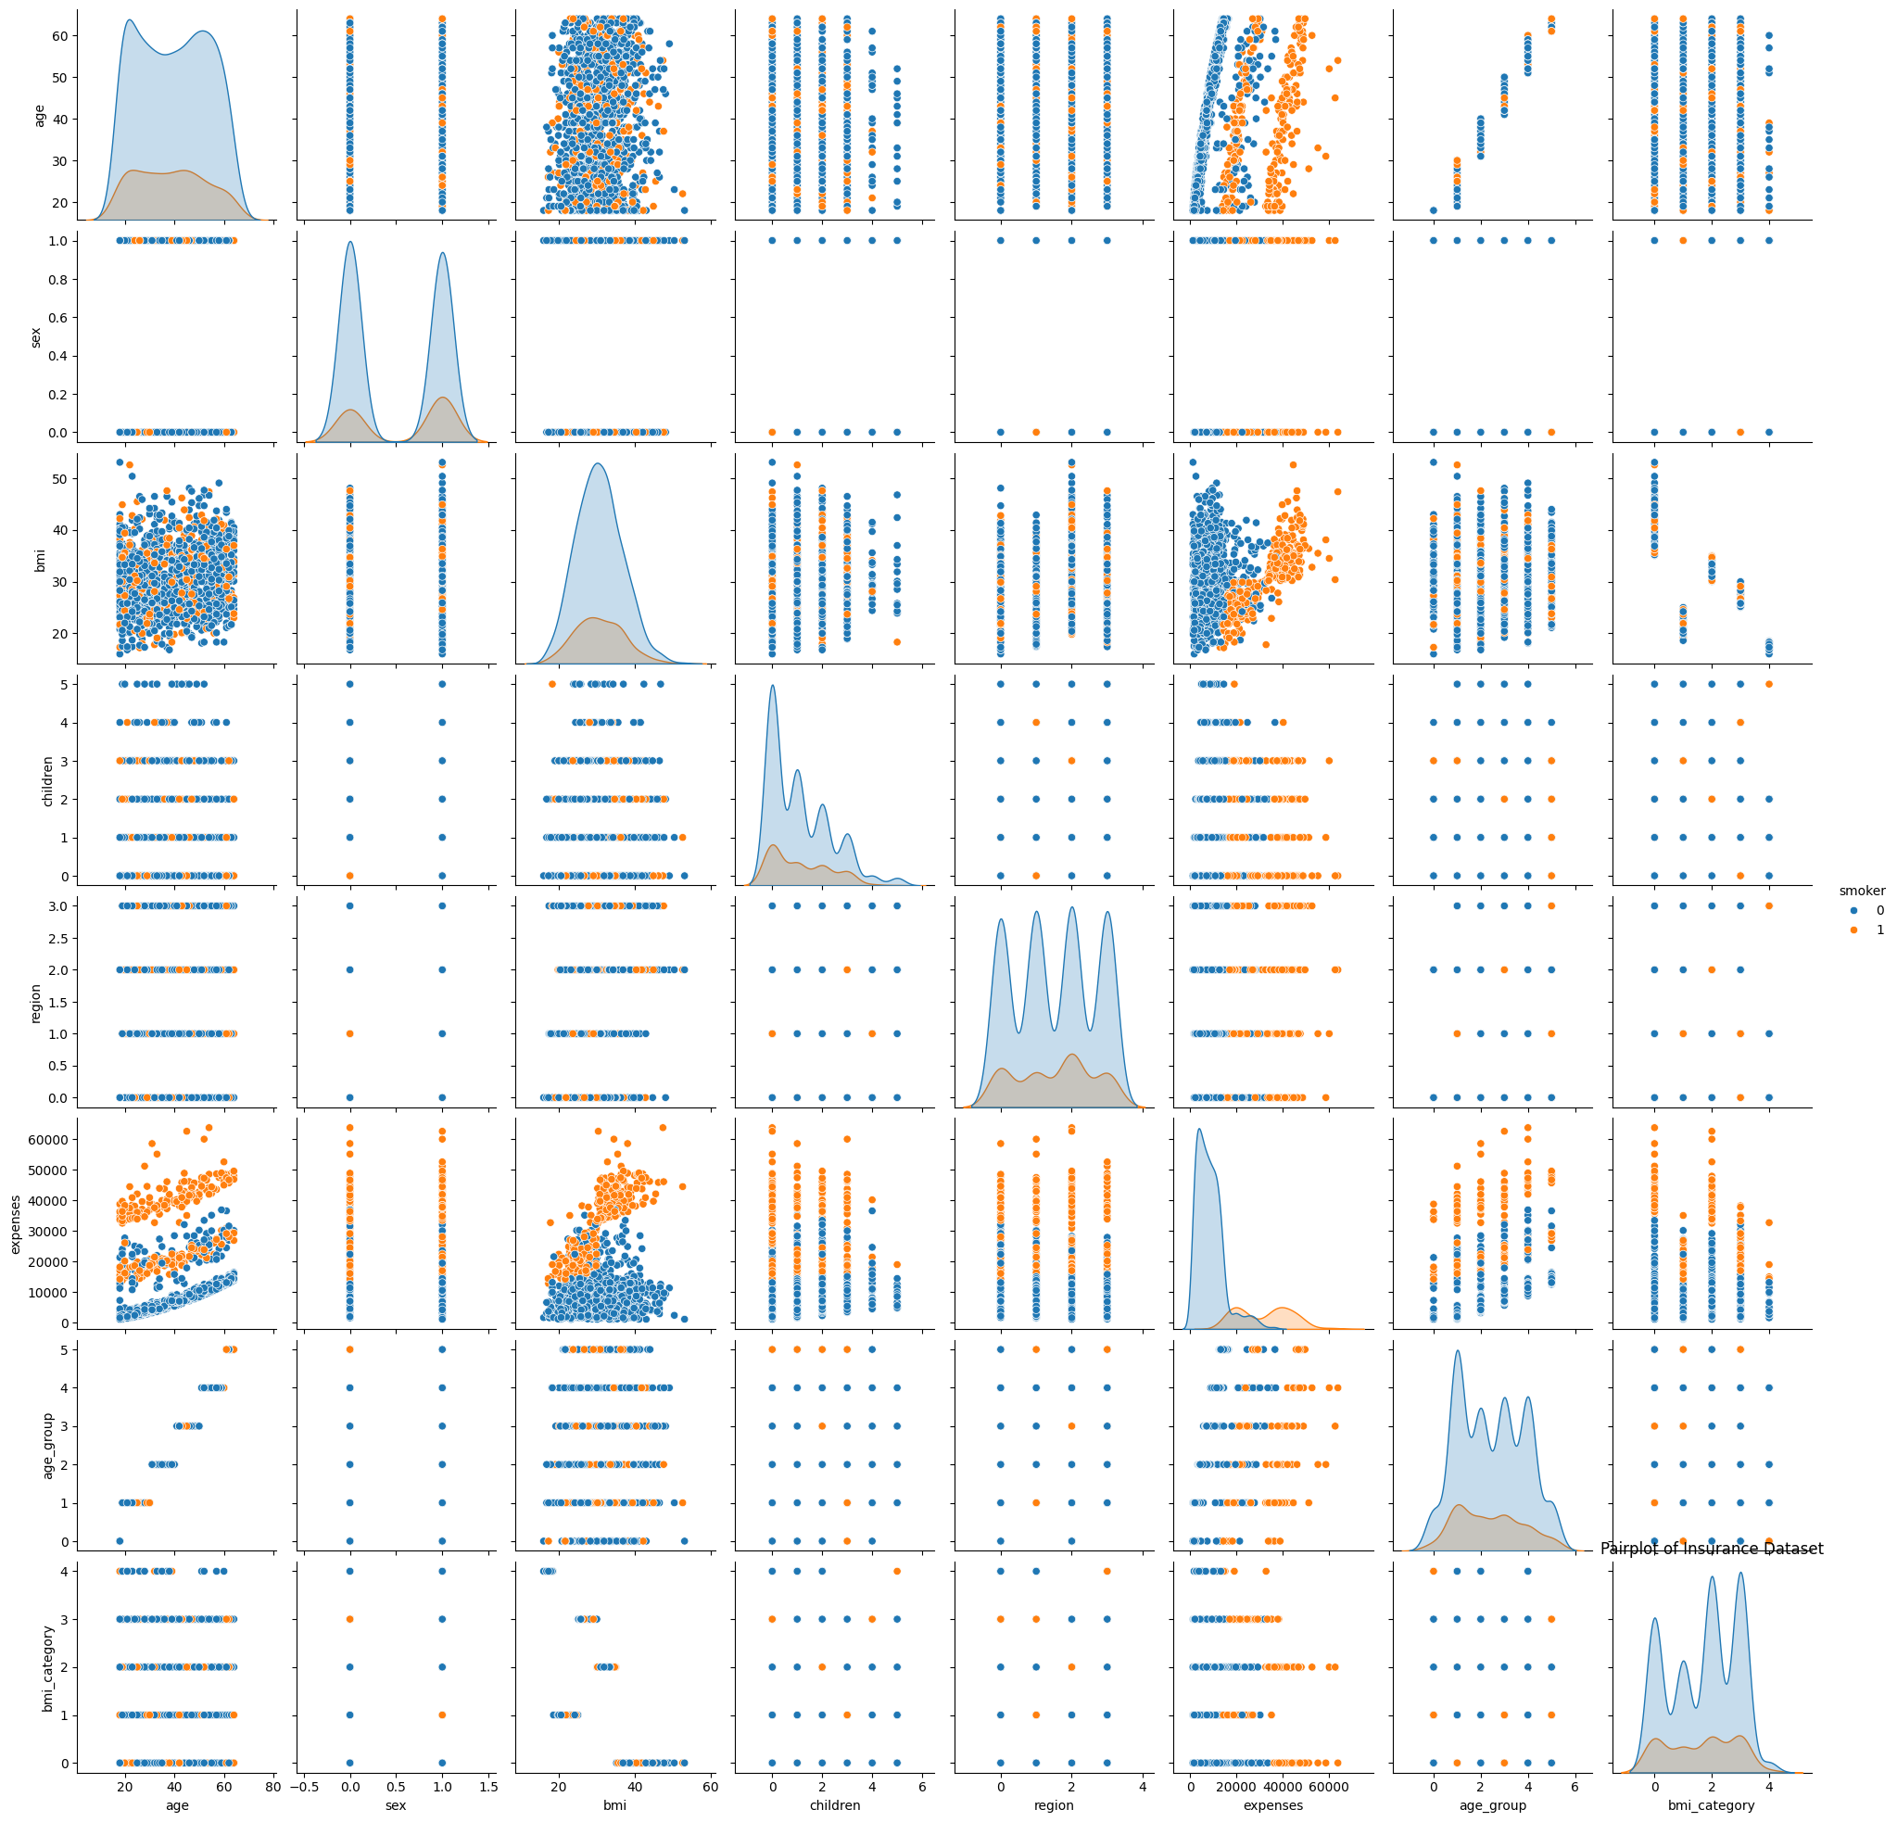
We used "pairplot" function for data visualization. It displays pairwise relationship between different features in the dataset. We set "hue" parameter to "smoker" to visualize how smoking habits affects these relationships, for deeper insights into the data .
Orange: Smoker
Blue: Non-Smoker

Slide 5
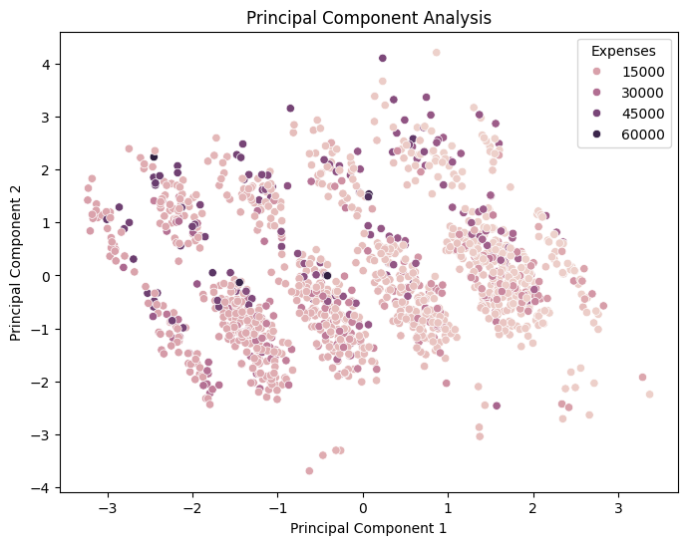
Dimensionality Reduction
We used Principal Component Analysis (PCA) for dimensionality reduction to visualize the high-dimensional dataset in a two-dimensional space.
PCA helps us identify patterns and relationships in the data by transforming the original features into a set of orthogonal principal components while preserving the maximum variance

Slide 6
Model Building
We have trained five models as follows:
Gradient Boosting Regressor
Decision Tree Regressor
Random Forest Regressor
Linear Regression
Artificial Neural Network (ANN)

Slide 7
Decision Tree Regressor
# Decision Tree Regressor
dt_model = DecisionTreeRegressor()
dt_model.fit(X_train, y_train)
# Model Testing
y_pred_dt = dt_model.predict(X_test)
Output
Model Evaluation: Decision Tree Regressor: Mean Squared Error: 44707427.82906008 R-squared: 0.7120271015693234
A Decision Tree is a non-parametric supervised learning method used for regression and classification tasks. It partitions the feature space into segments based on feature values, aiming to minimize impurity or maximize information gain at each node, resulting in a hierarchical structure resembling a tree.
The code implements a Decision Tree Regressor model using scikit-learn, fitting it to the training data (X_train, y_train) and predicting the target variable (insurance expenses) for the test data (X_test)

Slide 8
Hyperparameter tuning for decision tree
This code performs hyperparameter tuning for a Decision Tree Regressor using both RandomizedSearchCV and GridSearchCV techniques.
It systematically explores a parameter grid to find the optimal combination of hyperparameters for the model.
The best parameters obtained from the grid search are then stored for further use in model optimization and evaluation.
# Initialize Decision Tree Regressor
dt_model = DecisionTreeRegressor()
# Perform RandomizedSearchCV
random_search = RandomizedSearchCV(estimator=dt_model, param_distributions=param_grid, n_iter=10, cv=5, verbose=2, random_state=42, n_jobs=-1)
random_search.fit(X_train, y_train)
# Perform GridSearchCV
grid_search = GridSearchCV(estimator=dt_model, param_grid=param_grid, cv=5, verbose=2, n_jobs=-1)
grid_search.fit(X_train, y_train)
# Get the best parameters
best_params_grid = grid_search.best_params_

Slide 9
RESULTS FOR HYPERPARAMETER TUNING OF decision tree
RandomizedSearchCV -
Best Parameters: {'min_samples_split': 2, 'min_samples_leaf': 2, 'max_features': None, 'max_depth': 5} RandomizedSearchCV - Mean Squared Error: 23474022.328688428
R-squared: 0.8487973346696348
GridSearchCV -
Best Parameters: {'max_depth': 3, 'max_features': None, 'min_samples_leaf': 1, 'min_samples_split': 2}
Mean Squared Error: 22812670.31636753
R-squared: 0.8530572857587291

Slide 10
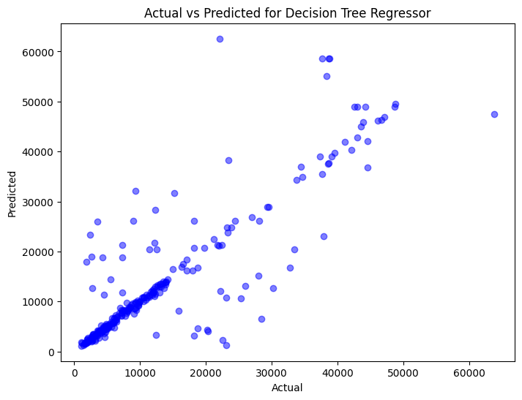
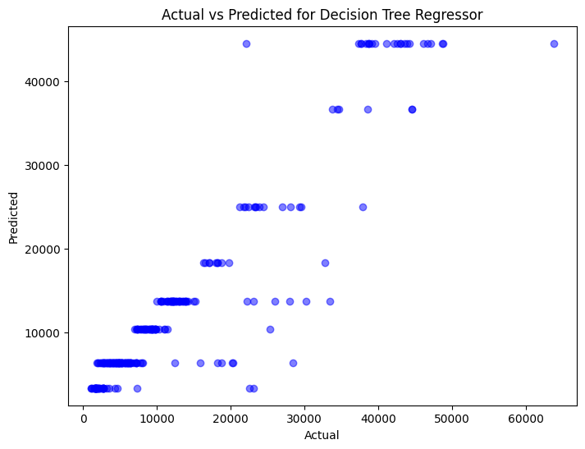
OUTPUT VISUALIZATION
Before Hyperparameter Tuning
After Hyperparameter Tuning​

Slide 11
Gradient Boosting Regressor
Gradient boosting is an ensemble learning technique that combines multiple weak learners sequentially, where each subsequent model corrects errors made by the previous ones, resulting in a strong predictive model.
Here, we implemented a Gradient Boosting Regressor model using the scikit-learn library. It trains the model on the training data (X_train, y_train) and predicts the target variable (insurance expenses) for the test data (X_test)
# Gradient Boosting Regressor
gb_model = GradientBoostingRegressor()
gb_model.fit(X_train, y_train)
# Model Testing
y_pred_gb = gb_model.predict(X_test)
Output of Gradient Boosting Regressor
Model Evaluation: Gradient Boosting Regressor: Mean Squared Error: 19127731.85259212 R-squared: 0.8767929928096798

Slide 12
Hyperparameter tuning for gradient boosting regressor
# Define Gradient Boosting model
gb_model = GradientBoostingRegressor(random_state=42)
# Perform RandomizedSearchCV
random_search = RandomizedSearchCV(estimator=gb_model, param_distributions=param_grid, n_iter=10, cv=5, verbose=2, random_state=42, n_jobs=-1)
random_search.fit(X_train, y_train)
# Get the best parameters
best_params = random_search.best_params_
# Perform GridSearchCV
grid_search = GridSearchCV(estimator=gb_model, param_grid=param_grid, cv=5, verbose=2, n_jobs=-1)
grid_search.fit(X_train, y_train)
# Get the best parameters
best_params_g = grid_search.best_params_
We performed hyperparameter tuning for a Gradient Boosting Regressor using both RandomizedSearchCV and GridSearchCV techniques to find the best combination of hyperparameters. It systematically searches through a predefined parameter grid to optimize the model's performance.

Slide 13
Results for hyper parameter tuning of gradient boost
RandomSearchCV
Best Parameters: {'subsample': 0.9, 'n_estimators': 300, 'min_samples_split': 10, 'min_samples_leaf': 2, 'max_depth': 5, 'learning_rate': 0.01}
Mean Squared Error: 19708335.773366116
R-squared: 0.8730531624945744
GridSearchCV
Best Parameters: {'subsample': 0.9, 'n_estimators': 300, 'min_samples_split': 10, 'min_samples_leaf': 2, 'max_depth': 5, 'learning_rate': 0.01}
Mean Squared Error: 19343727.16147153
R-squared: 0.8754017073306033

Slide 14
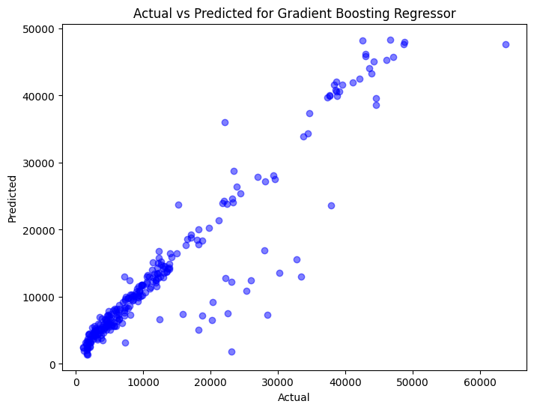
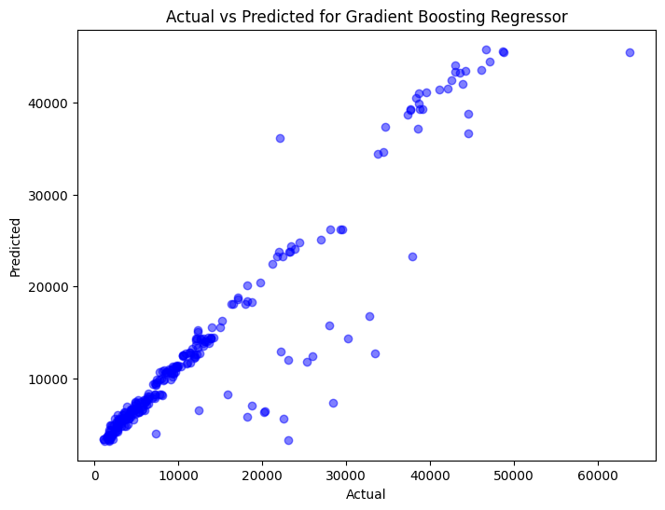
Output visualization
Before Hyperparameter Tuning
After Hyperparameter Tuning​

Slide 15
Random Forest Regressor
Random Forest Regressor model is a machine learning model from the scikit-learn library used for regression tasks. Random Forest is an ensemble learning method that constructs multiple decision trees during training and outputs the mean prediction (regression) of the individual trees.
# RandomForestRegressor
rf_model = RandomForestRegressor()
rf_model.fit(X_train, y_train)
# Model Testing
# Random Forest Regressor
y_pred_rf = rf_model.predict(X_test)
Output:
Model Evaluation:
Random Forest Regressor:
Mean Squared Error: 21232433.661857672
R-squared: 0.863236026780144

Slide 16
HYPERPARAMETER TUNING FOR random fOREST REGRESSOR
We performed hyperparameter tuning for a Random Forest Regressor using both RandomizedSearchCV and GridSearchCV techniques to find the best combination of hyperparameters.
RandomizedSearchCV to efficiently explore a predefined hyperparameter space (param_grid) for a Random Forest Regressor model. The objective is to identify the optimal set of hyperparameters (best_params) that maximize the model's performance on unseen data, as evaluated through cross-validation.
# define random forest model
rf_model = randomforestregressor(random_state=42)
# perform randomizedsearchcv
random_search = randomizedsearchcv(estimator=rf_model, param_distributions=param_grid, n_iter=10, cv=5, verbose=2, random_state=42, n_jobs=-1)
random_search.fit(x_train, y_train)
# get the best parameters
best_params = random_search.best_params_
# perform gridsearchcv
grid_search = gridsearchcv(estimator=rf_model, param_grid=param_grid, cv=5, verbose=2, n_jobs=-1)
grid_search.fit(x_train, y_train)
# get the best parameters
best_params_g = grid_search.best_params_

Slide 17
Results for HYPERPARAMETER TUNING of RANDOM FOREST REGRESSOR
Randomsearchcv
Best Parameters: {'N_estimators': 200, 'Min_samples_split': 2, 'Min_samples_leaf': 4, 'Max_depth': 10, 'Bootstrap': True}
Mean Squared Error: 18909175.033623908
R-squared: 0.8782007776831624
Gridsearchcv
Best Parameters: {'Bootstrap': True, 'Max_depth': 5, 'Min_samples_leaf': 4, 'Min_samples_split': 10, 'N_estimators': 100}
Mean Squared Error: 18971372.716579948
R-squared: 0.8778001452176802

Slide 18
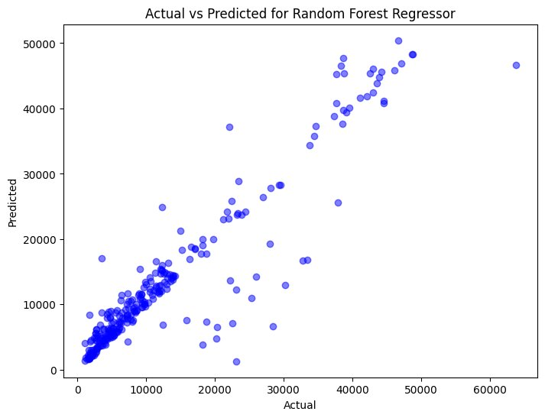

OUTPUT VISUALIZATION
Before Hyperparameter Tuning
After Hyperparameter Tuning​

Slide 19
Linear regression
# Model 4
# Linear Regression
lr_model = LinearRegression()
lr_model.fit(X_train, y_train)
# Model Testing
y_pred_lr = lr_model.predict(X_test)
Output
Model Evaluation:
Linear Regression:
Mean Squared Error: 33631970.5744218
R-squared: 0.7833671826685563
Linear Regression is a classic statistical method used for modeling the relationship between a dependent variable and one or more independent variables by fitting a linear equation to observed data points.
The provided code implements Linear Regression using scikit-learn, fitting the model to the training data (X_train, y_train) and predicting the target variable (insurance expenses) for the test data (X_test).

Slide 20
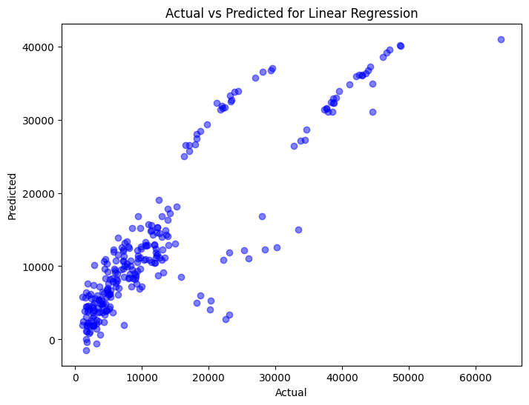
OUTPUT VISUALIZATION

Slide 21
ANN
# Define the TensorFlow model
model = tf.keras.Sequential([
tf.keras.layers.Dense(120, activation='relu', input_shape=(X_train.shape[1],)),
tf.keras.layers.Dense(64, activation='relu'),
tf.keras.layers.Dense(64, activation='relu'),
tf.keras.layers.Dense(1)
])
# Specify the optimizer
optimizer = tf.keras.optimizers.Adam(learning_rate=0.01)
# Compile the model
model.compile(optimizer=optimizer, loss='mse')
# Train the model
model.fit(X_train, y_train, epochs=50, batch_size=1, validation_split=0.2, verbose=0)
This code utilizes TensorFlow to implement a neural network model for regression tasks. The model consists of several densely connected layers with ReLU activation functions, aiming to capture complex relationships between input features and target variables.
By specifying the Adam optimizer and mean squared error loss function, the model is trained on the training data with a validation split, and its performance is evaluated on the test data using mean squared error and R-squared metrics.

Slide 22

Output and visualization
Mean Squared Error on Test Set: 25410754.91885054
R-squared on Test Set: 0.8363223048019668

Slide 23
Ensemble technique
# Define base models
base_models = [
RandomForestRegressor(random_state=42),
GradientBoostingRegressor(random_state=42),
DecisionTreeRegressor(random_state=42)
]
# Define meta-model
meta_model = LinearRegression()
# Split data into train and test
X_train, X_test, y_train, y_test = train_test_split(X, y, test_size=0.2, random_state=42)
# Initialize Stacking Regressor
stacking_reg = StackingRegressor(regressors=base_models, meta_regressor=meta_model)
# Fit the stacking model
stacking_reg.fit(X_train, y_train)
This code implements a Stacking Regressor, a meta-ensemble technique that combines predictions from multiple base regression models (Random Forest, Gradient Boosting, and Decision Tree) using a meta-regressor (Linear Regression) to improve prediction accuracy. The base models and the meta-regressor are trained on the training data (X_train, y_train) and then used to predict the target variable on the test data (X_test, y_test). Finally, the performance of the stacking model is evaluated using mean squared error and R-squared metrics.

Slide 24
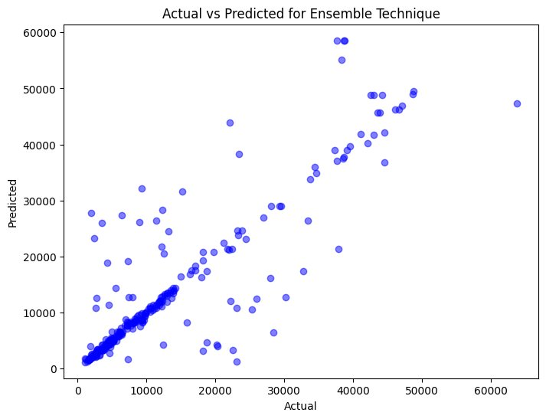
Output and visualization
Mean Squared Error: 42584021.07629183
R-squared: 0.7257045513094419

Slide 25
ANOVA
ANOVA, which stands for Analysis of Variance, is a statistical technique used to analyze the differences between the means of two or more groups. It assesses whether the means of different groups are statistically significantly different from each other.
ANOVA (Analysis of Variance) is used to determine whether there is a statistically significant difference in mean squared error (MSE) scores among different regression models (Gradient Boosting, Random Forest, Decision Tree, Linear Regression) when evaluated using cross-validation.
# Define models
models = {
'Gradient Boosting': GradientBoostingRegressor(),
'Random Forest': RandomForestRegressor(),
'Decision Tree': DecisionTreeRegressor(),
'Linear Regression': LinearRegression()
}
# Setup data and cross-validation
kfold = KFold(n_splits=10, shuffle=True, random_state=1)
# Perform ANOVA
mse_scores = [score for score in results.values()]
f_stat, p_value = f_oneway(*mse_scores)
ANOVA results:
F-Statistic: 54.39132875827116,
P-Value: 1.885569886796811e-13
There is a statistically significant difference between the models.

Slide 26
Results
Gradient Boosting Regressor:
Mean Squared Error: 19352793.68698779
R-squared: 0.875343307334039
Decision Tree Regressor:
Mean Squared Error: 39273835.24033545
R-squared: 0.7470263731142945
Random Forest Regressor:
Mean Squared Error: 21119330.007284034
R-squared: 0.863964558677689
Linear Regression:
Mean Squared Error: 33639075.08997807
R-squared: 0.7833214205203848
Artificial Neural Network (ANN):
Mean Squared Error (MSE) on Test Set: 25,410,754.92
R-squared (R2) on Test Set: 0.8363
After Tunning
Gradient boosting regressor (after tuning):
Mean squared error (MSE): 19,343,727.16
R-squared (R2): 0.8754
Decision tree regressor (after tuning):
Mean squared error (MSE): 22,812,670.32
R-squared (R2): 0.8531
Random forest regressor (after tuning):
Mean squared error (MSE): 18,971,372.72
R-squared (R2): 0.8778

Slide 27
Conclusion
Gradient Boosting Regressor:
The model's performance improved slightly after hyperparameter tuning, with a reduction in MSE and a slight increase in R-squared.
Decision Tree Regressor:
Despite hyperparameter tuning, the Decision Tree model's performance did not improve significantly compared to the initial results.
Random Forest Regressor:
Hyperparameter tuning resulted in notable improvements in the Random Forest model, reducing MSE and increasing R-squared.
Linear Regression:
Linear Regression showed the highest MSE among the models before tuning, indicating a weaker performance compared to ensemble models like Gradient Boosting and Random Forest.
Artificial Neural Network (ANN):
The ANN performed reasonably well with an MSE lower than Linear Regression but higher than some of the ensemble models.

Slide 28
Final Conclusion
ANOVA Analysis:
ANOVA results indicate a statistically significant difference in MSE scores among the regression models (Gradient Boosting, Random Forest, Decision Tree, Linear Regression).
This suggests that at least one of the models significantly outperforms the others in terms of predicting insurance expenses based on the provided dataset.
Based on the results:
Random Forest Regressor with tuned hyperparameters appears to be the most effective model for predicting medical insurance expenses, as it achieved the lowest MSE and a high R-squared value.

Slide 29
Thank You

