Slide 1
Threat Categorization Based on Malware’s C2 Communication
Key Words: Malware Analysis, C2, Threat categorization , Python, Fingerprinting, pcap
Group 6 – (KCST) Kerberos Cyber Security Team
ArkThor

Slide 2


Team
Sriram P Co-Founder
Mohammed Jawed Founder
Prof. Anand Handa
(Mentor)
Nitesh Kumar
(Mentor)
ArkThor

Slide 3
Problem Statement
The threat landscape facing modern organizations is constantly evolving and becoming increasingly complex,
Cyber-attacks are becoming more sophisticated and complex, and it is becoming increasingly difficult to detect and prevent them.
One of the key challenges in effectively defending against cyber threats is the ability to accurately categorize and analyze potential threats.
In particular, understanding the Command and Control (C2) communications used by attackers is critical in identifying and responding to cyber attacks.
Command-and-Control (C2) communication is a common technique used by attackers to control the infected hosts and steal sensitive information. It is crucial to identify C2 communication and categorize the network threats accurately to prevent and mitigate cyber-attacks.
The purpose of this capstone project is to develop a threat categorization product with user interrace and APIs based on C2 communication in Pcap files that can help organizations more effectively detect and respond to cyber threats.
ArkThor

Slide 4
Synopsis
Threat categorization is one of the biggest challenges that the security community faces today. Malwares are hidden using multiple layers of packers, obfuscators thus hiding from revealing its true identity unless unpacked.
Of late, it is also observed that the same codebase / framework is reused by multiple RAT builders and Backdoors. Some of these packers and obfuscators are also reused across multiple malware families.
This project aims at looking into the networking concept of these C2 communicating malwares and tries to parse the network packets and classify the threats based on the unique communication pattern used by these malware families. The rules also involve fingerprinting the TLS certificates used in the communication.
ArkThor

Slide 5
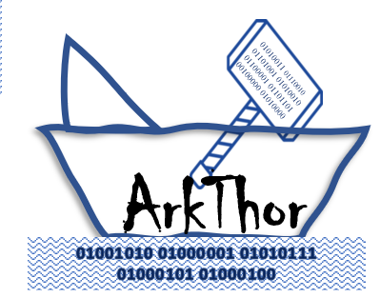
Presenting
"Ark" imply safety or protection
"Thor" is associated with strength or power
ArkThor

Slide 6
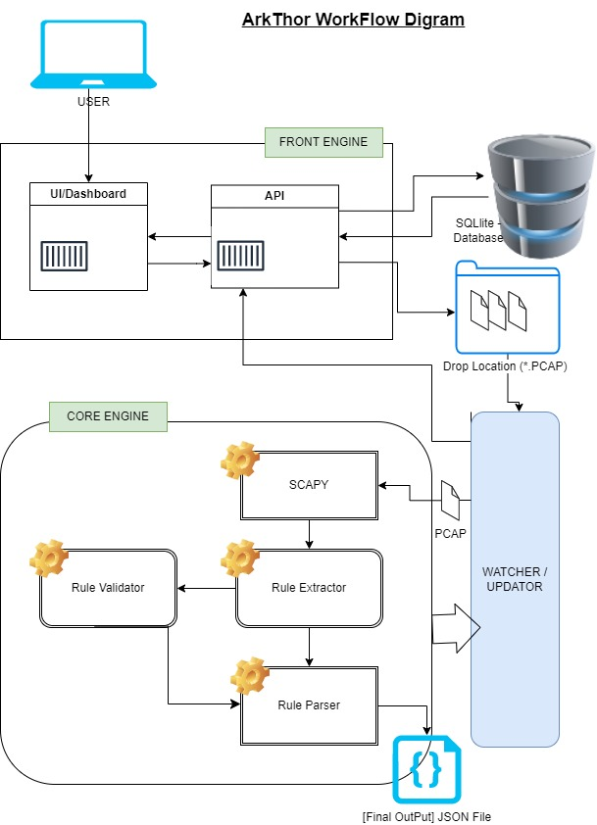
ArkThor Architect Diagram
ArkThor

Slide 7








ArkThor Architect Flow Diagram
User
Database(SQLite)
UI/
Dashboard
APIs
Drop Location (*.Pcap)
Watcher/Subscriber
SCAPY
Extractor
Parser
Validator
RabbitMQ
ArkThor

Slide 8
ArkThor Architect Flow Diagram
User
1
SCAPY
Extractor
UI/
Dashboard
APIs
Watcher/Subscriber
2
Parser
Validator
RabbitMQ (Message Broker)
Database(SQLite)
Drop Location (*.Pcap)
ArkThor

Slide 9
ArkThor Architect Flow Diagram
User
1
SCAPY
Extractor
UI/
Dashboard
6
APIs
Watcher/Subscriber
8
9
6
2
5
6
4
Parser
Validator
3
RabbitMQ (Message Broker)
7
Database(SQLite)
Drop Location (*.Pcap)
ArkThor

Slide 10
Front Engine Demo
ArkThor

Slide 11
Core Engine Demo
ArkThor

Slide 12
Learning
ArkThor

Slide 13
Dataflow Diagram (Static Packet)
Libpcap files
Scapy
Rule Extractor Engine
Rule Validator
Pcap from VT/C3i Cuckoo Replication
Extract TCP Streams
Command Line tool to classify threat
Rule parser and Threat classifier
ArkThor

Slide 14
Deliverables
Python based pcap parser
Rule and fingerprinting Compiler for pcap parser
Usage documentation
Complete Architect Diagram
Demo
ArkThor

Slide 15
Key Words
Malware Analysis
Threat categorization
C2
Python
Fingerprinting
Pcap
Compiler
TLS
ArkThor

Slide 16


ArkThor

Slide 18
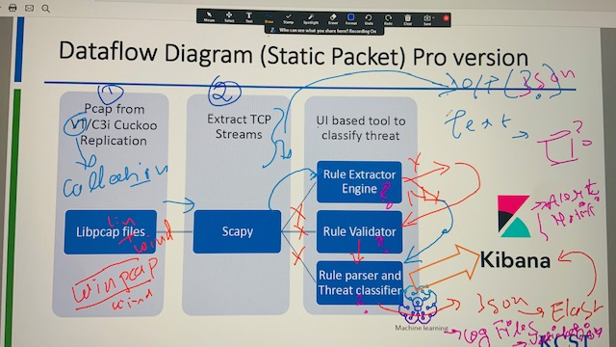

Slide 19

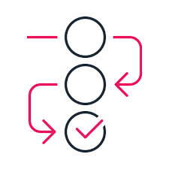



Slide 20
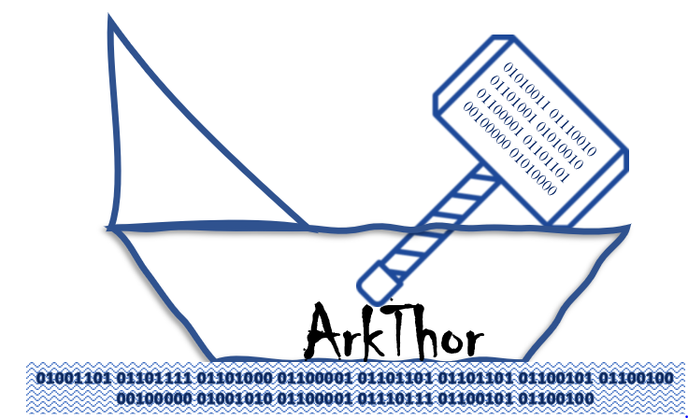
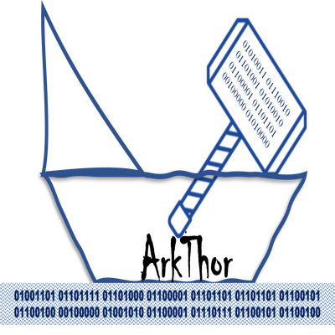
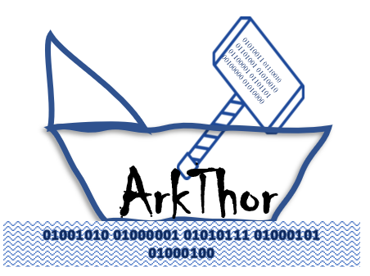

Slide 21
"Ark" could imply safety or protection, while "Thor" is associated with strength or power.
"ArkThor" could be a suitable name for your threat categorization project, as it conveys a sense of safety and strength
Choosing a name for a project is a subjective decision and ultimately depends on your personal preference and the specific context of your project. However, here are some things to consider:
Does the name reflect the purpose or nature of the project? "Ark" could imply safety or protection, while "Thor" is associated with strength or power. If your project involves threat categorization for security purposes, then the name could be appropriate.
Overall, "ArkThor" could be a suitable name for your threat categorization project, as it conveys a sense of safety and strength. However, it's ultimately up to you to decide if the name feels right for your project and effectively communicates its purpose.

Slide 22
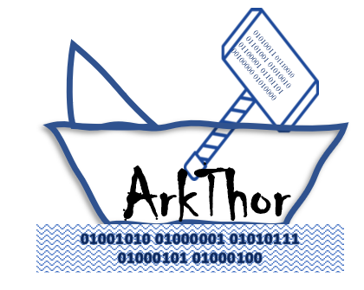

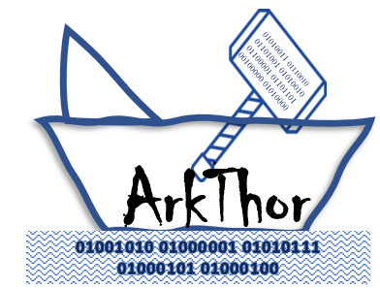
01010011 01110010 01101001 01010010 01100001 01101101 00100000 01010000
ArkThor
01001101 01101111 01101000 01100001 01101101 01101101 01100101 01100100 00100000 01001010 01100001 01110111 01100101 01100100
01010011 01110010 01101001 01010010 01100001 01101101 00100000 01010000
ArkThor
01001010 01000001 01010111 01000101 01000100

