Slide 1
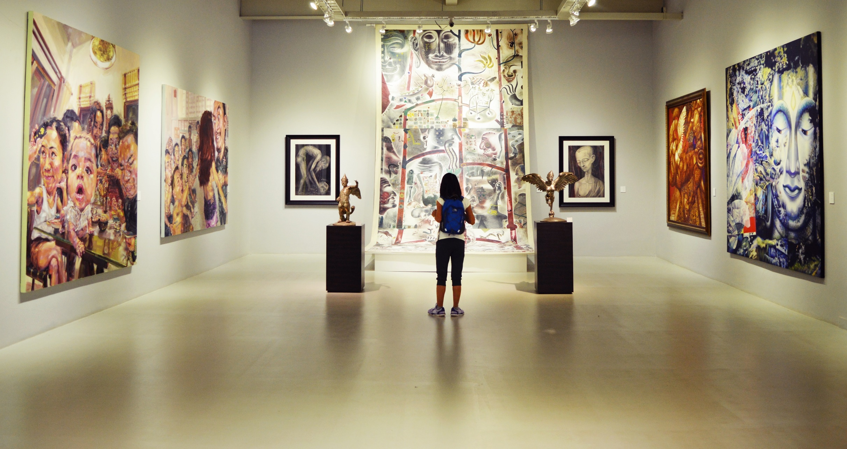
ART GALLERY MANAGEMENT SYSTEM

Slide 2
INTRODUCTION:
An " Art Gallery " is one of the medium or outlet through which the works of art are marketed. It is the wholesale or retail establishment through which one can acquire ownership of an item of art.
Online Art Gallery Management System is an application that allows buyers to purchase paintings, sculptures, models online.
The Purchase is just a click way you don’t have to go to some old museums and buy from selected stuff. This application will provide you with a wide range of choices.

Slide 3
PROBLEM STATEMENT:
Today art enthusiastic people do not have a common platform from where they can buy or sell the artwork. They have manually visit the art galleries to find their desired art.
It is time taking and wastes a lot of time.

Slide 4
PROPOSED SOLUTION:
We are bringing a digitalized system where a platform is created where an artist can sell their art and can purchase the art too.

Slide 5
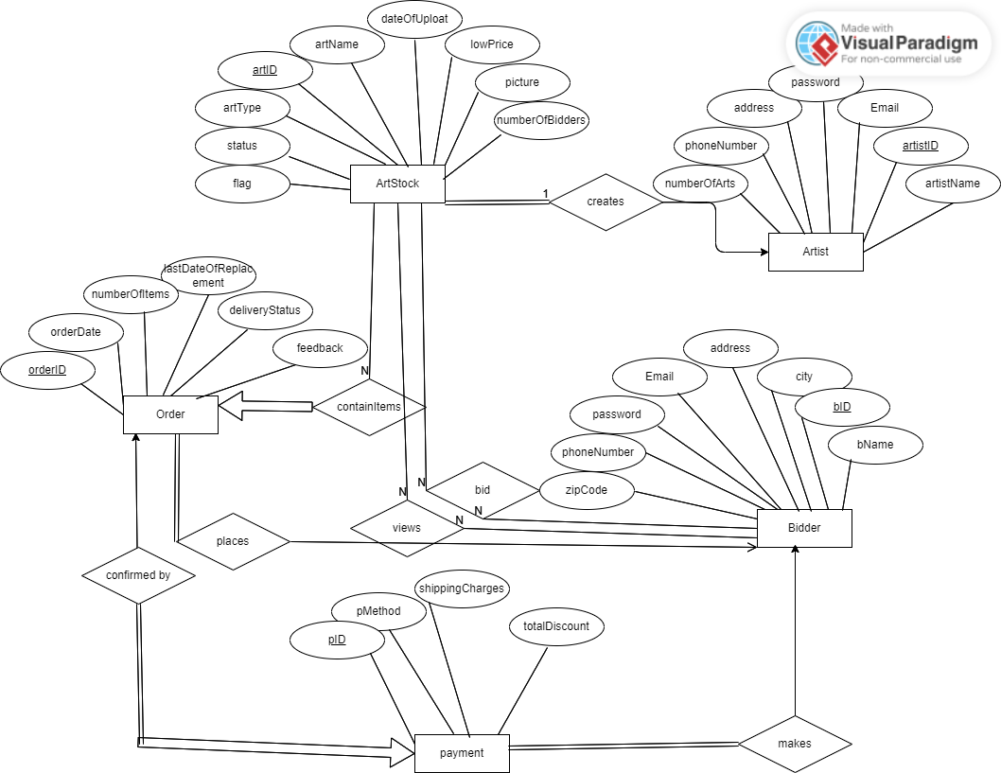

Slide 6
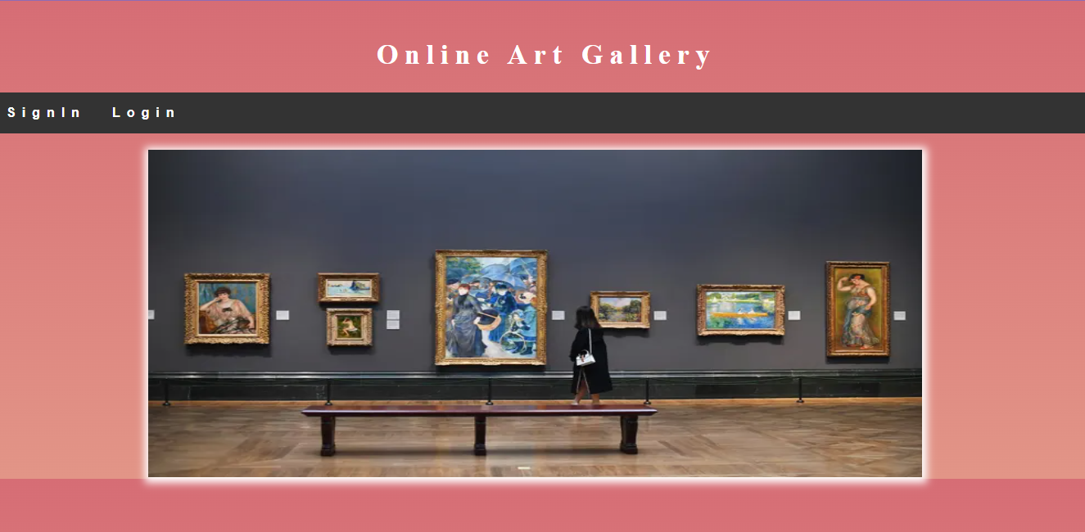

Slide 7
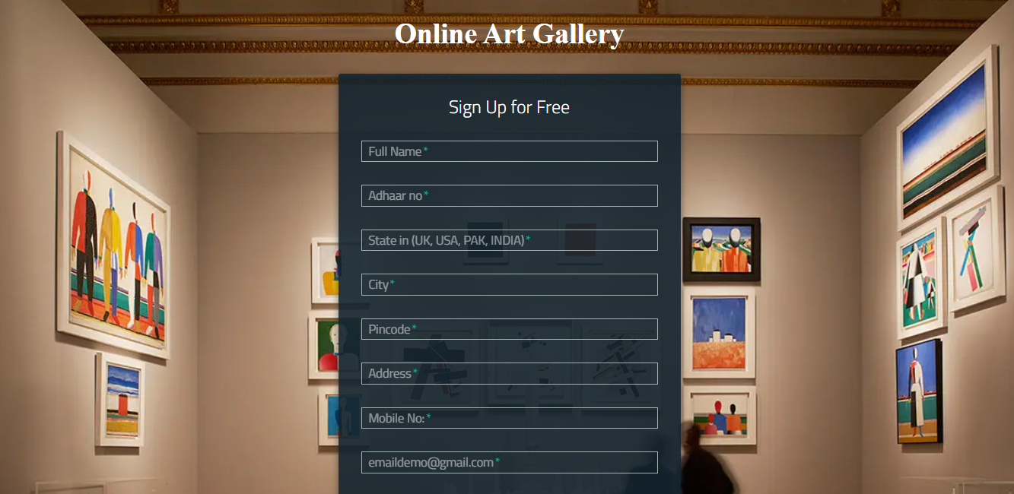

Slide 8
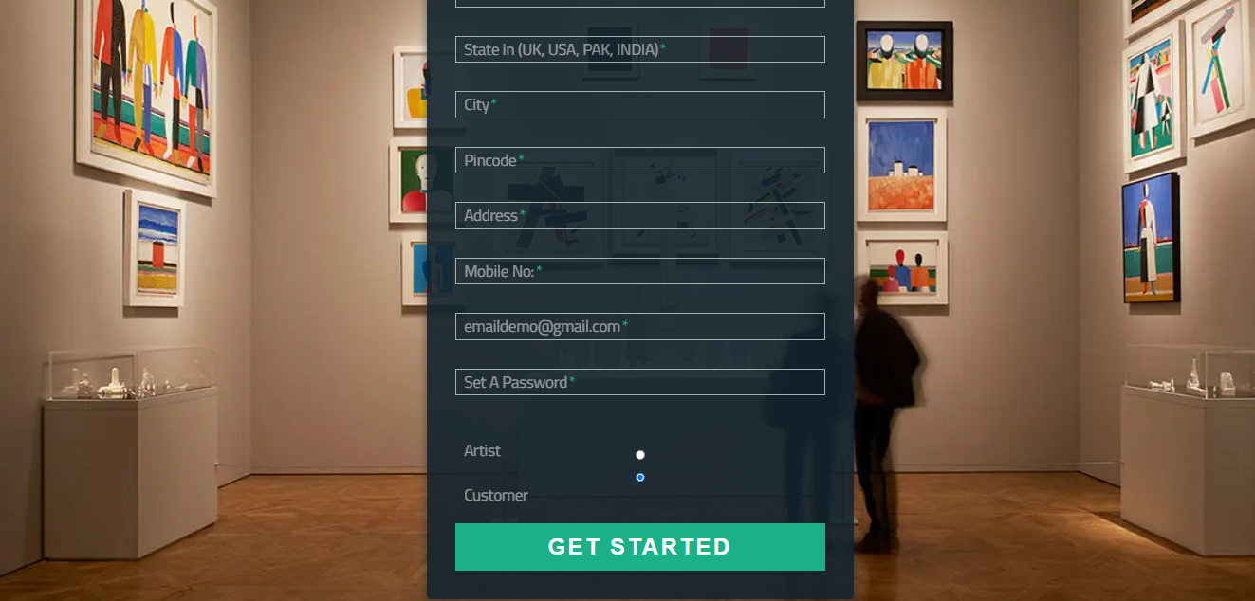

Slide 9
