Slide 1
IoT Hackathon: Homeautomation
Tim Ebner, Konstantin Garidis, Annika Glasbrenner, Lisa-Jo Heinrich, Elisabeth Mpessa, Frank Steiler

Slide 2
Agenda
Business Model Canvas
Living Lab Process
Minimum Viable Product
Technical Architectur
Implementation
Summary, Lessons Learned and Next Steps

Slide 3
Business Modell Canvas
Key Partners Belkin as device manufacturer IBM as IoT Platform provider Raspberry Pi as interface for connectivity Additional products available: Elgato Eve Wireless Power Sensor & Switch Osram LIGHTIFY Starter Kit | Key Activities Define and implement MVP Find additional services for further implementation | Value Proposition MVP Automated Services |  | Customer Relationship Customer relationship has to be developed Early adopters giving feedback about MVP | Customer Segments House/Apartment owners Companies from retail, industry and consulting Early adopters: Tech savy people (mostly Generation Y)
 | Key Ressources Devices, Platform, Developer, Network |  |  | Channels Local electronics dealer Online sales
Cost Structure Development costs of the solution Acquistion costs for IoT devices Small costs for MVP, due to reduced scope |  |  | Revenue Streams: Services: Make “stupid“ device smart through platform connectivity Save energy Automated control of devices using voice commands Automated control of lights

Slide 4
Living Lab Process
Co-creation
Problem: electricity consumption out of control
Exploration
Set-up a test Platform: IBM Bluemix
Experimentation
Set-up of Living Lab: room with functioning smart devices
Evaluation
Validation of Living Lab results: The process was successful
Needs: Switch lights from everywhere
Idea: Homeautomation
Initiating a test phase: Collection of smart devices and finding a way of connecting them to the IBM Bluemix platform
Use of technology: Control of lights, energy saving, communication via google and alexa
Exploration result analysis and conclusion: House control with smart devices
Test of the Soft- and hardware: turn devices on/off with an user interface
Conclusion: the power consumption can be reduce and better controlled due to homeautomation

Slide 5
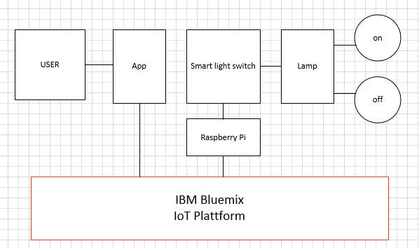
Minimum Viable Product
Connection of a Smart Switch to the IBM Bluemix Plattform
Possibility to control the switch & check its status

Slide 6
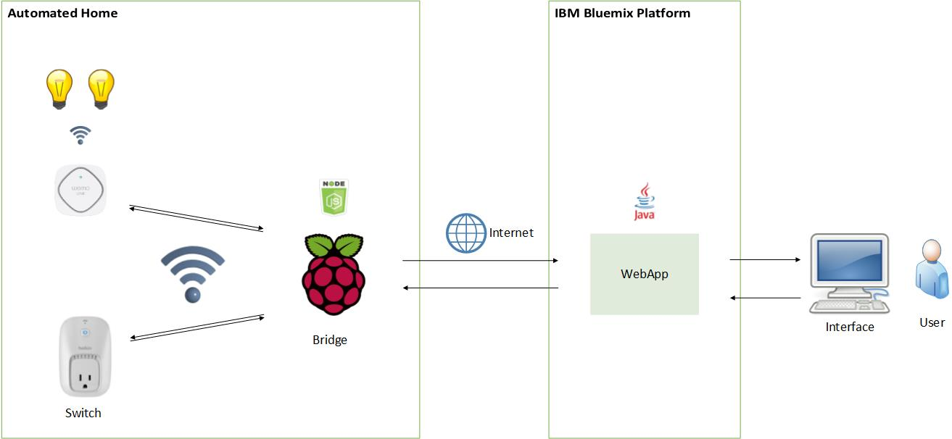
Technical Architecture

Slide 7
Implementation: Local Device Bridge
Raspberry Pi with Wifi Dongle
Physical IoT devices connected to the RPI’s Wifi
Modular NodeJS application bridging IoT Devices with IoT Platform
Functionality:
Connect IoT devices to Device Bridge
Connect Device Bridge to Platform
Exchange status and commands between platform & device
Support:
Belkin Wemo Switch
IBM BlueMix/Watson IoT Platform
Easily extensible!

Slide 8
Implementation: Home Control Center

Slide 9
Summary, Lessons Learned and Next Steps
Challanges
ConnectingWeMo Devices to the Rasberry Pi
Connecting the Rasberry Pi with BlueMix
Review and Motivation
WeMo App is Buggy and restricted to one phone
Only WeMo devices supported and just a limited amount
No Analytics functions
Only reachable within your WiFi network
Outlook
Integrate other devices to you home automation other than WeMo Devices (e.g. Osram lights)
User IBM Watson to Analyse Devices Usage
Enhance the functionality of the platform to build an intelligent HomeAutomation System
HomeAutomation system is now reachable from anywhere via Internet and offers more possibilities

Slide 10
Thank You! Check out our Repository: https://github.com/glasbran/Hackathon---Homeautomation/

