Slide 1
ASTAR / AUTONOMOUS SOLAR TUTORING AND RESOURCE SYSTEM
ASTAR / 2026
ASTAR
LEARNING WHEN
INFRASTRUCTURE FAILS
01 / 12
Notes:
Introduce ASTAR as an offline-first learning initiative. Software is available as a prototype; the solar device is a concept.
Sources: user-supplied ASTAR.pdf and brief; local ASTAR software and tests. Generated hardware image is a design concept. Fonts substituted with Arial Black and Arial for local editability.

Slide 2
ASTAR / AUTONOMOUS SOLAR TUTORING AND RESOURCE SYSTEM
ASTAR / 2026
WHEN INFRASTRUCTURE
FAILS
01 / POWER
02 / CONNECTIVITY
03 / CONTINUITY
Charging becomes uncertain
Online lessons become harder to reach
Students need a dependable fallback
ASTAR is designed to complement teachers and education services when access is disrupted.
02 / 12
Notes:
Explain the intended product and development stage.
Sources: user-supplied ASTAR.pdf and brief; local ASTAR software and tests. Generated hardware image is a design concept. Fonts substituted with Arial Black and Arial for local editability.

Slide 3
ASTAR / AUTONOMOUS SOLAR TUTORING AND RESOURCE SYSTEM
ASTAR / 2026
INTRODUCING
ASTAR
DEVICE
SOFTWARE
FORGE
Proposed low-power solar hardware
Offline reading, practice and progress
Content preparation, review and export
03 / 12
Notes:
Forge is the name used here for the existing textbook studio and its content-preparation role.
Sources: user-supplied ASTAR.pdf and brief; local ASTAR software and tests. Generated hardware image is a design concept. Fonts substituted with Arial Black and Arial for local editability.

Slide 4
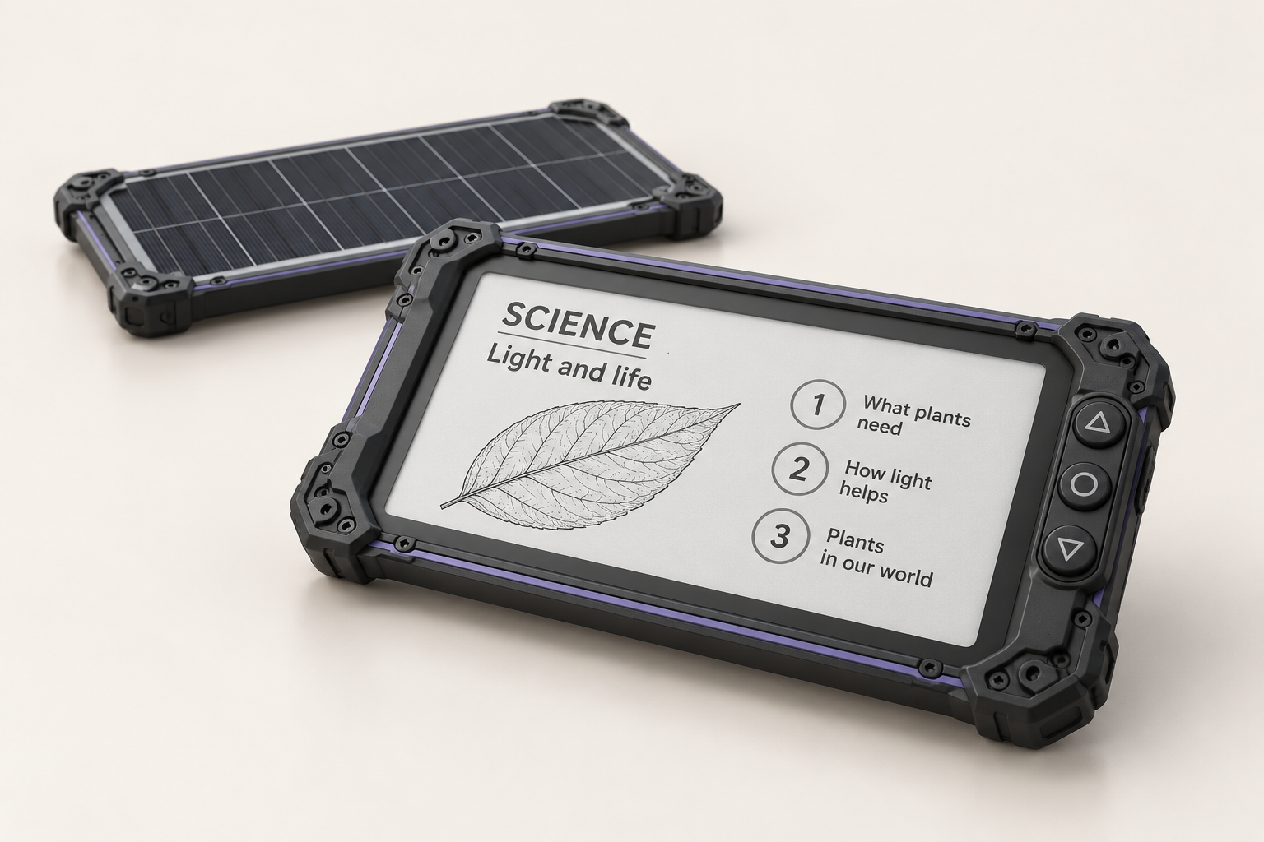
ASTAR / AUTONOMOUS SOLAR TUTORING AND RESOURCE SYSTEM
ASTAR / 2026
THE PRODUCT
CONCEPT
E-paper reading. Physical controls. Local storage. Solar charging.
DESIGN CONCEPT / SUBJECT TO VALIDATION
04 / 12
Notes:
Generated assembled visualization based on the supplied exploded view. Component compatibility, dimensions and runtime remain to be validated.
Sources: user-supplied ASTAR.pdf and brief; local ASTAR software and tests. Generated hardware image is a design concept. Fonts substituted with Arial Black and Arial for local editability.

Slide 5
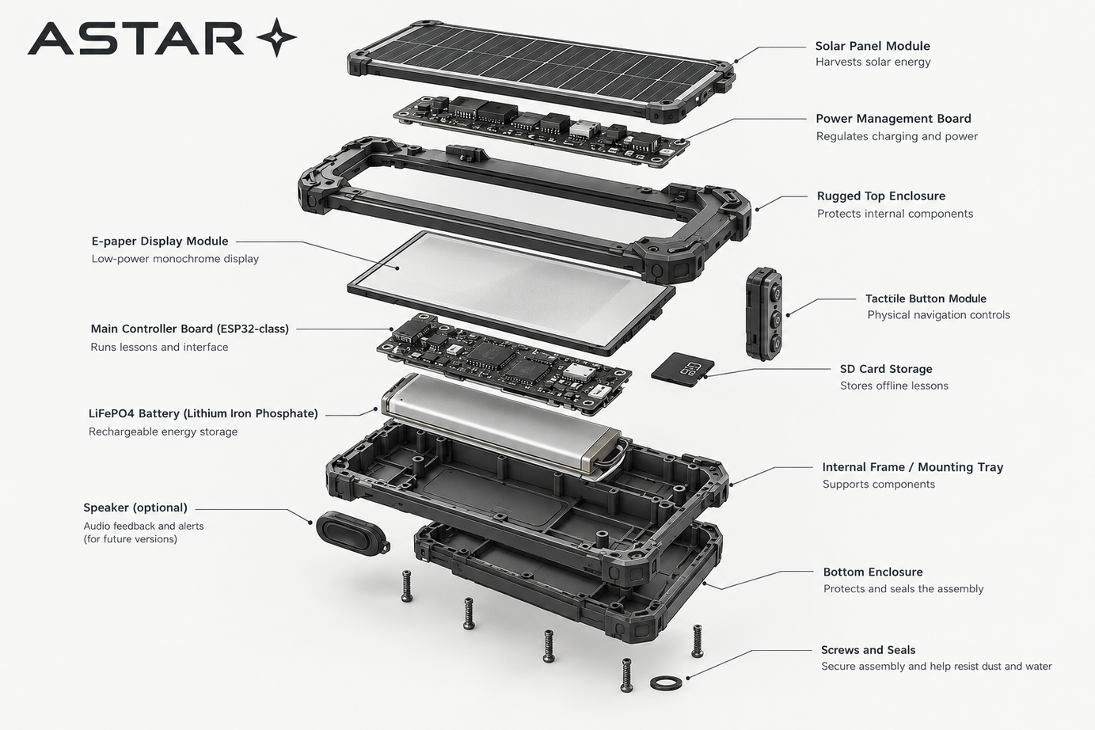
ASTAR / AUTONOMOUS SOLAR TUTORING AND RESOURCE SYSTEM
ASTAR / 2026
DESIGNED AS
A SYSTEM
An intended modular architecture for learning continuity.
DESIGN CONCEPT / SUBJECT TO VALIDATION
05 / 12
Notes:
Exploded reference image extracted unchanged from user-supplied ASTAR.pdf. Illustration is not a verified engineering drawing.
Sources: user-supplied ASTAR.pdf and brief; local ASTAR software and tests. Generated hardware image is a design concept. Fonts substituted with Arial Black and Arial for local editability.

Slide 6
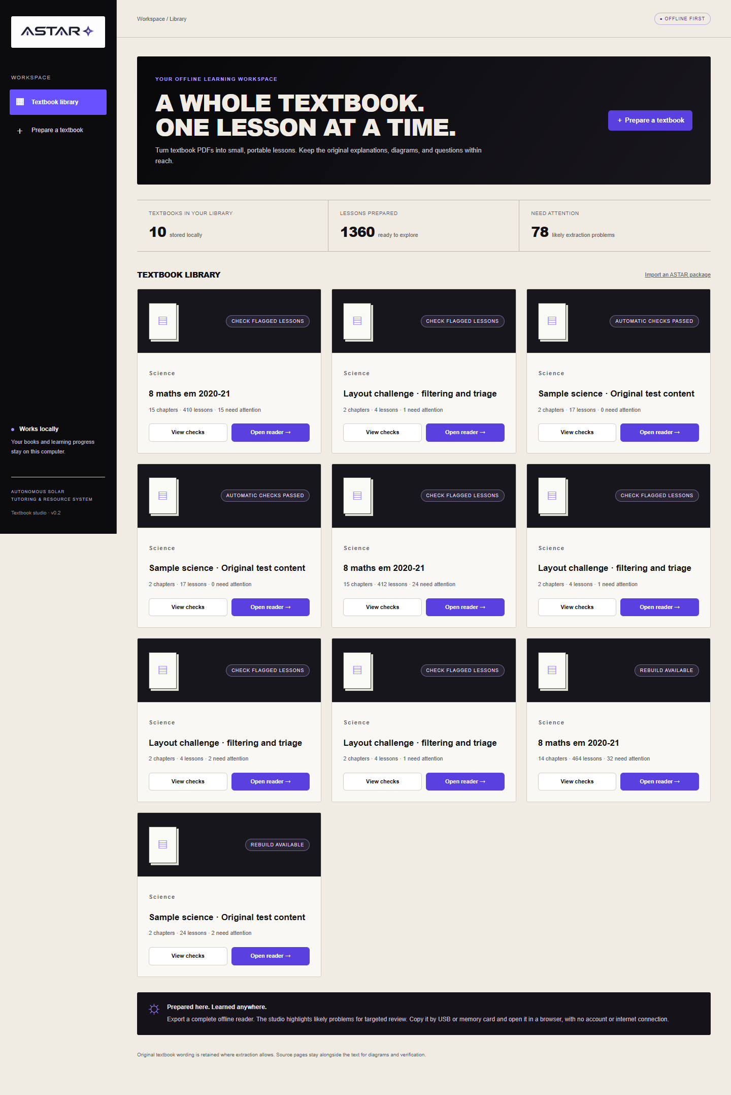
ASTAR / AUTONOMOUS SOLAR TUTORING AND RESOURCE SYSTEM
ASTAR / 2026
A WHOLE TEXTBOOK.
ONE LESSON AT A TIME.
Prepare material locally, then export an offline course.
06 / 12
Notes:
Screenshot captured from the current software build.
Sources: user-supplied ASTAR.pdf and brief; local ASTAR software and tests. Generated hardware image is a design concept. Fonts substituted with Arial Black and Arial for local editability.

Slide 7
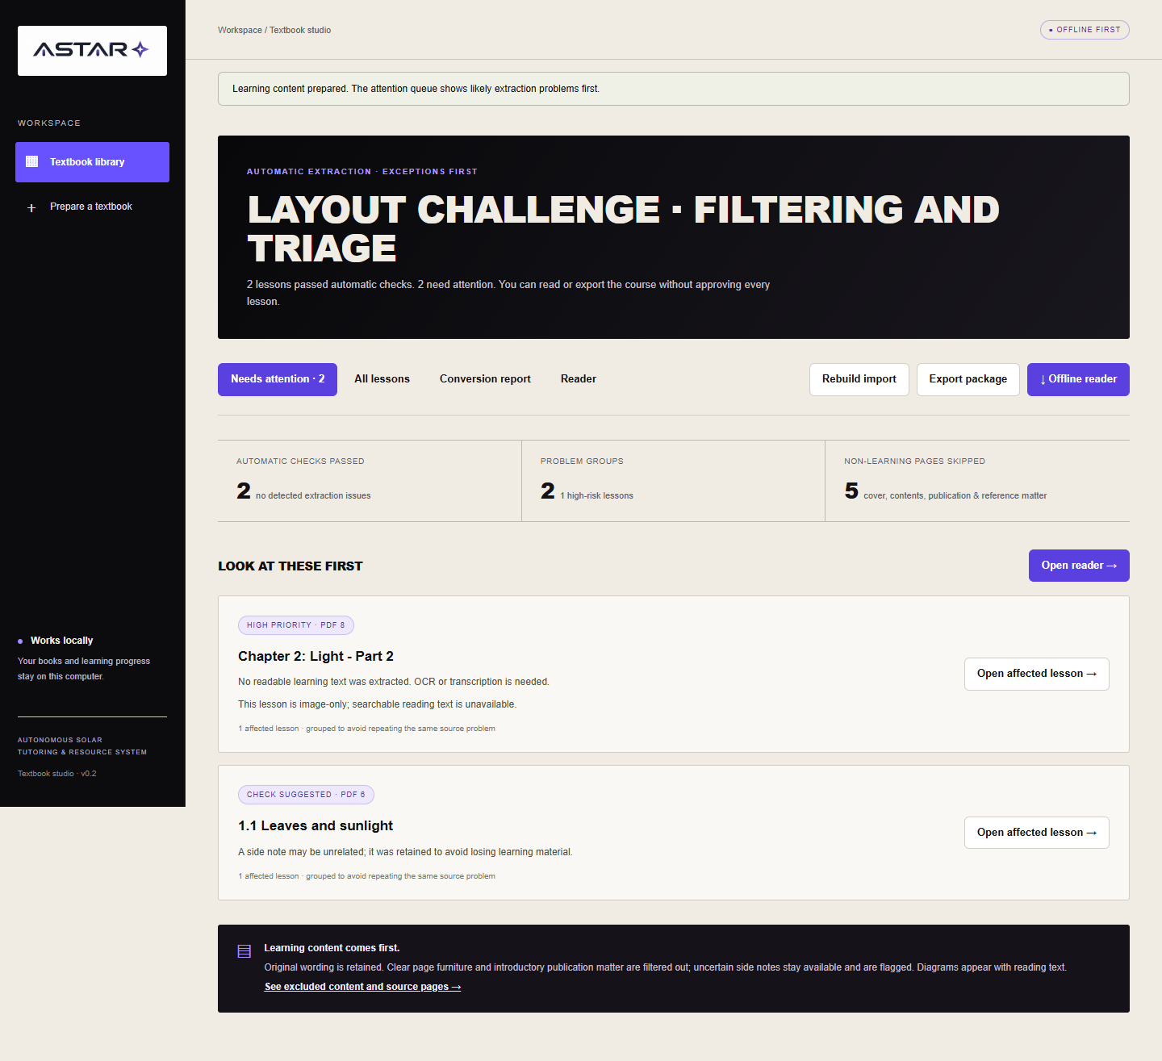
ASTAR / AUTONOMOUS SOLAR TUTORING AND RESOURCE SYSTEM
ASTAR / 2026
REVIEW WHAT
NEEDS ATTENTION
Ranked conversion checks. Source-page comparison. An exclusion log.
07 / 12
Notes:
Automatic checks help prioritise likely extraction issues. They are not a guarantee of teaching accuracy.
Sources: user-supplied ASTAR.pdf and brief; local ASTAR software and tests. Generated hardware image is a design concept. Fonts substituted with Arial Black and Arial for local editability.

Slide 8
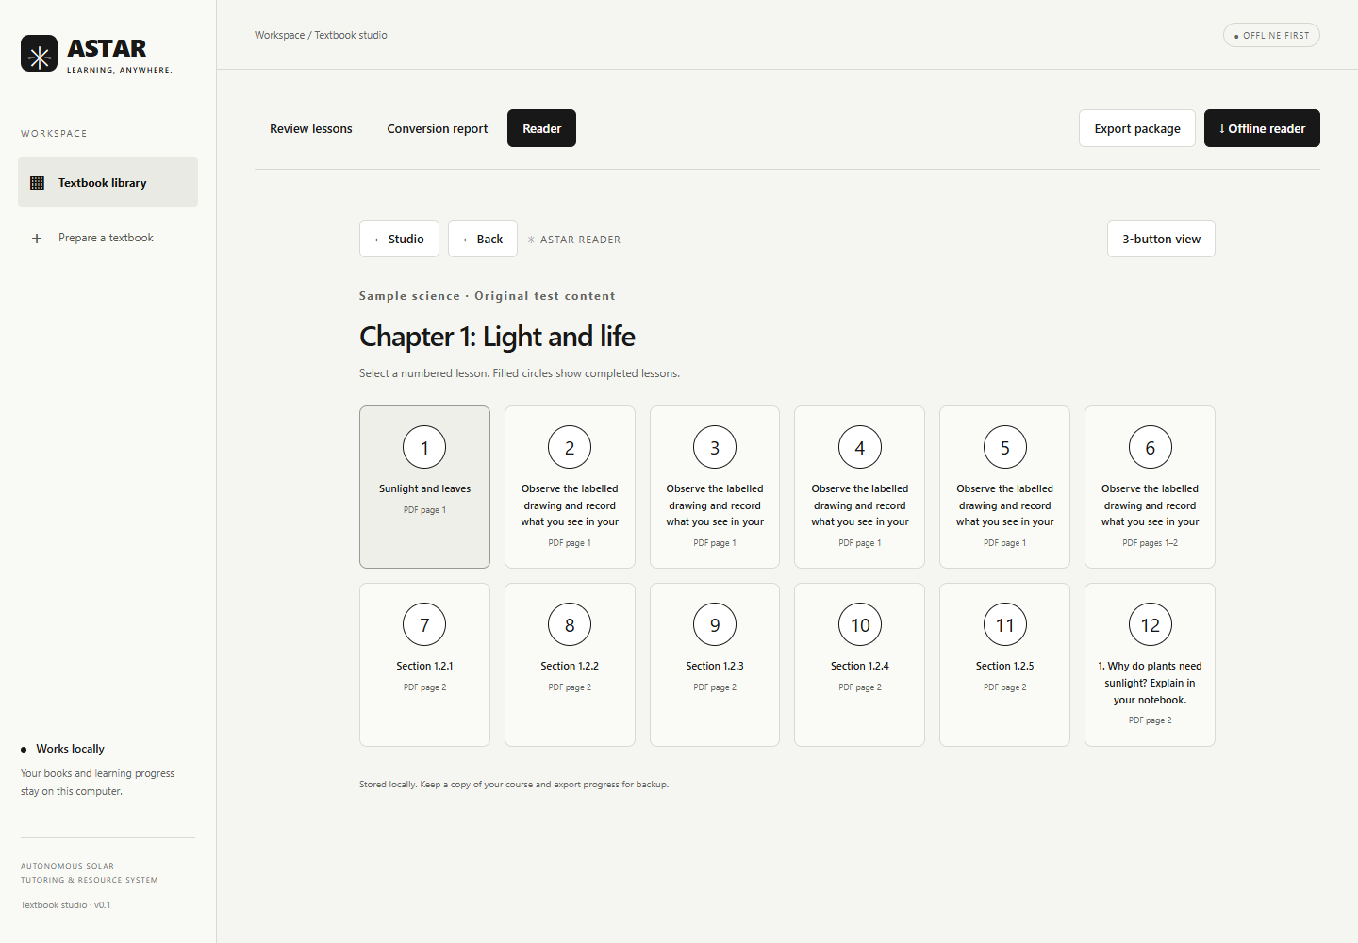
ASTAR / AUTONOMOUS SOLAR TUTORING AND RESOURCE SYSTEM
ASTAR / 2026
READ. PRACTISE.
KEEP LEARNING.
Numbered navigation, monochrome lessons and locally saved progress.
08 / 12
Notes:
Existing software. Teacher-authored MCQs use explicit answer keys. Long answers use notebooks. Hardware firmware is future work.
Sources: user-supplied ASTAR.pdf and brief; local ASTAR software and tests. Generated hardware image is a design concept. Fonts substituted with Arial Black and Arial for local editability.

Slide 9
ASTAR / AUTONOMOUS SOLAR TUTORING AND RESOURCE SYSTEM
ASTAR / 2026
WHO IS
ASTAR FOR?
LEARNERS
DEPLOYMENT
SUPPORT
Students aged 10-18 in disrupted or underserved settings
Education organisations and institutional pilots
Facilitators, reviewed content and local updates
09 / 12
Notes:
These are intended users and prospective partner types, not signed partnerships.
Sources: user-supplied ASTAR.pdf and brief; local ASTAR software and tests. Generated hardware image is a design concept. Fonts substituted with Arial Black and Arial for local editability.

Slide 10
ASTAR / AUTONOMOUS SOLAR TUTORING AND RESOURCE SYSTEM
ASTAR / 2026
A TARGET PRICE
TO VALIDATE
INR 3,700
INR 4,700
Founder target unit cost
Founder target selling price
Unvalidated estimates. Confirm components, battery, charging, testing, logistics and support costs.
10 / 12
Notes:
Targets from ASTAR.pdf, not current supplier quotations. No margin claim is made.
Sources: user-supplied ASTAR.pdf and brief; local ASTAR software and tests. Generated hardware image is a design concept. Fonts substituted with Arial Black and Arial for local editability.

Slide 11
ASTAR / AUTONOMOUS SOLAR TUTORING AND RESOURCE SYSTEM
ASTAR / 2026
THE NEXT
MILESTONE
01 / HARDWARE
02 / CONTENT
03 / PILOT
Measure power use and charging performance
Review a small teaching package
Test with learners and refine deployment
11 / 12
Notes:
Explain the intended product and development stage.
Sources: user-supplied ASTAR.pdf and brief; local ASTAR software and tests. Generated hardware image is a design concept. Fonts substituted with Arial Black and Arial for local editability.

Slide 12

ASTAR / AUTONOMOUS SOLAR TUTORING AND RESOURCE SYSTEM
ASTAR / 2026
LEARNING SHOULD
CONTINUE.
Seeking technical mentors and education collaborators.
astarco0@gmail.com
12 / 12
Notes:
End with the specific collaboration request and invite a demo.
Sources: user-supplied ASTAR.pdf and brief; local ASTAR software and tests. Generated hardware image is a design concept. Fonts substituted with Arial Black and Arial for local editability.

