Slide 1

ASTAR
Learning should not stop
when the lights go out
Autonomous Solar Tutoring and Resource System
01
Notes:
Open with the mission. ASTAR is an offline-first learning initiative. The software exists as a local prototype, while the solar device is proposed.
Source: user-supplied ASTAR brief and ASTAR.pdf. Software evidence: local ASTAR README.md and test-results screenshots. Hardware illustration is conceptual.

Slide 2
ASTAR
Learning needs a dependable fallback
When power, connectivity or access to schools is interrupted, students can lose access to digital lessons.
ASTAR is designed to keep structured learning materials within reach.
02
Notes:
Explain the design problem without quoting unverified statistics. ASTAR complements teachers and schools. It does not claim to replace them.
Source: user-supplied ASTAR brief and ASTAR.pdf. Software evidence: local ASTAR README.md and test-results screenshots. Hardware illustration is conceptual.

Slide 3
ASTAR
Three parts, one learning experience
01
02
03
ASTAR device
ASTAR software
ASTAR Forge
Proposed solar-powered
educational hardware
Offline lessons, practice
and local progress
Content preparation,
review and export
03
Notes:
Forge is the proposed name for the content-preparation role fulfilled by the current textbook studio. Hardware integration is future work.
Source: user-supplied ASTAR brief and ASTAR.pdf. Software evidence: local ASTAR README.md and test-results screenshots. Hardware illustration is conceptual.

Slide 4
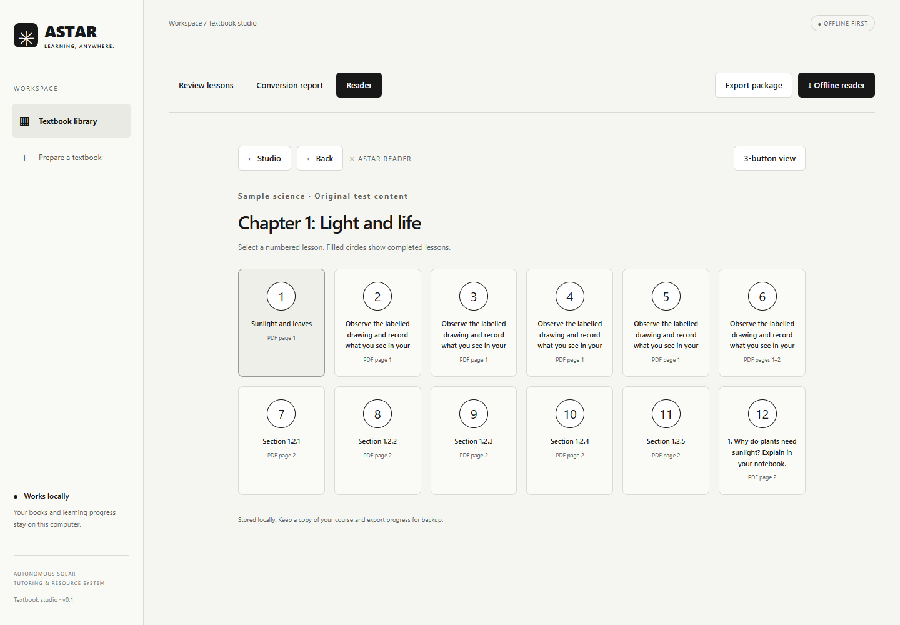
ASTAR
Choose a lesson. Keep learning.
Numbered chapters and lessons
Monochrome reading and diagrams
Local completion and resume state
Existing software / saved development screenshot
04
Notes:
Existing saved software screenshot from the workspace test-results folder. Demonstrate the current reader rather than describing a future interface.
Source: user-supplied ASTAR brief and ASTAR.pdf. Software evidence: local ASTAR README.md and test-results screenshots. Hardware illustration is conceptual.

Slide 5
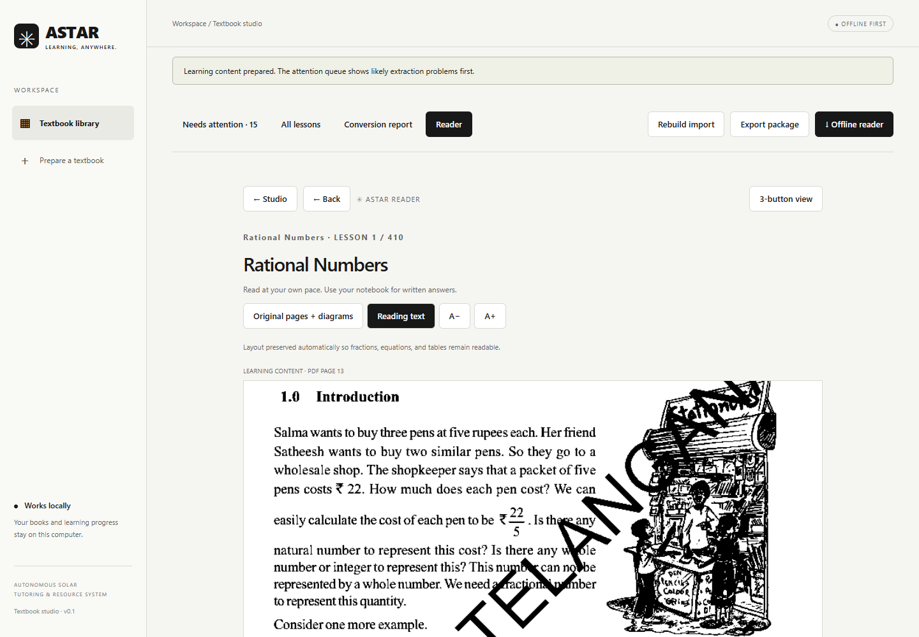
ASTAR
Preserve the detail that learning needs
Textbook reading with diagrams
Page references and original prompts
Teacher-authored interactive practice
Existing software / saved development screenshot
05
Notes:
Existing mathematics-reader screenshot. Complex notation is preserved as image regions. Original textbook MCQs are not reliably parsed into interactive options. Long answers are written on paper.
Source: user-supplied ASTAR brief and ASTAR.pdf. Software evidence: local ASTAR README.md and test-results screenshots. Hardware illustration is conceptual.

Slide 6
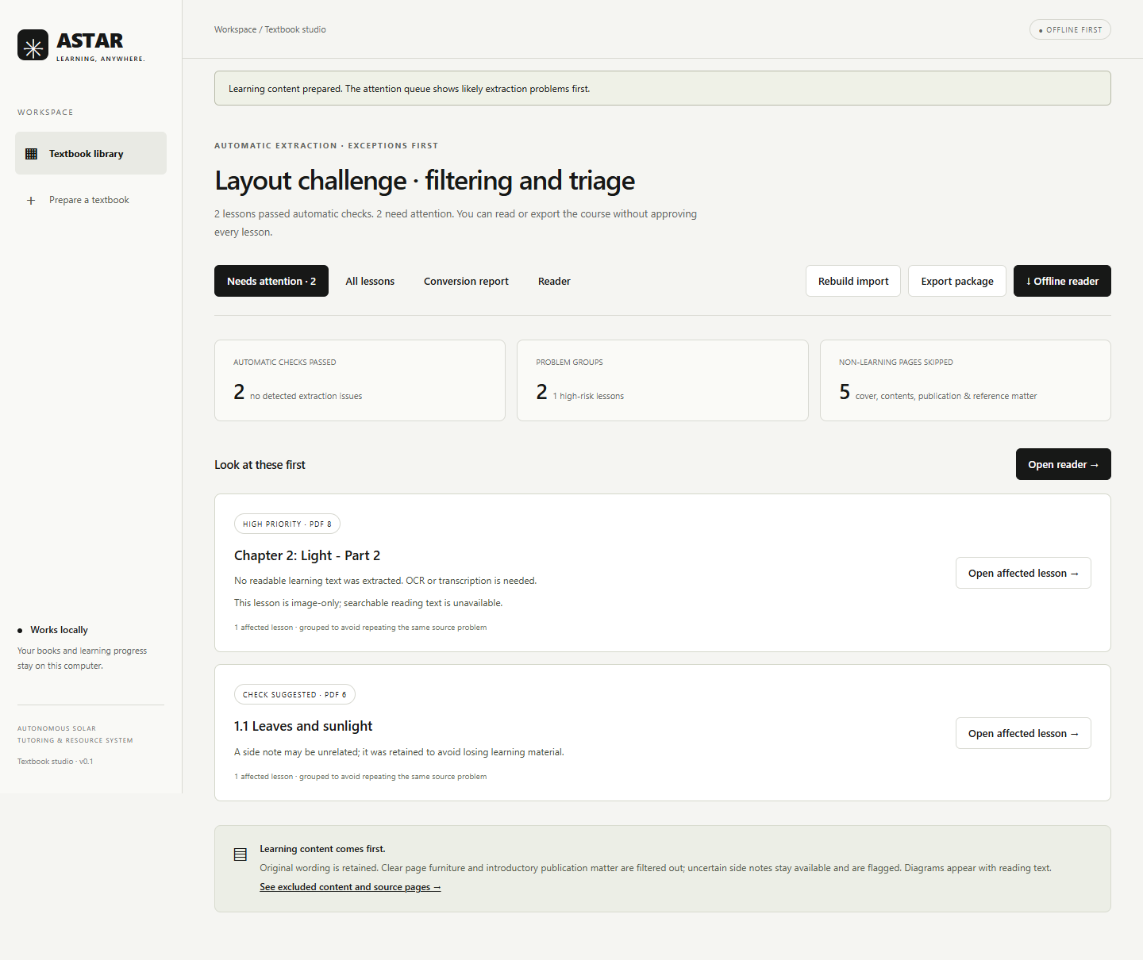
ASTAR
Prepare content with review built in
Import a textbook PDF
Inspect flagged conversion issues
Export a standalone offline reader
Existing software / saved development screenshot
06
Notes:
Existing saved textbook-studio screenshot. Conversion uses heuristics. Automatic checks are not a guarantee of educational accuracy. Human content review remains necessary.
Source: user-supplied ASTAR brief and ASTAR.pdf. Software evidence: local ASTAR README.md and test-results screenshots. Hardware illustration is conceptual.

Slide 7
ASTAR
The solar device is the next step
E-paper display and physical controls
Local lessons and storage
Solar charging with battery storage
Next: validate components, power use and firmware
ASTAR
01 SCIENCE
Light and life
Read. Try. Learn.
Device design concept
07
Notes:
The device illustration is a concept, not a photograph or manufacturing specification. Battery runtime, controller selection, dimensions and costs are not validated.
Source: user-supplied ASTAR brief and ASTAR.pdf. Software evidence: local ASTAR README.md and test-results screenshots. Hardware illustration is conceptual.

Slide 8
ASTAR
Start with an education partner
Intended learners
Students aged 10-18 in disrupted and underserved settings
Proposed route
Partner-led pilot, facilitator support and local content review
08
Notes:
Education NGOs and humanitarian organisations are prospective deployment partners. No partnership, signed procurement or field deployment is claimed.
Source: user-supplied ASTAR brief and ASTAR.pdf. Software evidence: local ASTAR README.md and test-results screenshots. Hardware illustration is conceptual.

Slide 9
ASTAR
An institutional model to validate
INR 3,700
INR 4,700
Founder target unit cost
Founder target institutional price
Unvalidated estimates. Full component, logistics and support costs remain to be established.
09
Notes:
Targets copied from supplied ASTAR.pdf, not supplier quotes. The implied INR 1,000 difference must cover costs not yet established. Validate battery, charging, testing, shipping, tax, support and content costs before claiming a margin.
Source: user-supplied ASTAR brief and ASTAR.pdf. Software evidence: local ASTAR README.md and test-results screenshots. Hardware illustration is conceptual.

Slide 10
ASTAR
Make the next milestone measurable
1 Validate the hardware energy budget
2 Review a small curriculum package
3 Test reading and navigation with learners
4 Refine cost and partner-led pilot design
10
Notes:
Measure task completion, reading usability, content errors and device energy use. These are proposed tests. No learning-outcome improvement or field results are claimed.
Source: user-supplied ASTAR brief and ASTAR.pdf. Software evidence: local ASTAR README.md and test-results screenshots. Hardware illustration is conceptual.

Slide 11
ASTAR
Help us make learning more resilient
Seeking technical mentors and education collaborators
astarco0@gmail.com
11
Notes:
Close with a focused invitation to technical mentors and organisations who can help design a responsible pilot. Mission: access to learning should not depend on access to infrastructure.
Source: user-supplied ASTAR brief and ASTAR.pdf. Software evidence: local ASTAR README.md and test-results screenshots. Hardware illustration is conceptual.

