Slide 1
Refactoring Procedural Code
Presented by Mark Ewer

Slide 2

Agenda
Procedural and Object-Oriented Differences
Converting Boolean Conditionals into Object Branching
Converting Procedural Iterators into Object Selectors
Converting Procedural Algorithms into Object Strategies
Work: Mewer@DiscoverTec.com
Personal: Mark@3w3r.com
Web: http://www.markewer.com
LinkedIn: http://www.linkein.com/in/markewer
Phone: (904) 238-7347

Slide 3
So, What is the Difference?
Procedural Code
Follows a top-down execution structure
Uses traditional programing constructs like IF, FOR, and WHILE to compose business logic
Is normally taught in academic settings so it is more familiar to most developers
Gets harder to maintain and understand as the code base gets larger
Object Oriented Code
Uses objects in different states to represent conditional logic execution
Treats collections of objects as a
Extracts optional behavior into encapsulated objects
Requires a different way of thinking about problems that may seem foreign to many developers
Normally results in code that is less expensive to maintain
Let’s look at some examples…

Slide 4
Converting Boolean Conditions
How many of you have ever added a boolean “flag” to your code like IsActive?
Later in your code you add a series of if(this.IsActive) { … } code statements
Over time the number of flags keeps growing and the number of IF statements to handle them become more and more complicated
With each new flag, the number of potential code execution paths increases logarithmically
Soon, you have a mess of branches that you just can’t follow even if you wrote it!
A
B
D
E
C
F
One
Two
Three
Four
Five
G
H
I
J
K
L
M
N
O
P
Q
R
T
U
S
V
X
Y
Z
AA
AB
AC
AD
AE
AF

Slide 5
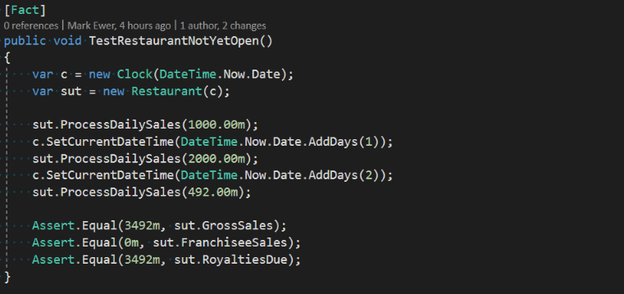
Code Demo

Slide 6
Transition Tactic: Action<T>
To remove much of the branching complexity we will change the boolean flags into a single Action<T> property.
Next, we change the conditional if() statements into an assignment that sets the value of the new action property to point to the correct implementation for the current state of the object.
The new code should now be shorter and each private method on the class will have only a single responsibility.

Slide 7
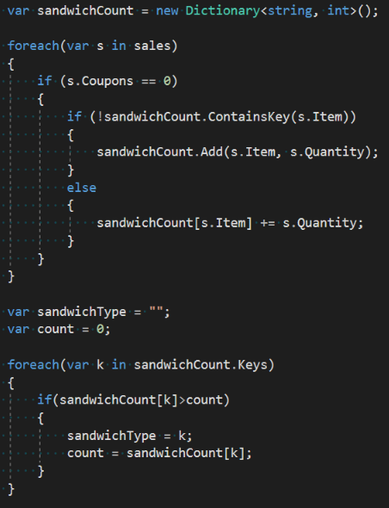
Converting Iterators
Iteration is normally used to operate on a series of elements
Many times we forget that the series is an object as well
Loops add complexity and are sometimes hard to read and understand
Can you tell me what this code is for?
Let’s consider a way to make this more expressive and easier to understand

Slide 8
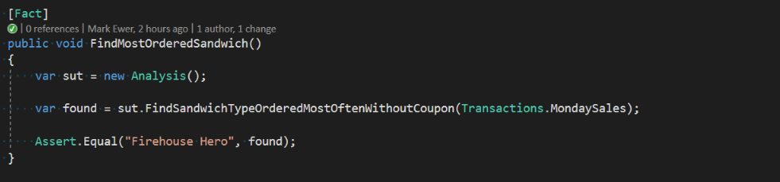
Code Demo

Slide 9
Transition Tactic: Linq
To remove much of the iteration logic that loops over sequences of objects, we can use the Language Integrated Query, or Linq.
Linq will enable us to express our loop operations declaratively to the sequence object instead of iteratively to each object in the sequence.
If you add some Linq extension methods with real meaning in your domain then this can become very easy to read.

Slide 10
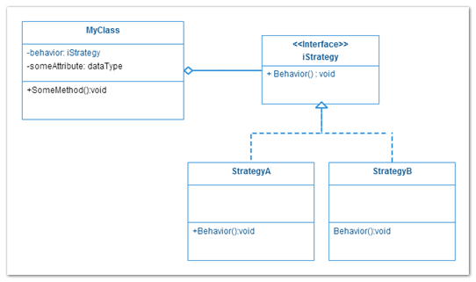
Converting Algorithms
Algorithms are at the heart of the business logic in your applications
I find the that important and valuable algorithms are also the complicated and difficult ones
The often represent the “hot spots” in your business requirements that change frequently
Lots of little changes over time add up to technical debt and slowly grow into a mess
Separating the code into classes then composing them together can often make it much easier to adapt changes over time
Let’s look at the Object Oriented technique called the Strategy Pattern

Slide 11
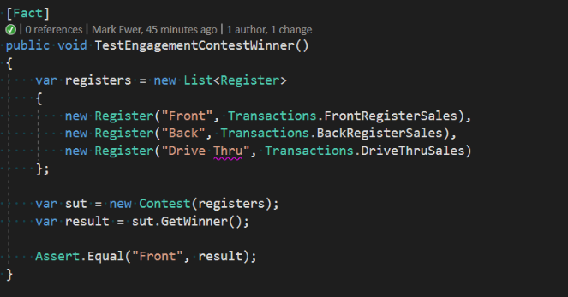
Code Demo

Slide 12
Transition Tactic: Strategy Objects
Algorithms often contain some of the most important and complex business logic of an application.
They also are often the most commonly changed parts of an application.
You can avoid much of the code decay and associated headaches by wrapping the algorithm into a Strategy object
Strategy objects work very well with Dependency Injection frameworks.
Strategy objects also give you the option to switch implementations at runtime instead of only at compile time … nothing says you can’t have some objects with strategy A and some with strategy B.

Slide 13
Converting Process Flows
Procedural code often leaks into methods that are procedures
This code, over time, become harder and harder to modify
It often collects technical debt as incongruent requirements from external systems
You want to design for change and long procedural methods are not the way to make change easy
Let’s look as a simple Object Oriented Process Engine

Slide 14
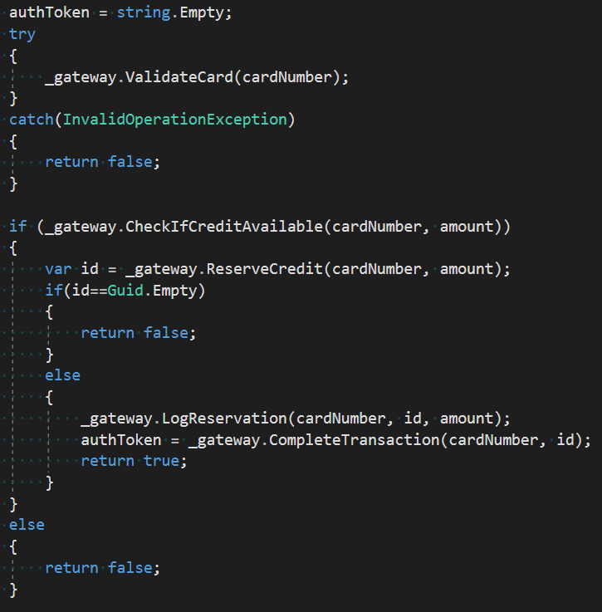
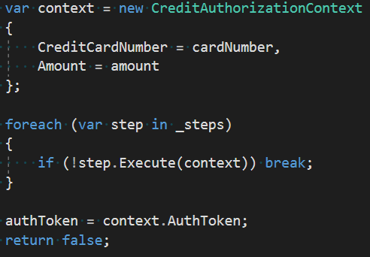
Code Demo

Slide 15
Transition Tactic: Process Engine
Wrap all of the process data into a context object that tracks the state of the execution.
Convert each step of the process into a command object that executes with a common execution interface.
Wrap external interface control requirements into the execution step so that the step serves as an adapter layer.
Configure the execution pipeline as a collection of step objects so you can change the steps by just changing the number of objects in the collection.
Execute the steps with a simple loop.

Slide 16




Thanks to all the Jax DEVS!
Sample code and slides available online via my GitHub repository:
https://github.com/MarkEwer/JaxDugSamples
Work: Mewer@DiscoverTec.com
Personal: Mark@3w3r.com
Web: http://www.markewer.com
LinkedIn: http://www.linkein.com/in/markewer
Phone: (904) 238-7347

