Slide 1
Overview & Demo of Akka.Net
Presented by Mark Ewer

Slide 2

Agenda
What is an Actor System?
Code Demos
UntypedActor – Simplest Actor
RecieveActor – Simplest Useful Actor
Router – Scaling Up With Message Systems
Become() – High Performance State Machines
TestKit – Complex Example with Unit Tests
Looking Forward
Clustering with Akka.Cluster
CQRS and Akka.Persistance
Work: Mewer@DiscoverTec.com
Personal: Mark@3w3r.com
Web: http://www.markewer.com
LinkedIn: http://www.linkein.com/in/markewer
Phone: (904) 238-7347

Slide 3
What is an actor system?
It is a system architecture where every Actor sends and receives messages
Each actor has its own mailbox that is essentially a message queue
Actors encapsulate their own internal data and state
All methods on an actor are normally private – you don’t call the methods, you send it a message
Actors are single-threaded while actor systems are multi-threaded
Each message is processed on a single thread
No actor ever processes more than one message at a time
High levels of concurrent processing are achieved by making lots of actors
Location transparency
Each actor has an “address” that you send messages to
The address will find the actor no mater what process or server it is on
Coding for local actors is exactly the same as remote actors
Clustering support is already in Beta
Fault Tolerance
Actors

Slide 4
Basic Actor demo
Sender 1
Sender 2
Actor’s Inbox
Sender N
Message N
Actor
Message 2
Message 1

Slide 5
Basic Actor Demo
Root
User
Top Actor
Other Top
System
Scheduler
Others
Child 1
Child 2
Sub 1
Sub 2

Slide 6
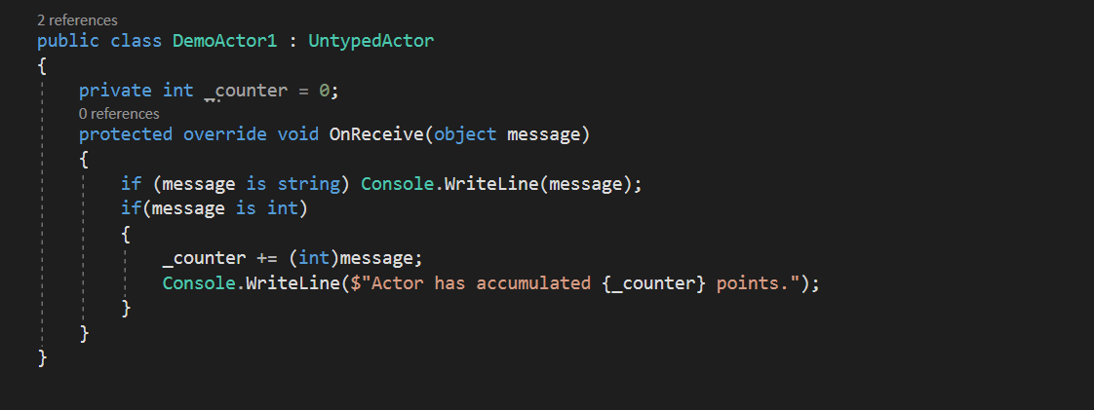
Untyped Actor Demo
Most Basic Example

Slide 7
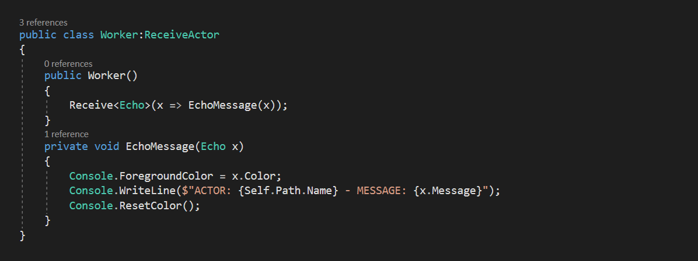
Receive Actor
Using typed messages

Slide 8
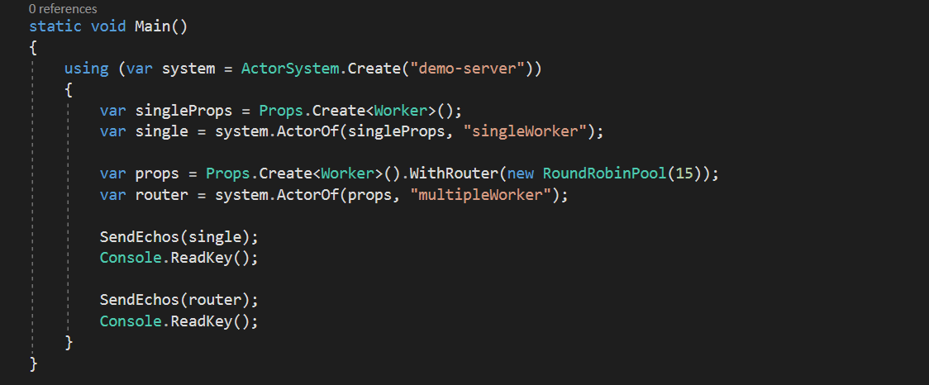
Router demo
Routers and actor pools

Slide 9
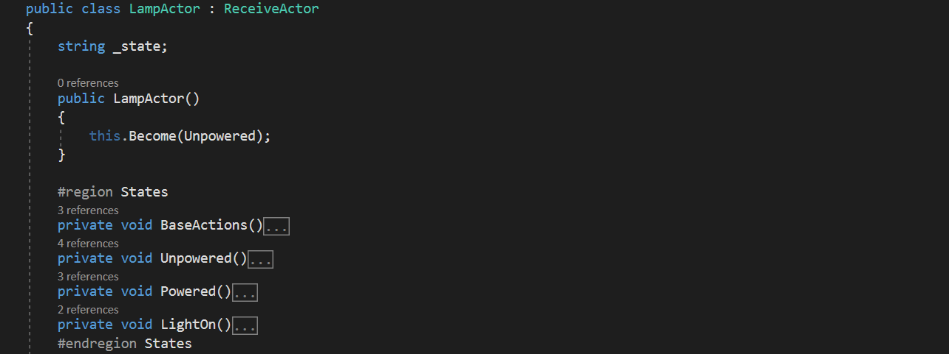
State Machines
Using Become() to create finite state machines

Slide 10
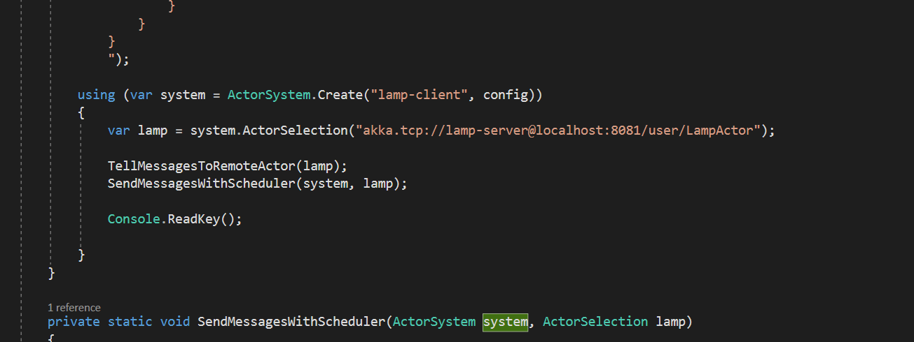
Remoting
Location transparency and
client-server operations

Slide 11
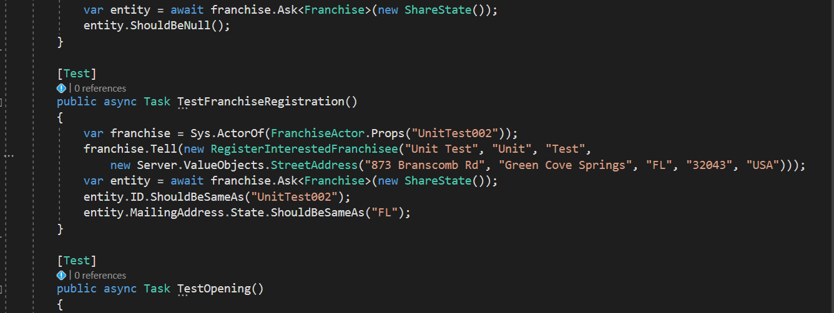
TestKit
Unit testing with the Akka.net

Slide 12
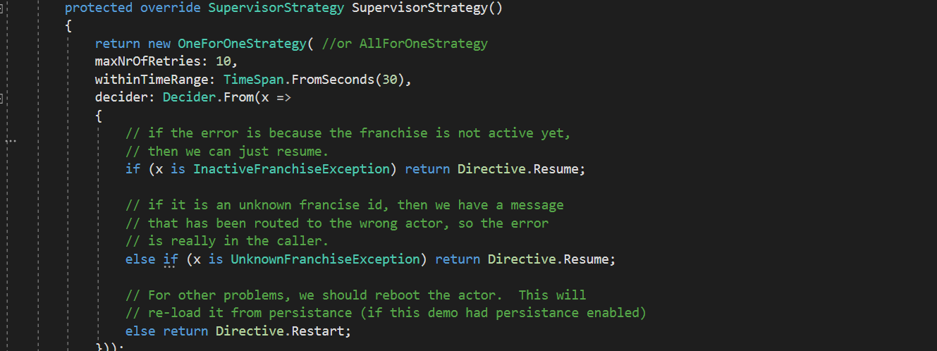
Fault Tolerance
Recovering from errors to get to the 5-9s of uptime

Slide 13
Akka.Persistance
Full CQRS and Event Sourcing plugin for the Akka.net actors
Enables stateful actors to persist their internal state
Includes automatic recovery after restart.
Stateful actors are recovered by replaying stored changes to these actors from which they can rebuild internal state
Uses snapshots for faster recovery
Also includes some helpers for reliable messaging and other delivery semantics

Slide 14
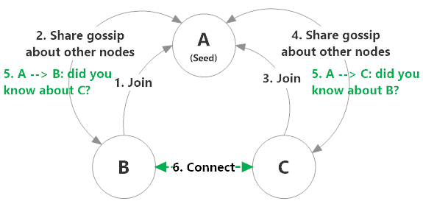
Akka.Cluster
Makes it easy to create peer-to-peer networks of Akka.NET applications
Allows peers to automatically discover new nodes and removed dead ones automatically with no configuration changes
Allows user-defined classes to subscribe to notifications about changes in the availability of nodes in the cluster
Introduces the concept of "roles" to distinguish different Akka.NET applications within a cluster; and
Allows you to create clustered routers, which are an extension of the built-in Akka.NET routers, except that clustered routers automatically adjust their routees list based on node availability.

Slide 15



Thanks to all the new jaxdug members!
Sample code and slides available online via my GitHub repository:
https://github.com/MarkEwer/JaxDugSamples
______________________________
Work: Mewer@DiscoverTec.com Personal: Mark@3w3r.com Web: http://www.markewer.com LinkedIn: http://www.linkein.com/in/markewer Phone: (904) 238-7347
Mark Ewer
And, thanks to the sponsor for this event, Community First

