Slide 1

WLAN Game Server
Wireless Game Server example
with open-source Xonotic as the game

Slide 2
Content
Hardware
Topography
Network (bond)
Game download
Sever configure
Other terminal commands
Game ON

Slide 3

Hardware
Intel i7 (6700) 8-cores
Intel H170 chipset
64Gigs DDR4
1TB SSD (Debian-12)
Two 2.5 NIC’s (bond0)

Slide 4
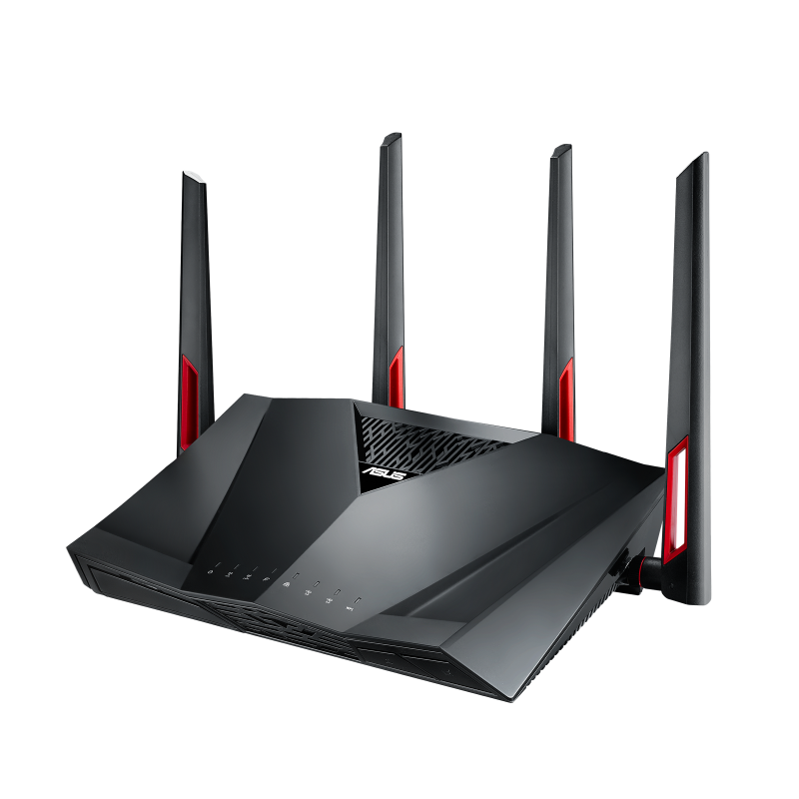

Hardware
Router RT-AC88U
1.4 dual core, 516RAM
802.11a/b/g/n/ac
2.4 & 5GHz
8-port BaseT 1000
Supports 64 IP addresses
FTP USB has the zip file

Slide 5


Topography
Game Server
Port aggregation (bond)
Wireless Access Point
Wireless Users
Basically everyone will access the Game_Server via a wireless signal a/b/g/n/ac. (11Mbps on b),(54Mbps on a and g) if you have anything higher.

Slide 6
Network
Find the alternate name of your NIC cards.
Use the command :~# ip address to see the interfaces in your machine.
1: lo: <LOOPBACK, UP,LOWER UP> inet 127.0.0.1/8
2: ens2: = use the altname provided “enp2s0”
3: ens3: = use the altname provided “enp4s0”
4: ensl0: = your motherboard nic (not used)

Slide 7

Creating a bond0
Use an editor and edit the /network/interfaces file: root@machine:~# nano /etc/network/interfaces
auto enp2s0
iface enp2s0 inet manual
bond-master bond0
bond-mode balance-rr
auto enp4s0
iface enp4s0 inet manual
bond-master bond0
bond-mode balance-rr
auto bond0
iface bond0 inet static
Address 192.168.2.16
netmask 255.255.255.0
network 8.8.8.8
Gateway 192.168.2.1
bond-slaves enp2s0 enp4s0
bond-mode balance-rr
bond-miimon 100
bond-downdelay 200
bond-updelay 200

Slide 8
Checking the bond0
Check the bond has loaded by using:
:~# sudo lsmod | grep bond
The result should be a something like this:
Bonding 221184 0
tls 135168 1 bonding
IF the bond0 is not active, send this command:
:~# sudo Ifup bond0

Slide 9
Checking the bond0
Check the settings in your bond0.
Use :~# sudo ethtool bond0
Settings for bond0:
Supported ports: [ ]
Supported link modes: Not reported
Supported pause frame use: No
Supports auto-negotiation: No
Supported FEC modes: Not reported
Advertised link modes: Not reported
Advertised pause frame use: No
Advertised auto-negotiation: No
Advertised FEC modes: Not reported
Speed: 2000Mb/s
Duplex: Full
Auto-negotiation: off
Port: Other
PHYAD: 0
Transceiver: internal
Link detected: yes

Slide 10
Network
192.168.2.16
192.168.2.1
Port aggregation (bond)
Wireless Access Point
SSID = Game_Server
Password = JaxLUG2024
Xonotic
Game_Server

Slide 11
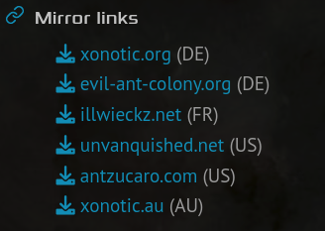
Game Download
GO to xonotic.org/download/ and select one of the mirror sites.
The zip file is 1.2 GB
The router will have a copy
The .ORG is Germany.
Xonotic 0.8.6 is the current version.

Slide 12
Game Installation
There are two ways to install Xonotic into your machine.
#1 Use GIT repository to build from source. (painful)
#2 Download the .zip and unzip it to your Home directory.
Extract, create, and move to (/Home/Xonotic) folder.
To PLAY select the ./xonotic-linux64-sdl (single dynamic layer) -gpl(OpenGLL)for 64 bit systems.
./xonotic-linux32-sdl for 32 bit.

Slide 13
Server Configuration
By downloading the zip file and uncompress to the /Home/Xonotic/ directory, you have ALL the files required for a server or game.
For a server setup, you need to move 2 files
  “server_linux.sh”
  “server.cfg”
  Both files are already in the /Home/Xonotic/server/ folder.

Slide 14
Server Configuration
1. Copy the “server_linux.sh” file, from /Xonotic/server/ folder into the main game directory /Xonotic/.
This will allow shell script to launch the game executable in the server mode.
2. Copy the “server.cfg” file, from /Xonotic/server/ folder into the /Xonotic/data/ folder.
This will be the server configuration file you need to manualy edit.

Slide 15
Test the server
To test a session during Troubleshooting you can cd /Home/Xonotic and execute:
./server_linux.sh -sessionid-test
To run the server side, cd /Home/Xonotic and execute:
./xonotic-linux64-dedicated

Slide 16
Check other settings
Other terminal commands that help troubleshoot
  netstat -inet -ap
  netstat -rn
  netstat -anp tcp
  netstat -anp udp
You must manually edit the “server.cfg” and activate sv_public 1
Port is 26000 UDP & TCP and it needs to point to your server IP.

Slide 17
Client side /etc/hosts
Open the the /etc/hosts file utilizing the editor of your choice (vi, nano, emacs etc…)
Inside the file, after the the last IPV4 address in the file, add:
192.168.2.16 game_server gs

Slide 18
OK Let’s Play
Connect to SSID: Game_Server (192.168.2.1)
Password = JaxLUG2024
Launch your Xonotic game in your laptop
Go to Multiplayer
In address at the bottom, type “gs” or (192.168.2.16)
Be patient because is wireless!!!!

