Slide 1
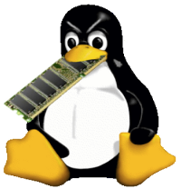
Memory and Linux
Ramon Dominguez
July 17, 2024

Slide 2
Content
Physical and Virtual Memory
The Kernel and Memory
Graphical User Interface (GUI) Usage
Memory Management (terminal)

Slide 3
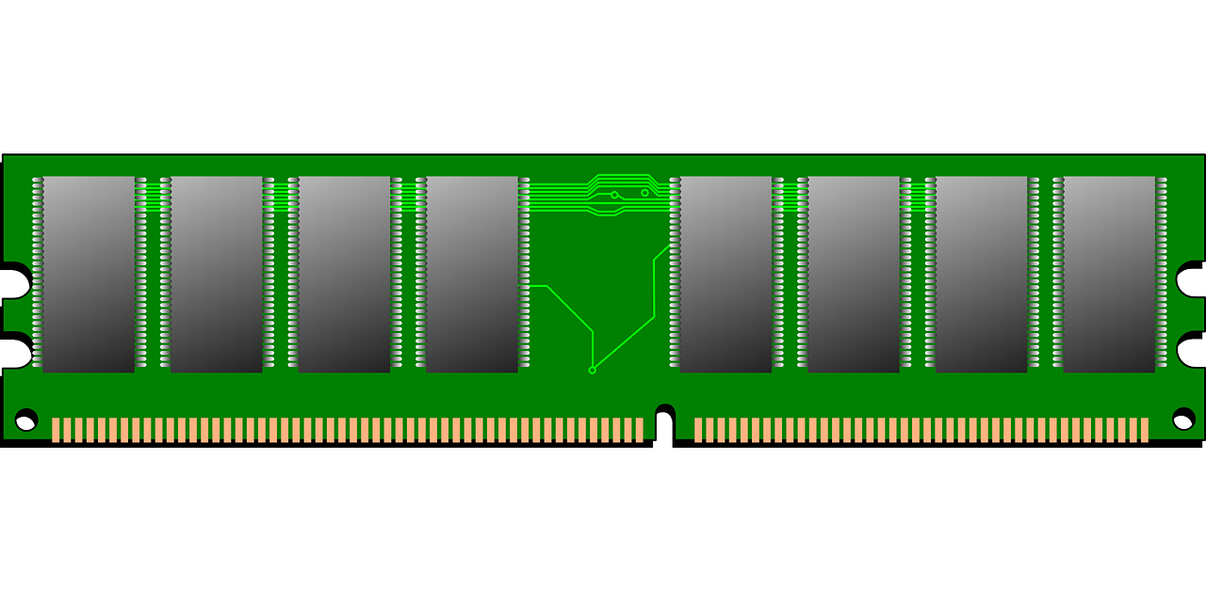
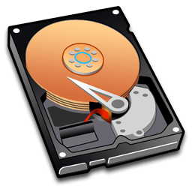
Physical Memory
RAM installed and the Hard drive partition dedicated for Swap.
Do not consider the internal CPU L2 and L3 cache as memory.

Slide 4
Virtual/Logical Memory
Exist in the MMU tables and it “MAPS” the physical memory (RAM). Inside the cashe.
It prevents memory override.
Pages are in 4k and re-direct to the physical address.
The MMU also handles memory swap locations.

Slide 5
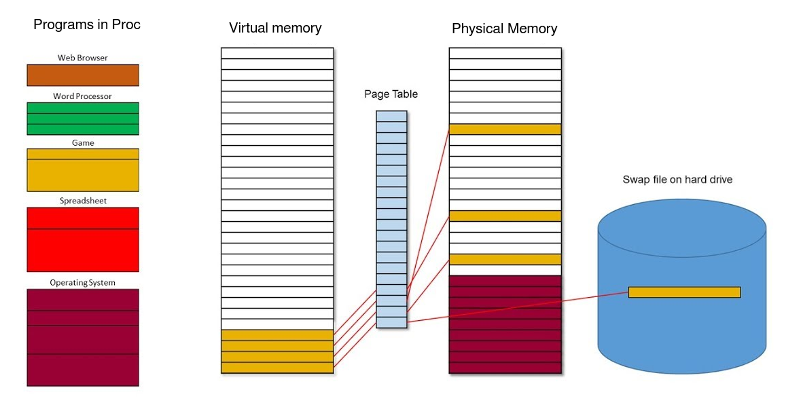

Slide 6
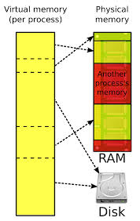
Virtual Memory
Virtual memory comes from the pageing tables in the CPU.

Slide 7
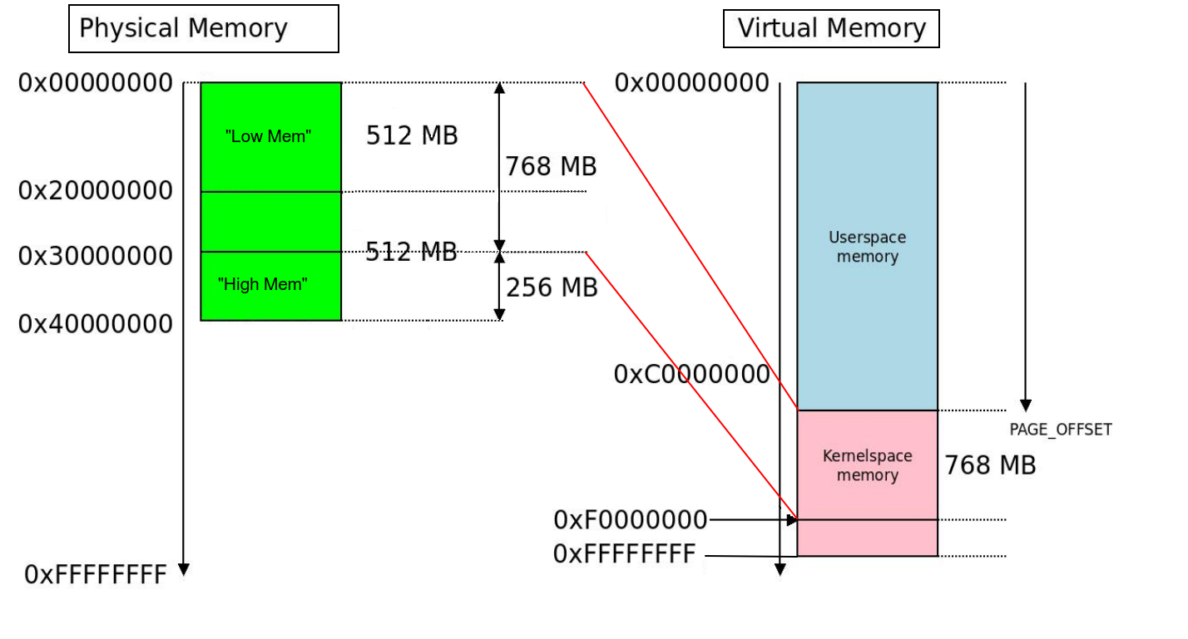
Kernel to Ram
700 – 900 usual Kernel size

Slide 8
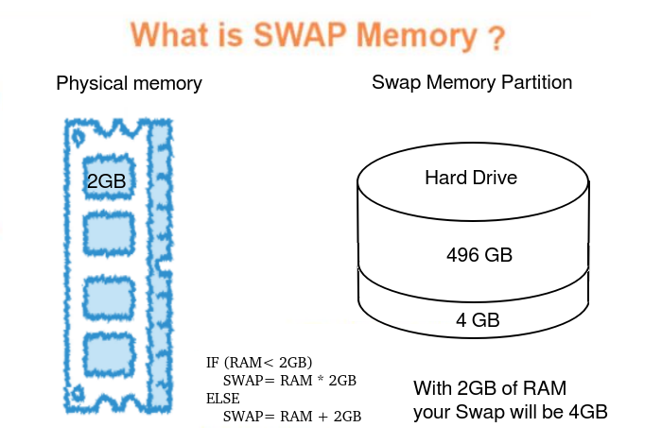
Swap
Swap memory dictated in OLD systems.
Try to keep it under 10% in new systems.
sysctl vm.swappiness

Slide 9
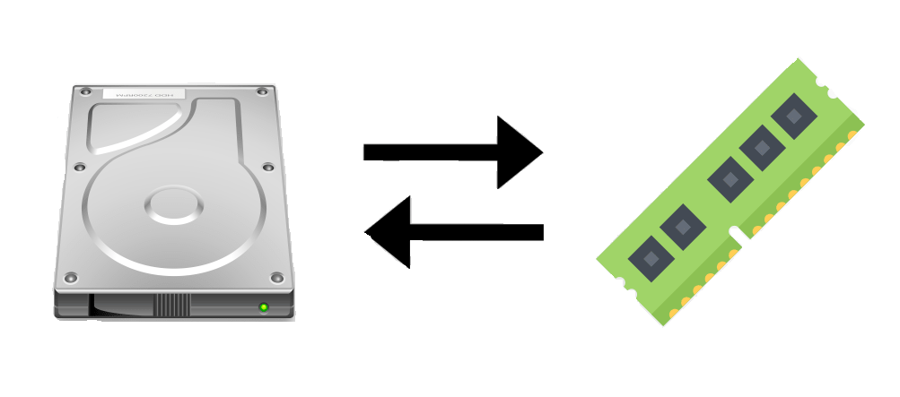
Swap
The MMU will move a program that has NOT been active for a while.
Virtually reference and mapped for latter use.
RAM not mapped is RAM not used (free)
SWAP is the slowest memory available.

Slide 10
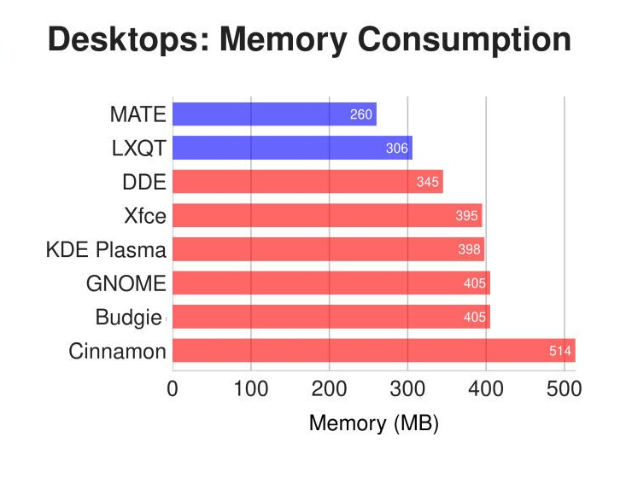
GUI Usage
Generalized table with GUI Usage.
Minimums.

Slide 11
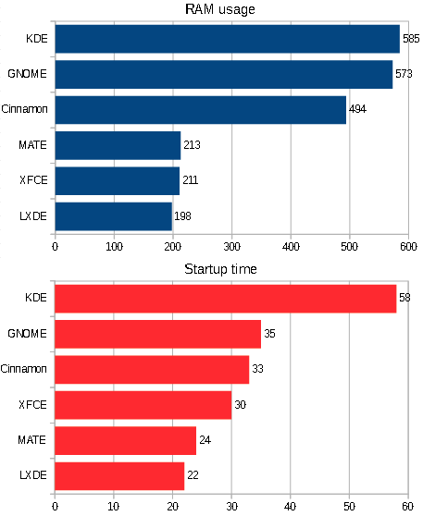
GUI Usage
Light versions will average 150-210MB
While a Heavy version will use up to 600MB

Slide 12
Memory management
There are many tools to manage your memory requirements, we will only cover the basics:
  ~$ FREE
  ~$ TOP
  ~$ VMSTAT

Slide 13
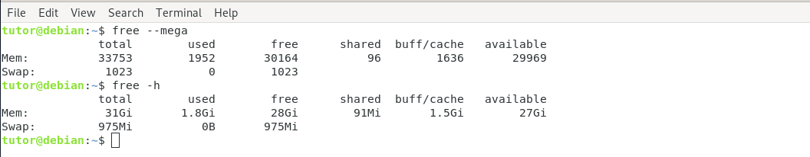
FREE
The free command displays:
Total amount of free and used physical memory
Total amount of swap memory in the system
Buffers and caches used by the kernel
--mega (megabytes), -h (human readable), -t (total)

Slide 14
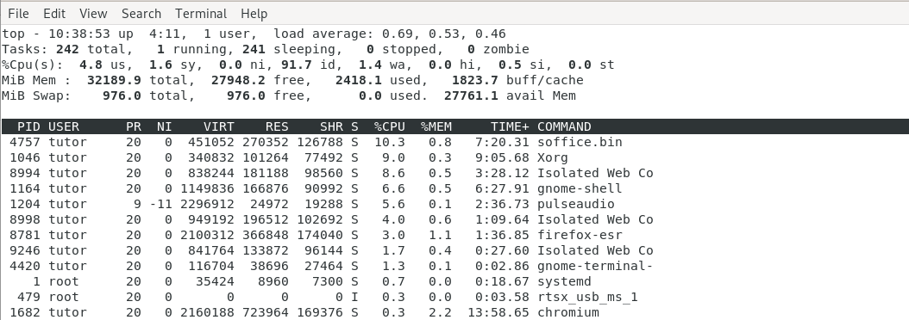
TOP
The top command,
provides a dynamic, real-time view of a running system. Included in that system summary is the ability to check memory usage on a per-process basis.
~$ top -o %MEM (will prioritize on percentage used)

Slide 15
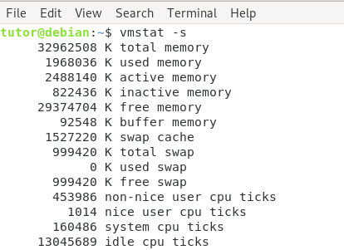
vmstat -s
Reports virtual memory and total memory usage.
vmstat -s (single column), -a (active)
vmstat 1 (will give you information in one second intervals)

Slide 16
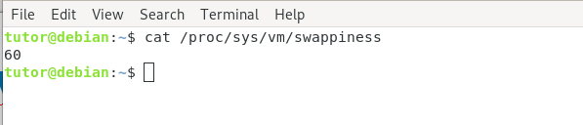
vm.swappiness
If you want to change the percentage of swap file you are running.
Run this command:
~# sudo sysctl vm.swappiness=10

Slide 17
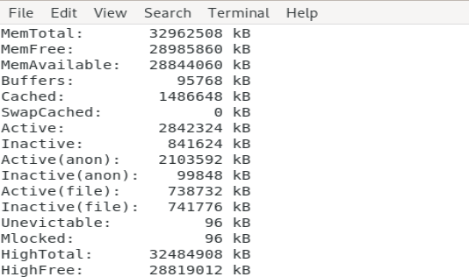
~# sudo /proc/meminfo
This reads a virtual file that contains the real-time dynamic information
f you want to get fancy:
egrep –color ‘Mem|Cache|Swap’ /proc/meminfo.
Sudo less /proc/meminfo (allow you to scroll)

Slide 18
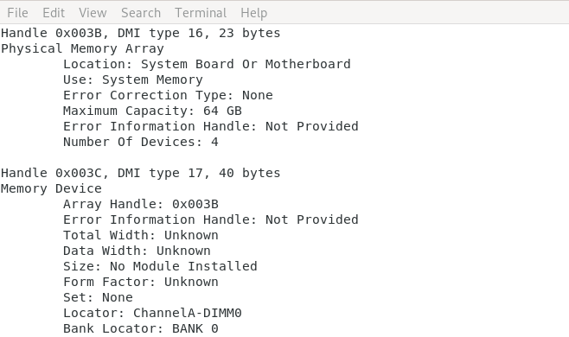
~# sudo dmidecode
Is a long list of all items in the computer including the Physical Memory array (RAM banks)

Slide 19
Clearing PageCache
To clear the PageCache only, you can use the following command, which will specifically clear the PageCache, helping to free up memory resources.
~# sudo sync;echo 1> proc/sys/vm/drop_caches
;echo 1 – Clears only the page cache.
;echo 2 – Clears dentries and inodes.
;echo 3 – Clears page cache, dentries, and inodes.

Slide 20
Questions
conclusion
    Research the programs your using and give your self some more RAM that what is needed.
    Monitor your programs RAM consumption and kill any unwanted use of resources.
    Be careful when clearing your cache.

