Slide 1
COSTCO’S HEARING AID MARKET
Jacqueline Wilson
Claudia Brito
Juana Connors-Trujillo
November 2022

Slide 2
Question
Costco and hearing aid accessibility
How can Costco increase over the counter hearing aid accessibility due to the new Legislation?
Notes:
Oct. 17, FDA’s new regulations on sale of quality hearing aids allowed them to be made available as over-the-counter product. (been in works for 5 years)
Previously aids only available through licensed audiologists and other professionals
Our study focused on how Costco, as a leading provider or hearing aids, could make them even move accessible to people with the new availability of over the counter aids.
Current market no price transparency –
market was insulated from price competition due to consolidation among manufacturers
limiting consumer choice keeping prices high
prescription hearing aids can cost $3 – 5,000.
Short term effect of legislation –
more than a 20% decrease in price
less costly testing procedures, rise of online hearing/audio tests
New devices will be clearly labeled as FDA approved
Choose from variety of devices
not only amplify sound
address other components of hearing loss, such as distortion.
A person would be able to walk into almost any pharmacy or big-box store and buy a sophisticated pair of hearing aids for a few hundred dollars

Slide 3
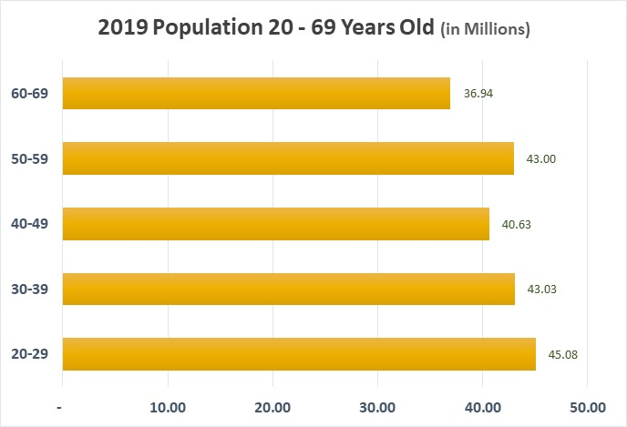
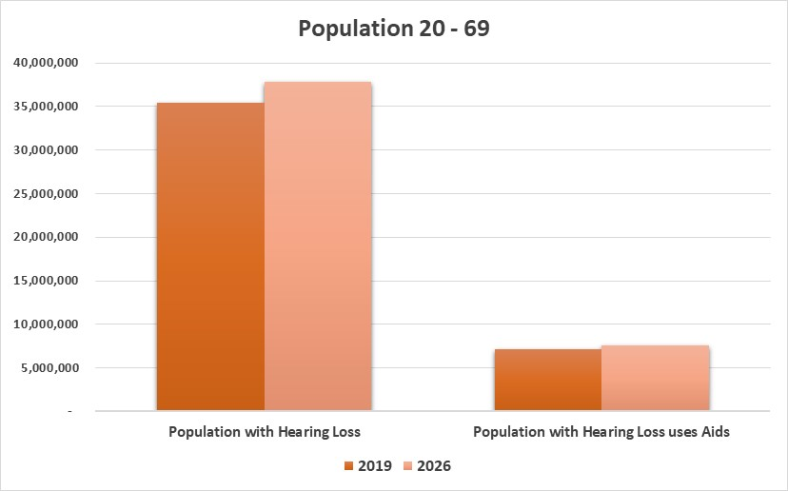
U.S. Population Affected
35 million people in 2019 had some degree of hearing loss and estimated to be 37.8MM in 2026.
Only 1 – 6 people who need hearing aids use hearing aids.
7 million people in 2019 used a hearing aid, and an estimated 7.6MM people are expected to wear a hearing device before the OTC hear aid legislation.
Notes:
Our study focused on people 20 – 69. Generally people under 20 and over 70 generally have hearing loss that requires more than over the counter hearing aids.
17% of adults between 20-69 years of age have hearing impairments
Men are almost twice as likely as women to have hearing loss among adults aged 20-69
Hearing loss effects a large % of our population

Slide 4
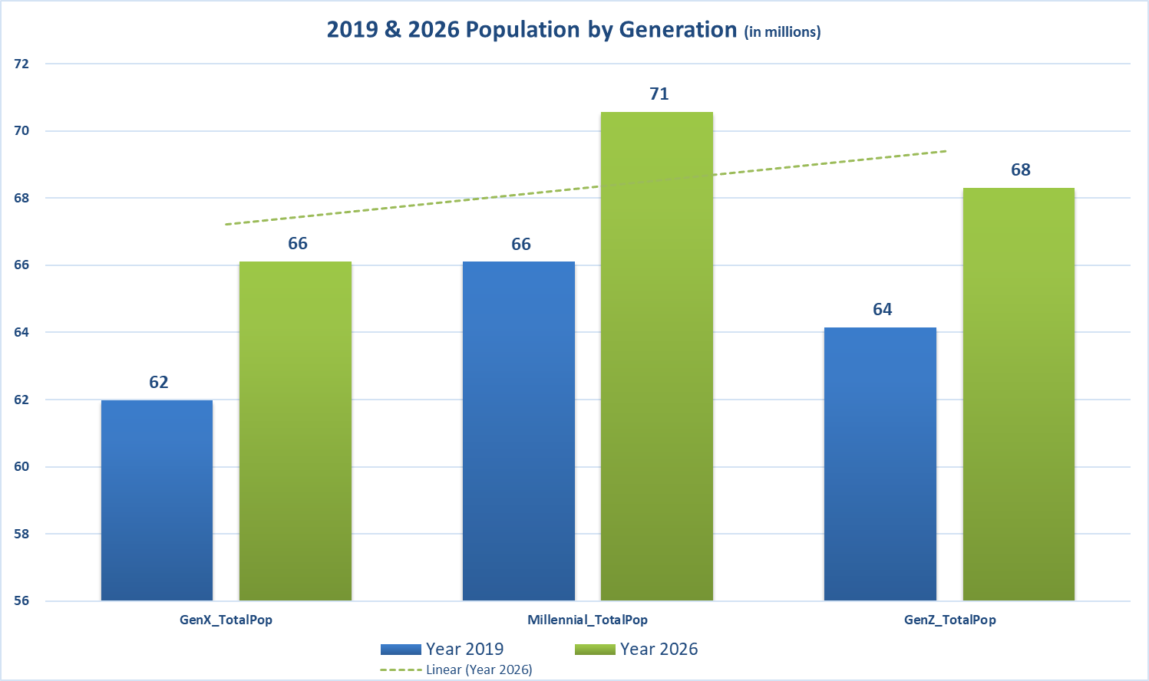
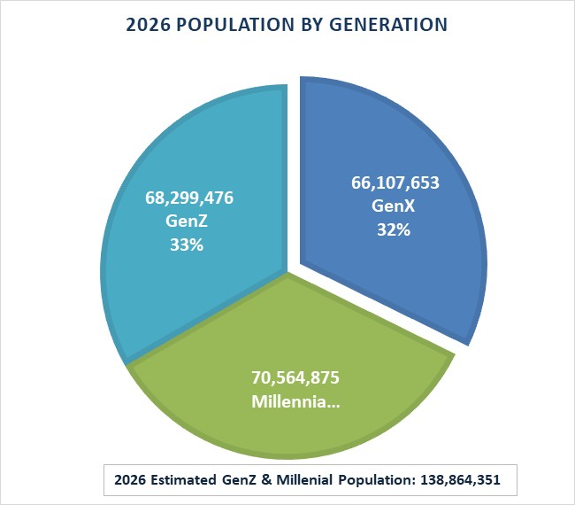
Millennials & GenZ
The number of individuals of all ages with mild to complete hearing loss will increase from 44 MM to nearly 55 MM in 2030.
An estimated 23.6MM+ Millennial and Gen Z individuals are more likely to experience hearing loss by 2026
Notes:
National Institute of Health indicates that millennial and Gen Z individuals are more likely to experience hearing loss compared to previous generations

Slide 5
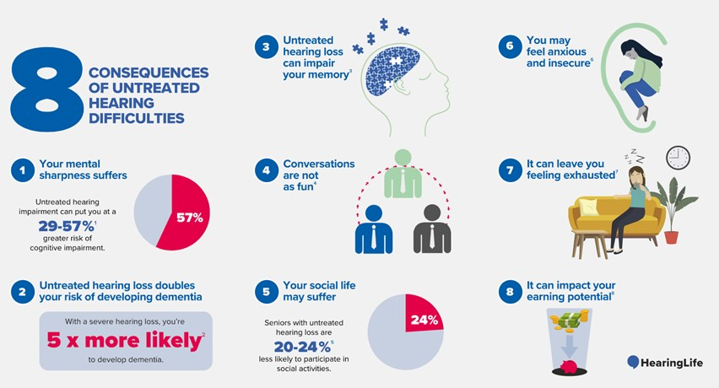
Hearing Loss Impact
Notes:
Hearing loss effects long term health.
Social isolation
More likely to develop dementia
can impact your performance at work
you risk missing key information in meetings or directives from supervisors.
can account for up to $30,000 in lost income annually

Slide 6
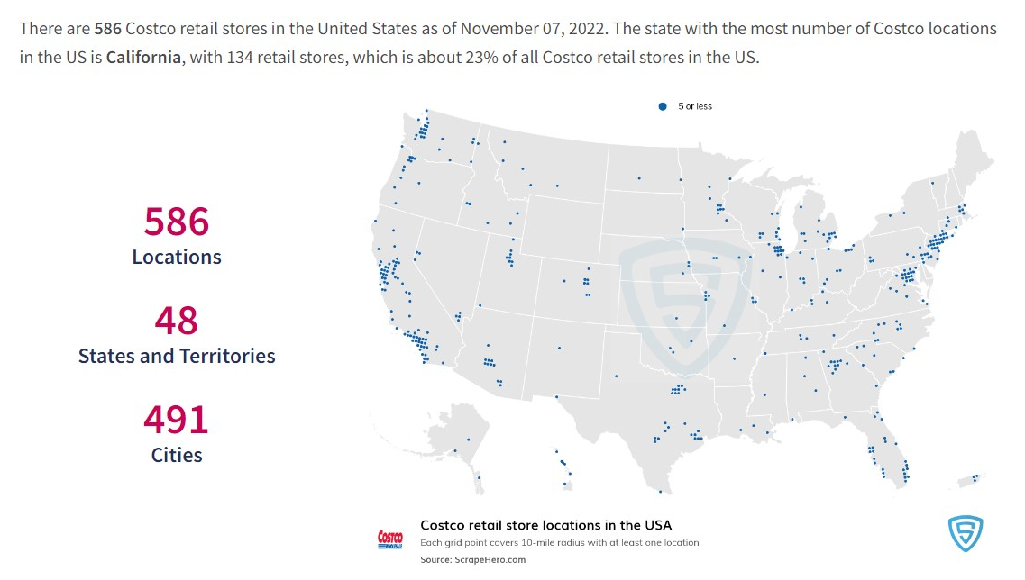
Costco Locations
Notes:
https://www.scrapehero.com/location-reports/Costco-USA/

Slide 7
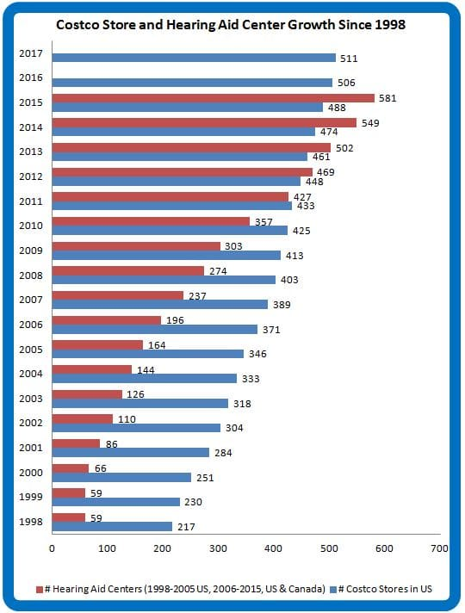
Costco Hearing Center Growth
Costco sells 11% of the hearing aids market
Annual unit growth averages over 20%, 3 - 5x’s faster than sales through independent practices
Distributes almost as many hearing aids in the U.S. as the Veterans Administration
Notes:
When Costco entered the market – leveraged their buying power to significantly negotiate down the price of hearing aids.
They currently carry branded aids but also private label their own hearing aids.
Global hearing market projected to grow at a CAGR of 8.1% for 2022-2029
Competition
Best Buy will open hearing centers in more than 300 stores by late October.
Customers will use an online hearing assessment tool and choose from nine over-the-counter brands with help from specialized trained sales staff members. Prices will range from $200 to $3,000.
Sony has announced a partnership with WS Audiology Denmark, one of the big five hearing aid manufacturers.
Bose Corporation and Lexie Hearing will introduce a new self-fitted over-the-counter aid for about $900.

Slide 8









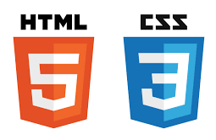

Data, Technology & Storage
Data Storage:
Preprocessing
Data Storage / Repository
Machine Learning
Dashboard
DATA
Notes:
Data: census demographic data, Costco locations and geographic csv files
Data cleaning, preprocessing and machine learning - Jupyter Notebook, Colab, Python, Pandas & PySpark:
VS Code, HTML, JavaScript & Tableau: Dashboard:
Amazon S3 Bucket: data storage & notebook files
Github: project collaboration
Jacqueline to take you through our data & preprocessing

Slide 9
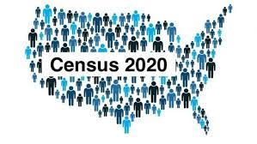

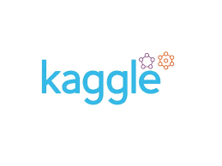
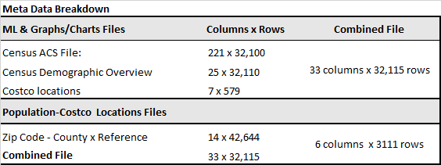
Exploratory Data Analysis
Data
Processing
Using Excel to edit Costco file
Dropping irrelevant columns
Creating consistency in label names
Locating Costco hearing clinics
Merging demographic data files
Transformed census data into csv files
Data Search
Manual search from each team member
Sourced from:
Notes:
Data:
Costco Data: Kaggle & Costco website to update locations
Census data: ESRI census population data 2019 & 2021
Data Needed: Discussion and decision of what data we need for this project. •Who would benefit? •How could we find who benefits? – need demographic •How could we increase accessibility? – a few thoughts, landed on Location of hearing center Search process: We each searched manually •Looking on websites •Including specific tools like google scholar.
Sourced Data: •Census data: ESRI census population data 2019 & 2021 DEMOGRAPHIC •Costco Data: Kaggle & Costco website LOCATION
•Zipcode file: USPS zip codes by county/MSA cross reference
Processing Machine Learning: •Excel and Costco Locations – Determined which topics in demographic we needed •Cross referenced locations with official Costco site for accurate locations •Merging demographic •Merging locations Tableau Merged files + Zipcode file: USPS zip codes by county/MSA cross reference

Slide 10
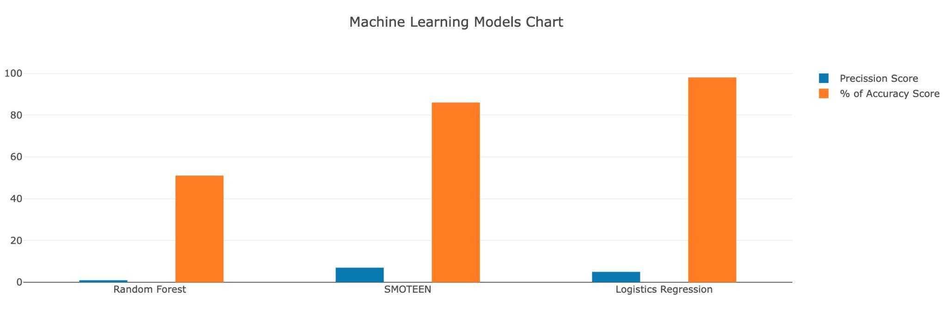
Machine Learning
Notes:
Dropped Costco locations that do not have hearing aid centers
Dropped age population younger than 20 and older than 69
Dropped all other demographic columns except education levels reached and household income columns
· Trained on Costco locations by zip-codes as our y and demographic columns for our features (X)
Using standard scaler, scaled our features to become identical in terms of the range so our columns could be compared
Used competitive model structure Ran Logistic Regression, SMOTEENN, and RandomForest to find best predictor
Trained on Costco locations to recommend where Costco should open a new location, specifically for hearing centers.
·
Using precision and recall rather than accuracy to predict where they should have a hearing center but do not.
Smoteen algorithm had the best results of all three machine learning as it balances the 1's (Costco locations,minority class), as well as the 0's (no Costco locations). This model may be good as additional information tool in determining a new store location but is not a good application for this type of prediction Lowering the decision threshold from 50% to 10% to get a higher precision or high recall ML model. This output maybe good as additional information tool in determining a new store location but is not a good application for this type of prediction
Logistic Regression predicted a binary outcome, 0 or 1. Unfortunately, it couldn’t predict optimal zip codes. Accuracy: .98, although is very high, this a poor metric for the type of dataset we have. It’s only considering all the “yes, costco location here” and not considering the other option “no, costco location here”.·
Random Forest has the same limitations as Logistic Regression in as there are so few "yes'" it considers them irrelevant. Dataset is imbalanced.
Feature engineering: our results point to our dataset needing additional look into additional data to predict new locations for CHC's.
Additional data to consider:
·Bucketing population data into decades or generations but keeping in mind not overfitting
Visualizing outliers to detect outliers
Adding % hearing impaired and hearing aid's cost

Slide 11
Key Findings
Refocus on how Costco can make affordable and accessible solutions available to the hearing impaired.
By Identifing individuals with hearing impairment through online/web based hearing assessment tool.
Using web based and in store kiosk assessment data along with demographic data allows for data gathering to create a prediction model.
Notes:
This would allow Costco to reach out to their current customer base and those that may be outside Costco's physical location.

Slide 12
Visualization
HTML Dashboard

Slide 13
FINAL PROJECT PIPELINE
Resources
Question
Data & Preprocessing
Machine Learning
Charts, Graphs, Maps
JavaScript & Html
Findings/
Conclusion
https://www.nytimes.com/2022/10/10/health/hearing-aids-fda.html
https://hearingreview.com/inside-hearing/regulation/national-academies-sciences-release-report-hearing-aid-accessibility-affordability
https://www.costco.com/warehouse-locations
https://www.scrapehero.com/location-reports/Costco-USA/
https://www.fortunebusinessinsights.com/industry-reports/hearing-aids-market-101573

Slide 14
FINAL PROJECT PIPELINE
Question
Exploratory Data Analysis
Machine Learning
Visualization
Findings/
Conclusion
Data Storage
Question:
How will over the counter hearing aids affect Costco?
Exploratory Data Analysis:
US Census Data, Kaggle, and Costco website
Jupyter notebook & Excel: preprocessing and merging data
Data Storage:
AWS S3 Bucket: data files, notebooks/script files,
images, Readme, presentation
Machine Learning:
Linear Regression, SMOTEENN, and RandomForest
Using Jupyter Notebook and Google Collab
Visualization:
Create a website using JavaScript & Html files
Charts, Graphs, Maps
Findings/Conclusion
Did we address our question by finding opportunities for Costco to open new stores?
Did we find new locations to consider?
What could we do to better evaluate the data?

