Slide 1
COSTCO’S HEARING AID MARKET
Jacqueline Wilson
Claudia Brito
Juana Connors-Trujillo
November 2022

Slide 2
Question
Costco and hearing aid accessibility
How does the Legislation recently passed allowing over the counter (OTC) hearing aids allow Costco to increase accessibility?
Notes:
The world of hearing health changed on Oct. 17, when the FDA’s new regulations, made quality hearing aids an over-the-counter product.
For decades, the sale of hearing aids was restricted to licensed audiologists and other professionals; that has kept prices high — prescription hearing aids can cost $4,000 to $5,000 — and access limited https://www.nytimes.com/2022/10/10/health/hearing-aids-fda.html
The hearing aid industry has remained insulated from price competition because of consolidation among manufacturers, widespread state licensing laws that mandate sales through audiologists or other hearing professionals, and the acquisition of hearing professionals’ practices by device-makers.
the new devices will be clearly labeled as FDA approved and consumers. These are different from inexpensive personal devices that amplify sound but do not address other components of hearing loss, such as distortion.
A person would be able to walk into almost any pharmacy or big-box store and buy a sophisticated pair of hearing aids for a few hundred dollars, no prescription required.
Prices for the exact same pair of hearing aids can vary dramatically depending on where a buyer looks. A report from the National Academies of Science, Engineering, and Medicine—that sparked the OTC movement—blamed high hearing aid cost on limited consumer choice and lack of transparency.
More than a 20% decrease in price
Less costly testing procedures (rise of online hearing/audio tests)

Slide 3
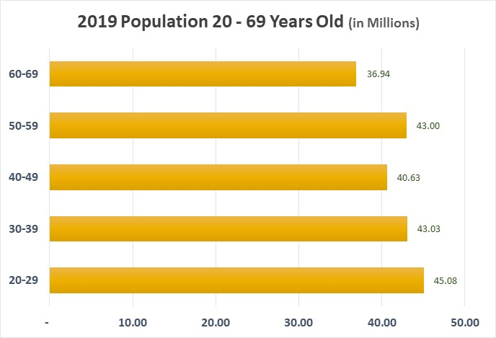
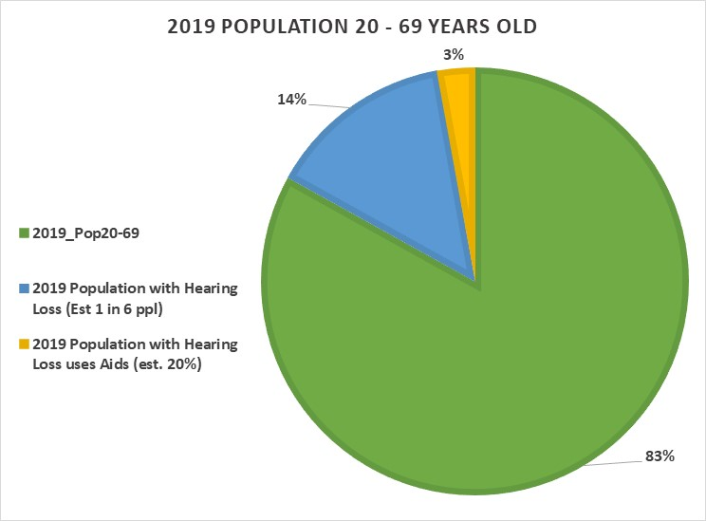
Topic insights: # of U.S. population affected
DO NOT USE SLIDE Pie is confusing
Notes:
Our study we focused on people 20 – 69. People younger than 20 and those 70 and older generally have hearing loss that requires more than over the counter hearing aids.
National Institute of Health indicates that millennial and Gen Z individuals are more likely to experience hearing loss compared to previous generations
18% of adults between 20-69 years of age have hearing impairments
Men are almost twice as likely as women to have hearing loss among adults aged 20-69
More than 550 Costco locations across the United States
Global hearing market projected to grow at a CAGR of 8.1% for 2022-2029

Slide 4
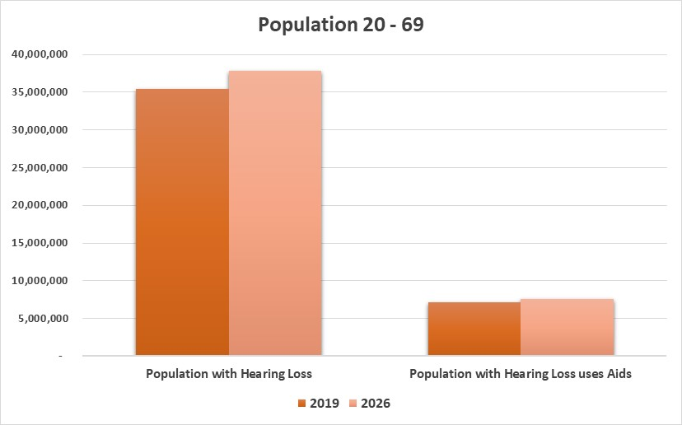
# of U.S. population affected
35 million people in 2019 had some degree of hearing loss and estimated to be 37.8MM in 2026.
Only 1 – 6 people who need hearing aids use hearing aids.
7 million people in 2019 used a hearing aid, and an estimated 7.6MM people are expected to wear a hearing device before the OTC hear aid legislation.
Notes:
Our study we focused on people 20 – 69. People younger than 20 and over 70 generally have hearing loss that requires more than over the counter hearing aids.
17% of adults between 20-69 years of age have hearing impairments
Men are almost twice as likely as women to have hearing loss among adults aged 20-69
Global hearing market projected to grow at a CAGR of 8.1% for 2022-2029

Slide 5
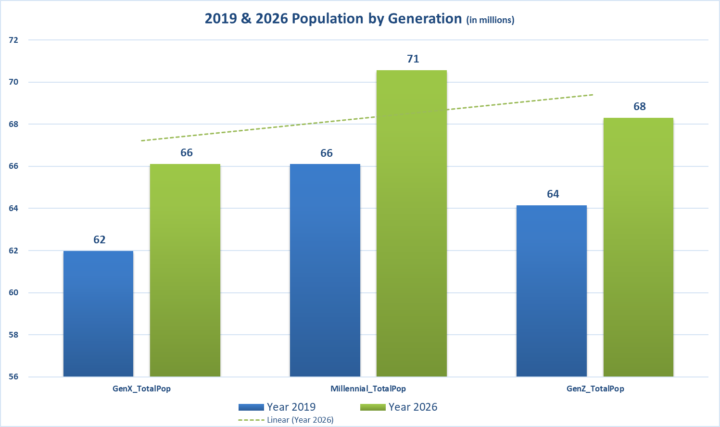
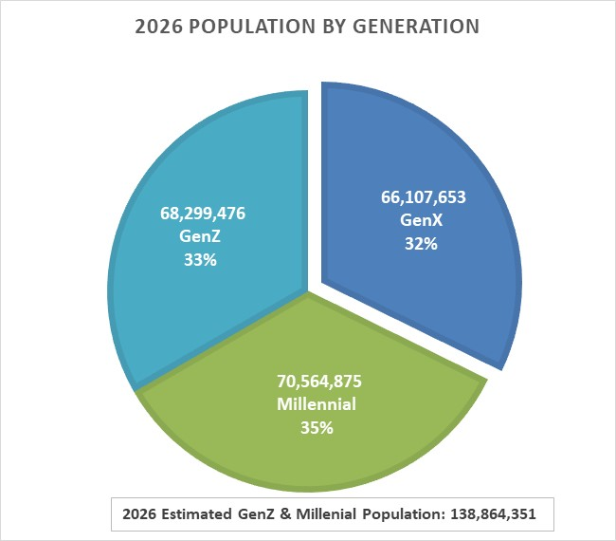
Millennials & GenZ
The number of individuals of all ages with mild to complete hearing loss will increase from 44 MM to nearly 55 MM in 2030.
Millennial and Gen Z individuals are more likely to experience hearing loss compared to previous generations (National Institute of Health )
Notes:
National Institute of Health indicates that millennial and Gen Z individuals are more likely to experience hearing loss compared to previous generations
Global hearing market projected to grow at a CAGR of 8.1% for 2022-2029

Slide 6
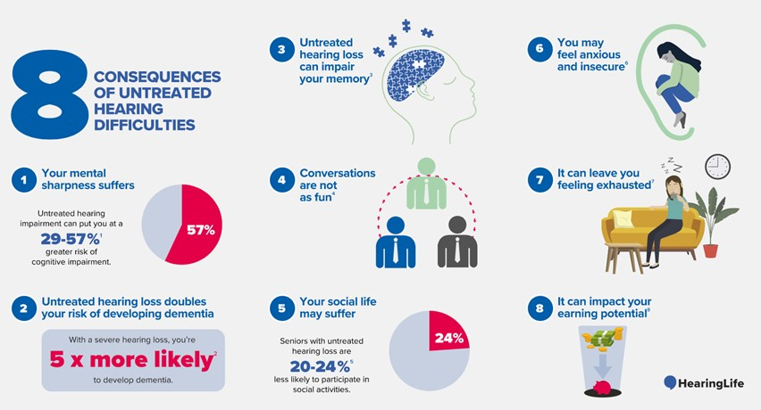
Hearing loss impact on health and wealth
Notes:
It can account for up to $30,000 in lost income annually and can impact your performance at work. When you don't hear clearly, you risk missing key information in meetings or directives from supervisors.

Slide 7
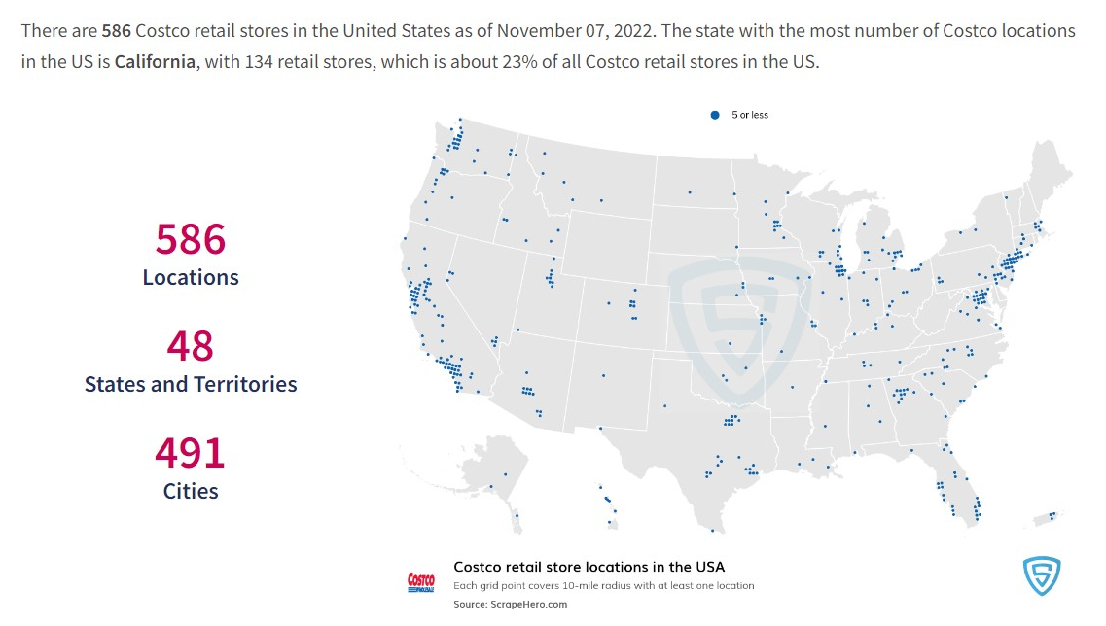
Costco
Notes:
https://www.scrapehero.com/location-reports/Costco-USA/

Slide 8
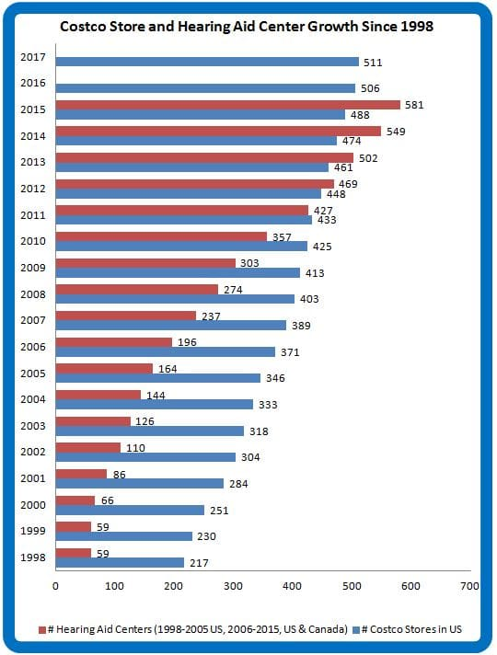
Costco’s effect on hearing aid accessibility
Costco has 11% of the hearing aids sold
Annual unit growth averages over 20%, 3 - 5x’s faster than sales through independent practices
Distribute almost as many hearing aids in the U.S. as the Veterans Administration
Notes:
Their buying power is such that they can buy hearing aids in huge quantities that qualify them for equally huge discounts on the wholesale cost of the devices. Costco has accessibility through cost and location and size/reach.
(https://hearinghealthfoundation.org)
Competition
Best Buy will open hearing centers in more than 300 stores by late October. Customers will be able to use an online hearing assessment tool and choose from nine over-the-counter brands with help from sales staff members, who will undergo specialized training. Prices will range from $200 to $3,000. https://www.nytimes.com/2022/10/10/health/hearing-aids-fda.html
Sony has announced a partnership with WS Audiology Denmark, one of the big five hearing aid manufacturers.
Bose Corporation and Lexie Hearing will introduce a new self-fitted over-the-counter aid for about $900, well below traditional prices but “still a price point people will think twice about,” Ms. Kelley said. https://www.nytimes.com/2022/10/10/health/hearing-aids-fda.html

Slide 9








Technologies
Notes:
Excel: original Costco, demographic data as csv files
Jupyter Notebook & Colab, Python & Pandas: Data cleaning, preprocessing and machine learning
VS Code & JavaScript: Html dashboard
Amazon S3 Bucket: data storage
Github: project collaboration

Slide 10
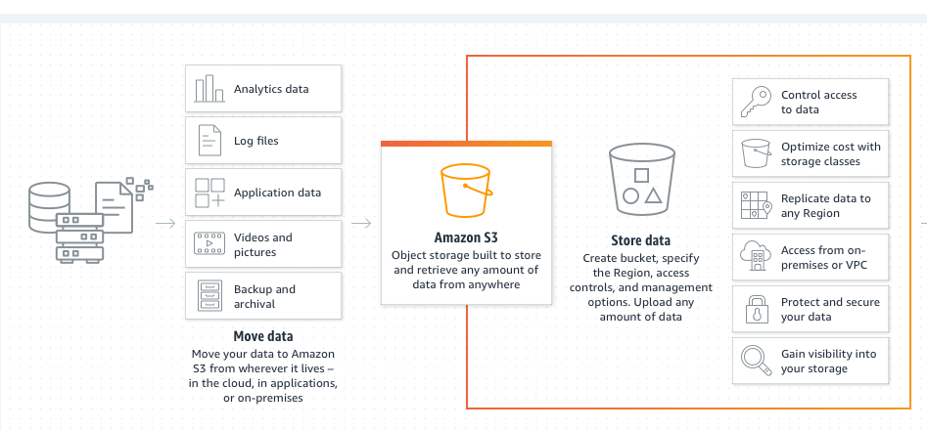
Costco’s effect on hearing aid accessibility
Data Storage:
Notes:
Storing pictures, files, graphs, and more
Easily accessible among teammates
Connecting changing data to S3 Bucket
Connects to machine learning through pyspark
Easy to use on multiple platforms
Plenty of storage space

Slide 11

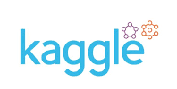
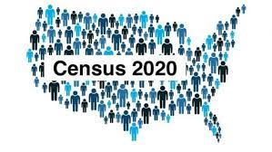
Exploratory Data Analysis
Data
Processing
Using Excel to edit Costco file
Dropping irrelevant columns
Creating consistency in label names
Locating Costco hearing clinics
Merging demographic data files
Transformed census data into csv files
Data Search
Manual search from each team member
Sourced from:
Notes:
Data:
Costco Data: Kaggle & Costco website to update locations
Census data: ESRI census population data 2019 & 2021
Zipcode file: USPS zip codes by county/MSA cross reference

Slide 12
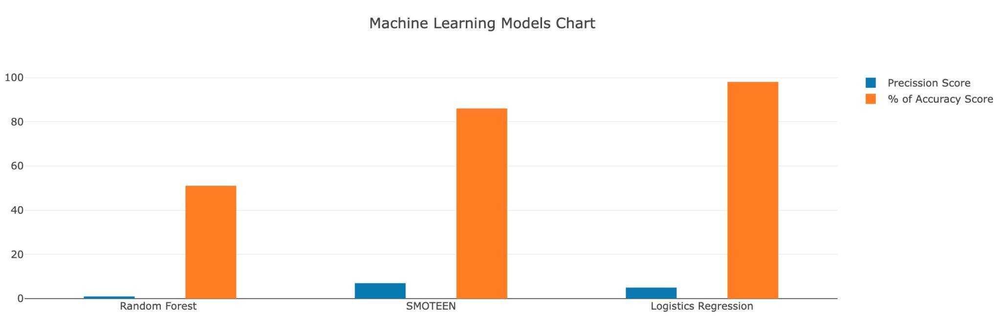
Machine Learning
Notes:
Dropped Costco locations that do not have hearing aid centers
Dropped age population younger than 20 and older than 69
Dropped all other demographic columns except education levels reached and household income columns
· Trained on Costco locations by zip-codes as our y and demographic columns for our features (X)
Using standard scaler, scaled our features to become identical in terms of the range so our columns could be compared
Used competitive model structure Ran Logistic Regression, SMOTEENN, and RandomForest to find best predictor
Trained on Costco locations to recommend where Costco should open a new location, specifically for hearing centers.
·
Using precision and recall rather than accuracy to predict where they should have a hearing center but do not.
Smoteen algorithm had the best results of all three machine learning as it balances the 1's (Costco locations,minority class), as well as the 0's (no Costco locations). This model may be good as additional information tool in determining a new store location but is not a good application for this type of prediction Lowering the decision threshold from 50% to 10% to get a higher precision or high recall ML model. This output maybe good as additional information tool in determining a new store location but is not a good application for this type of prediction
Logistic Regression predicted a binary outcome, 0 or 1. Unfortunately, it couldn’t predict optimal zip codes. Accuracy: .98, although is very high, this a poor metric for the type of dataset we have. It’s only considering all the “yes, costco location here” and not considering the other option “no, costco location here”.·
Random Forest has the same limitations as Logistic Regression in as there are so few "yes'" it considers them irrelevant. Dataset is imbalanced.
Feature engineering: our results point to our dataset needing additional look into additional data to predict new locations for CHC's.
Additional data to consider:
·Bucketing population data into decades or generations but keeping in mind not overfitting
Visualizing outliers to detect outliers
Adding % hearing impaired and hearing aid's cost

Slide 13
Visualization
HTML Dashboard
Link to dashboard

Slide 14
Conclusion
Refocus on how Costco can make affordable solutions available to the hearing impaired.
Identify individuals with hearing impairment through online/web based hearing assessment tool.
A web based and in store kiosk assessment along with demographic data allows for data gathering to create a prediction model.
Notes:
This would allow Costco to reach out to their current customer base and those that may be outside Costco's physical location.

Slide 15
FINAL PROJECT PIPELINE
Question
Exploratory Data Analysis
Machine Learning
Visualization
Findings/
Conclusion
Data Storage
Question:
How will over the counter hearing aids affect Costco?
Exploratory Data Analysis:
US Census Data, Kaggle, and Costco website
Jupyter notebook & Excel: preprocessing and merging data
Data Storage:
AWS S3 Bucket: data files, notebooks/script files,
images, Readme, presentation
Machine Learning:
Linear Regression, SMOTEENN, and RandomForest
Using Jupyter Notebook and Google Collab
Visualization:
Create a website using JavaScript & Html files
Charts, Graphs, Maps
Findings/Conclusion
Did we address our question by finding opportunities for Costco to open new stores?
Did we find new locations to consider?
What could we do to better evaluate the data?

Slide 16
FINAL PROJECT PIPELINE
Resources
Question
Data & Preprocessing
Machine Learning
Charts, Graphs, Maps
JavaScript & Html
Findings/
Conclusion
https://www.nytimes.com/2022/10/10/health/hearing-aids-fda.html
https://hearingreview.com/inside-hearing/regulation/national-academies-sciences-release-report-hearing-aid-accessibility-affordability
https://www.costco.com/warehouse-locations
https://www.scrapehero.com/location-reports/Costco-USA/
https://www.fortunebusinessinsights.com/industry-reports/hearing-aids-market-101573

