Slide 1
COSTCO’S HEARING AID MARKET
Jacqueline Wilson
Claudia Brito
Juana Connors-Trujillo
November 2022

Slide 2
Question:
Costco and hearing aid accessibility
How does the Legislation recently passed allowing hearing aids to be available over the counter affect Costco?
Notes:
The world of hearing health changed on Oct. 17, when the FDA’s new regulations, made quality hearing aids an over-the-counter product.
A person would be able to walk into almost any pharmacy or big-box store and buy a sophisticated pair of hearing aids for a few hundred dollars, no prescription required.
More than a 20% decrease in price
Less costly testing procedures
Accessibility through cost and location
National Institute of Health indicates that millennial and Gen Z individuals are more likely to experience hearing loss compared to previous generations
18% of adults between 20-69 years of age have hearing impairments
More than 550 Costco locations across the United States
Global hearing market projected to grow at a CAGR of 8.1% for 2022-2029

Slide 3








Technologies:
Notes:
Excel: original Costco, demographic data as csv files
Jupyter Notebook & Colab, Python & Pandas: Data cleaning, preprocessing and machine learning
VS Code & JavaScript: Html dashboard
Amazon S3 Bucket: data storage
Github: project collaboration

Slide 4
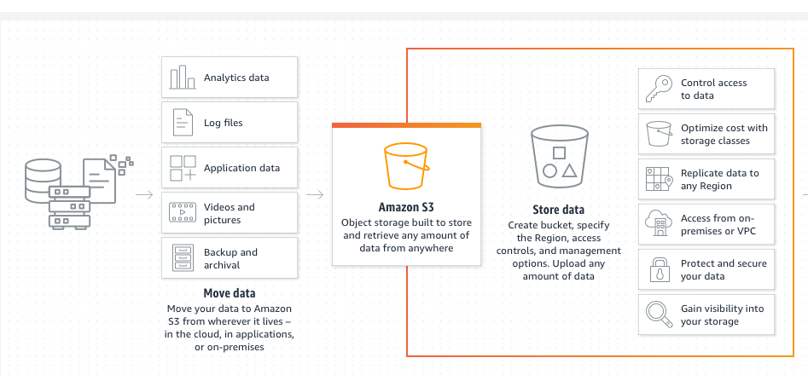
Data Storage:
Notes:
Storing pictures, files, graphs, and more
Easily accessible among teammates
Connecting changing data to S3 Bucket
Connects to machine learning through pyspark
Easy to use on multiple platforms
Plenty of storage space

Slide 5

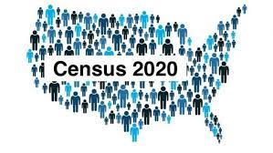

Exploratory Data Analysis:
Data
Processing
Using Excel to edit Costco file
Dropping irrelevant columns
Creating consistency in label names
Locating Costco hearing clinics
Merging demographic data files
Transformed census data into csv files
Data Search
Manual search from each team member
Sourced from:
Notes:
Data:
Costco Data: Kaggle & Costco website to update locations
Census data: ESRI census population data 2019 & 2021
Zipcode file: USPS zip codes by county/MSA cross reference

Slide 6
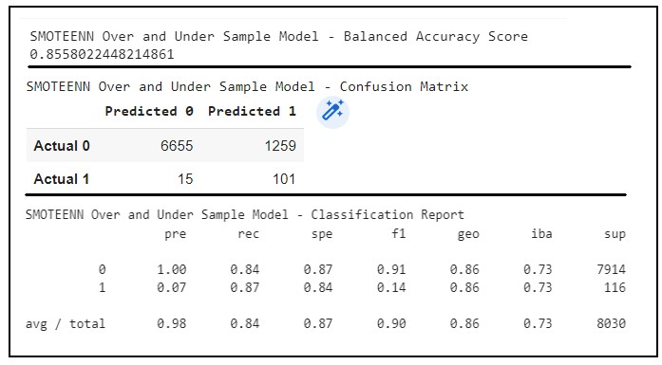
Machine Learning:
Add scatter plot image of our data ?
Notes:
Using competitive model structure and training on Costco locations to recommend where Costco should open a new location, specifically for hearing centers.
Using precision and recall rather than accuracy to predict where they should have a hearing center but don’t.
3 Supervised Machine Learning Models:
Logistic Regression
Predicts probability of binary outcome, yes and no
Observes a data set to find patterns to allow prediction
Accuracy
RandomForest
Builds decision trees on different samples
Calculates majority for classification
Calculates average for regression
Accuracy is
SMOTEENN
Chooses random points from training data-set to perform calculations (imbalanced classification)
Accuracy is

Slide 7
Visualization:
HTML Dashboard
Link to dashboard

Slide 8
Conclusion:
Results
Recommendations for future analysis
Things team would have changed

Slide 9
FINAL PROJECT PIPELINE
Question
Exploratory Data Analysis
Machine Learning
Visualization
Findings/
Conclusion
Data Storage
Question:
How will over the counter hearing aids affect Costco?
Exploratory Data Analysis:
US Census Data, Kaggle, and Costco website
Jupyter notebook & Excel: preprocessing and merging data
Data Storage:
AWS S3 Bucket: data files, notebooks/script files,
images, Readme, presentation
Machine Learning:
Linear Regression, SMOTEENN, and RandomForest
Using Jupyter Notebook and Google Collab
Visualization:
Create a website using JavaScript & Html files
Charts, Graphs, Maps
Findings/Conclusion
Did we address our question by finding opportunities for Costco to open new stores?
Did we find new locations to consider?
What could we do to better evaluate the data?

Slide 10
FINAL PROJECT PIPELINE
Resources
Question
Data & Preprocessing
Machine Learning
Charts, Graphs, Maps
JavaScript & Html
Findings/
Conclusion
Links to resources used

Slide 11
Extra slide
Question
Data & Preprocessing
Machine Learning
Charts, Graphs, Maps
JavaScript & Html
Findings/
Conclusion

Slide 12
Extra Slide

