Slide 1

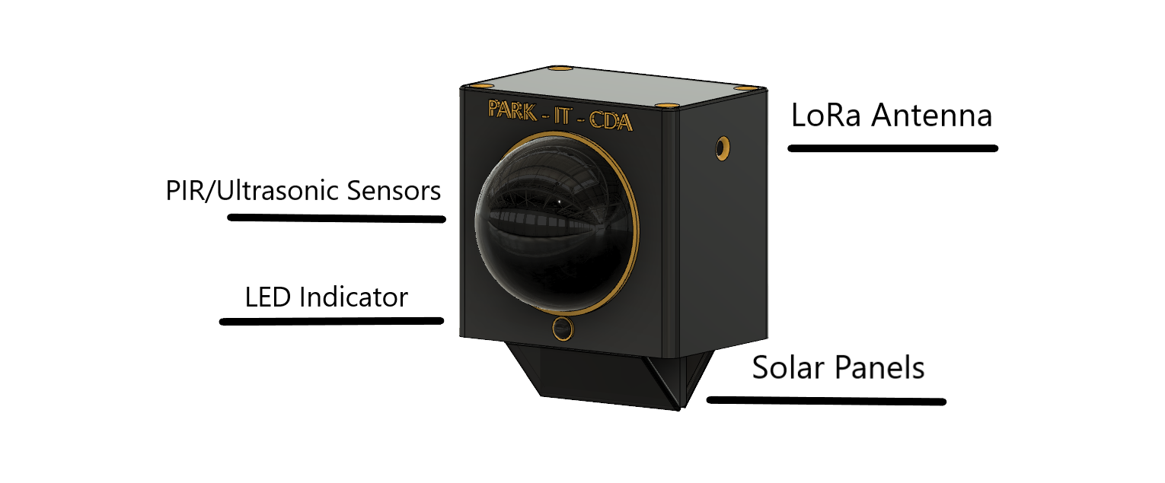
Park-it-CDA

Slide 2
Team
Nikolai
  Mesh Networking
Tyrel
  Simulation
  Database
Zane
  Unit design
  Sensor prototyping

Slide 3

Requirements
5 Units
1 year battery life
Sense obstacle
Indicate blockage
Mesh network
Auto choose gateway
Report state changes
Simulate the rest of garage

Slide 4
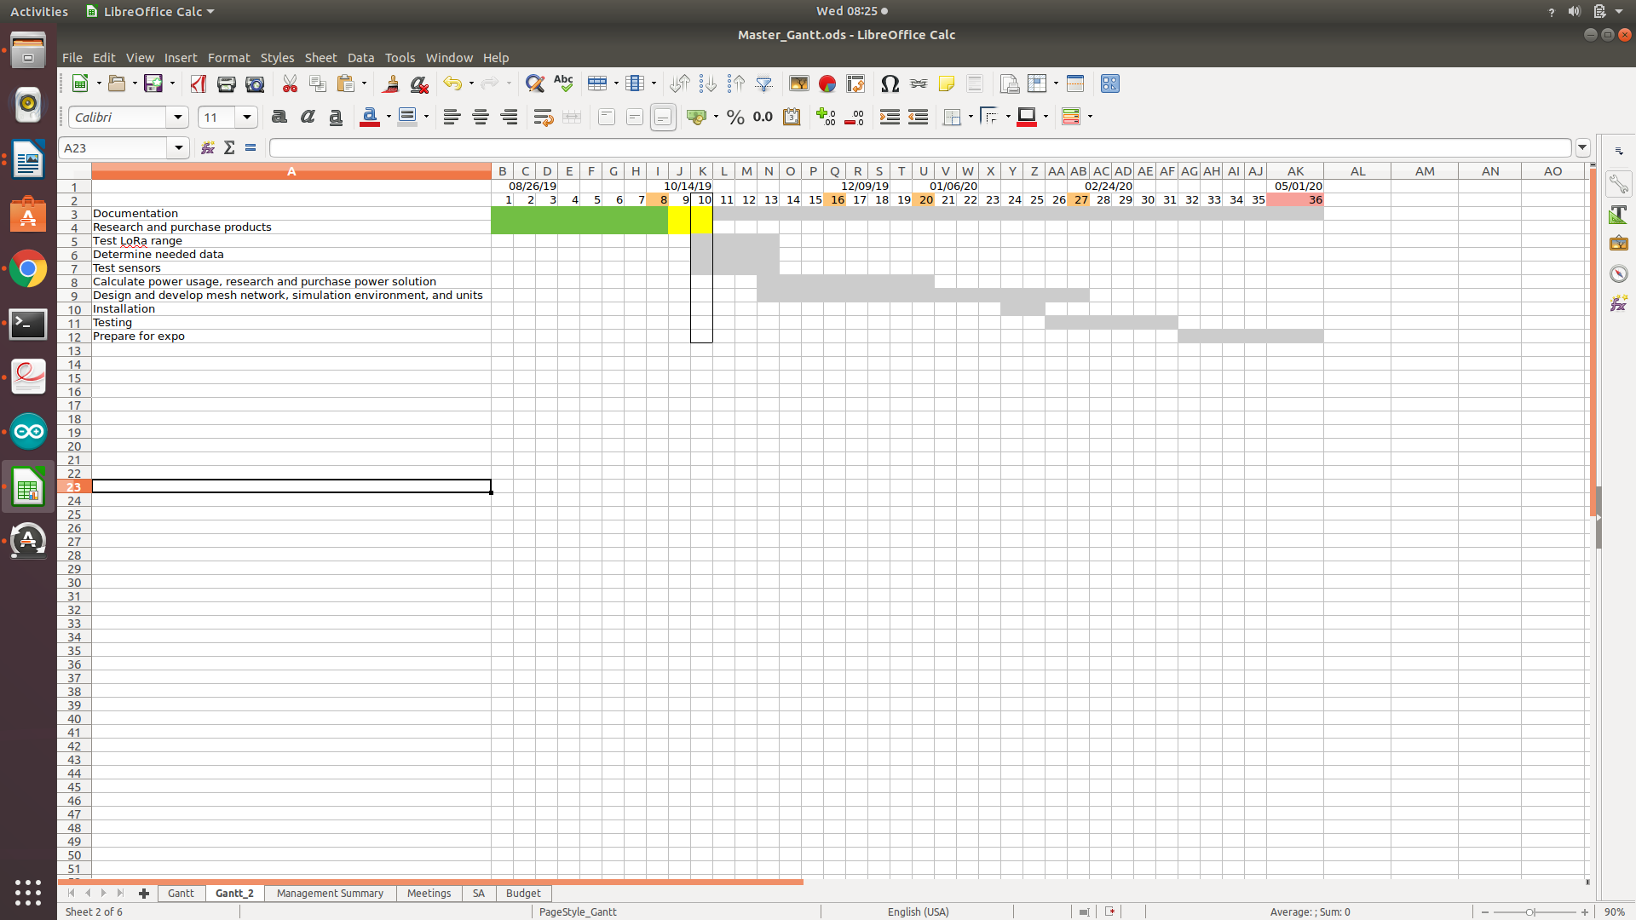
Schedule

Slide 5
Assumptions
We assume that LoRa will have the distance capabilities to reach the den.
We assume that we can achieve everything on a 3.3v system.
We assume that we can survive for a year on a 10000 mAh battery utilizing deep sleep.

Slide 6
Issues
The battery life will be the bottleneck.
  With a 3.7% PWM duty cycle on an arduino mega we can run the led for approximately 235 days with a 10000 mAh battery.
  We assume that with a few solar panels we could extend the battery life to allow for a full year even with indirect lighting.
  We could also blink the LED at regular intervals instead of having them on all the time. This requires timing between units.
  We still need to allow for the networking.

Slide 7
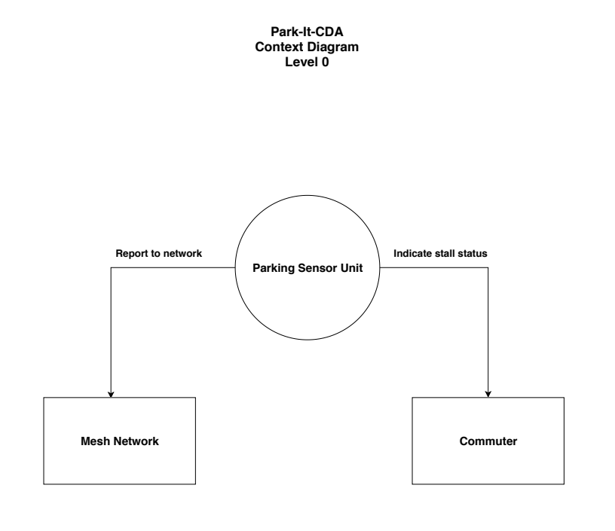
Context Diagram

Slide 8
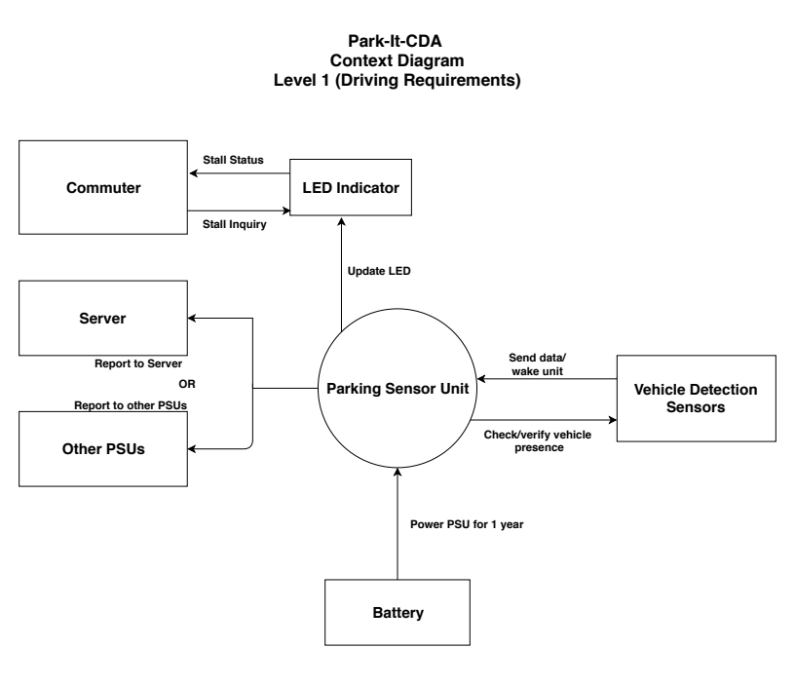
Context Diagram

Slide 9
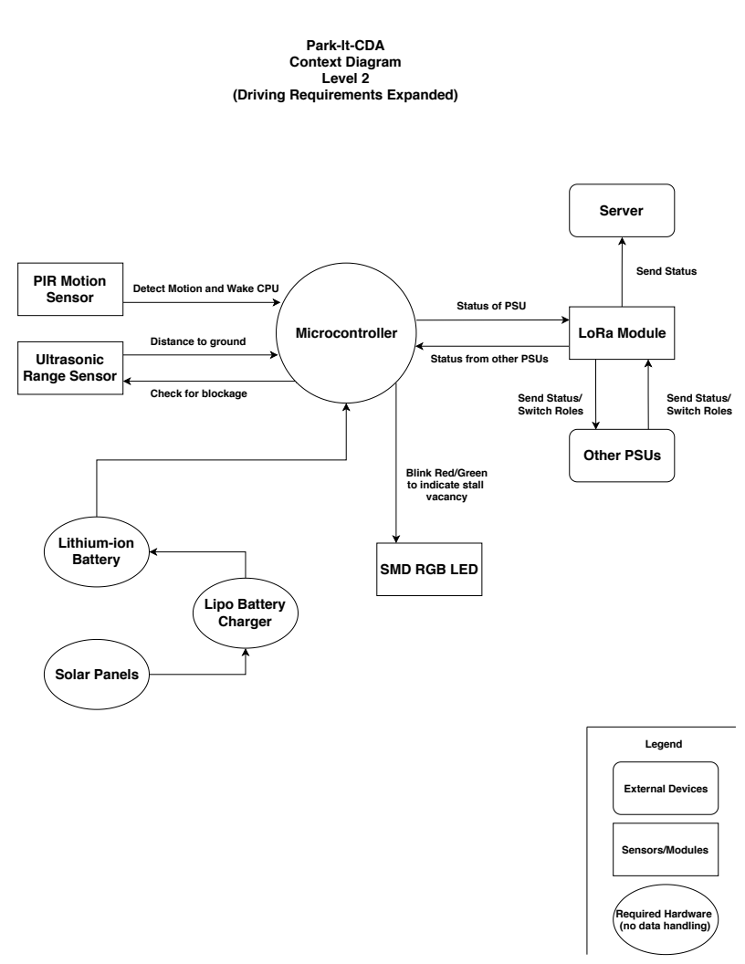
Context Diagram

Slide 10
Impacted Modules
We could purchase an off the shelf Arduino MKR 1310 which has a built in hardware encryption chip and 107uA deep sleep with built in LoRa.
We would be relying on the open source LoRa libraries for our communication packages, and an open source package for the discreet simulator.

Slide 11
Three Prototype Test Cases
Sensor
  Identify a car, truck, and possibly a motorcycle
Network
  Mesh communication
  External reporting
Simulation
  How do we test the simulation????

Slide 12
Traceability Approach
"the ability to describe and follow the life of a requirement in both a forwards and backwards direction (i.e., from its origins, through its development and specification, to its subsequent deployment and use, and through periods of ongoing refinement and iteration in any of these phases)"
We need to develop a way to show how this works.

Slide 13
Schedule

Slide 14
Current Status – LoRa Testing
We have received hardware and have tested the viability of using LoRa and Arduino
Test conditions:
  3 Arduino Uno/Mega with a LoRa radio attached – A Garage Sensor Unit (GSU)
  Used the LoRa mesh network implementation at https://github.com/nootropicdesign/lora-mesh
  Broadcasts at maximum power – 100mA per transmission
  This implementation periodically sends messages including the Received Signal Strength Indicator (RSSI) of each radio in the network
  Placed one GSU by the entrance to UofI’s office at the Den
  Using a laptop and console, measure how far another GSU can be before connection drops out (Goal is to get to the garage ~400 ft away)

Slide 15
Current Status – LoRa Testing
When next to one another, RSSI is -40 to -60
As soon as we leave the Den, RSSI dropped to -90 – the brick construction of the Den is causing a large loss of signal strength
The signal completely drops out at -120 – halfway between the Den and the traffic lights on 4th (approx 120 ft)
Conclusion: We need the Garage Sensor Gateway (GSG) above the Den

Slide 16
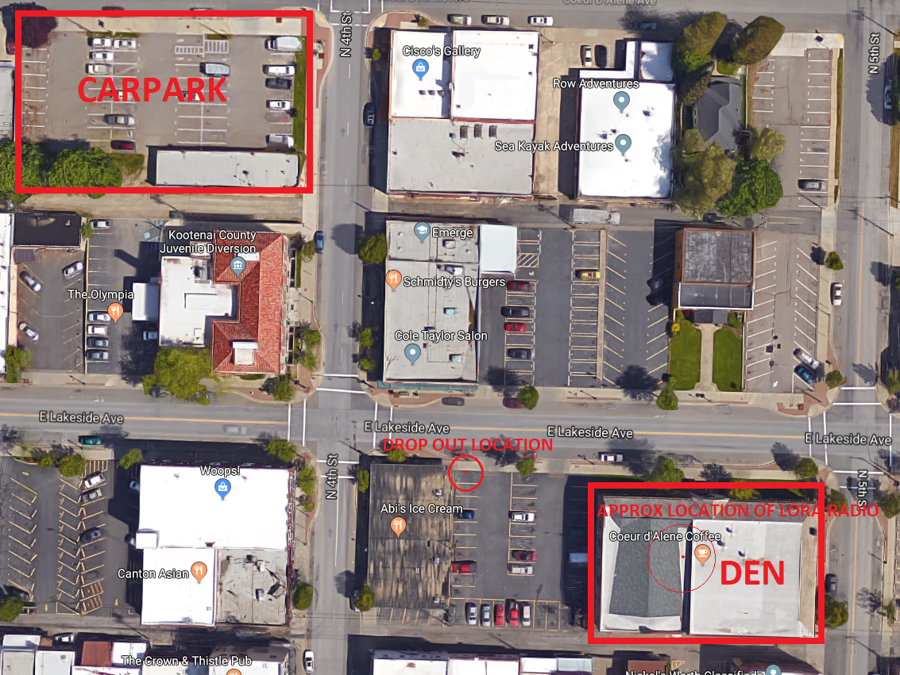
Current Status – LoRa Testing

Slide 17
Current Status – LoRa Testing
Carpark Testing
  Zane and I stand by the gate at the entrance and Tyrel walks with one of the GSUs
  Signal strength varies between -90 and -120 RSSI as Tyrel walks around and up the garage levels
  Connection drops out once as Tyrel is at the farthest corner from us on the second floor
  Typical RSSI was -100 to -110
  Conclusion: connection between GSUs within the garage shouldn’t be an issue

Slide 18
Current Status – LoRa Testing
The final test was to see if we can reach the garage from the Den when outdoors
  Tyrel stood on the second floor with the GSU with line of sight (LOS) to the Den’s rooftop
  Zane and I then walked back to the then while monitoring RSSI
  We get to the Den and stand below where the weather station above the Den is
  RSSI without LOS is about -100 to -110
  Conclusion: RSSI should be better than this with LOS

Slide 19
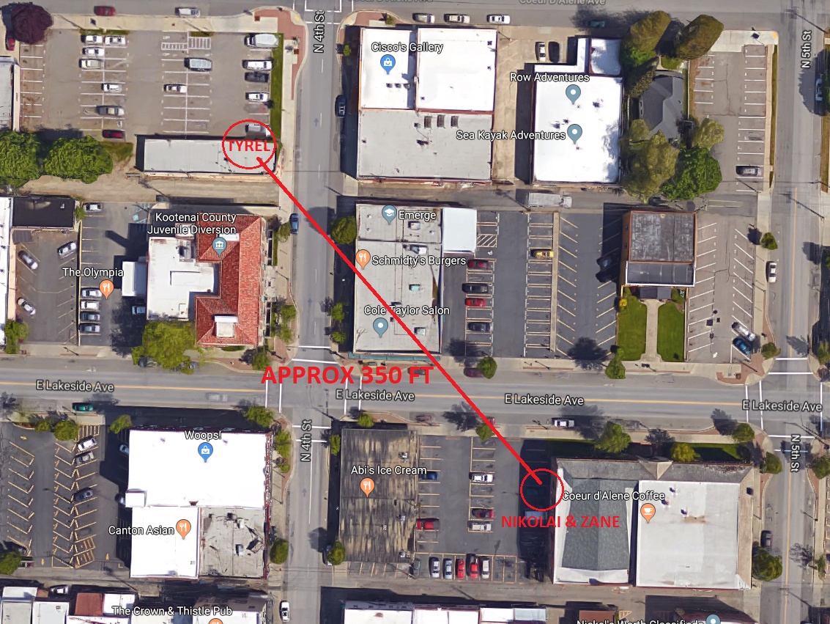
Current Status – LoRa Testing

Slide 20
Current Status – LoRa Testing
Overall Conclusion
  LoRa will work throughout the garage and will be able to communicate with a GSG on top of the Den
  We need to test lower power output on the LoRa radios
Concerns
  The mesh network implementation uses 1400 bytes of RAM: ~70% of what’s available on the Arduino Uno/Pro Mini and 40% of the available FLASH. We may not have enough RAM for our implementation along with sensing on a Pro Mini.

Slide 21
Action Items
Intentionally left blank.

