Slide 1

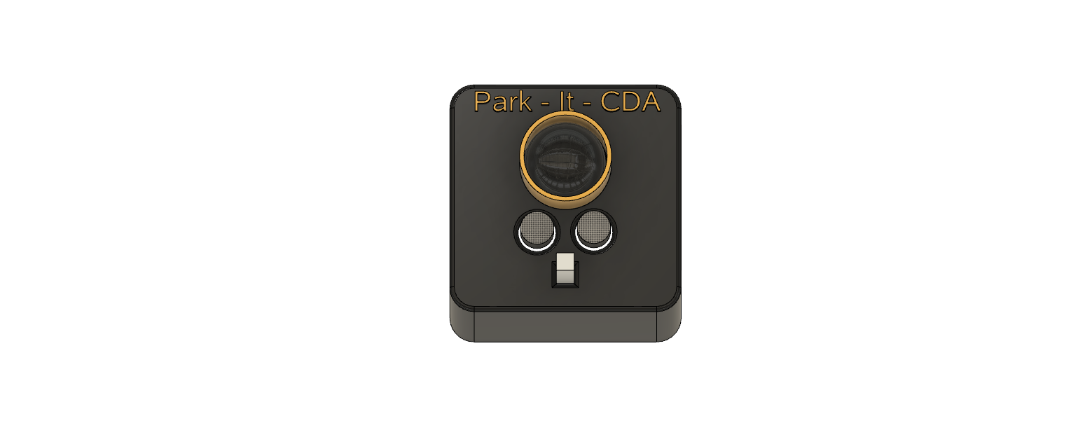
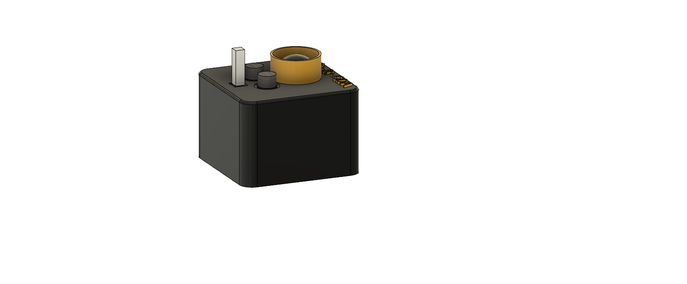
Park-it-CDA

Slide 2
Team
Nikolai
  Mesh Networking
Tyrel
  Simulation
  Database
Zane
  Unit design
  Sensor prototyping

Slide 3

Requirements
5 Units
1 year battery life
Sense obstacle
Indicate blockage
Mesh network
Auto choose gateway
Report state changes
Simulate the rest of garage

Slide 4
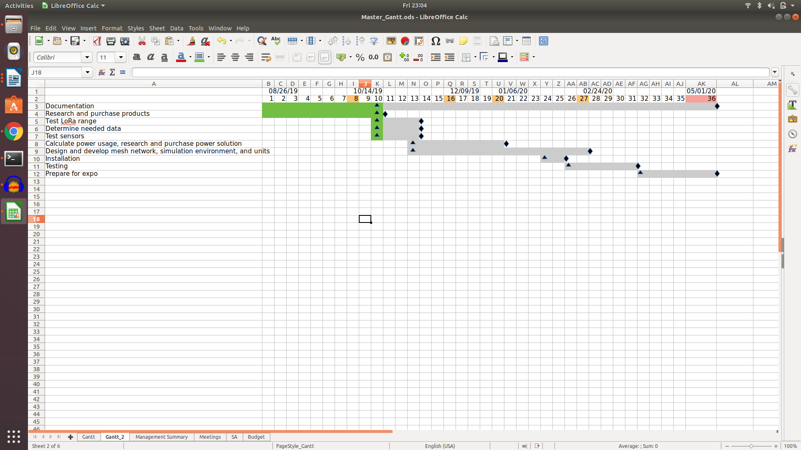
Schedule

Slide 5
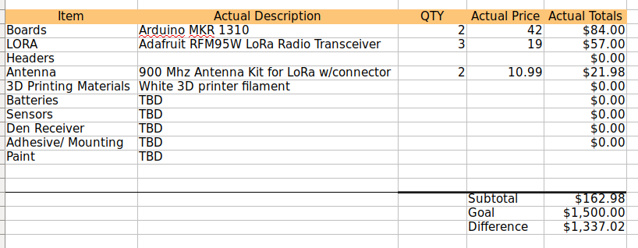
Budget

Slide 6
Assumptions
We assume that LoRa will have the distance capabilities to reach the den.
We assume that we can achieve everything on a 3.3v system.
We assume that we can survive for a year on a 10000 mAh battery utilizing deep sleep.

Slide 7
Issues
The battery life will be the bottleneck.
  With a 3.7% PWM duty cycle on an arduino mega we can run the led for approximately 235 days with a 10000 mAh battery.
  We assume that with a few solar panels we could extend the battery life to allow for a full year even with indirect lighting.
  We could also blink the LED at regular intervals instead of having them on all the time. This requires timing between units.
  We still need to allow for the networking.

Slide 8
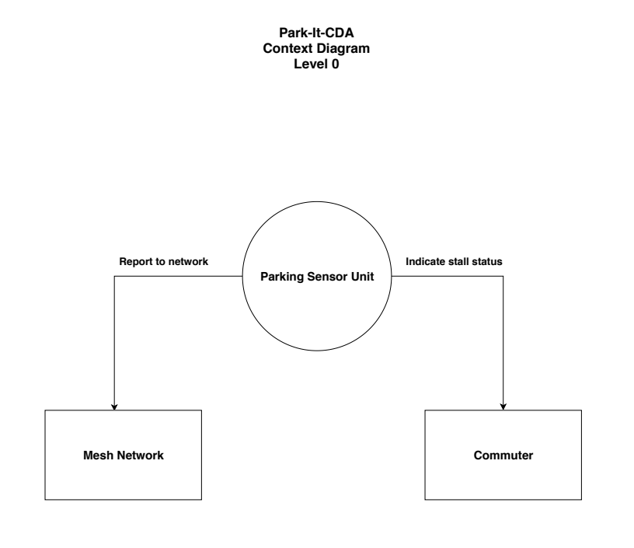
Context Diagram

Slide 9
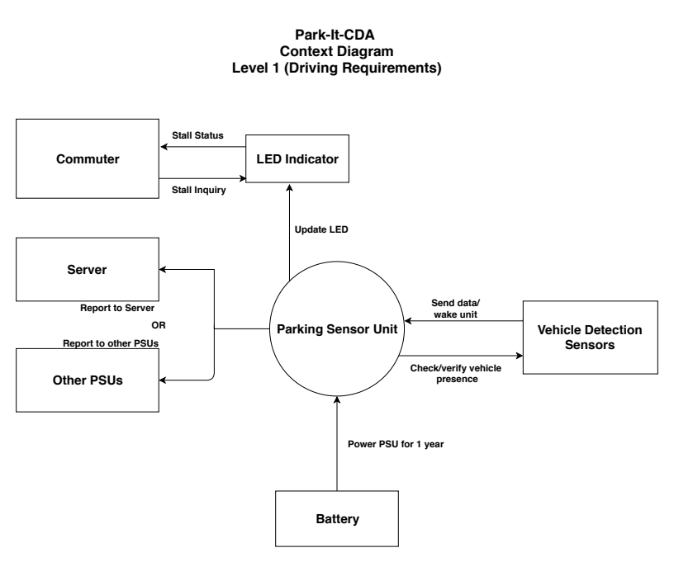
Context Diagram

Slide 10
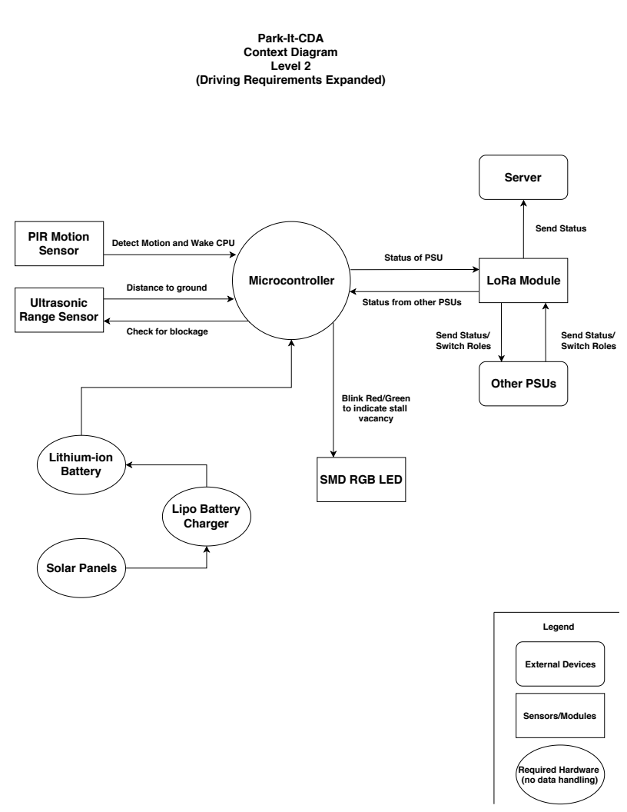
Context Diagram

Slide 11
Impacted Modules
We could purchase an off the shelf Arduino MKR 1310 which has a built in hardware encryption chip and 107uA deep sleep with built in LoRa.
We would be relying on the open source LoRa libraries for our communication packages, and an open source package for the discreet simulator.

Slide 12
Three Prototype Test Cases
Sensor
  Identify a car, truck, and possibly a motorcycle
Network
  Mesh communication
  External reporting
Simulation
  Visually display the probable use of the garage based on recorded data

Slide 13
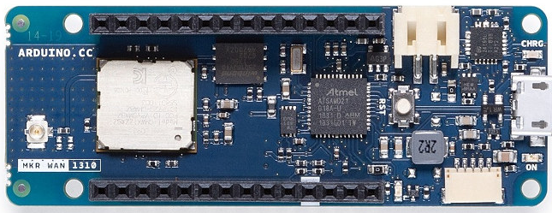
Board/Modules
Arduino MKR WAN 1310 LoRa Board
Specifications that relate to this project:
48MHz Processor
32KB SRAM
-256KB Flash Memory
2MB SPI Flash (external)
Built-in LoRa Module
Built-in Crypto Chip
Designed for Li-Po use with 2-Pin Header
Power Consumption as low as 104uA (deep sleep)

Slide 14
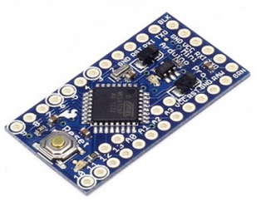
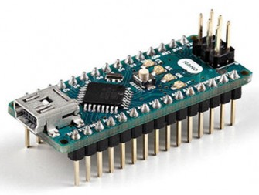
Board/Modules
Limitations of Other Boards Considered:
Arduino Nano:
Needs separate modules/config for LoRa and encryption
Still uses ~.15mA in deep sleep!
Arduino Pro Mini (3v):
32KB Flash memory
2Kb SRAM
No USB means FTDI programming; not ideal for bigger projects

Slide 15
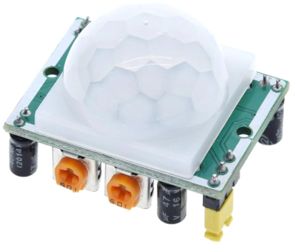
Board/Modules
Sensors:
HC-SR501 PIR Motion Detection Sensor:
Used for initial vehicle detection
3-7 Meter detection distance
Can be used as external interrupt to wake Arduino from deep sleep
Draws 60uA when idle
Draws ~2mA when active

Slide 16
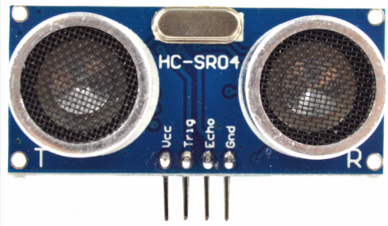
Board/Modules
Sensors:
HC-SR04 Ultrasonic Distance Sensor:
Used to periodically check if there is still a blockage in parking stall
Measuring distance up to 4.5 Meters
Draws ~6mA when active
Can be turned off through port manipulation to achieve 1uA of current draw when inactive
Can be modified to work with 3.3V

Slide 17
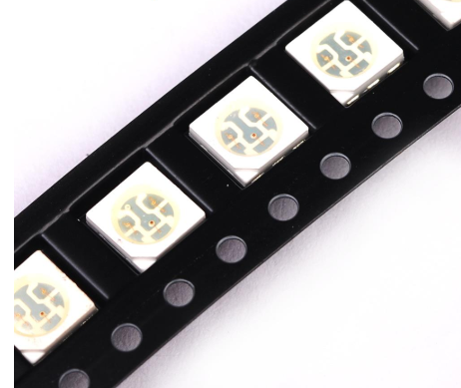
Board/Modules
LED
A Single SMD RGB LED:
Used to indicated stall status
Uses ~20mA for Red/Green
Will be flashed at a set interval that balances power consumption and visibility
Can be easily diffused with a 3D printed enclosure to direct light more efficiently

Slide 18
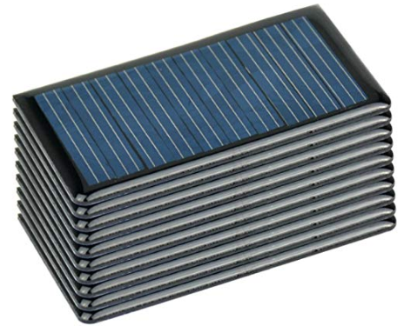
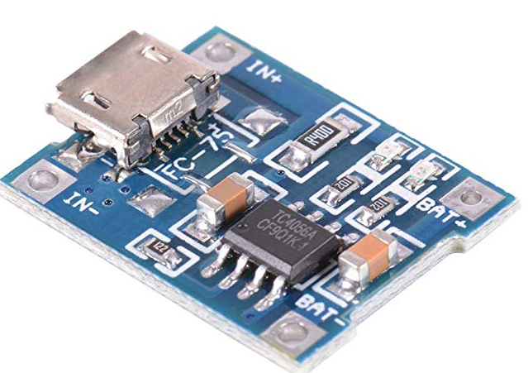
Board/Modules
Other Components
60mA Epoxy Solar Panels:
Will provide a trickle charge to the battery from ambient light in garage
Will not be heavily considered as having a contribution to the overall battery life of the Unit
~2.6 X 1.5” panels, 2 per Unit
Litihum Power Charger:
- Used for charging Units as well as directing solar energy to Li-Po battery

Slide 19
Current Status – LoRa Testing
We have received hardware and have tested the viability of using LoRa and Arduino
Test conditions:
  3 Arduino Uno/Mega with a LoRa radio attached – A Garage Sensor Unit (GSU)
  Used the LoRa mesh network implementation at https://github.com/nootropicdesign/lora-mesh
  Broadcasts at maximum power – 100mA per transmission
  This implementation periodically sends messages including the Received Signal Strength Indicator (RSSI) of each radio in the network
  Placed one GSU by the entrance to UofI’s office at the Den
  Using a laptop and console, measure how far another GSU can be before connection drops out (Goal is to get to the garage ~400 ft away)

Slide 20
Current Status – LoRa Testing
When next to one another, RSSI is 0 to -60
As soon as we leave the Den, RSSI dropped to -90 – the brick construction of the Den is causing a large loss of signal strength
The signal completely drops out at -120 – halfway between the Den and the traffic lights on 4th (approx 120 ft)

Slide 21
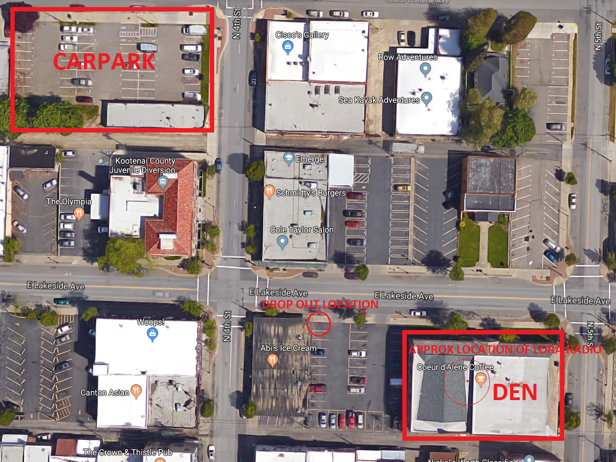
Current Status – LoRa Testing

Slide 22
Current Status – LoRa Testing
Carpark Testing
  Stand by the entrance and Tyrel walks with one of the GSUs
  Signal strength varies between -90 and -120 RSSI as Tyrel walks around and up the garage levels
  Connection drops out once as Tyrel is at the farthest corner from us on the second floor
  Typical RSSI was -100 to -110
Reaching the garage from the Den when outdoors
  Walked back to the Den while monitoring RSSI
  We get to the Den and stand below where the weather station above the Den is
  RSSI without LOS is about -100 to -110

Slide 23
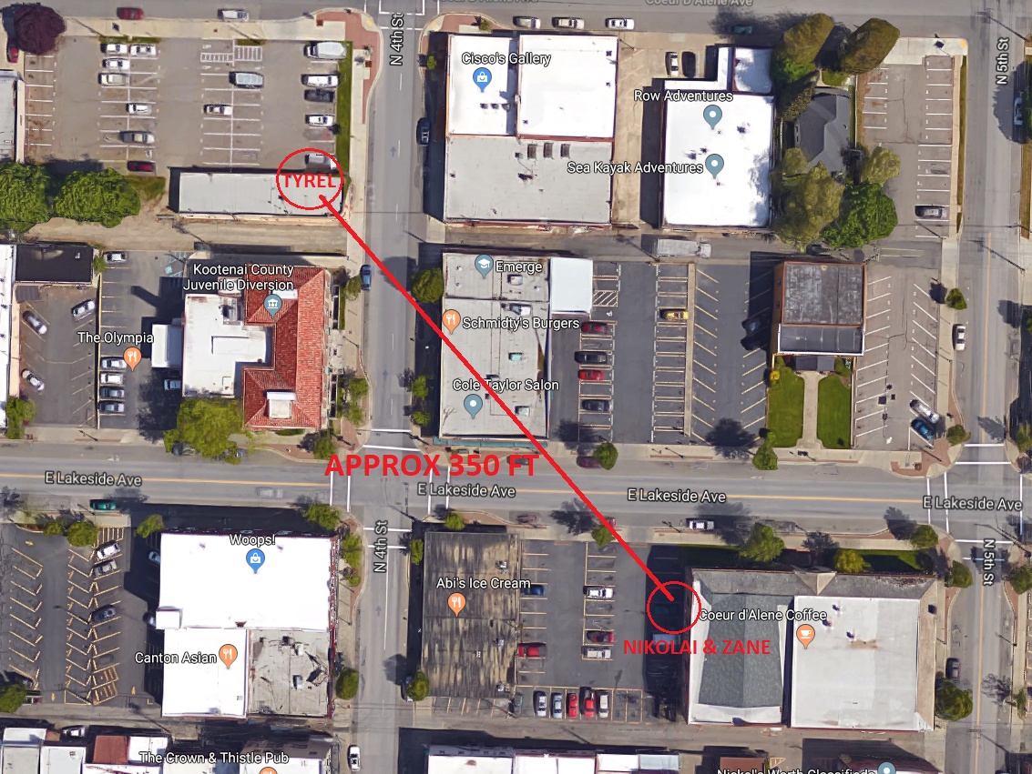
Current Status – LoRa Testing

Slide 24
Current Status – LoRa Testing
Overall Conclusion
  LoRa will work within the garage and will be able to communicate with a GSG on top of the Den if we have line of sight
  We need to test lower power output on the LoRa radios to preserve battery
Concerns
  The mesh network implementation uses 1400 bytes of RAM: ~70% of what’s available on the Arduino Uno/Pro Mini and 40% of the available FLASH. We may not have enough RAM for our implementation along with the sensing on a Pro Mini.

Slide 25
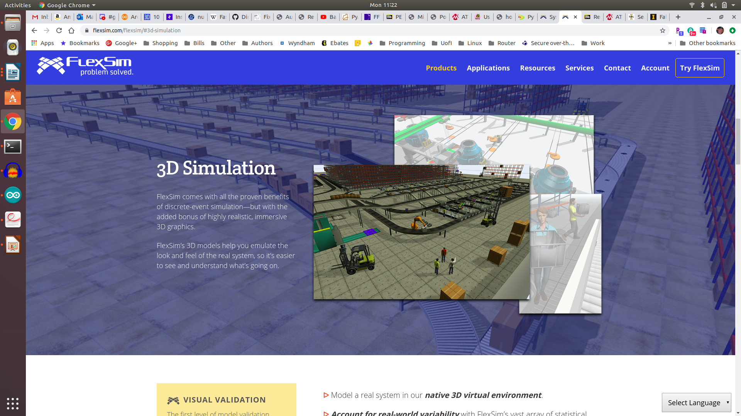
Current Status – Simulation
Using FlexSim, I will create a model of the garage and simulate the frequency of use (cars parking, arriving, and leaving) in the model.
Once we get battery life calculations we will also simulate the life and death of the units.

Slide 26
Current Status – Simulation
We currently don’t have any information about the frequency of use for the garage, so I will need to gather some data and estimate usage frequencies.

Slide 27
Milestones
Mesh Network
  ??
Simulation
  ??
Sensors
  ??

Slide 28
Action Items
Intentionally left blank.

