Slide 1
Business Process Evaluation PowerPoint Show
Process
People
Data
Mechanism
Approach
This slide is 100% editable
This slide is 100% editable.
This slide is 100% editable.
This slide is 100% editable.
Practice
This slide is 100% editable.
This slide is 100% editable.
This slide is 100% editable.
This slide is 100% editable.
Key Indicators
This slide is 100% editable.
This slide is 100% editable.
This slide is 100% editable.
This slide is 100% editable.
Partnership
This slide is 100% editable.
This slide is 100% editable.
This slide is 100% editable.
This slide is 100% editable.

Slide 2
Instructions To Edit This Slide
This slide has been made in PowerPoint using basic PowerPoint shapes, and all graphics are 100% editable in PowerPoint.
You can change color, size and orientation of any element to your liking, and add/edit any piece of text anywhere.

Slide 3
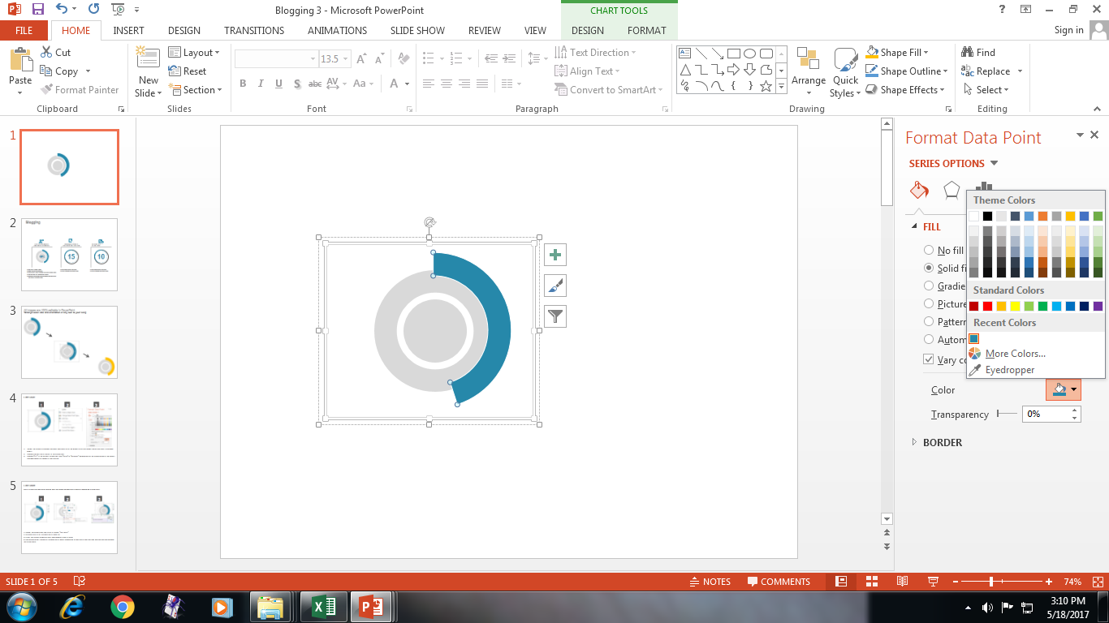
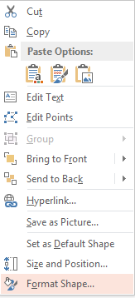
Edit Color
1
2
3
Select the shape to change the color and Right click the object (click any object which you want to change color)
Choose Format Data Series in the dialog box.
Choose “Fill” in the Format Shape box then “Solid” or “Gradient” depending on the appearance of the object. Change colour as shown in the picture.

Slide 4
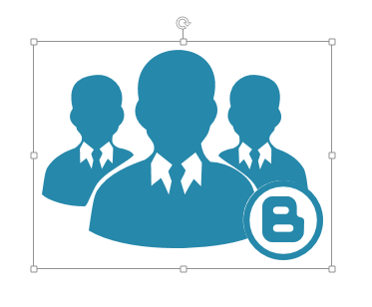
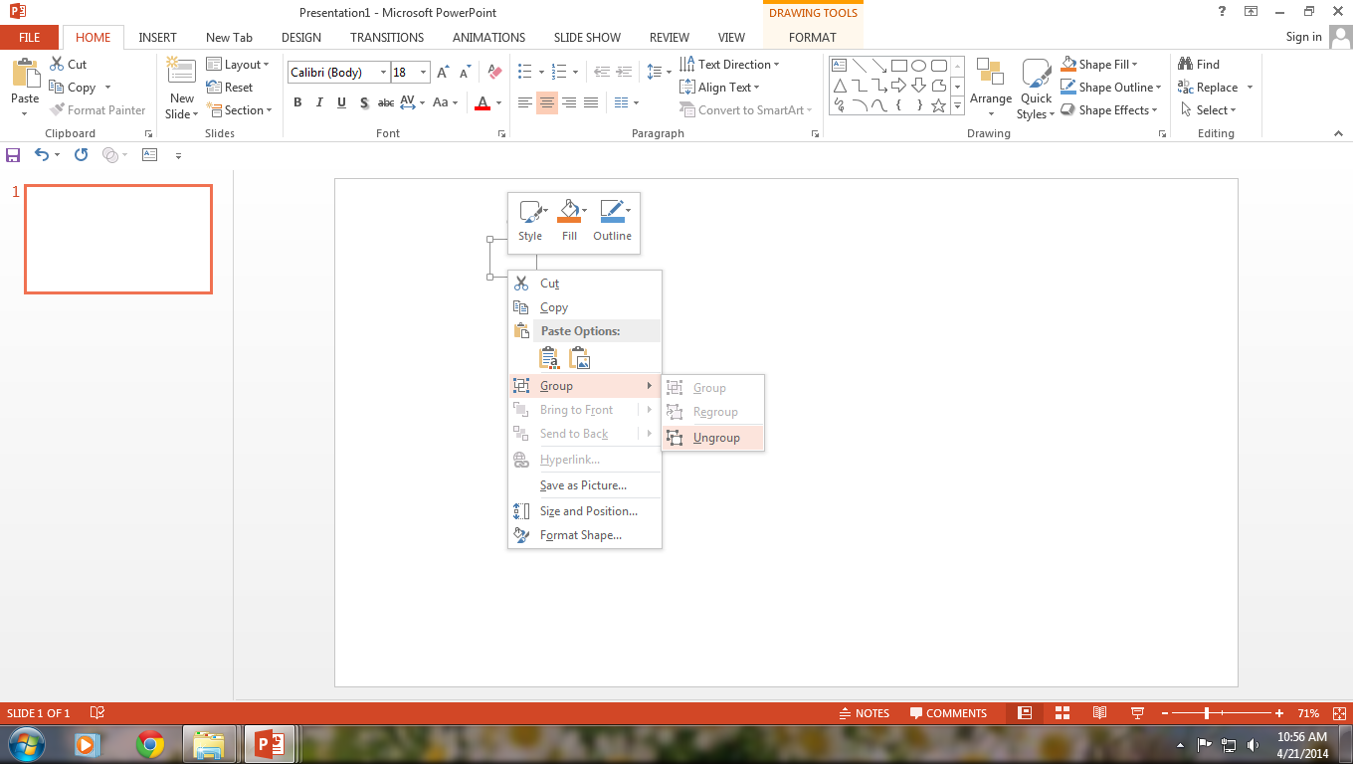
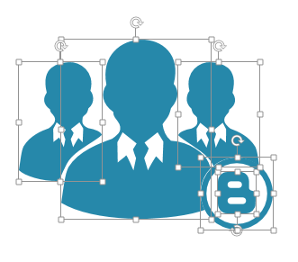
Edit Icons or Use your own icons in any slide
The icons are completely editable. You can also replace the icons in this slide with any icons you like from our site, or completely remove them if required.
1
2
3
The icons are completely editable and use can change the colors of the icons as shown in the previous slide. You can also replace the icons, if required. We have a large collection of icons to choose from.
To replace any icon, double click on it and select it, and then right click it to ungroup it.
Delete the icon and replace it with any icon or graphic from our site.

Slide 5
Select From Thousands Of Editable Icons On Every Topic
These icons are available at the Icons section on www.slideteam.net

