Slide 1
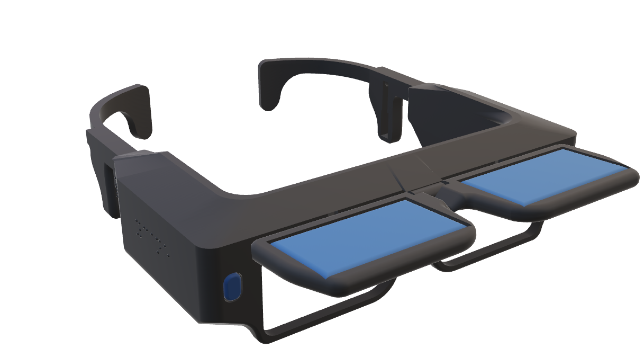
Product
Ycane system is designed as a cheap but highly functional product to help the visually impaired with traveling social life.
Stereophonic feedback
Bone conducting sound tracks
Provide user with exact position of the obstacle
YCane
Gain power through solar panel
Able to store power in battery for cloudy days
Provide YCane with unlimited power
Internet of Things
Connecting products with YApp
Connecting products with Ycare program
Bluetooth included

