Slide 1
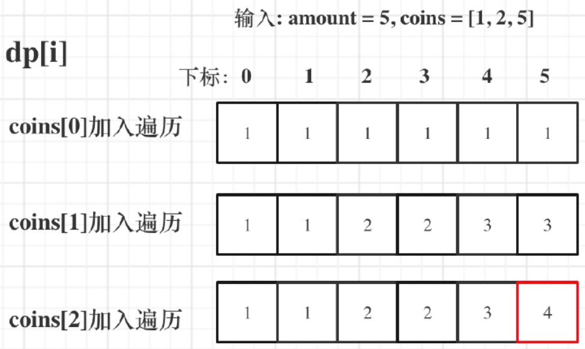

Slide 2

0
1
2
3
4
5
0
1
1
2
2
3
0
1
1
2
2
1

