Slide 1
SoundBridge
01
A little sound.
A lot of connection.
Everyday sound help, from one person to another.
SASEHacks for Good
Notes:
Open with a concrete moment: “A kettle whistles. A name is called. A train announcement changes. What if you could ask a person what that sound means, and read the answer?” SoundBridge connects Deaf and hard-of-hearing people with community volunteers. The user asking for help controls the interaction. This project grew from the founder’s Good Samaritan concept.

Slide 2
SoundBridge
02
Everyday sound has context
“Was that my name?”
“What did that announcement say?”
A short conversation can make an unfamiliar sound understandable.
The person asking decides what to share and what to ask.
Notes:
Describe the problem without assuming all Deaf people have the same preferences. SoundBridge offers an optional way to get context about a sound. It does not interpret sign language or replace professional accessibility services. No prevalence statistics or user research results are claimed.

Slide 3
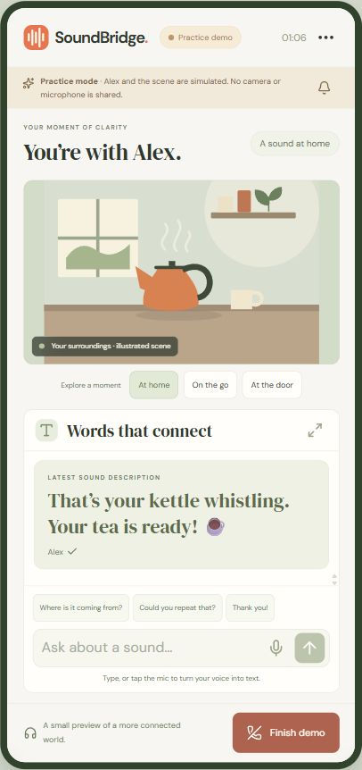
SoundBridge
03
A person on the other end
Ask for help
A nickname and an optional camera check.
Meet a volunteer
A real video call with text, quick replies and visible attention cues.
Your conversation. Your pace. Leave anytime.
Notes:
Switch to the live app here. Show a request on the phone and a volunteer on the laptop. Point at a kettle or play a familiar sound from another tab. Have the volunteer type a description. Send an attention signal and a quick reply. If two devices are unavailable, use the clearly labeled guided demo with its illustrated scenes and scripted volunteer. Voice typing creates a draft for review before sending.

Slide 4
SoundBridge
04
A working connection, end to end
WebRTC
Browser video and audio travel directly between peers when the network allows.
Supabase Edge Functions
Opaque session credentials protect call actions and participant access.
Postgres transactions
Atomic matching prevents double claims. Room locks coordinate messages and call cleanup.
React on Vercel
Responsive interface, local preferences and a shareable HTTPS app.
Notes:
Media uses WebRTC with STUN. Restricted networks may require a TURN relay. The Edge Function authenticates each session using a hash of an unpredictable bearer token, then checks room membership. Database tables deny browser access. Text and signaling use authenticated polling, roughly once a second while connected. Postgres uses transaction locks for random matching and one-use invitations. Append and end operations lock the same room, so a racing message cannot survive call cleanup. Messages are ephemeral, and the app never records audio or video. Automated integration tests exercise matching, authorization and cleanup. Generated camera streams verify the real WebRTC path without accessing physical devices.

Slide 5
SoundBridge
05
A campus is a place to begin
People asking for context
Deaf and hard-of-hearing students who want occasional sound help.
People willing to give a few minutes
Student volunteers, accessibility offices and community organizations.
Pilot proposal: free to users, supported by campus partners.
Notes:
This is a pilot proposal, not validated demand, traction or a confirmed partnership. Co-design with Deaf and hard-of-hearing students first. An accessibility office could coordinate opt-in volunteer shifts, while SASE members could provide the initial volunteer pool. Measure time to a useful response and user-rated helpfulness. A possible funding model is institutional sponsorship while keeping access free. Before a public pilot, add volunteer screening, staffed reporting, abuse controls and TURN coverage.

Slide 6
SoundBridge
06
A little more understanding
Your world.
A little clearer.
soundbridge-sasehacks.vercel.app
Live app and source are ready for review.
Devpost submission remains under the team’s control.
Notes:
Close with the theme: a positive community change can begin with one person making a few minutes available to another. Invite the judges to scan the app URL or try the practice demo. Repository: https://github.com/Jaxonize/soundbridge-sasehacks. Do not imply the Devpost project has been submitted. The team will complete submission after final review.

