Slide 1

A Tutorial on Git and Github
By Reyhane Askari and Arnaud Bergeron

Slide 2
Table of contents:
Version control systems and git
Git Basics
Branch Management
Git Merge, Update and Rebase
Git Conflicts and How to Resolve them
Interaction with Remote Repos
Git Stash
Some Useful Tips
Git cheat sheet

Slide 3
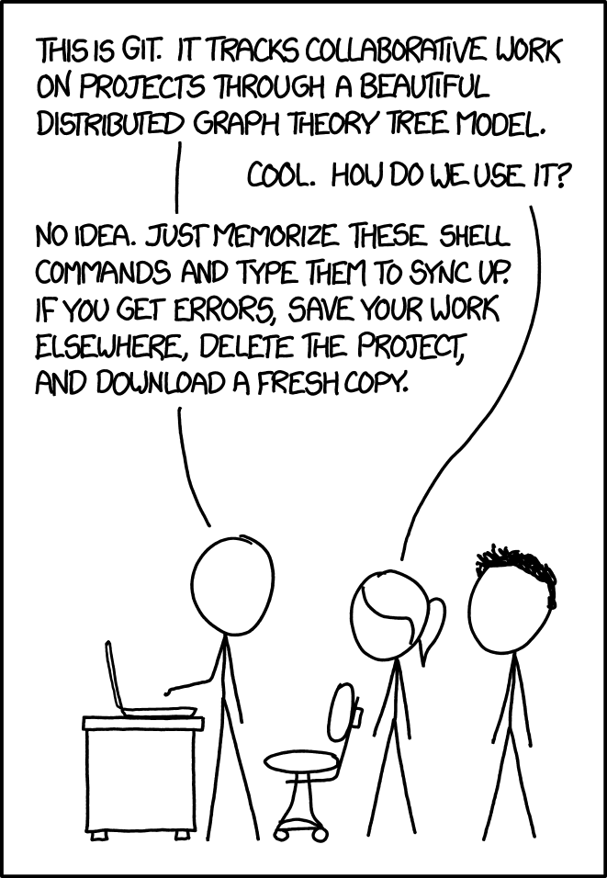
Version Control System
Manage multiple versions of your source code.
Great way to work as a team where you work concurrently.
Go back and forth between the versions of your code.
Source: https://xkcd.com/1597/

Slide 4
Git Basics
git clone /url/to/repository
git config user.name <username>
git config user.email <email>
git add <filename>
git status
git diff
git add <filename> -p
git add .
Remote Repository
Push
Fetch
Pull/clone
Local Repository
Commit
Staging
Checkout
Add
Working Copy
Notes:
create a repo on github, show the license and clone it.

Slide 5
Git Basics
git commit -m "Commit message"
git status
git log
git push
git pull
Remote Repository
Push
Fetch
Pull/clone
Local Repository
Commit
Staging
Checkout
Add
Working Copy

Slide 6
Branch Management
The full project code and history is called a repository.
A commit is a snapshot of your code at different stages of the project.
Also, a branch is a pointer to a commit that you can change.
master

Slide 7
Branch Management
Initial State
master

Slide 8
Branch Management
Create a new branch:
git branch new_branch
master
new_branch

Slide 9
Branch Management
Create a new branch:
git branch new_branch
Move between branches:
git checkout new_branch
master
new_branch

Slide 10
Branch Management
Create a new branch:
git branch new_branch
Move between branches:
git checkout new_branch
Create a new branch and check it out:
git checkout -b new_branch
master
new_branch

Slide 11
Branch Management
Create a new branch:
git branch new_branch
Move between branches:
git checkout new_branch
Create a new branch and check it out:
git checkout -b new_branch
Delete a branch:
git branch -d new_branch
master

Slide 12
Branch Management
git checkout -b cool_feature
master
cool_feature

Slide 13
Branch Management
git checkout -b cool_feature
Add some code
git commit -m “Cool feature”
master
cool_feature

Slide 14
Branch Management
git checkout -b cool_feature
Add some code
git commit -m “Cool feature”
git checkout master
master
cool_feature

Slide 15
Branch Management
git checkout -b cool_feature
Add some code
git commit -m “Cool feature”
git checkout master
git checkout -b feature_2
master
feature_2
cool_feature

Slide 16
Branch Management
git checkout -b cool_feature
Add some code
git commit -m “Cool feature”
git checkout master
git checkout -b feature_2
Add some more code
git commit -m “Second feature”
master
feature_2
cool_feature

Slide 17
Merge
You’ve just made some changes but someone else also did. What to do?
master
cool_feature

Slide 18
Merge
You’ve just made some changes but someone else also did. What to do?
git merge master
master
cool_feature

Slide 19
Merge
You’ve just made some changes but someone else also did. What to do?
git checkout master
master
cool_feature

Slide 20
Merge
You’ve just made some changes but someone else also did. What to do?
git checkout master
git merge cool_feature
master
cool_feature

Slide 21
Rebase
You’ve just made some changes but someone else also did. What to do?
master
cool_feature

Slide 22
Rebase
You’ve just made some changes but someone else also did. What to do?
git rebase master
master
cool_feature

Slide 23
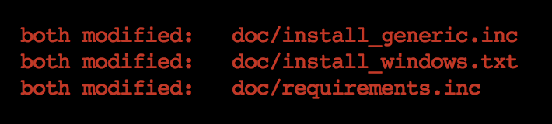
How to Resolve Git Conflicts?
Find which files have conflicts using:
git status

Slide 24
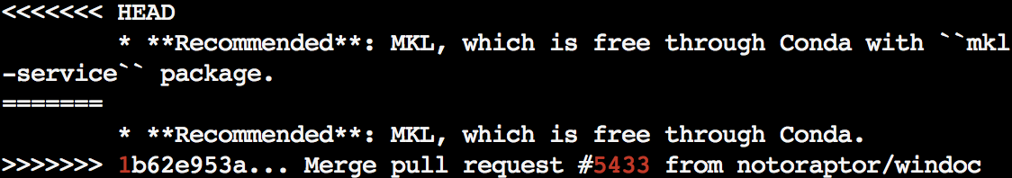
How to Resolve Git Conflicts?
Go to that file and find the conflict and choose the line that you want to keep.

Slide 25
How to Resolve Git Conflicts?
Resolve all the conflicts and add them:
  git add path/to/files/with/conflicts
Then commit your changes:
  git commit
Continue to rebase or merge:
  git rebase --continue
  git merge --continue
Or abort the rebase/merge in case you want to stop applying the changes:
  git rebase --abort
  git merge --abort

Slide 26
Git Update
Remote Repository
Fetch the changes from a repository but do not merge them:
git fetch repo/branch
Update local repository to the newest commit:
git pull repo/branch
Push
Fetch
Pull
Local Repository
Commit
Staging
Checkout
Add
Working Copy

Slide 27
Interaction with remote repos
Remote Repository
See your remote repos:
git remote -v
Add a remote repository:
git remote add [name] [url]
Send the changes from a local repo to a remote repo:
git push repo/branch
Push and force the local changes to the remote:
git push -f repo/branch
Push
Fetch
Pull
Local Repository
Commit
Staging
Checkout
Add
Working Copy

Slide 28
Workflows for contributing to other repos
Fork the repo to contribute to
Checkout your forked repo
Add a remote pointing to the repo to contribute to
Create a pull request

Slide 29
Git Stash
If you have unstaged files, and you want to checkout to another branch, you need to save your changes:
git stash
To retrieve the saved changes on that branch:
git stash pop
You can see the current stash list:
git stash list

Slide 30
Some Useful Tips
Never ever commit to the master, always create a new branch first.
Make the commit messages informative not like: "new changes", give a short description like: "changed make_node() to be more readable"
Before starting to implement a new feature, always fetch and pull the changes in the remote branch which is often called the upstream.
If you want to revert uncommitted local changes use:
git reset --hard
If you want to go to a specific commit:
git checkout {sha1-code}
Select one commit and apply it to the active branch:
git cherry-pick {sha1-code}

Slide 31
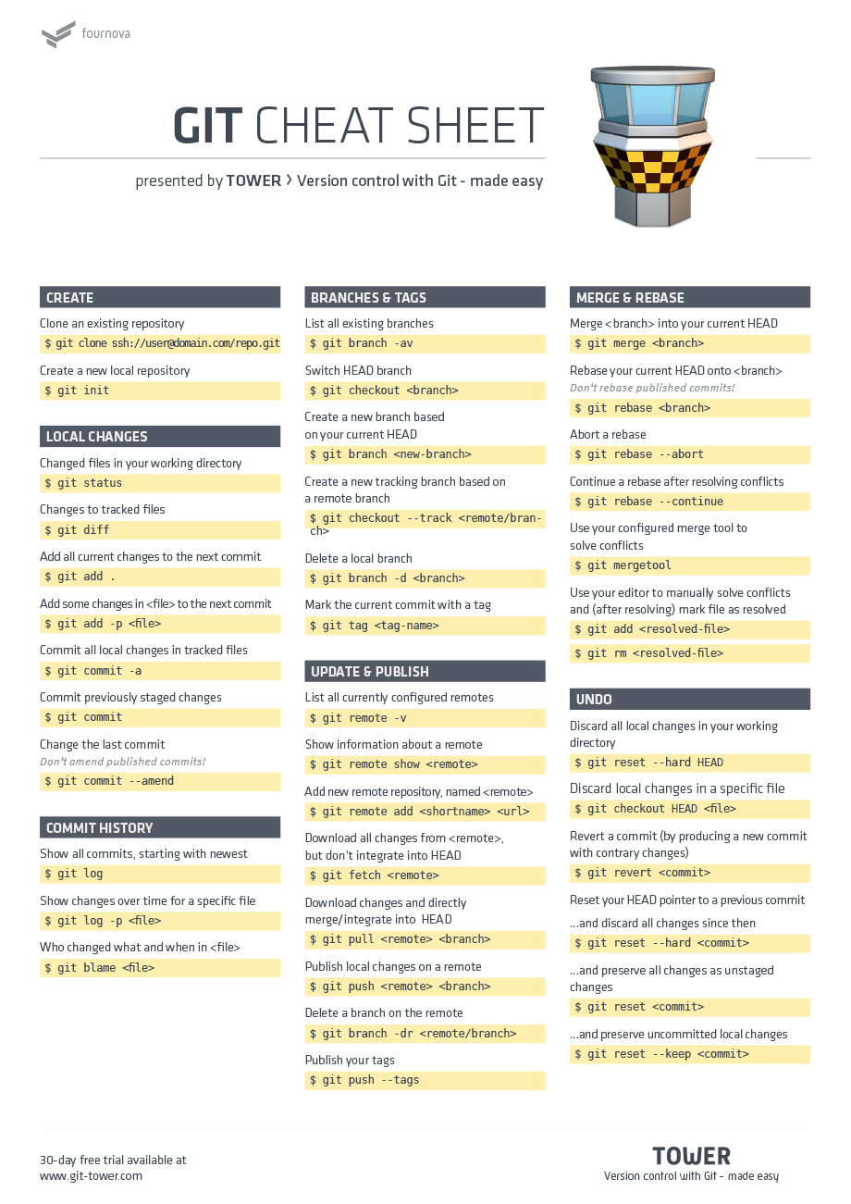

Slide 32
References:
https://sites.google.com/a/lisa.iro.umontreal.ca/lisainfo/getting-started/welcome/tutorials-kick-off-meeting/tutorials-2015/git_github_tutorial
https://learngitbranching.js.org
http://git-school.github.io/visualizing-git/
https://git-scm.com/docs/
http://rogerdudler.github.io/git-guide/
https://www.slideshare.net/anuragupadhaya/git-101-for-beginners
https://github.com/jlord/git-it-electron#what-to-install

