Slide 1

CUSTOMER CHURN PREDICTION

Slide 2

Group 8 members
Jonathan Okwaro
Hellen Mwangi
Nazra Nyangwara
Denis Kipkorir
Kenneth Kimani
Janet Khainza

Slide 3
Outline
Business Understanding
Data Understanding
Modeling
Evaluation
Conclusion
Recommendations
Data preparation

Slide 4

Overview
Customer churn is a critical focal point in the telecommunications industry
It costs 5 times more to acquire a new customer than to keep an existing one
For telecoms, gaining a firm understanding of churn rates and prioritizing customer retention sets the stage for sustained profitability and long-term success

Slide 5

Business Problem
Syriatel Telecommunications is experiencing a substantial increase in customer churn rates in USA and wants to understand the underlying factors contributing to this trend

Slide 6
Objectives
To understand which factors or variables contribute the most to customer churn
To identify different customer segments based on churn behaviour
To develop a model that can accurately predict customer churn
To obtain valuable insights that help generate the best recommendations to protect Syriatel's revenue

Slide 7

Data understanding
The analysis investigates a telco dataset containing 3333 records and 21 variables
The features encompass a mix of numerical and categorical variables
The target variable is "churn"

Slide 8

Data preparation
The dataset underwent cleaning, including checking for duplicated rows and missing values, and dropping unnecessary columns
Data analysis included univariate analysis of the target variable "churn" , bivariate and multivariate analysis of churn in relation to other features in the dataset

Slide 9
Churn vs. Retention
Total number of customers: 3,333
Terminated accounts: 483
Churn rate: 14.5%

Slide 10
Churn by State
California and New Jersey exhibit the highest churn rates, surpassing 25%
Alaska and Hawaii have the lowest rates, both below 6%

Slide 11
Churn by area code
Area code 415 (San Francisco City ) in California state exhibits the highest percentage of account terminations

Slide 12
How does an international plan affect churn?
42.4% of the customers that terminated their accounts had an international plan

Slide 13
How does a voicemail plan affect churn?
Of the 483 customers that terminated their accounts, 83.4% did not have a voicemail plan

Slide 14
Churn by customer service calls
Majority of account terminations are associated with customers who made only one call to customer service
A considerable proportion of customers terminated their accounts without contacting customer service

Slide 15
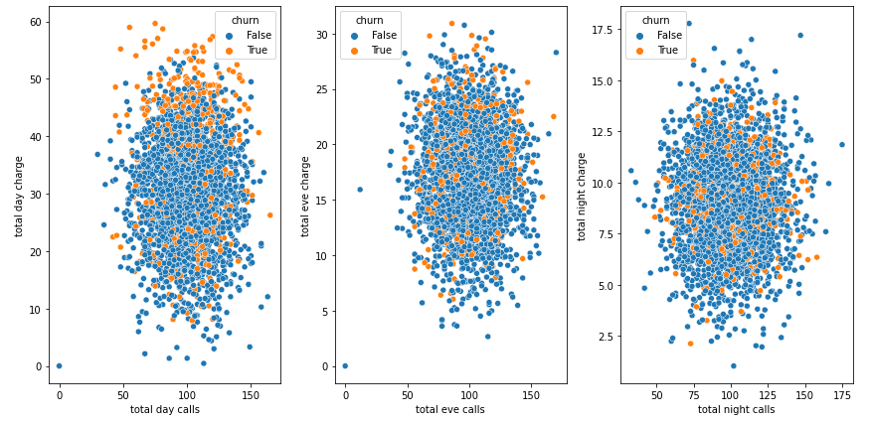
Churn by Total calls vs. Total charges
Churn rates are higher during the day due to the relatively higher call charge rates compared to the cheaper evening and night calls
Call charges for daytime, evening, and nighttime are higher even with fewer calls made

Slide 16
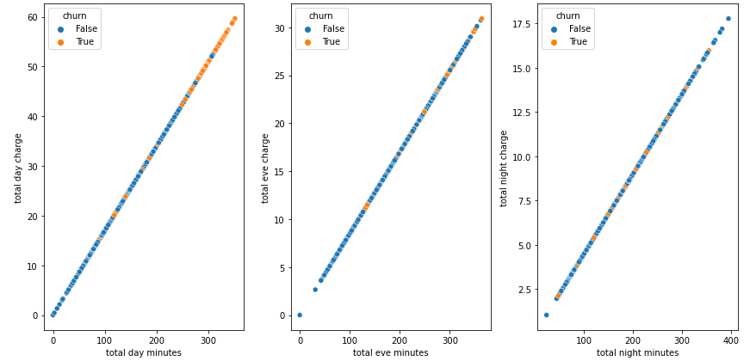
Churn by Total minutes vs. Total charges
On average, customers who terminated their accounts appear to have subscribed to more day minutes, leading to higher charges

Slide 17
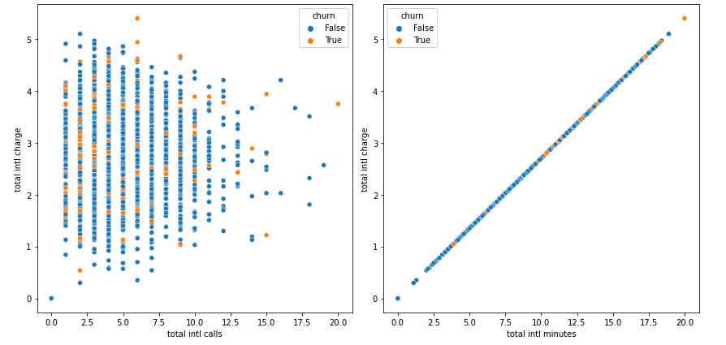
Churn by Total international calls and minutes vs. Total international charges
A significant number of account terminations are linked to higher charges on fewer international calls

Slide 18
Modeling
Classification modeling algorithms used:
Logistic Regression
Decision Tree
Random Forest
XG Boost

Slide 19
Evaluation
Based on:
ROC_AUC curve – shows how efficient the model is in distinguishing between customers who churned and those who did not
Recall - quantifies the model's capacity to accurately detect customers who are likely to churn among all the customers who churn
Accuracy – measures the ability of the model to classify customers correctly

Slide 20
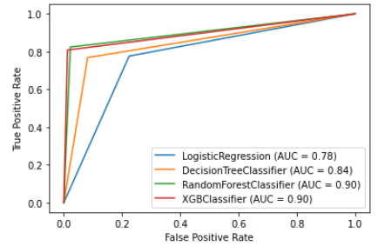
ROC-AUC results
Out of the 4 algorithms used, XGB classifier and Random Forest Classifier achieve the highest efficiency rates in churn prediction at 90%

Slide 21
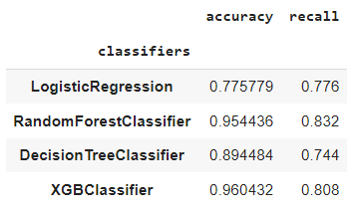
Recall results
Based on recall, Random Forest Classifier achieves 83.2% accuracy in detecting customers that are likely to churn

Slide 22

Winning model: Tuned Random Forest Classifier
Surpassed other models with an 89% AUC score, highlighting its robust capability to distinguish between churned and active customers
1
Has a good balance between sensitivity (recall) and specificity, capturing a high proportion of both churned and active customers accurately
2
At 82% recall score, performed marginally better in identifying churned customers
3
Achieved 95% accuracy in correctly classifying the total number of customers
4

Slide 23
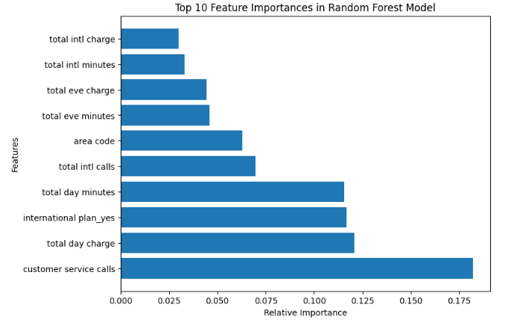
Which features contribute most to customer churn?
Customer service calls is the key factor contributing to high customer churn
Other important features: total day charge, having an international plan, total day minutes, total international calls, and area code

Slide 24

Conclusions
Poor customer service was the leading cause of account terminations by customers
Customers with an international plan churn more than those with no plan
Customers with higher charges on day calls, especially those who have subscribed to more day minutes, are significantly more likely to churn
The significantly higher charges observed for total daytime calls and minutes, in comparison to evening and night-time calls and minutes, were a contributing factor to customer churn
There is a lack of proportionality between the total number of international calls made and the corresponding charges, with higher charges even for fewer calls made

Slide 25
Recommendations
Prioritize customer service initiatives to strengthen customer loyalty and satisfaction
Review cost of daytime calls and minutes charges
Review pricing plans to align with the market and retain price-sensitive customers
Tailor personalized data and voice plan products for international customers based on their unique needs
Regularly gather customer feedback to understand pain points and areas of improvement

Slide 26

THANK YOU!
GitHub:
https://github.com/Jay-Khainza
LinkedIn:
https://www.linkedin.com/in/janet-khainza-0950008a

