Slide 1
SIXTH-SENSE AGENCY HOUSE PRICE PREDICTION MODEL

Slide 2

BACKGROUND
Home prices declining by approximately 10% compared to the previous year due to interest rate increases and economic uncertainty.
Despite the drop housing affordability remained a challenge for many potential buyers as well as Inventory shortages and a lack of new listings leading to increased competition among buyers.
The number of available homes was considerably lower than the previous year, which impacted the overall sales activity in the market.

Slide 3

PROBLEM STATEMENT
Problem Statement:
Which combinations of features provide the most accurate predictions for housing prices?
By creating a multiple linear regression model, we can see how each coefficient works with pricing and better advise 6th sense agency on how to meet the changing needs of buyers and sellers while improving sales.
Objective: To develop a model that accurately predicts the optimal prices of houses based on a variety of price predictors.

Slide 4

DATA UNDERSTANDING
Dataset: 21 variables, 21,597 records
Key Predictors: Square foot of living, house grade, condition of the house, No. of floors, bedrooms and bathrooms, presence of a waterfront, year renovated, year the house was built etc.
Features are a combination of numerical and categorical variables.
Target Variable: Sales price

Slide 5
Methods
Data Cleaning of null, outliers and placeholders
Exploratory data Analysis – Univariate and Bivariate Analysis
Feature Engineering: Introduce a new column ‘renovated’
Perform a simple Linear Regression using high correlated predictor
Perform a multiple Linear Regression using highly correlated predictors
Standardization using logarithm transformation
Perform the final Multiple linear regression using transformed values.
Model Evaluation: Assess performance of our final multiple linear regression model

Slide 6
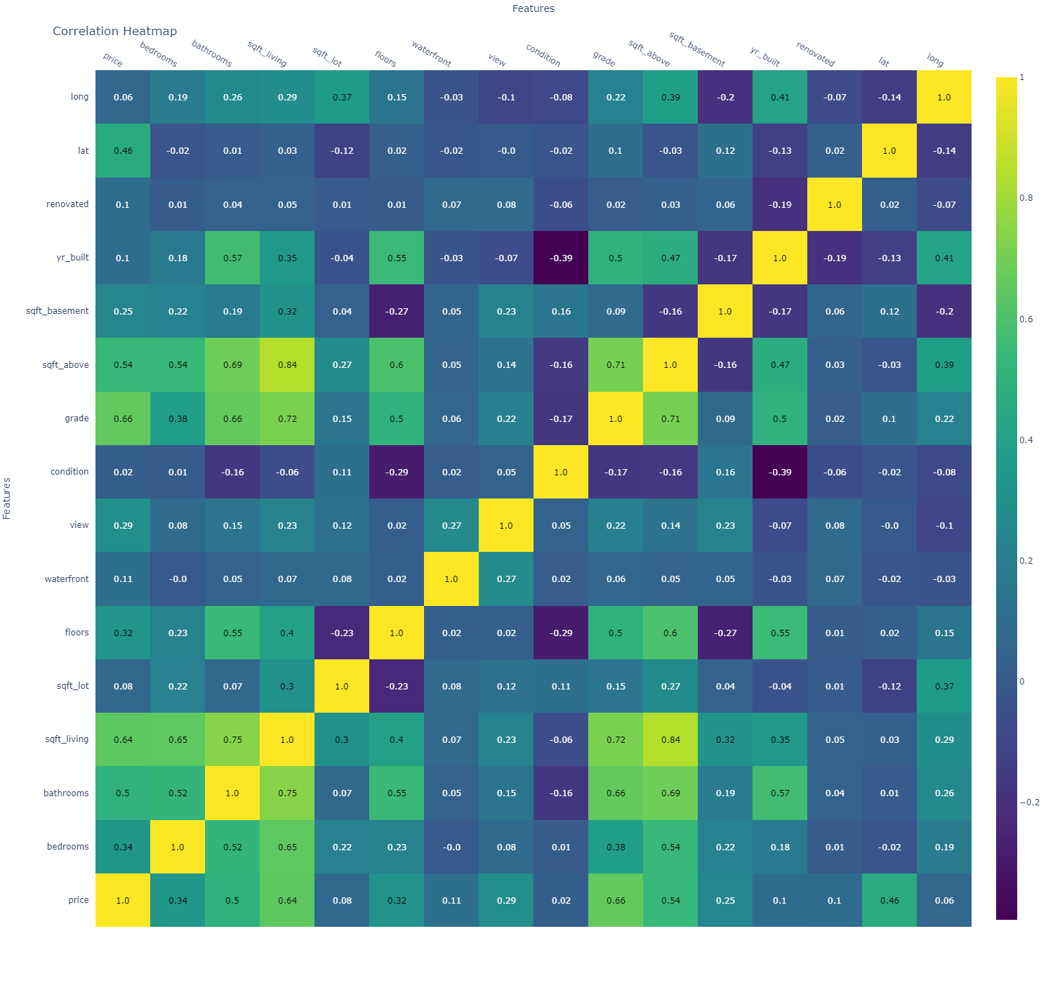
CORRELATION OF THE PREDICTOR VARIABLES
sqft_living, bathrooms, grade and sqft_above have multicollinearity of 0.7 and above. This information is useful in deciding which variables to use in our model to avoid inaccuracies.
Square fit leaving has the highest correlation with price

Slide 7
BASELINE MODEL
MULTIPLE LINEAR REGRESSION MODEL
Our baseline model is statistically significant shown by p-value less than alpha of 5%
The model explains about 49% variance in price.
For a unit increase in square foot of living, there is $280k increase in price.
The Model explains a variance of 67.7%
The large condition indicates strong multicollinearity between the predictors.
There is need to refine the model more by sorting out multicollinearity.

Slide 8
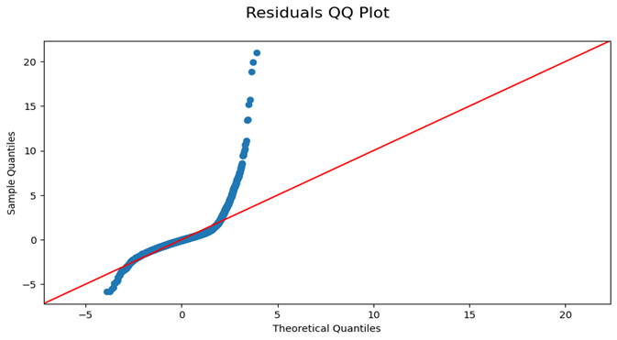
Baseline Model Residual Plot
The Simple Linear Model captures only a small pattern in the data. It fails to capture most patterns and relationships in the data.
Improvements needs to be done

Slide 9
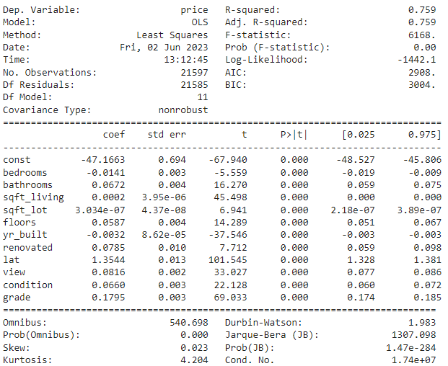
IMPROVED MODEL
Our multiple linear regression model was improved using log Transformation.
From the results of the model, there is a significant change in our r-squared. The 76% explains the variance in price
We can conclusively say that our model is statistically significant.

Slide 10
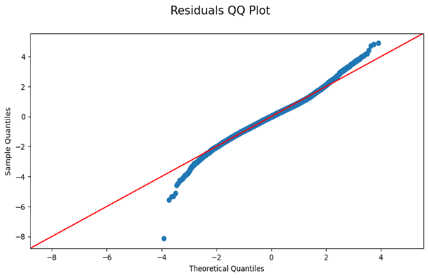
Residual plot for our Improved Model
From the plot we can now say that it follows the normality assumption.
The spread/dispersion of residuals is more relatively consistent
We have a close to perfect goodness of fit.

Slide 11

MODEL EVALUATION
Our r-squared of about 76% explains the variance in price. This shows that a larger proportion of the variability in price is accounted for by the predictor variables.
Our Mean Absolute Error, Mean squared Error and Root Mean Squared error of approximately 0.2, 0.1 and 0.3 is low meaning that our model performance is good.

Slide 12

Data Limitation
Data is only from 2014 to 2015.
Models to predict future sales price would need to be updated with newer data.
Some data might be missing requiring us to make assumptions that might affect our model performance

Slide 13

CONCLUSIONS
Square foot of living, grade, square foot above, bathrooms and view are the top 5 factors showing very high influence in the price of a house.
The higher the house grade, the more price it fetches. Houses with average condition and above tend to fetch high prices. This could be because of several factors e.g. a house with average condition and above could have been renovated, recently build or have a higher square foot of living.
From our analysis we can almost conclusively say that renovations have increased the quality of the house thereby increasing in price.

Slide 14
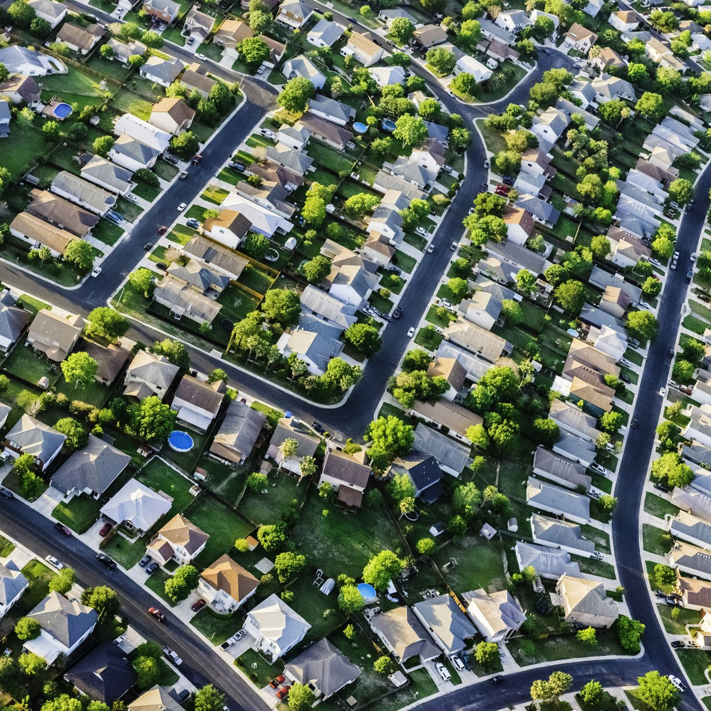
RECOMMENDATIONS
Encourage renovations to improve the overall condition and raise the property's grade as this has a great impact on the value of a house.
Highlight the significant impact of square footage of living space on house prices and use this information to justify higher listing prices for properties with more extensive square footage.
The number of bathrooms and bedrooms also have a positive correlation with the value of a house. Therefore, during renovation adding a bedroom would increase the value of the house.

Slide 15

NEXT STEPS
While the model provides insights into specific variables, it is important to consider broader market trends and factors influencing real estate prices. Keep track of market conditions, economic indicators, and buyer preferences to provide clients with up-to-date and accurate data
Continuously Refine and Validate the Model: Understand the limitations and assumptions of the model and its applicability to specific markets, and update while refining the model based on new data and local market knowledge to improve its accuracy and relevance.

Slide 16

END
THANKYOU

