Slide 1

SALARY INSIGHTS IN TECH CAREERS

Slide 2

Paycheck Storytellers 1. Peggy Obam 2. Vivian Maiyo 3. Sheilah Machaha 4. Janet Khainza

Slide 3
Problem Statement
The global job market is changing rapidly, with different considerations on changes in salaries, employment types, remote work trends, and company structures. However, understanding how factors such as experience level, job title, company location, and remote work policies impact salaries and employment trends remains a challenge.
This analysis aims to provide insights into salary distribution, employment patterns, and workforce trends to help companies and potential employees make data-driven decisions

Slide 4
Introduction
Objective: Understanding salary variations based on different factors such as experience level, geography, remote work, and company size.
Data Source: Salaries dataset for 2025, standardized in USD from Kaggle(Salary_Dataset)
Tools Used: Power BI for visualization and analysis.
Key Columns: Work Year, Experience Level, Job Title, Salary, Currency, Employee Residence, Remote Ratio, Company Location, Company Size.
Standardization: All salaries converted to USD for consistency.

Slide 5
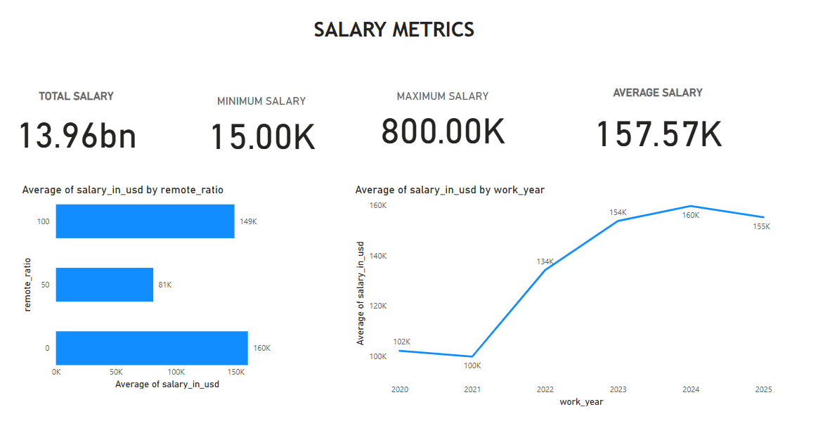
Visualization metrics
Employees working from the office earn a higher average salary, while those in hybrid roles have the lowest average salary
Average salaries in the tech industry have increased from 2021 to 2025
Notes:
zAQ

Slide 6
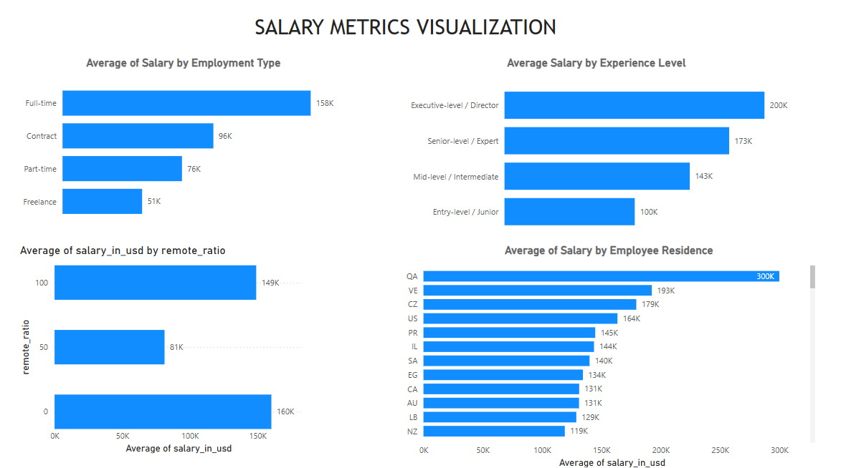
Visualization metrics
Full-time employees receive the highest average salary.
Executives at higher levels earn the highest salaries.

Slide 7
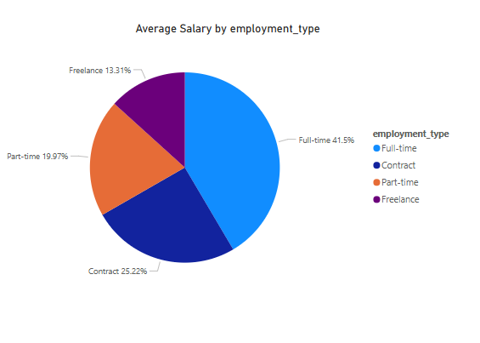
Employment type pie chart
Full-time positions have the highest average salary.

Slide 8
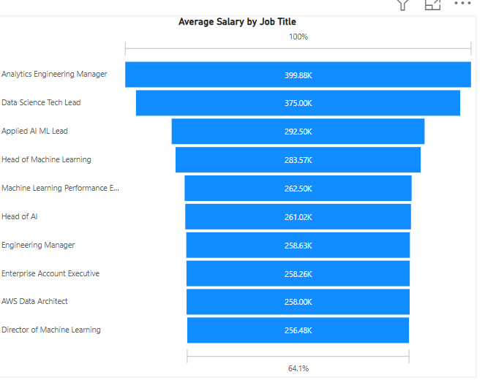
Top 10 Average salary per Job Title
The Analytics Engineering Manager role has the highest average salary.

Slide 9
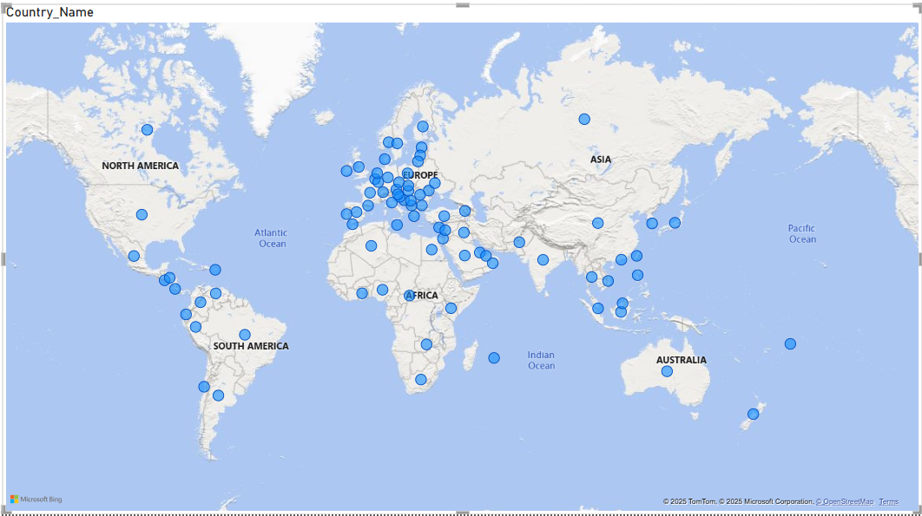
Company location
The majority of tech companies are based in Europe.

Slide 10
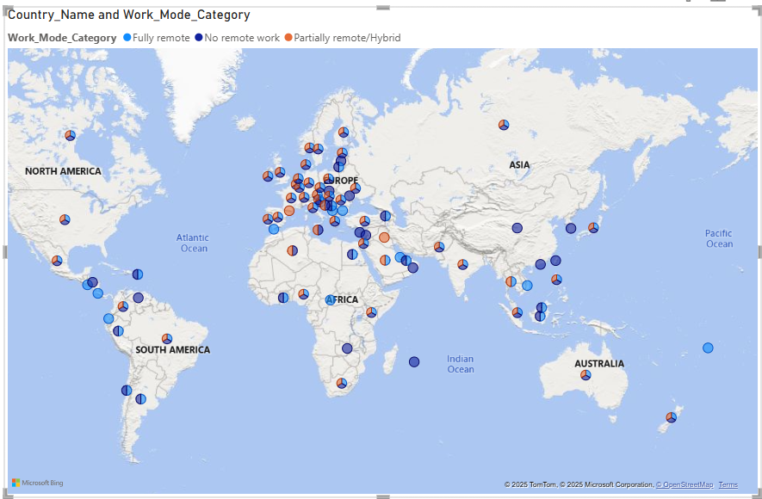
Work mode by company location

Slide 11

Experience Matters: Senior roles command higher salaries.
Location Influences Pay: Salaries differ significantly by country/region.
Remote Work Trends: Remote positions can be lucrative, but variability exists.
Company Size Impact: Larger firms generally offer better pay package

Slide 12
Next Steps & Recommendations
For Job Seekers: Consider location, experience, and remote work options when negotiating salaries.
For Employers: Benchmark salaries competitively based on industry standards.
Future Research: Explore salary trends over multiple years for deeper insights.

Slide 13


