Slide 1
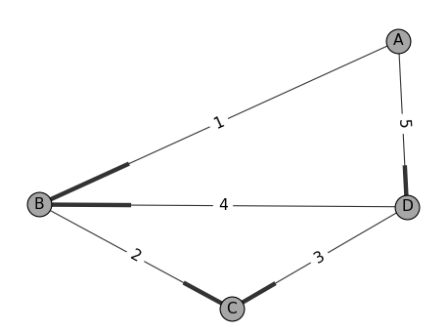





Graph $G\left(\overset{⃑}{N},\overset{⃑}{E}\right)$
Edge $E\left(N_{A} , N_{B}\right)$
Node $N_{A}$
Edge Weight:

