Slide 1
Predicting Disease Outbreaks Using Time Series Forecasting and Classification
Data Mining
Aniket Ranjeet Sharma
Jayanand Hiremath
Preetham Reddy Vinnamala

Slide 2
Agenda:
Predictions of COVID disease outbreaks aid in resource allocation, policymaking, and public health interventions. Prediction models can be used to identify high-risk populations and target preventive measures - vaccination campaigns, health screenings, and educational programs.
Performing time series analysis to predict /forecast the new cases and deaths. Utilizing the prediction to classify the regions/countries as low risk, medium risk, high risk depending upon the medical facilities, GDP, population density and infrastructure like adult intensive care beds, doctors, number of hospitals etc to deal with the disease.
Brief about the approach taken to meet the goals of agenda:
Data collection and preprocessing.
Time series forecasting(ARIMA, Prophet and LSTM)
Classification(Decision tree, Random forest)
Conclusion
Data collection from recognized and established platforms to address the credibility of data concern: Merged multiple datasets from various statistical data sources:
Disease outbreaks in the world, Covid19 data containing the new cases, cumulative cases, new deaths, cumulative deaths(sources: WHO, Disease Control and Prevention (CDC)). (~2lakh rows).
Data on medical facilities, GDP, population density and infrastructure(Sources: OECD, UN-Department of Economic and Social Affairs).

Slide 3
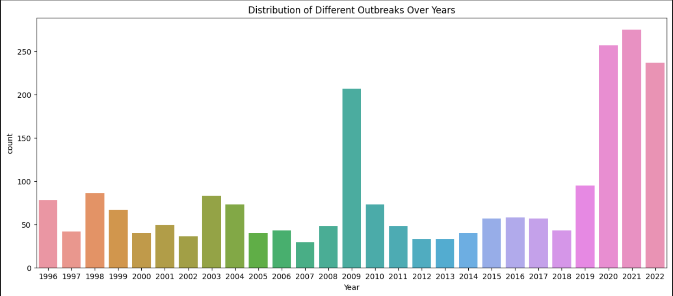
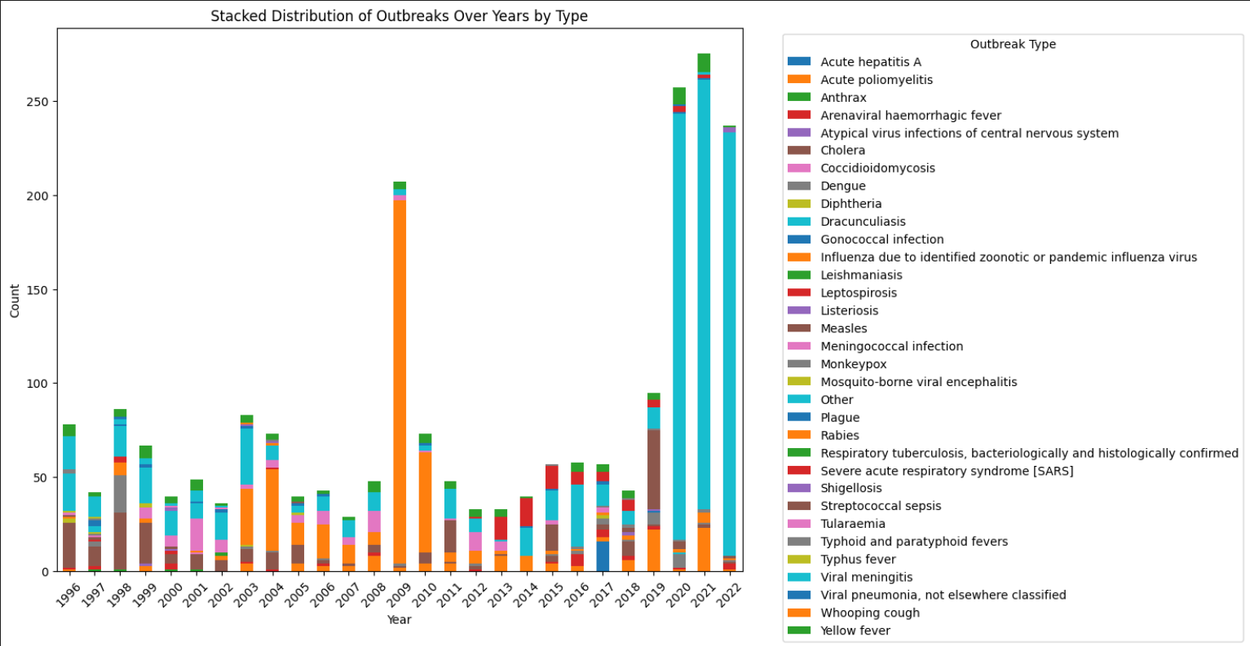
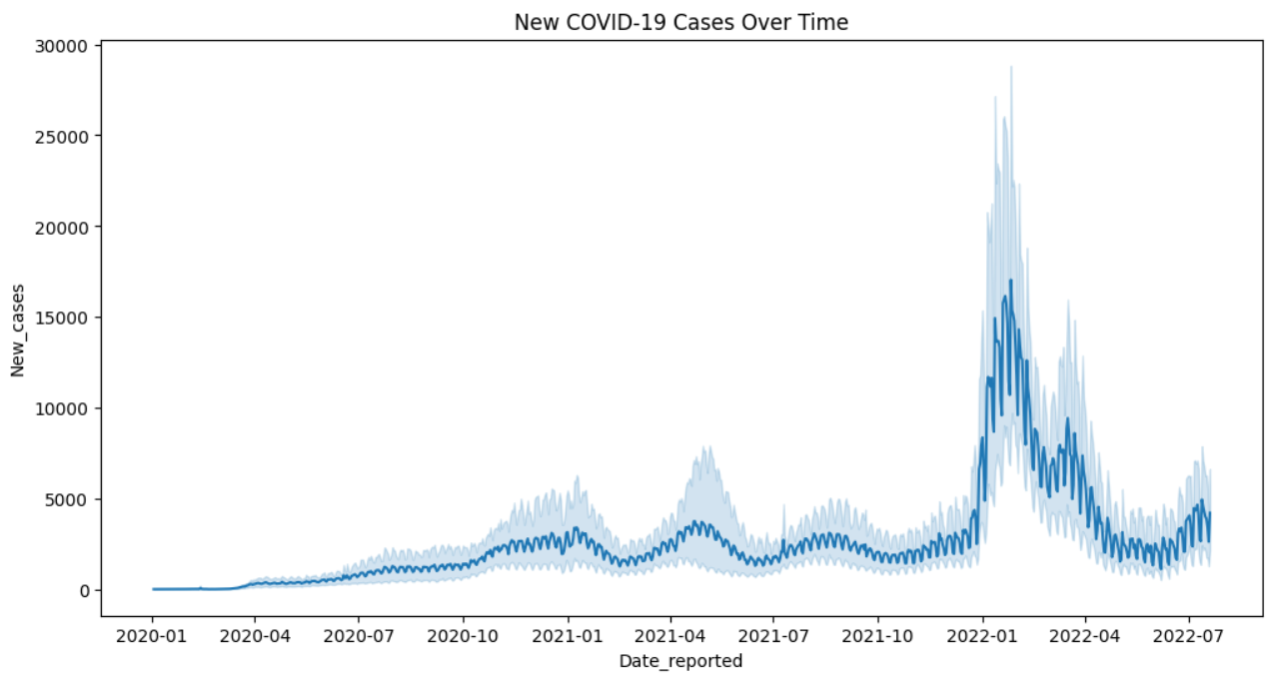
Data description and preprocessing:
Data files for Outbreaks, WHO-COVID-19-global-data, COVID-outbreaks, iso-codes were loaded which contained the data for information of the disease outbreaks in the past based on country, information of the new cases, total cases, total deaths based on country and date of data collection, information of the country code and region(continent). Preprocessing the data to deal with null values, missing data and wrong data.
Created a consolidated data sets based on country, country iso code, date and year of outbreaks.
graph to identify the total outbreaks per year worldwide Stacked distribution of outbreaks over years by type of diseases
COVID-19 reported cases over time worldwide

Slide 4
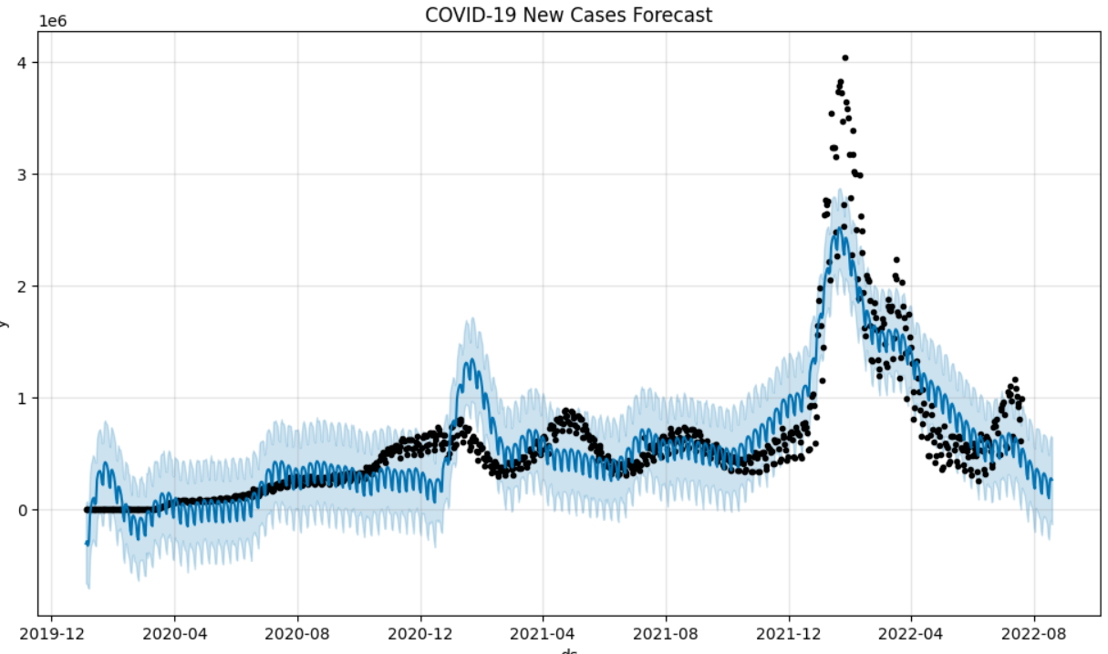
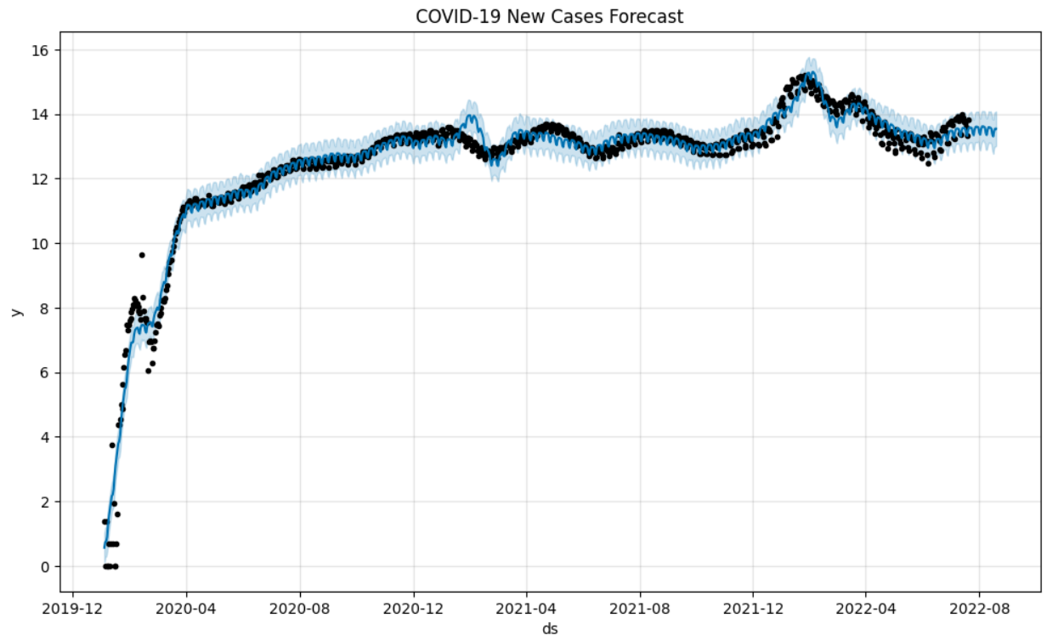
Prophet:
Prophet: forecasting tool developed by Facebook for time series forecasting. Prophet deals with multiple seasonalities and irregular patterns. Reasons for implementing the prophet as it is capable of handling seasonality, and flexibility in incorporating external factors, unlike ARIMA which performs better for well-behaved time series data.
The prophet model is fitted for the data (new cases). A new Data-Frame containing future dates necessary to make predictions is derived. Generates predictions for the future dates provided by the data-frame containing future dates.
To assess the performance of the prophet model predictions on the original training data cross validation and performance metrics are carried out. Performance metrics is performed on cross validation data frame to calculate the forecast accuracy metrics.
Plot of forecast from prophet model date vs New cases
Plot of forecast from prophet model with logarithmic operated data-set of date vs New cases

Slide 5
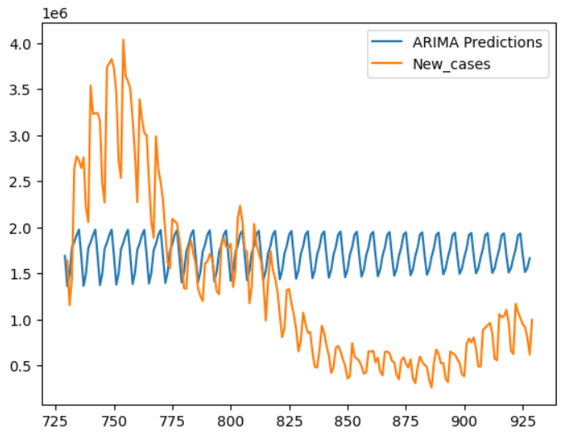
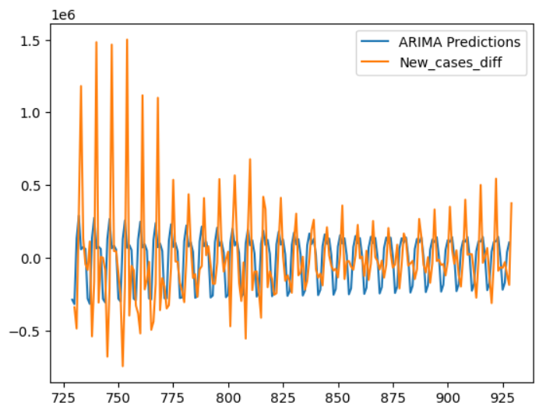
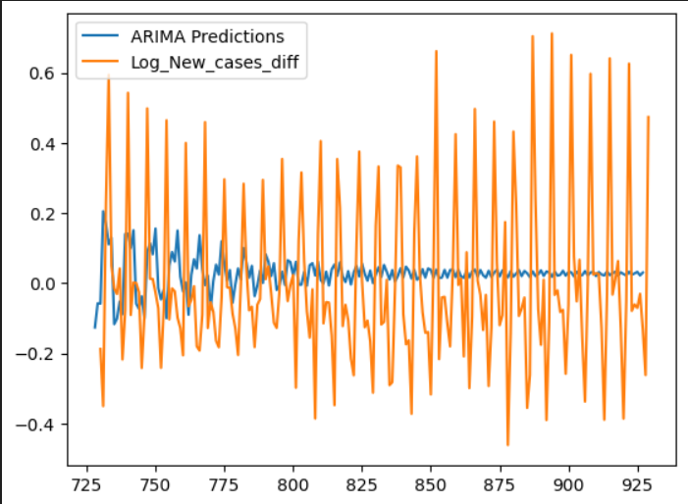
ARIMA:
ARIMA (AutoRegressive Integrated Moving Average): components autoregression, differencing, and moving averages. Autoregressive(AR) component represents the linear dependence of the current value on its past values(p) indicating the number of past observations to consider. Integrated component represents the differencing needed to make the time series stationary order of differencing is denoted by d, moving average component represents the linear dependence of the current value on past forecast errors, number of past errors to consider is denoted by q. ARIMA models are often built based on observed patterns in autocorrelation and partial autocorrelation functions. Dataset is distributed in [80:20] [training:testing].
ARIMA predictions for ‘New_cases’ and actual data
ARIMA predictions for differenced ‘New_cases’ and actual data
ARIMA predictions for logarithmic operated-differenced ‘New_cases’ and actual data

Slide 6
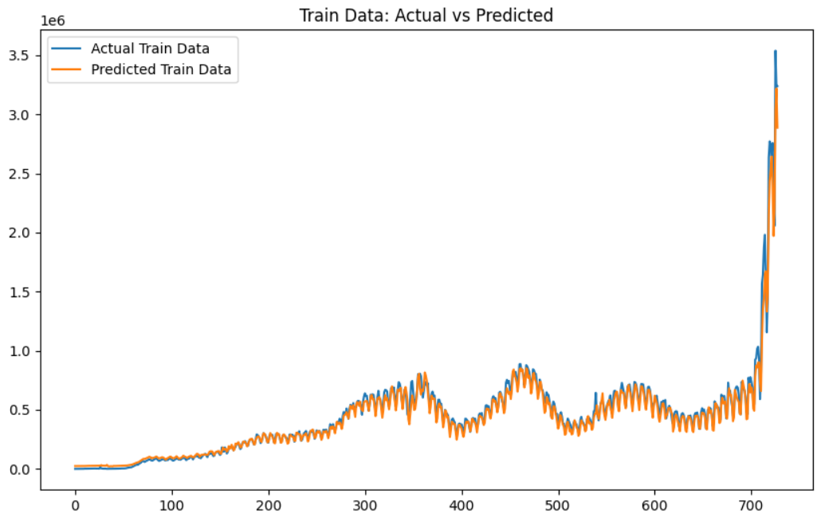
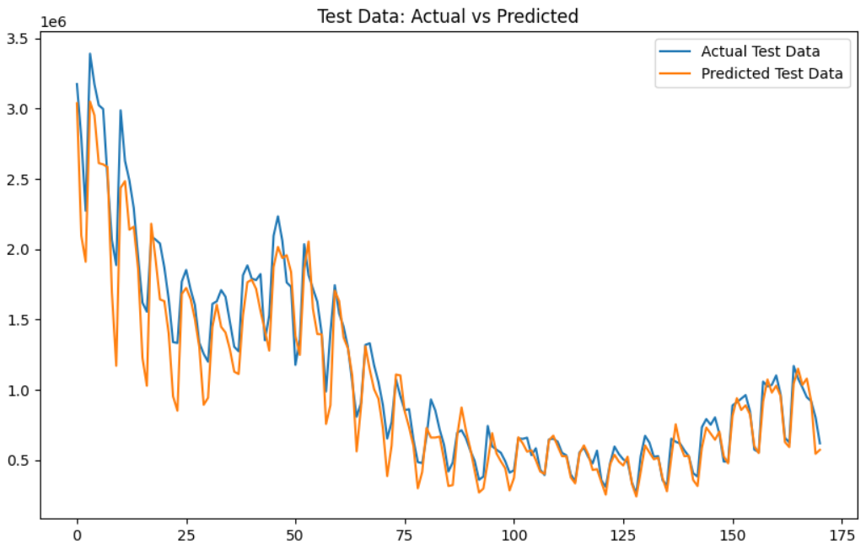
LSTM (Long Short-Term Memory):
LSTM(Long Short-Term Memory): Historical time series dataset, LSTMs are trained to predict future values. Training a model on historical time series data and using the trained model to make predictions for future time steps. LSTM is type of recurrent neural network (RNN) works best with sequential prediction and long term dependency data alongside. Scaling of the data is done to maintain Consistent Model behavior by ensuring different features or variables in the time series data are on a similar scale and scaling also gives numerical stability.
Data set matrix is generated from the array of values and is reshaped in-order to include features and timesteps. Sequential is used to develop neural networks layer by layer, this is suitable for feedforward neural networks, where information flows in one direction. Layers are defined: dropout-regularization technique used to prevent overfitting, dense-used for tasks such as classification or regression.
Plot of Actual train data vs Predicted train data
Plot of Actual train data vs Predicted train data

Slide 7
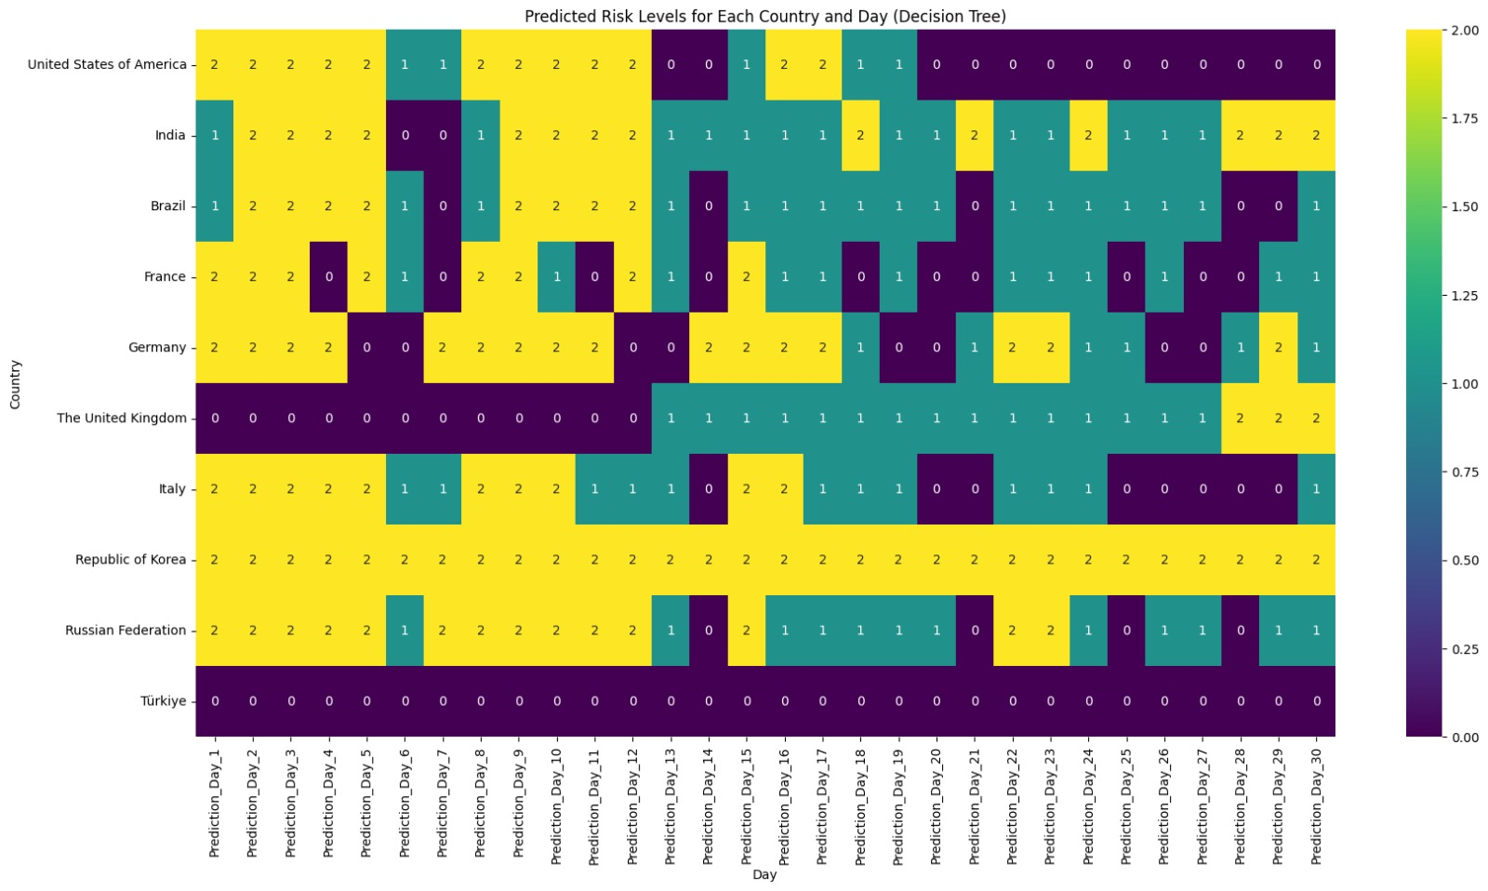
Decision Tree:
Machine learning model used for classification tasks by recursively partitioning. Decision tree is constructed based on a training dataset.
The forecast data given by the LSTM model is used for classification of the countries into low risk, medium risk and high risk based on medical facilities and population density factors.
For the chosen 10 countries where most number of covid 19 cases reported, the predicted risk levels for each country are described below in the heat map:

Slide 8
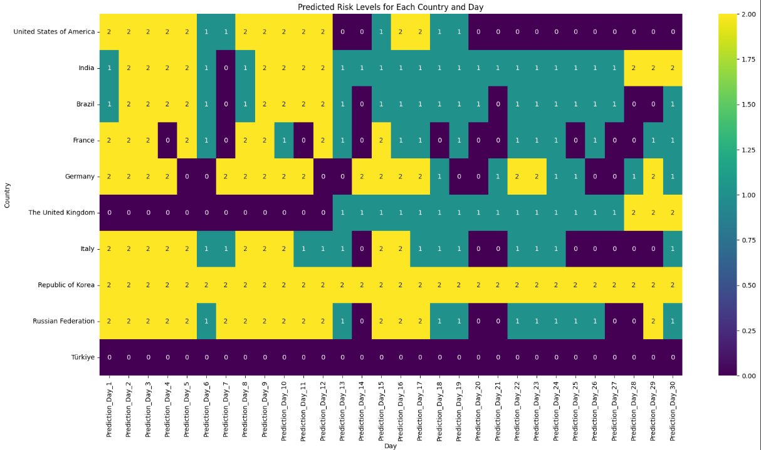
Random Forest:
Method that operates by constructing a multitude of decision trees during training and outputs the class that is the mode of the classes (classification) or mean prediction (regression) of the individual trees.
The forecast data given by the LSTM model is used for classification of the countries into low risk, medium risk and high risk based on medical facilities and population density factors.
For the chosen 10 countries where most number of covid 19 cases reported, the predicted risk levels for each country are described below in the heat map:

Slide 9
Conclusion:
From performing the time series analysis using ARIMA, prophet, LSTM and studying the performance of the model forecast, based on the accuracy of the prediction LSTM gave more suitable and satisfactory results. With the prediction containing the data for next 30 days. Which can be used to identify the risk prone regions.
From classifications using Decision tree and random forest. The results of the prediction from both the classifiers are moderately decent and working on the improving accuracy, precision recall and f1 score and also implementing the neural networks.

Slide 10


